Slide 1
Daily observations are enough to transfer
an hourly streamflow model
Phase I, global hourly streamflow. 8,843 gauges across six agencies, five-fold cross-validation,
plus 282 African basins as an external test.
Weikang Kong · KAUST
Notes:
The claim in one sentence: an hourly model can be adapted to a region using only daily observations, and it improves at the hourly scale. The premise is enforced in code, not in wording: the target stations' hourly targets are hidden from the loss and from epoch selection, and scoring uses them.

Slide 2
The problem is coverage, not accuracy
Flood forecasting needs hourly resolution. Hourly discharge records do not exist in most of the world.
CAMELSH alone contributes 5,767 US gauges. All 282 African basins tested here have zero hourly discharge.
If an hourly model needs hourly data to adapt, it can never reach the regions that need it most.
Phase I asks whether daily observations, which most of the world does have, are enough to adapt one.
Notes:
Keep this slide short. The point is that this is a coverage problem. Do not get drawn into model architecture here; the model is sMTS-LSTM from Gauch et al. 2021 and the contribution is the transfer protocol.

Slide 3
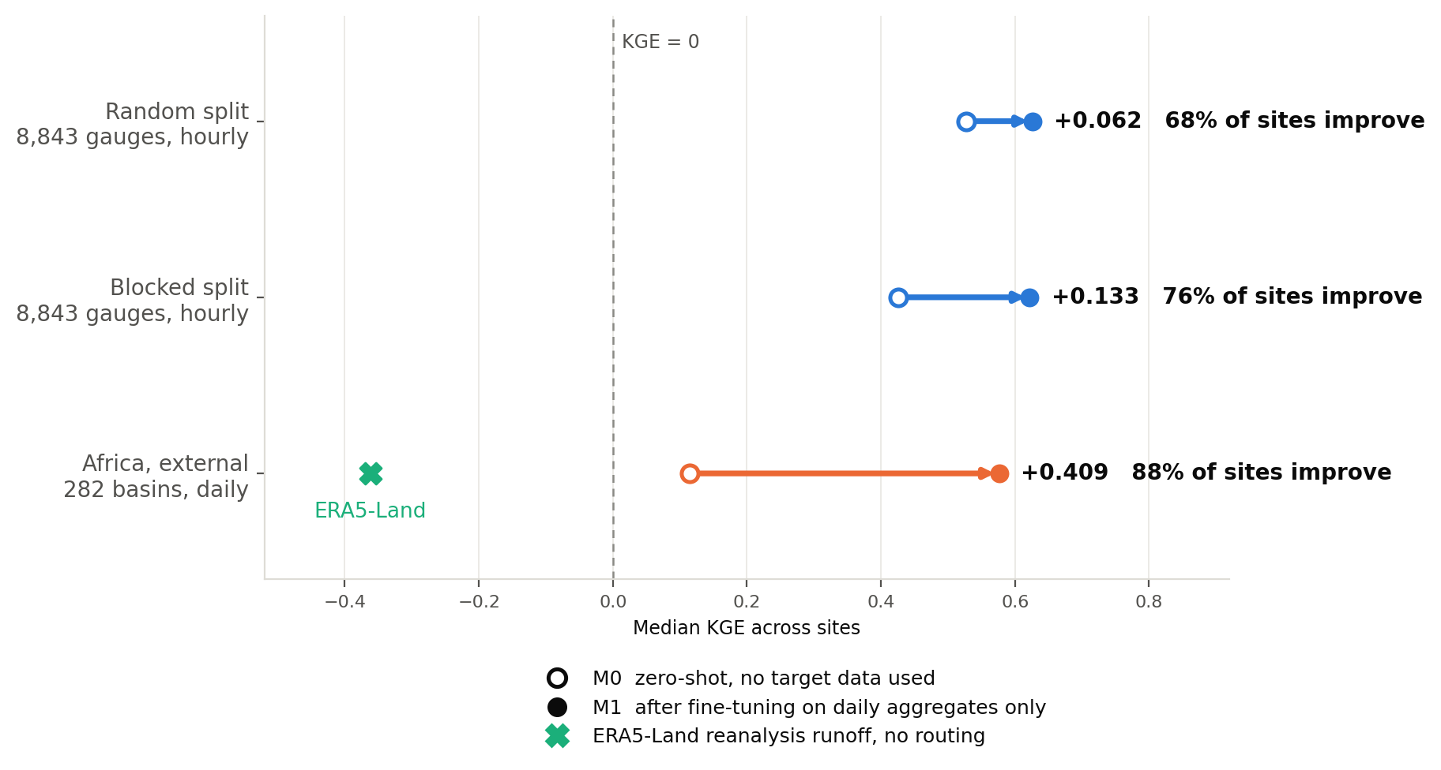
The result: the harder the test, the more daily data helps
The gain grows from +0.062 to +0.133 to +0.409 as the test gets harder, while the two temperate endpoints land 0.0069 apart.
The zero-shot baseline's apparent skill was partly spatial proximity. The gain from daily data was not.
Fine-tuning uses 24-hour aggregates only. The target stations' hourly observations are hidden from the loss and from epoch selection, and used solely for scoring.
Notes:
This is the slide. Spend the most time here.
Random split: 0.527 -> 0.626, 68% of 8,843 gauges improve.
Blocked split: 0.426 -> 0.622, 76% improve. The blocked split is 120 k-means blocks on the sphere packed into 5 folds, which moves the median distance to the nearest trainable gauge from 10.4 km to 94.9 km.
Africa: 0.114 -> 0.576, 88% of 282 basins improve. ERA5-Land is at -0.362, and it has no river routing, so it is a reference rather than a fair hydrological competitor.
If asked why the gain is larger under blocking: there is more deficit to remove, because the zero-shot model no longer has a near neighbour to lean on.

Slide 4
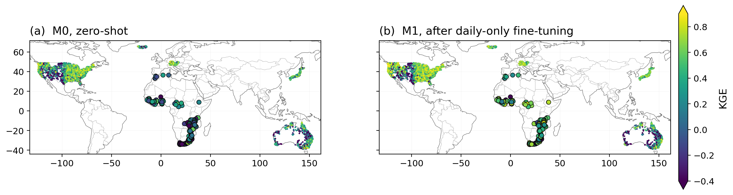
The same result, seen rather than tabulated
Panel (b) is greener almost everywhere, across four continents and six national networks.
A median cannot show that the result belongs to no single region. The African basins are the larger markers.
Both panels share one colour scale, so they are read against each other by construction. Coastlines and national borders at 110 m resolution.
Notes:
Use this slide for scale and generality, not for a number. Four continents, six agencies, 8,843 gauges plus 282 African basins.
Australia and the western United States stay dark in both panels. Those are the arid and highly regulated catchments, where a rainfall-runoff model has the least to work with. Saying so before being asked is better than being asked.
The report's version of this map has twelve panels and adds the three KGE components and a normalised difference column. That density suits a page, not a glance.

Slide 5
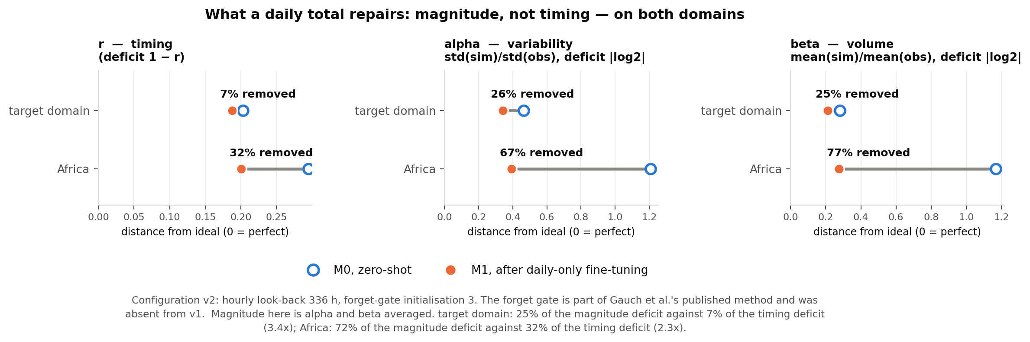
Why it works, and what it cannot do
A 24-hour total carries magnitude information and no sub-daily timing information, so it should repair amplitude and volume and leave timing alone.
It does. Temperate: 25% of the magnitude deficit against 7% of the timing deficit. Africa: 72% against 32%.
Deficit is 1 - r for the correlation and |log2 x| for the two ratios, so only the fraction removed is comparable across components.
Notes:
This is both the mechanism and the limitation, and saying so is the point. Daily supervision recalibrates magnitude. It does not teach sub-daily timing, and no daily signal could.
Expect the question: is this just a bias correction? Current answer: if it were only a rescaling, hourly supervision should do everything daily does and add timing, and it does not. It loses by 0.021 and it loses on alpha. The direct test is the rescaling control, still running.

Slide 6
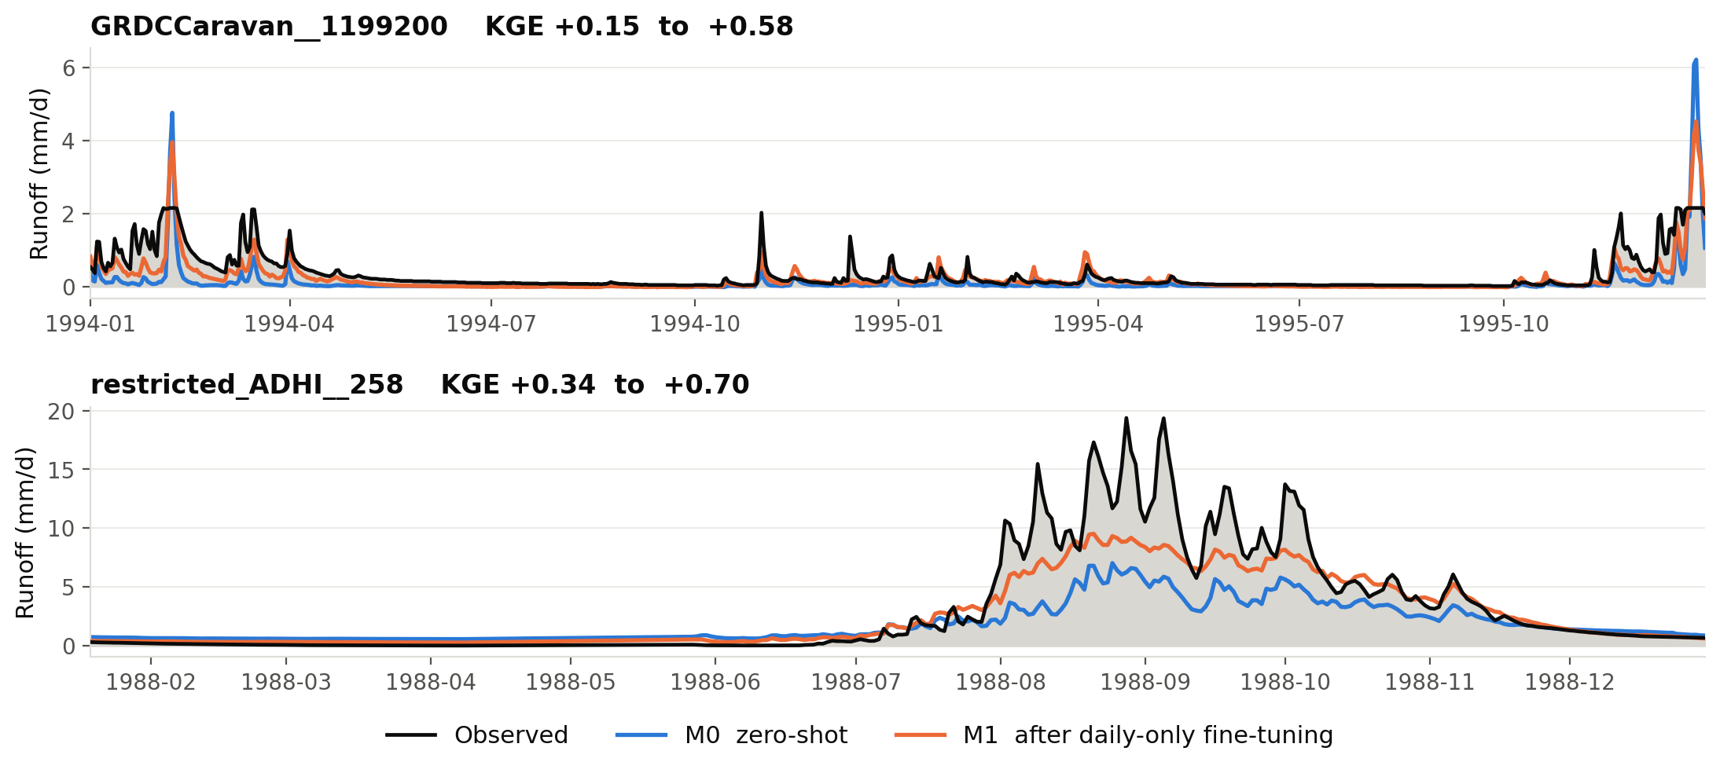
What the repair looks like in a single catchment
The zero-shot model in blue already has the shape and sits far below the peaks. Fine-tuning on daily totals lifts it toward the observation and leaves the shape alone.
This is the previous slide's mechanism in a form that needs no metric.
The median and upper-quartile African catchments by fine-tuned KGE, chosen by rank rather than by eye. Neither appears anywhere in pretraining.
Notes:
This is the slide that makes the result felt rather than reported. Point at the lower panel: blue peaks at about 7 mm/d against an observed 19, orange reaches about 10. The correction is real and it is incomplete, and both are visible.
Chosen by rank, the median and upper quartile, so the pair cannot drift into being the two that happen to look best. The lower-quartile catchment is nearly flat all year and shows an honest but unreadable case; it is in the report as fig07 with all three.

Slide 7
The one claim Africa cannot support
The premise is that Africa has no hourly discharge. That is why the region needs this method, and it is also why the hourly output there cannot be scored. No observation exists to score it against, in any of the 294 basins.
What can be said is what the hourly output looks like, not how accurate it is.
Within-day variability falls after fine-tuning, from a coefficient of variation of 0.1246 to 0.1053 over 284 basins (paired, p = 2e-04), and it rises in 40% of them.
The model damps the rainfall diurnal cycle heavily: forcing peaks at 5.36 times its own mean over the average day, the model at 1.17, a factor of 4.6.
Where hourly observations DO exist, in the temperate domain, the average day is measured to be nearly flat too, so a flat response is not evidence of a flattened model.
The claim that the method improves HOURLY skill rests entirely on the temperate experiment, where hourly truth exists. Africa shows the method reaches a region that has no hourly data, at daily resolution. Those are two different claims and the paper keeps them apart.
Notes:
Say this before being asked. The deck's title claims hourly transfer and its most striking application cannot verify hourly skill, so a listener who notices that on their own will trust the rest less.
The fix worth proposing for Phase II: a pseudo-Africa holdout. Take a climatically similar region that DOES have hourly observations, tropical Australia or Brazil, pretend it has none, run the full protocol, then score the hourly output against the observations that were withheld. That converts Africa's unverifiable claim into a verifiable analogue.

Slide 8
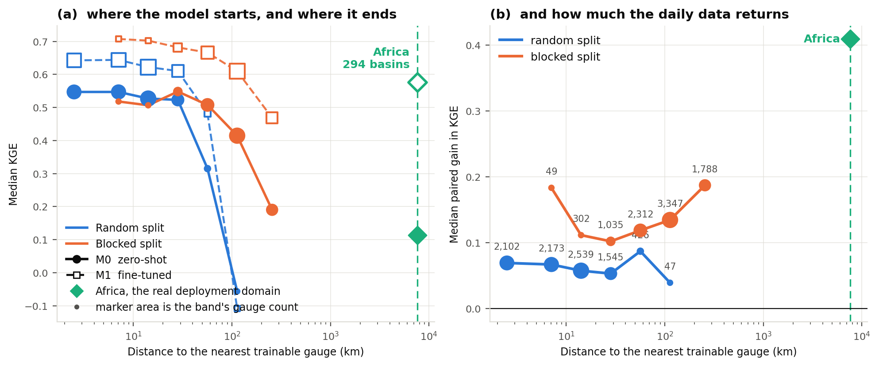
Which evaluation number applies, and to what
The two curves have opposite slopes: the further the model sits from anything it trained on, the worse it starts and the more the daily data returns.
The deployment domain is measured, not assumed. Africa sits a median 7,621 km from the training network, so 100% of real targets are further away than either split's median.
Marker area is the band's gauge count. Under a random split 48% of held-out gauges have a trainable one within 10 km and 3.8% within 1 km, often the same river.
Notes:
Use this slide if asked how we know a random split is contaminated, and if asked which number to believe.
The strongest single piece is within-split: zero-shot KGE falls from 0.551 at 2.5 km to 0.460 at 32 km, Spearman -0.090. Training set, hyperparameters and fold count are identical across those bands, so only distance varies and the blocked split holding out harder regions cannot explain it.
Say the uncomfortable part before being asked: the deployment domain is about 81 times further than the blocked split, so 0.436 is still optimistic for Africa. The profile closes with a measurement rather than an extrapolation, since Africa's zero-shot median is observed at 0.114.
One objection to blocked folds is residual dependence at block borders. Our minimum is 3.0 km and 4.1% sit within 20 km; removing those 361 gauges changes the gain from +0.1329 to +0.1338. The same buffer removes 77% of the random split and drops its zero-shot median from 0.531 to 0.476.
A random split also flatters the PRECISION: fold-to-fold standard deviation of M1 is 0.0035 random against 0.0411 blocked, a factor of 11.8.

Slide 9
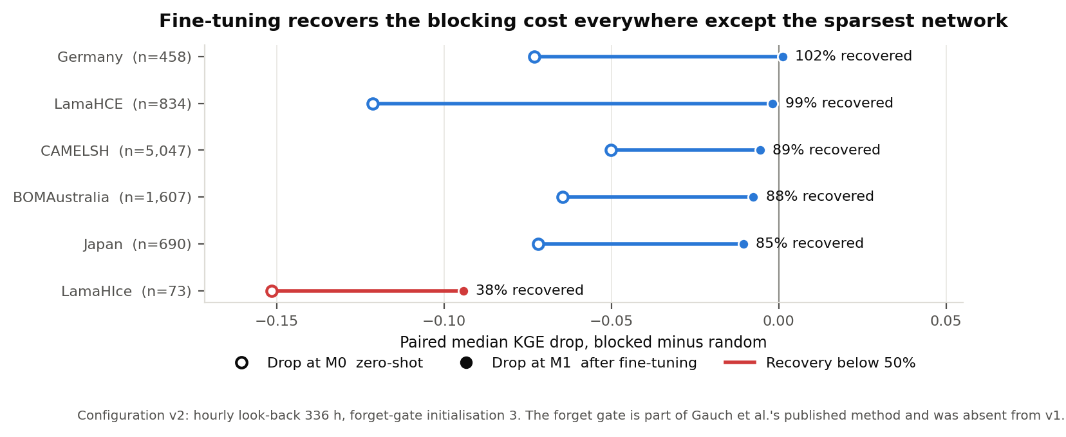
The blocked split, agency by agency
Five of six networks recover 85 to 102 percent of what spatial blocking costs. Iceland, with 73 gauges, recovers 38 percent.
The method is weakest exactly where the gauge network is sparsest, which is worth stating plainly.
Blocking is 120 k-means blocks on 3-D unit vectors, packed whole into five folds, so fold sizes stay within 10 gauges of the random split's.
Notes:
Fold-to-fold spread also rises sharply under blocking, from 0.0035 to 0.0411, a factor of 11.8, because each blocked fold holds out different continents and climates rather than a different sample of the same regions. Report the blocked numbers as the honest ones; the random split flatters both the level and the precision.

Slide 10
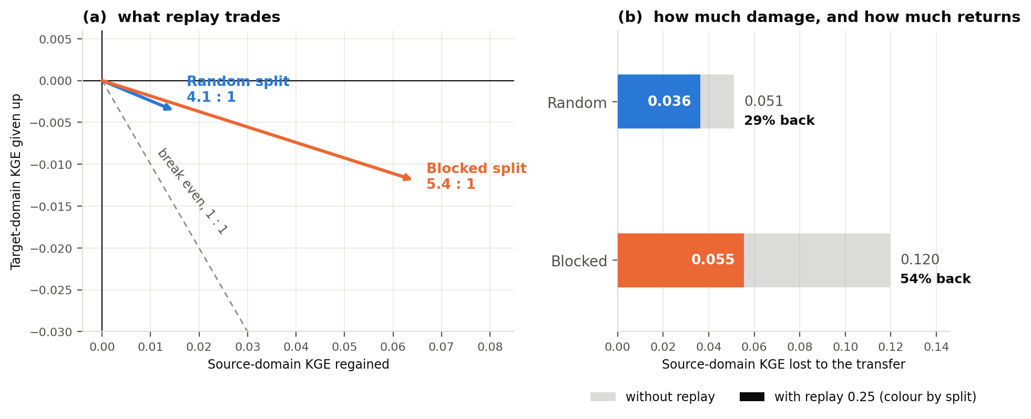
The cost to the source domain, and how much of it comes back
Adapting to the daily domain degrades the hourly one: the median source gauge loses 0.054 KGE, in every fold.
Replaying source batches returns 29% of it under a random split and 54% under a blocked one, at 4.1 to 1 and 5.4 to 1.
Replay is legitimate rather than leakage: the premise hides the target stations' hourly data and never the source's. Paired per gauge.
Notes:
Most transfer-learning papers do not report what the source domain loses. This slide is about method rigour as much as about replay.
Note the asymmetry that matters: blocking more than doubles the damage, from 0.051 to 0.120, and replay then returns a larger share of it. So replay is not an artefact of the easy split.

Slide 11
Two readings that would deflate the result, and the runs that answer them
The gain repairs amplitude and volume. A per-gauge rescaling repairs those with arithmetic, so does it?
No. Fitted on the training-period daily means and applied to the zero-shot output, a volume correction gives -0.0015 against fine-tuning's +0.0573, and fine-tuning leads on 70% of gauges.
Volume is already near-right at M0. The gain is in amplitude, and the standard deviation of daily means is not that of the hourly series, so no daily-derived factor can express the correction the model performs.
The premise hides hourly data. So hourly supervision would be better?
No. Daily-only gains +0.0576; hourly supervision +0.0327 to +0.0335.
All three arms were swept over the transfer learning rate, which had never been searched. Each peaks at 2e-4, and there the daily objective still leads by +0.0121.
The difference is entirely amplitude: daily supervision moves alpha 0.821 to 0.856, hourly supervision to 0.794.
Notes:
These two slides' worth of runs are what moved the claim from 'daily data is a workable substitute' to 'daily aggregate supervision is the better transfer signal'. Both objections are the reader's natural next thought, and neither is answerable by argument.
Remaining caveat, state it if asked: hyperparameters other than the learning rate were inherited from the daily configuration.
The plausible mechanism for the second result is that the daily objective is a constrained one, weighting the aggregate term at 0.5 and leaving the hourly branch frozen, and the constraint regularises.

Slide 12
Where this stands
Settled
Five-fold cross-validation on 8,843 gauges, six agencies
Spatially blocked split, 10.4 km to 94.9 km nearest trainable neighbour
External test on 282 African basins, none seen in training
Single-variable ablation, all five folds:
forget gate 0 -> 3: +0.0176 (sd 0.0086, 5 folds)
hourly look-back 72 -> 336: +0.0581 (sd 0.0313, 5 folds)
Rescaling control and hourly-supervision reference arms, five folds each
Every arm re-run at a second transfer learning rate: the random-split gain spans +0.0577 to +0.0630, the blocked +0.1230 to +0.1263, both far inside the blocked split's own fold spread
Scope, stated rather than defended
Catchments to 10,000 km2, median 363. Large basins untested, and the forcing reaches the model as catchment-mean scalars, so routing is not learnable from it.
Six of seven available networks; the Czech 437 gauges sit inside the retained attribute range on every compared property.
Publication: the two controls above answer the objections that would have forced a smaller claim. The result is a methodological one now, not only an application.
Notes:
Optional next step worth mentioning: the daily arm's own best rate is 2e-4, not the 5e-4 used throughout, which would lift the headline gain from +0.058 to +0.064. Re-running the blocked, Africa and replay arms at that rate is a few hours and would make every number consistent at the better configuration.

Slide 13
What Phase II should do, in priority order
1. Make the hourly claim verifiable outside the temperate domain
A pseudo-Africa holdout: take tropical Australia or Brazil, which do have hourly observations, hide them, run the full protocol, then score the hourly output against what was withheld. This is the single largest gap in the story and the cheapest to close, since no new data is needed.
2. Find where catchment size breaks the method
The database holds 668 catchments above the current 10,000 km2 cap and they are already prepared upstream. Raising the cap and re-running the evaluation locates the breakpoint without changing the model. Expect degradation, since the forcing reaches the model as catchment-mean scalars, but measuring where it starts is worth more than predicting it.
3. Ask whether the constrained objective is the mechanism
Daily supervision beating hourly supervision is the most interesting result here and its explanation is currently a hypothesis. Varying the aggregate loss weight and the frozen-module set under hourly supervision would test it directly.
4. Add the seventh network
437 Czech gauges with complete records, absent for reasons that predate this work. Low scientific value, since they add no attribute space, but it removes a question a reviewer will ask.
Notes:
Items 1 and 2 are the ones that change what the paper can claim. Item 3 would turn an observation into a mechanism and is the most interesting of the four scientifically. Item 4 is housekeeping.
If asked what would be needed to serve large basins properly rather than just measure the failure: distributed forcing instead of catchment means, or an explicit routing component. Both are architecture work, not a re-run.

