Slide 1

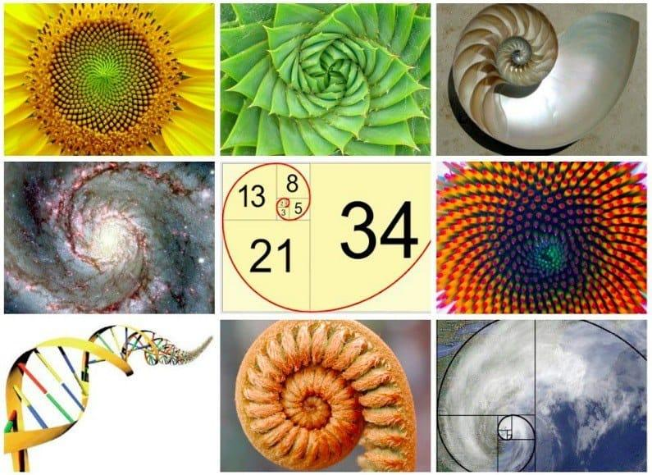
CS 131
Brian Kelly
What is the Fibonacci Sequence
Examples in nature as well as within math, music and applications in computer science
Present the program that I made for this project. Creating a rhythm based off the Fibonacci numbers

Slide 2
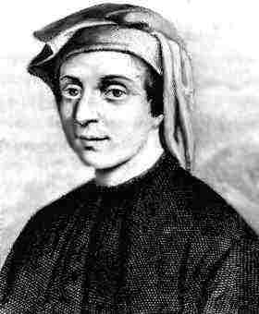
Fibonacci was introduced to the sequence from a book written by a mathematician from India, named Acharya Hemachandra.
Fibonacci wrote his own book, called 'Liber Abaci', in 1202 A.D which introduced the west to what is now known as the Fibonacci sequence
Leonardo Fibonacci
(c. 1170 – c. 1250)

Slide 3
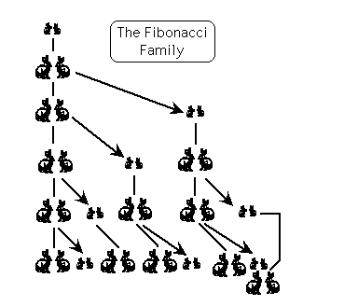
In his book, he simplified the sequence found in Hemachandra's book by comparing it to the growth of a rabbit population
The question was 'if a pair of rabbits is placed in an enclosed area, how many rabbits will be born if we assume every month a pair of rabbits produces another pair, and the rabbits begin to bear young two months after their birth?'

Slide 4
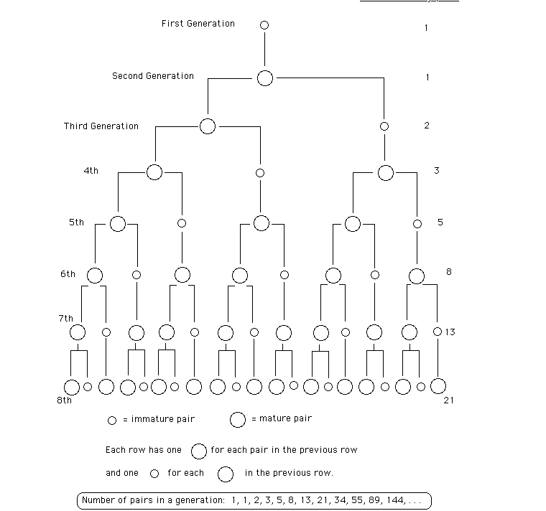

Slide 5
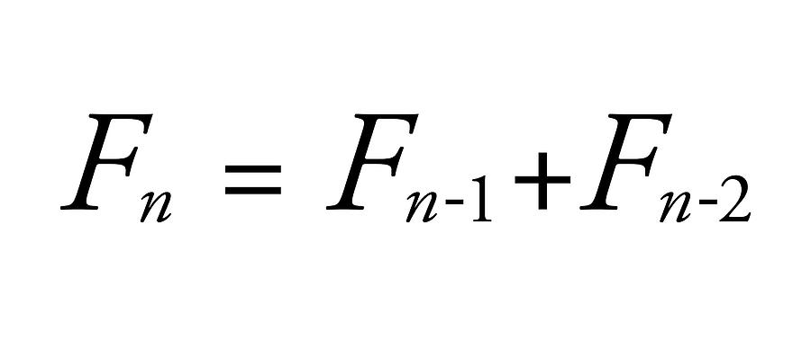

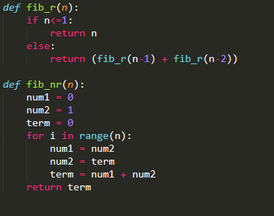
Recursive formula. Adding the two previous numbers, starting with 0 and 1
Recursive and Non-Recursive Functions to return the Nth term of Fibonacci sequence in Python

Slide 6
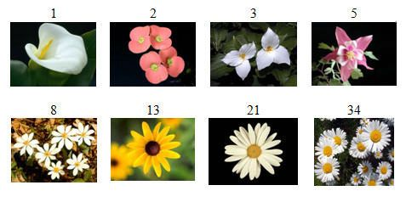
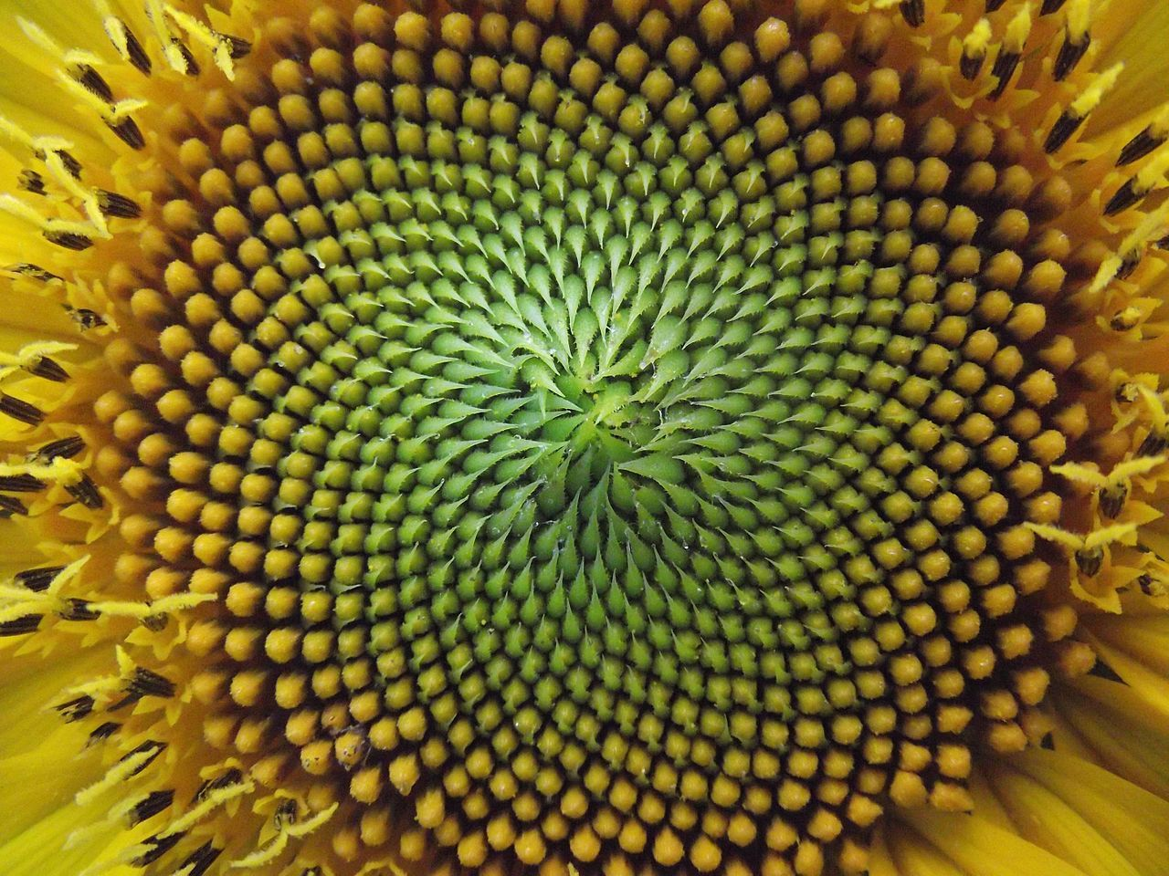
This sequence can also be observed in nature, occuring in the biological structures and forms of life.
The fibonacci numbers create a spiral which can be seen in the seeds of a flower

Slide 7
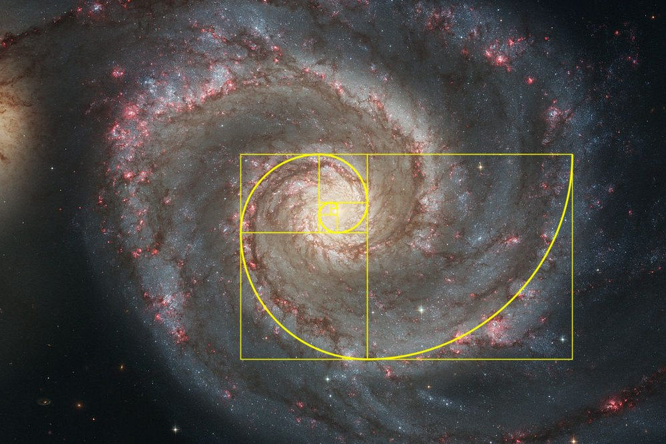

Slide 8
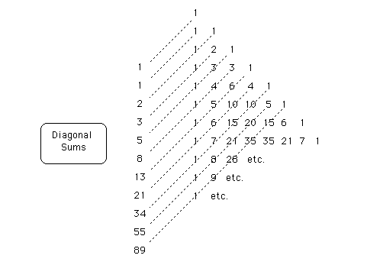
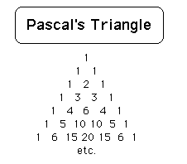
The diagonal sums of Pascal's Triangle add up to the Fibonacci Sequence

Slide 9
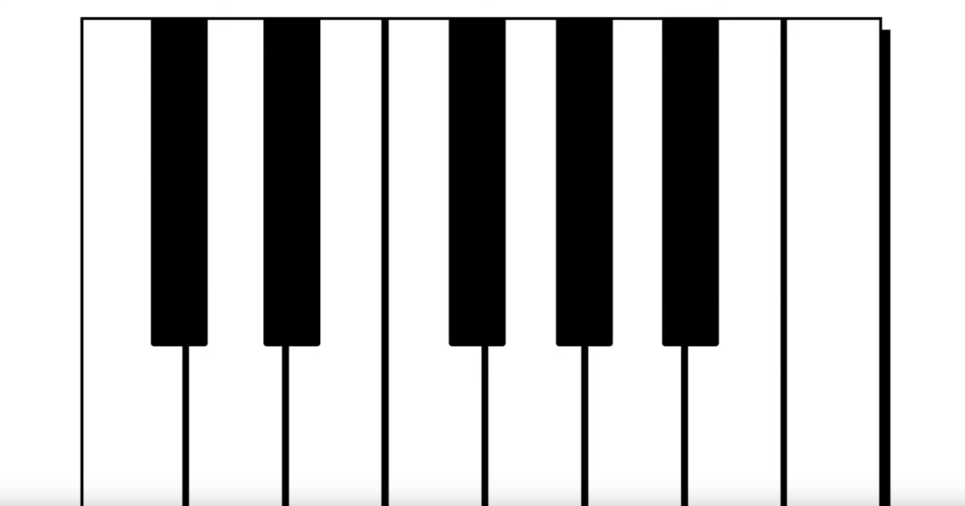

Slide 10


Slide 11
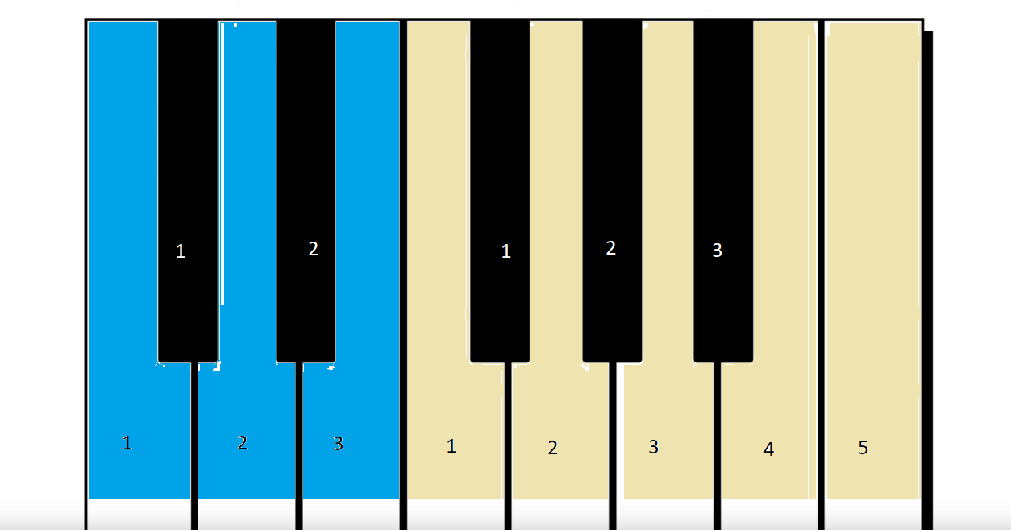

Slide 12
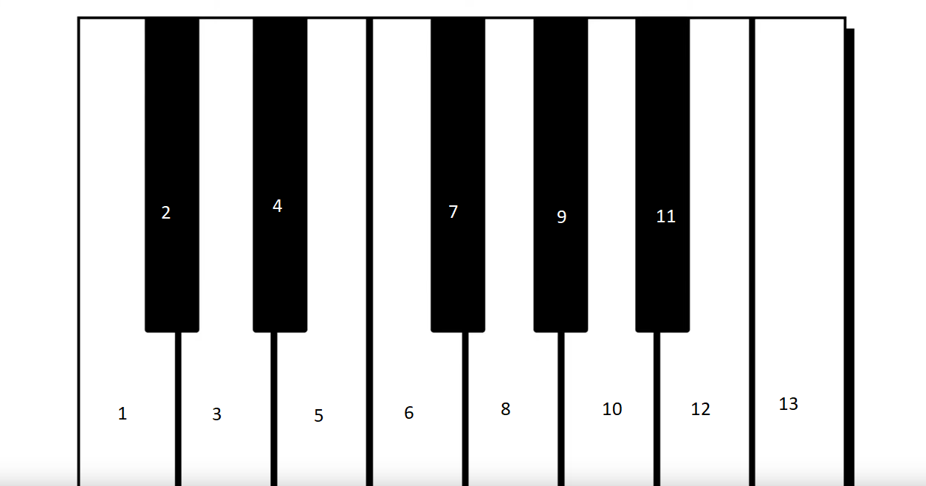

Slide 13
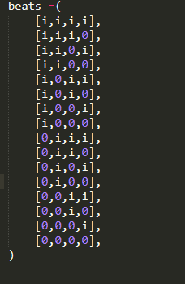

Slide 14

