Slide 1

Dynamic Programming
The Concept of Memoizaition and Time Complexity
CS_131 Prof. Yuen Oliver Bohler

Slide 2

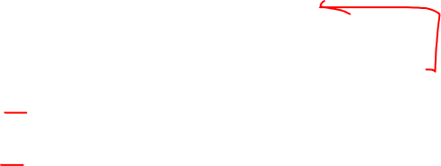
Concept of Recursion
Concept of Dynamic Programming
Memoization
Space Complexity

Slide 3
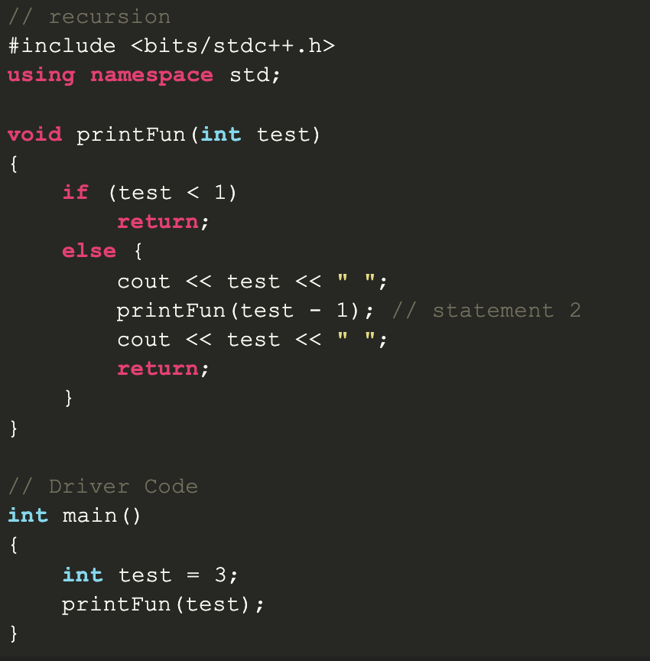
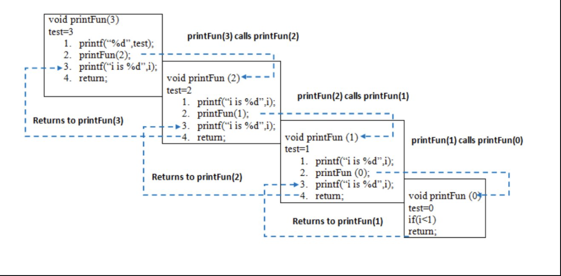

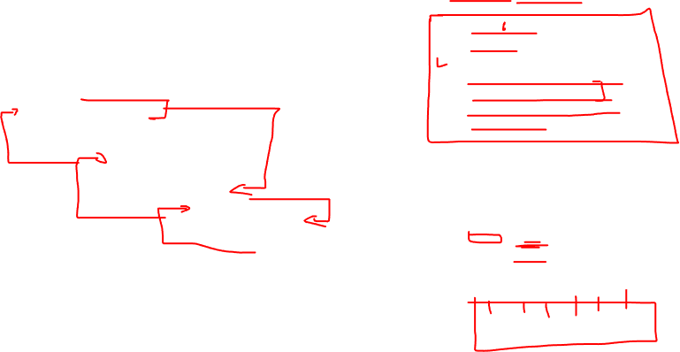
Concept of Recursion

Slide 4
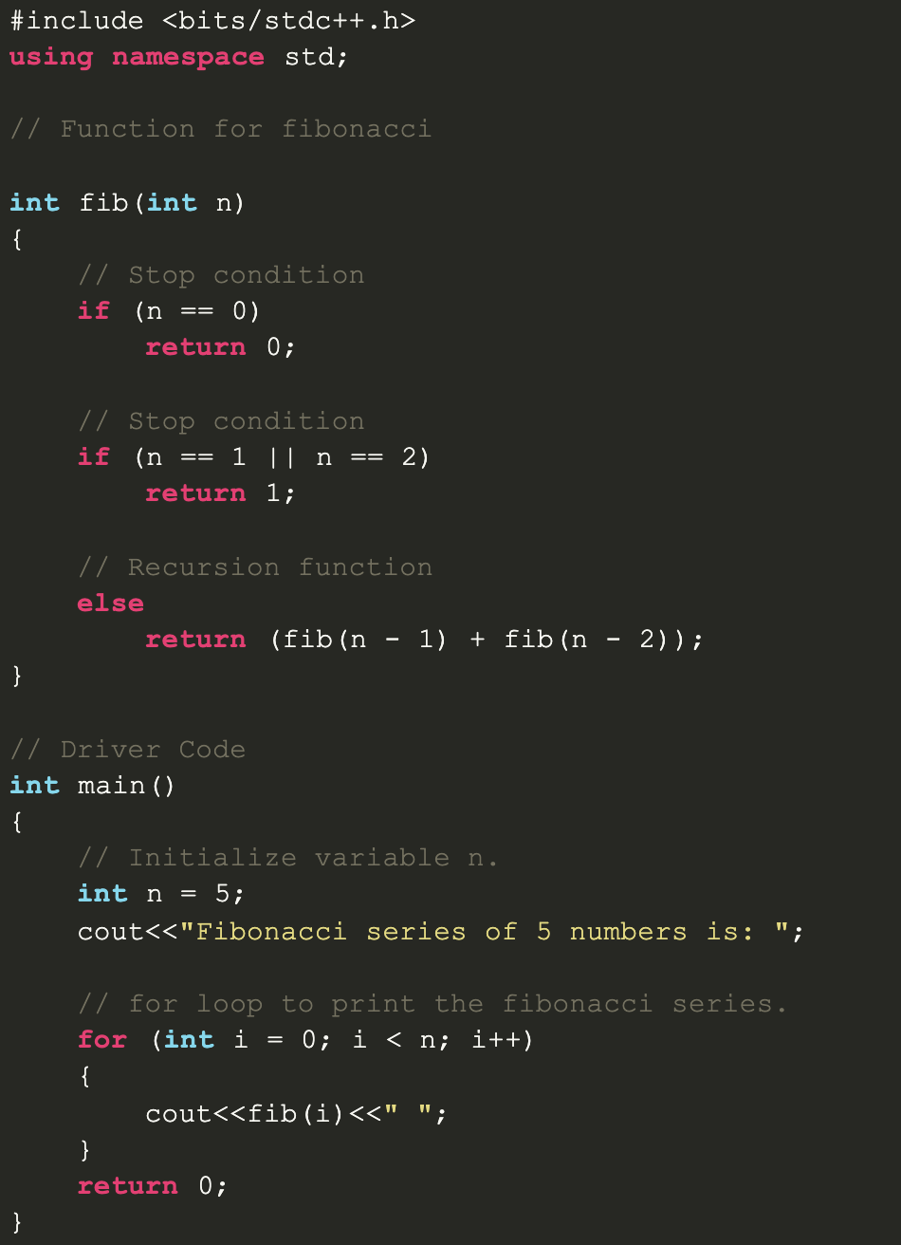
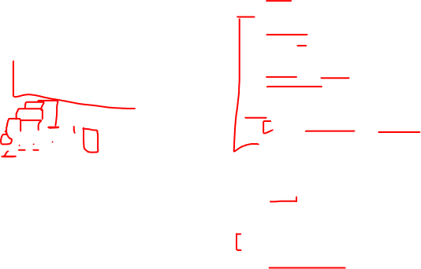
The Fibonnaci Sequence 1,1,2,3,5,8….

Slide 5
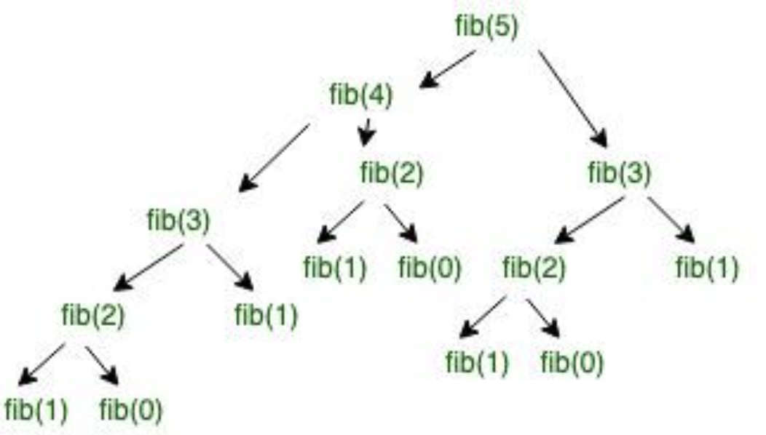
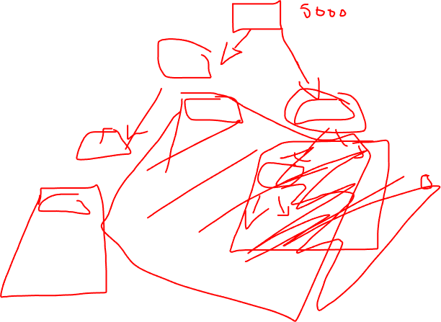
FIB(3) called 2x FIB(2) called 3x Time Complexity: (2^n)

Slide 6



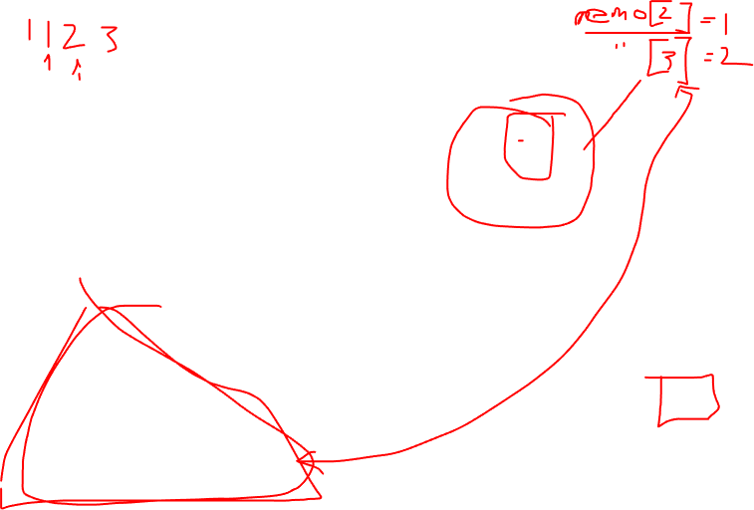




Time Complexity
O(n)
A big improvement in processing time!

Slide 7
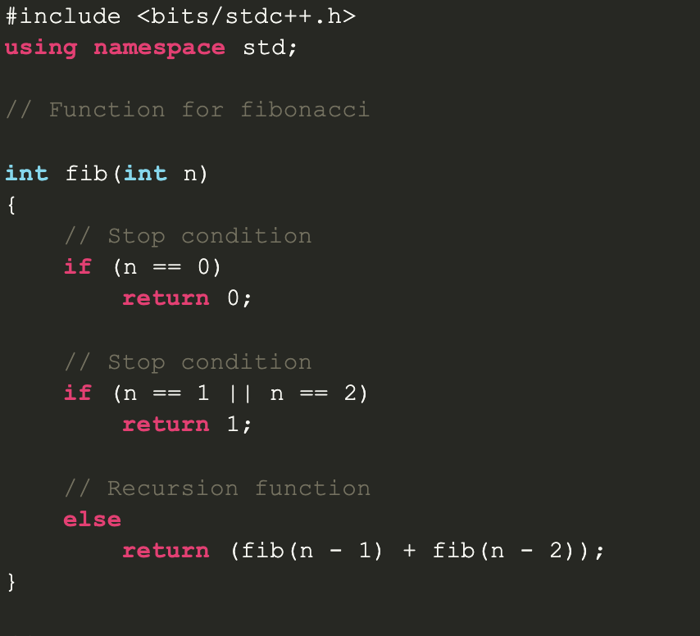
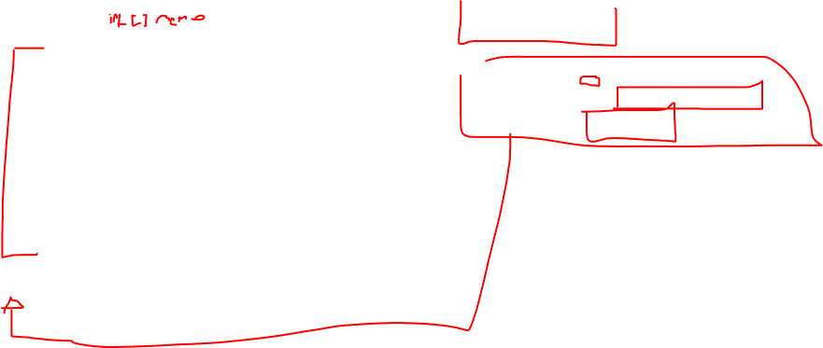
Memoization
Else if (memo[n])
memo[n]=fib(n-1)+fib(n-2)
return memo[n]

Slide 8
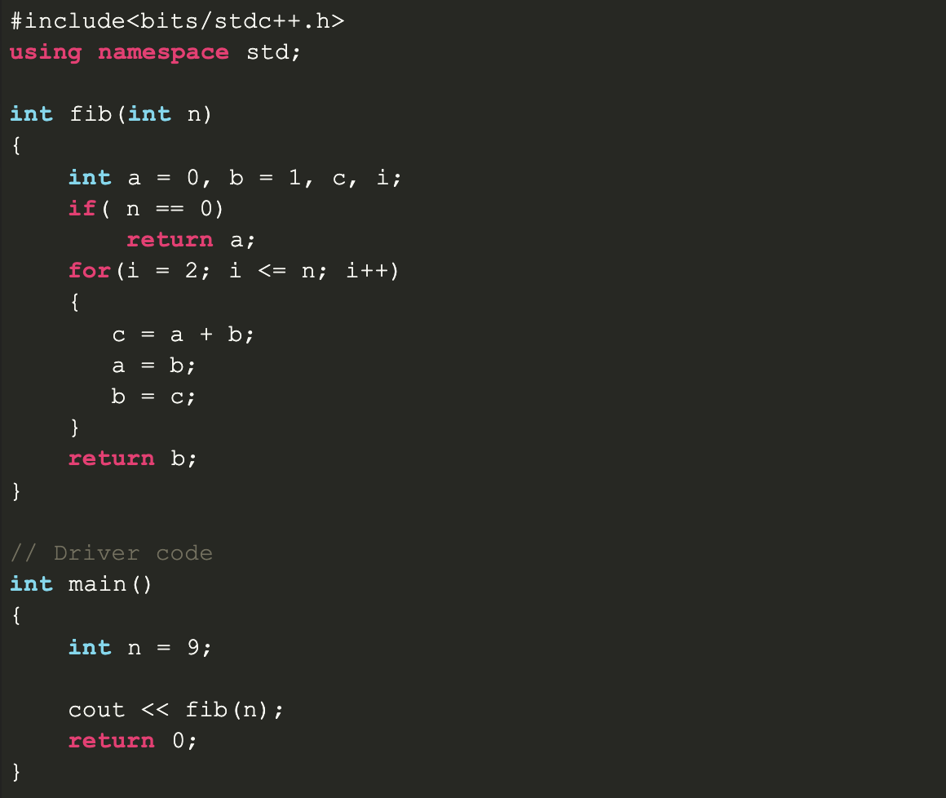
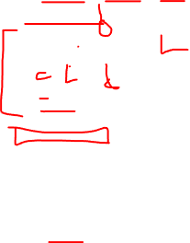
Space Complexity

