Slide 1
Cryptocurrency and Energy use
Matthew Dominguez CS 131

Slide 2
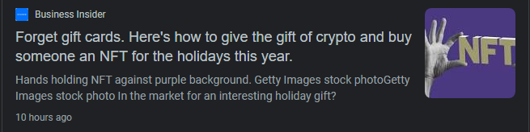
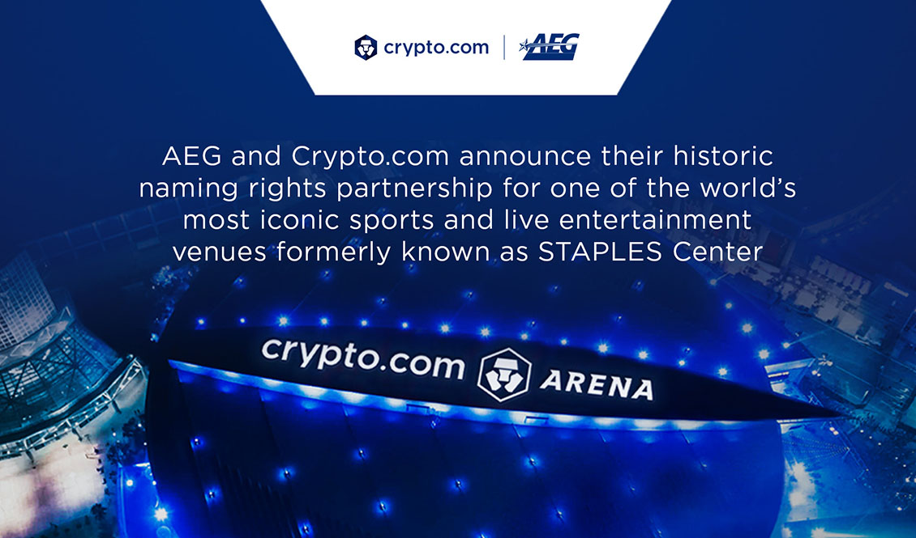
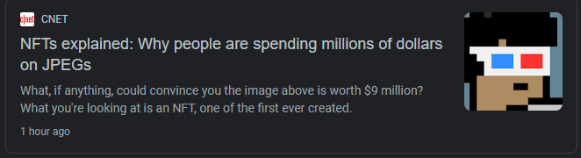
It’s everywhere!!

Slide 3

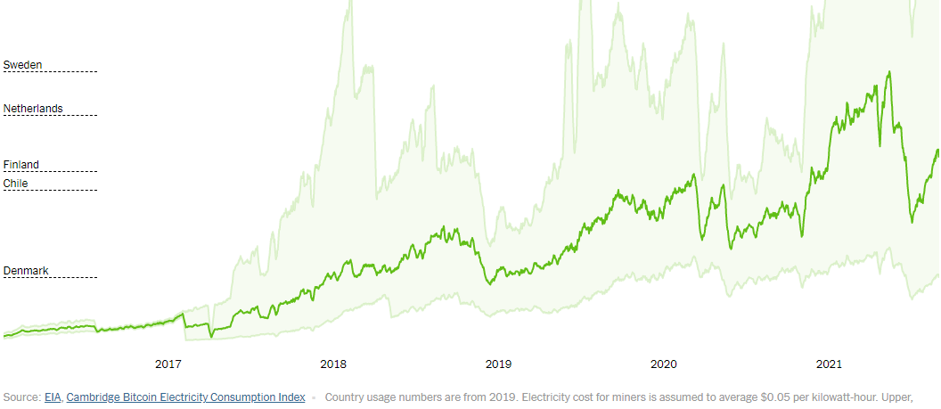

Slide 4

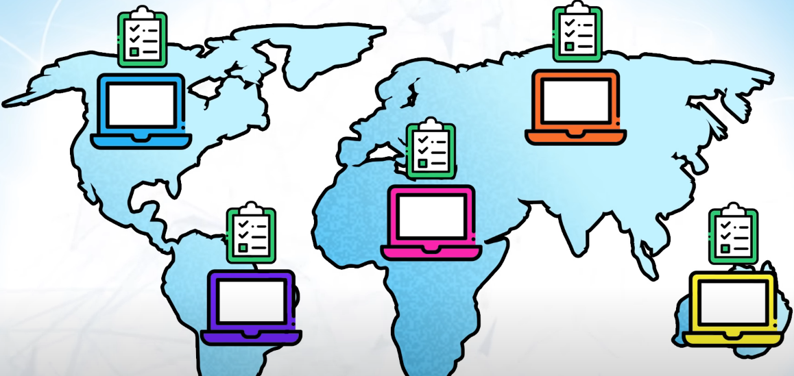
What is cryptocurrency?
Peer to Peer electronic cash system
No banks? No government?
Public ledger
Every peer has a full list of every transaction!
How do we know these transactions are valid though?

Slide 5
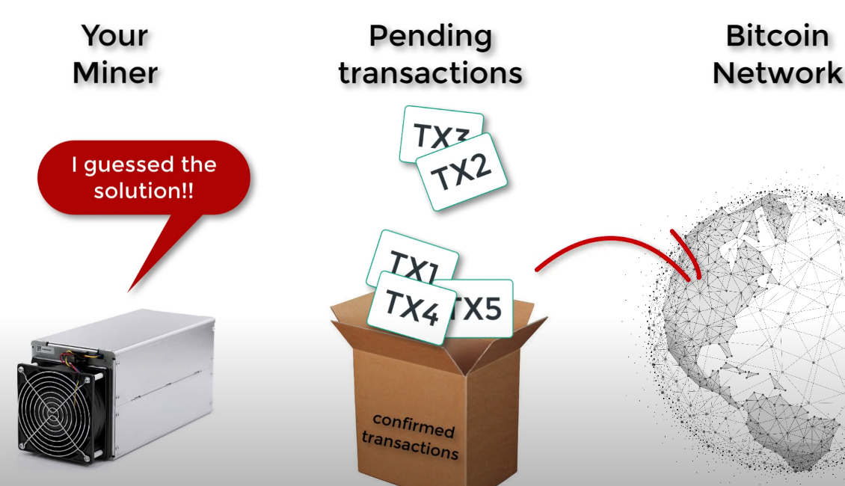
Proof of Work
The ledger with the most computational work is trusted.
What is this work?
People use their computer to guess a random number that solves an equation given by the system
Only one person succeeds every 10 minutes!
You receive currency for the effort!

Slide 6

Problems?
What happens if you don’t solve the problem?
Difficulty scales with the number of people mining!

Slide 7
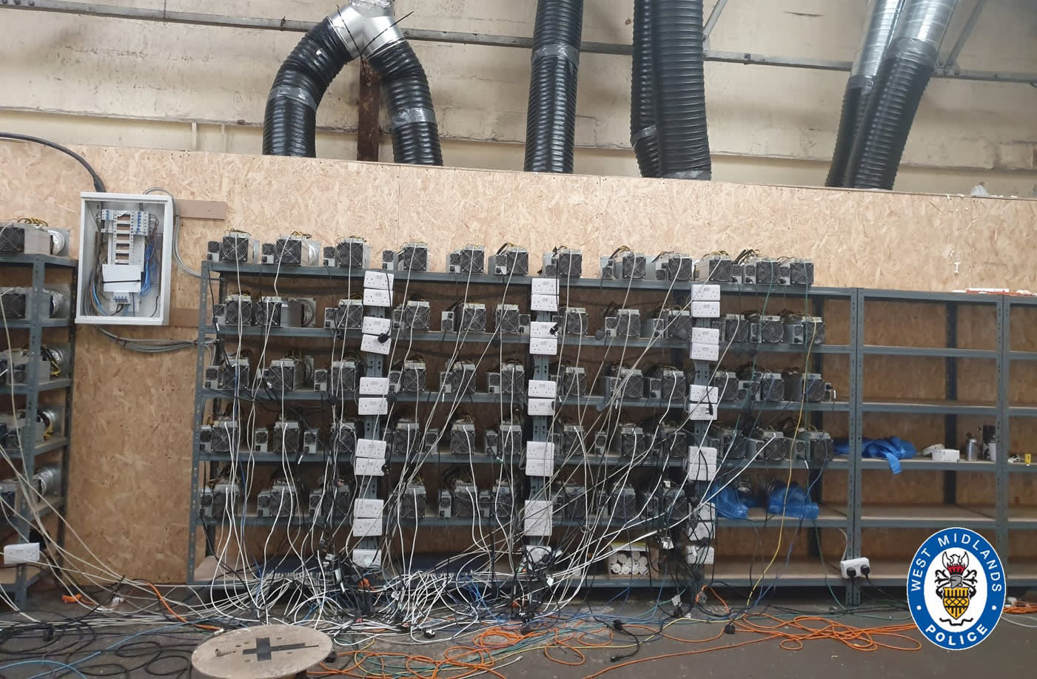
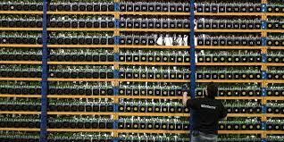
Farms

Slide 8
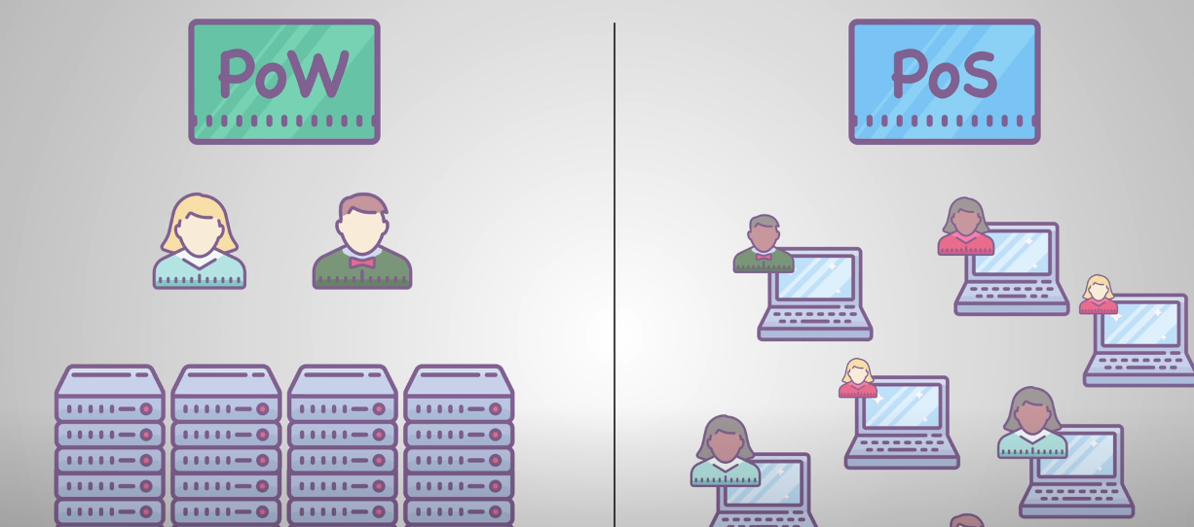
Proof of Stake
Instead of having computers do computations (mining)
We stake!
You deposit a minimum amount of funds (stake)
The people who staked can get selected to update the ledger like before
They get rewarded currency just as before!
Chances to be selected are affected by numerous
factors such as stake amount, randomization, and
how long you have staked without success.

