Slide 1

Alpine Linux
http://www.alpinelinux.org/

Slide 2
What is it?
security-oriented, lightweight Linux distribution based on musl libc and busybox
smaller and more resource efficient than traditional GNU/Linux distributions
a container requires no more than 8 MB
a minimal installation to disk requires around 130 MB of storage
uses its own package manager called apk, the OpenRC init system, script driven set-ups
v2.3 in 20/10/2011, v3.3.1 in 6/1/2016

Slide 3
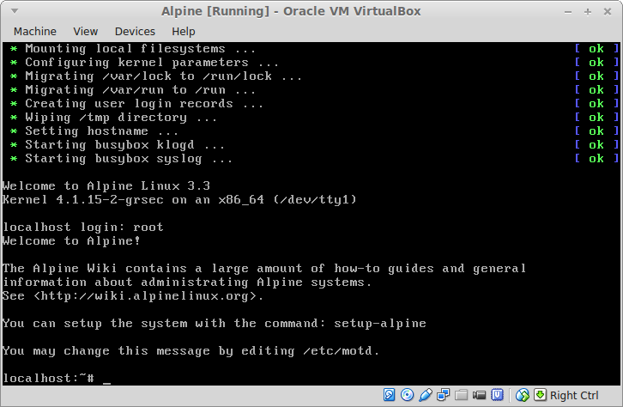
Installation

Slide 4
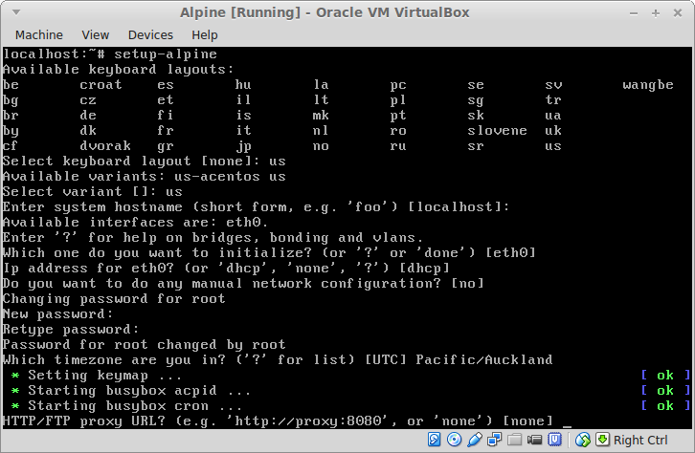
Installation
keyboard, hostname, network interface, dhcp, root pw, proxy

Slide 5
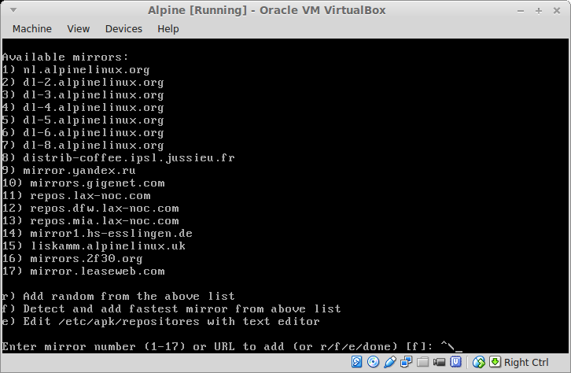
Installation
mirror selection

Slide 6
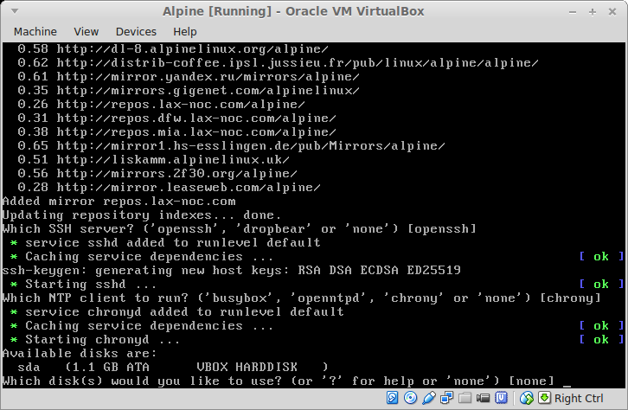
Installation
ssh server, ntp client

Slide 7
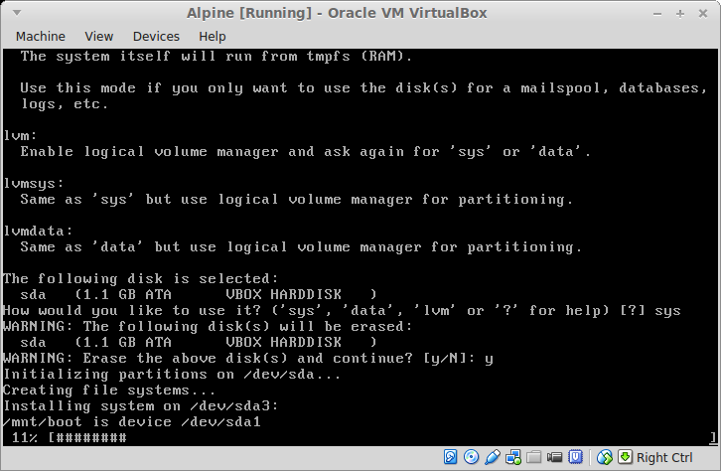
Installation
formatting disk

Slide 8
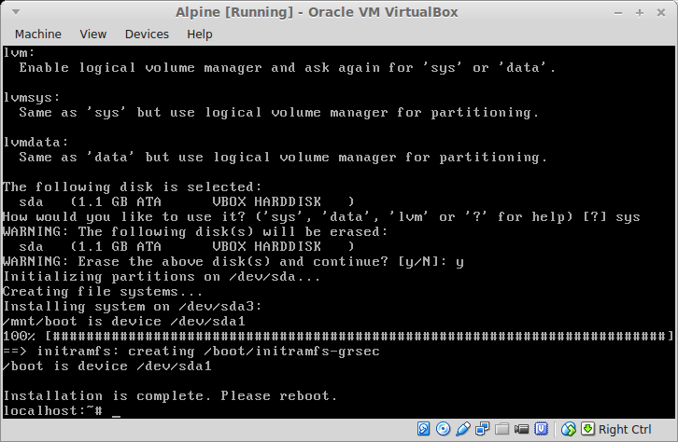
Installation
base installation finished!

Slide 9
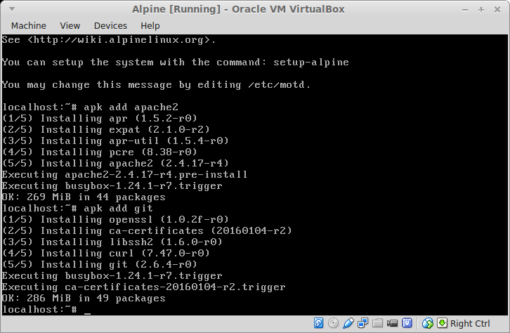
Customization
installing apache2 and git using “apk add <pkg>”

Slide 10
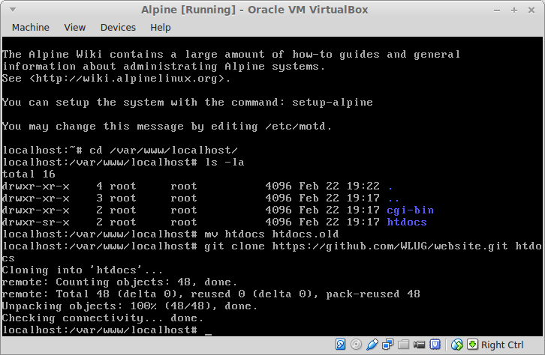
Customization
setting up WLUG website

Slide 11
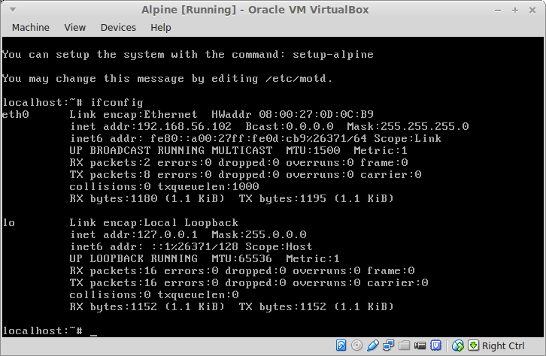
Testing webserver

Slide 12
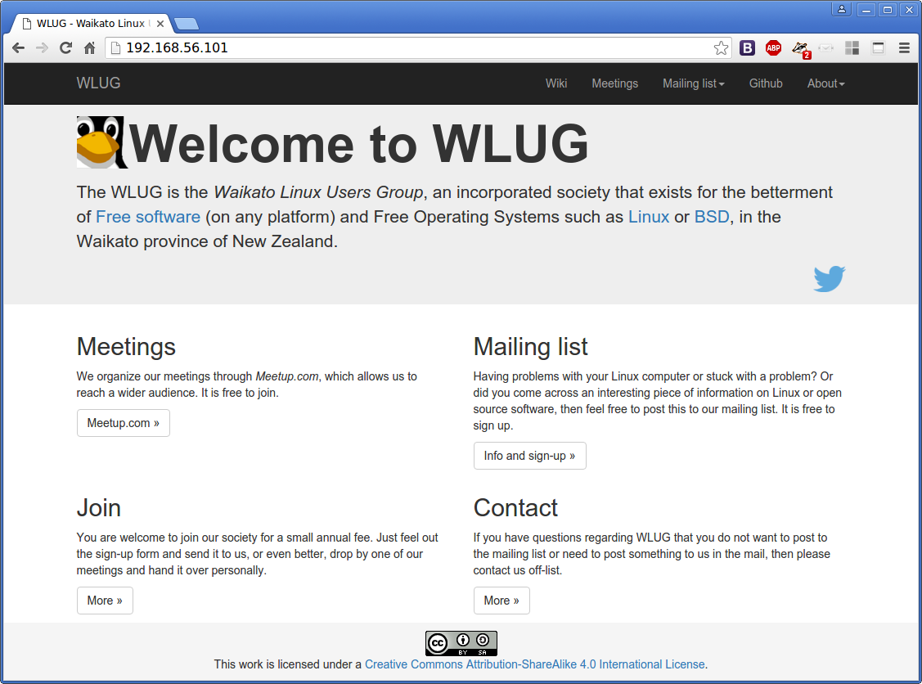
Testing webserver

