Slide 1
HTML5 and CSS
An Introduction
...and a problem I struck
Wlug Meeting - 27 Feb 2017
February Theme: Web browsers
Presented by: Ian Stewart

Slide 2
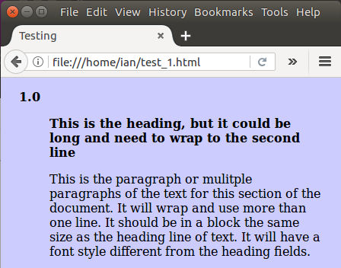
HTML - CSS
test_1.html
3 x CSS style classes to define different sections of text.
Class
.indent1
Numbering
Class
.indent2
Heading
Class
.indent3
Paragraph

Slide 3
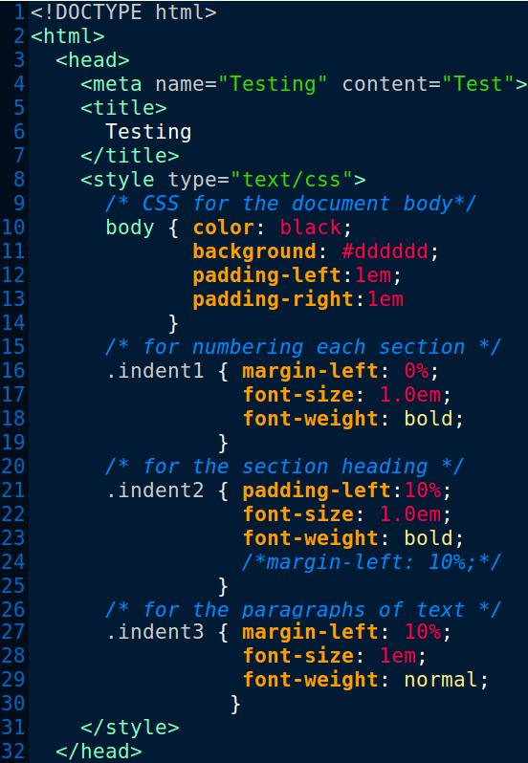
html5 Doctype and start
Header - Start
CSS Style - Start
Body CSS
CSS Class
.indent1 Numbering
CSS Class
.indent2 Heading
CSS Class
.indent3 Paragraph
Style & Header - End

Slide 4
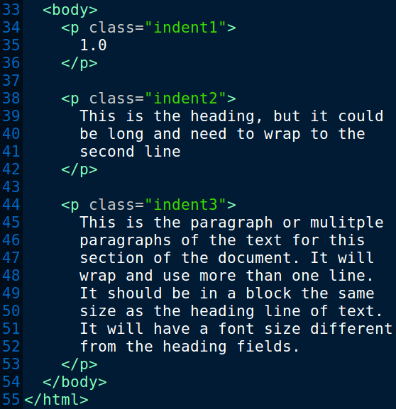
Body - start
Apply .indent1 for
Numbering
CSS .indent2 for
Heading
CSS .indent3 for
Paragraph
Body - end
html - end

Slide 6
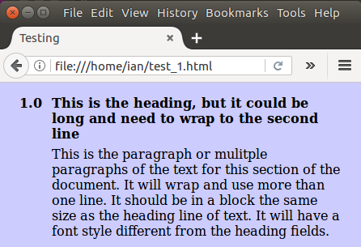
Change
this...
..to
this.
Note: This screen-shot faked by using the GIMP editor.

Slide 7
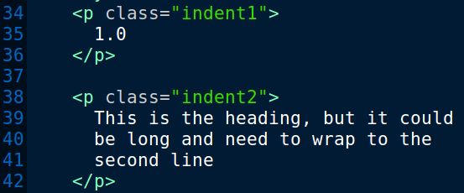
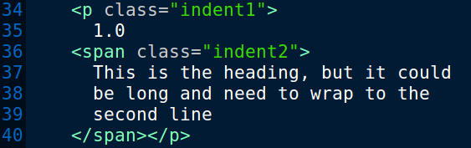
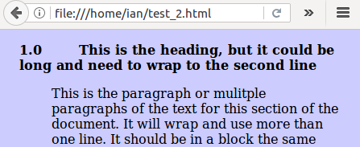
Original html for
Numbers and
Heading
Modified html.
Nesting through
using line <span>
Whoopsie!
Header
10% indent
and wraps
to Numbers
indent

Slide 8
HTML - CSS
Any ideas how to have the Numbers with their indent, and on the same line have the Heading with its own indent and wrapping?
Don’t want to use <ul> as dealing with weird numbering. E.g. 1.b.(ix).(a).
<div> ... </div> ?
End.

