Slide 1
TOR Browser
Wlug Meeting: 27 Feb 2017
Meeting Theme: Web Browsers
Presentation by: Ian Stewart

Slide 2
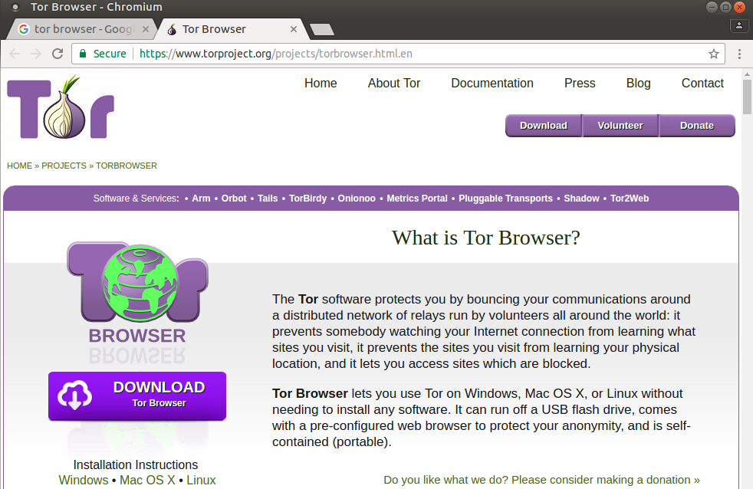
TOR Browser
https://www.torproject.org/projects/torbrowser.html.en

Slide 3
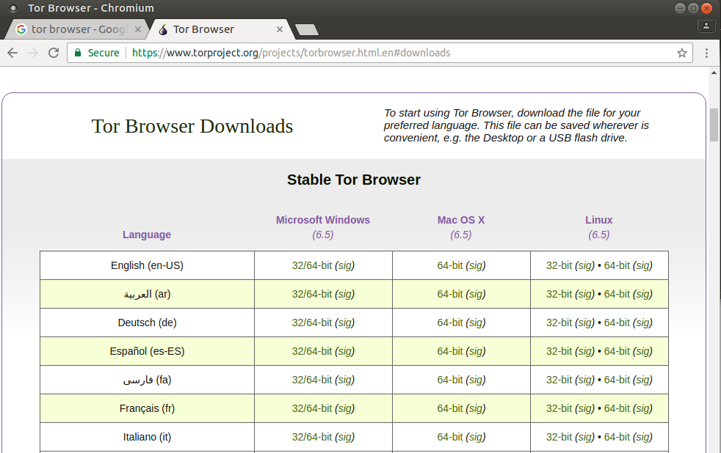
TOR Browser
Download...
Linux 64-bit
English

Slide 4
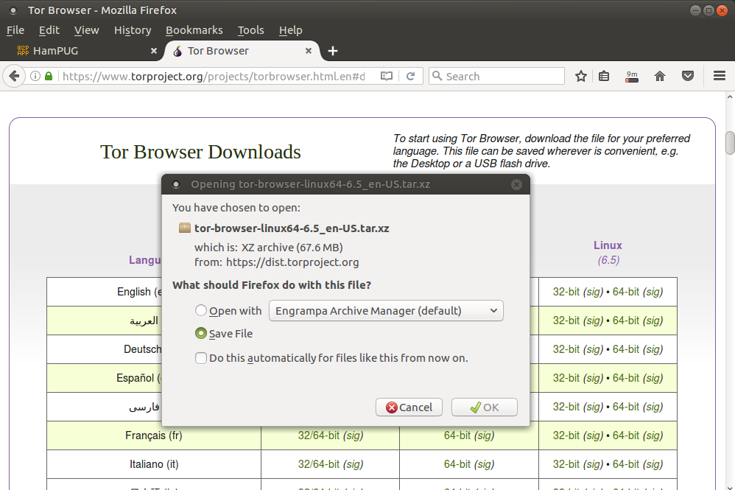
TOR Browser
Download...

Slide 5
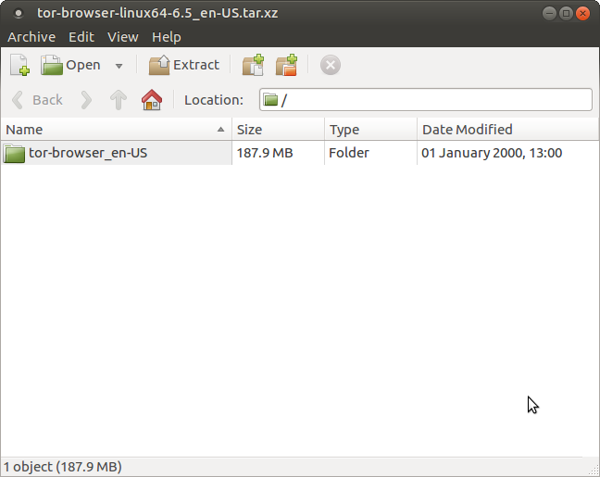
TOR Browser
Unpack...

Slide 6
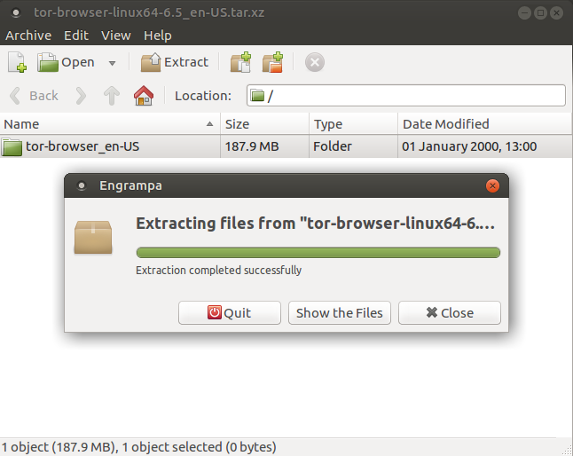
TOR Browser
Unpack...

Slide 7
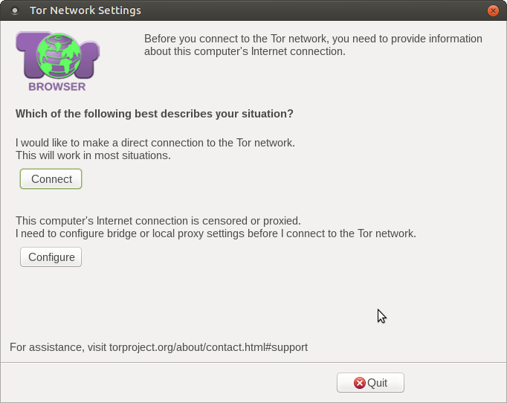
TOR Browser
Launch. Go to the installation directory and click on “setup”.
The “setup” Icon will change to “Tor Browser” launcher icon.
Clicking on “Connect” should start the TOR browser.

Slide 8
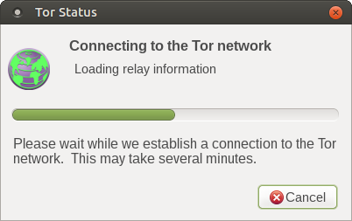
TOR Browser
Connecting...
It says “may take several minutes”, I found it only took
about 10 seconds.

Slide 9
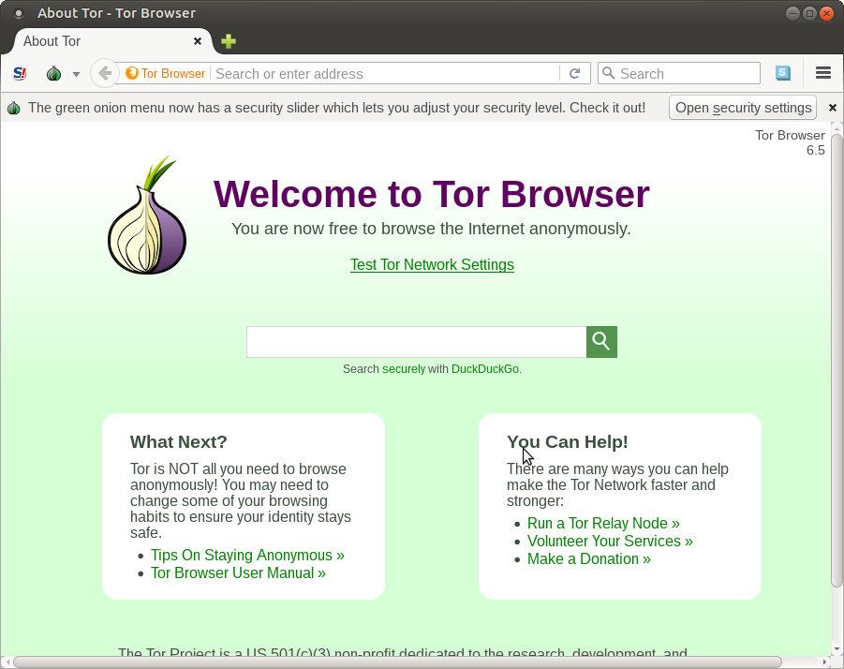
TOR Browser
TOR Browser – based on Mozilla Firefox...

Slide 10
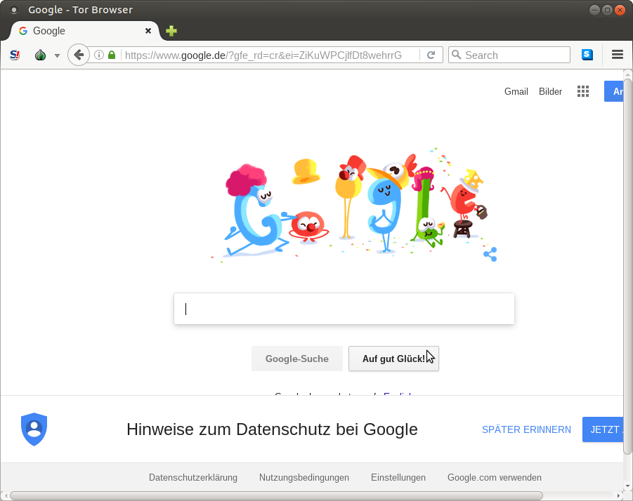
TOR Browser
www.google.com --> www.google.de...

Slide 11
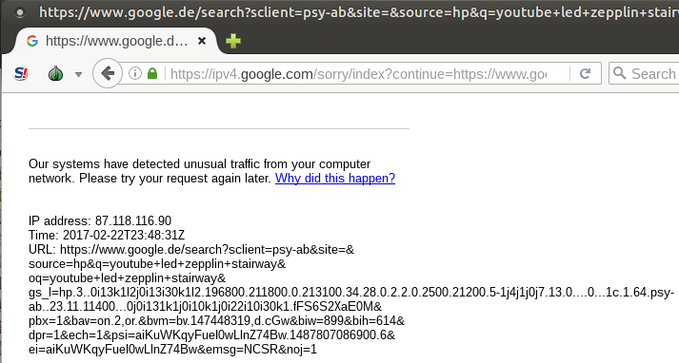
TOR Browser
Search for you tube clip using google...

Slide 12
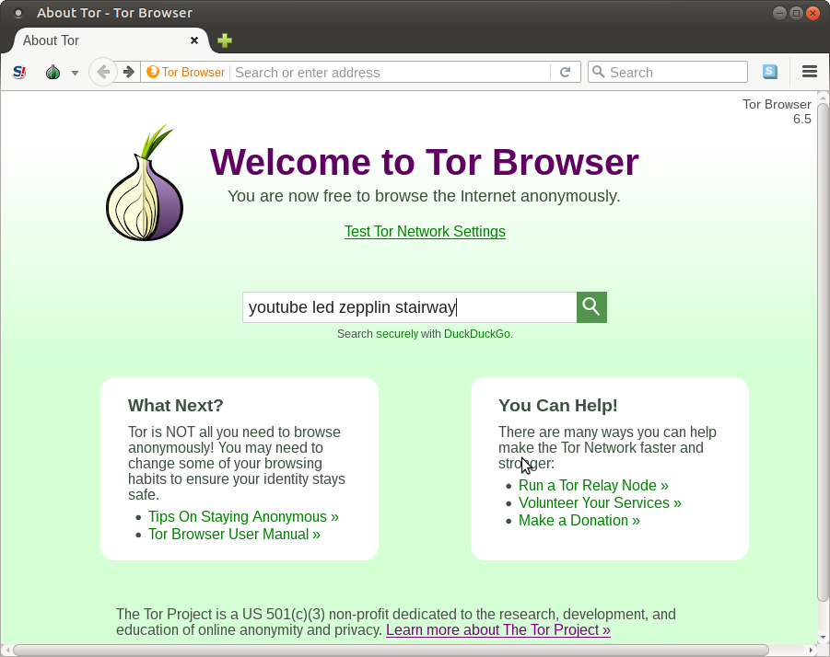
TOR Browser
Back to browser / duckduckgo...

Slide 13
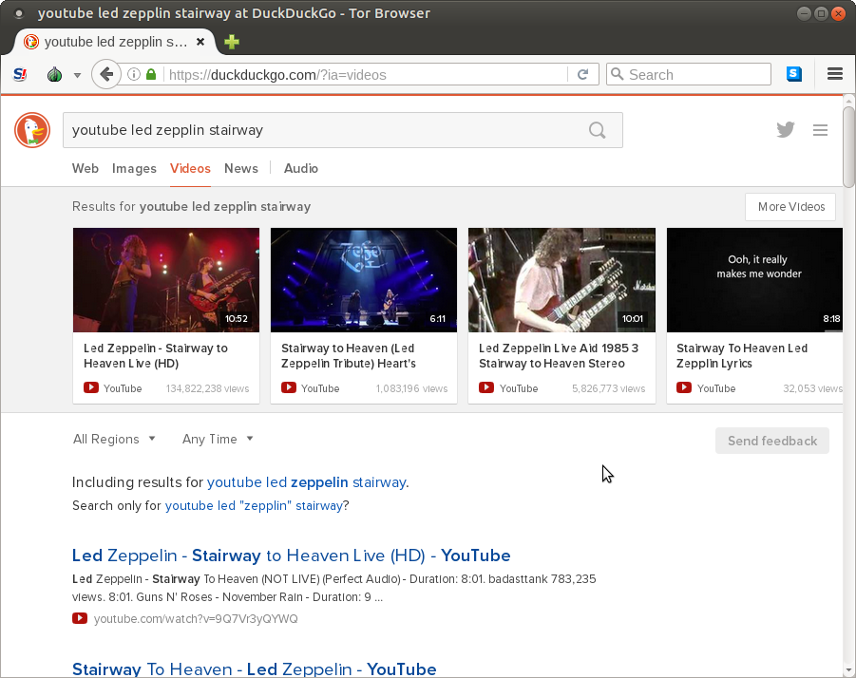
TOR Browser
Search on youtube...

Slide 14
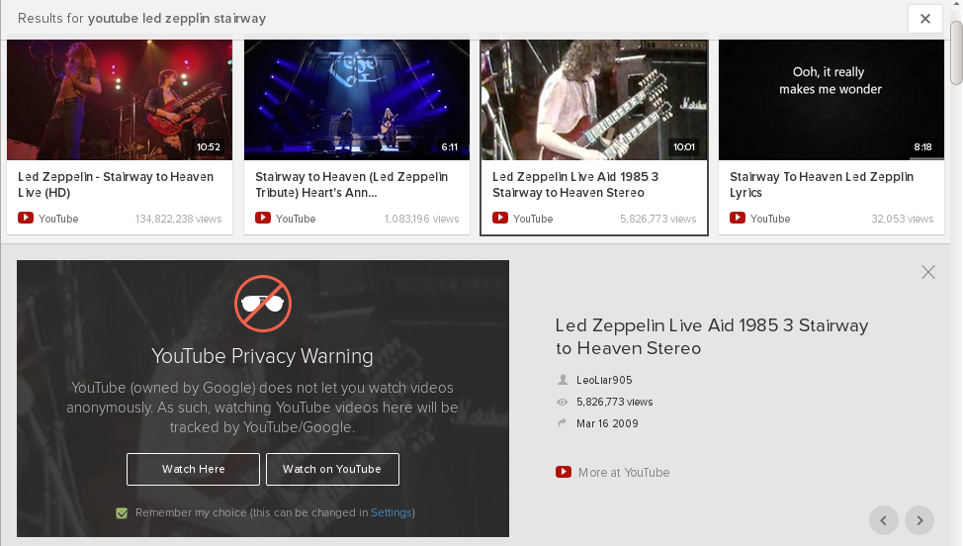
TOR Browser
Warning...

Slide 15
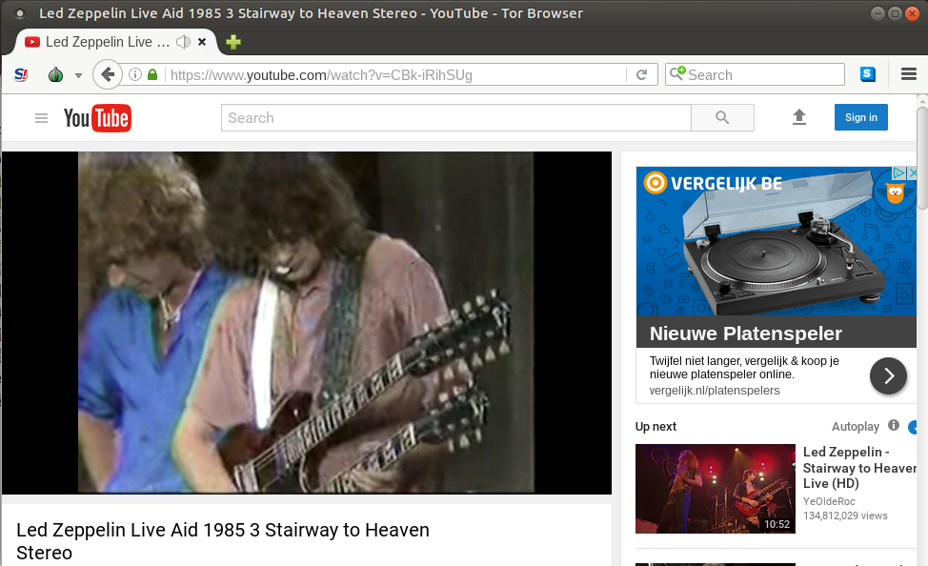
TOR Browser
Playing youtube clip...

Slide 16
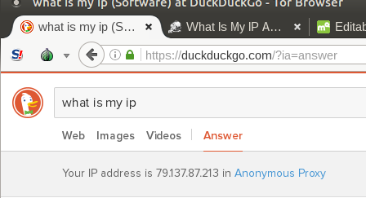
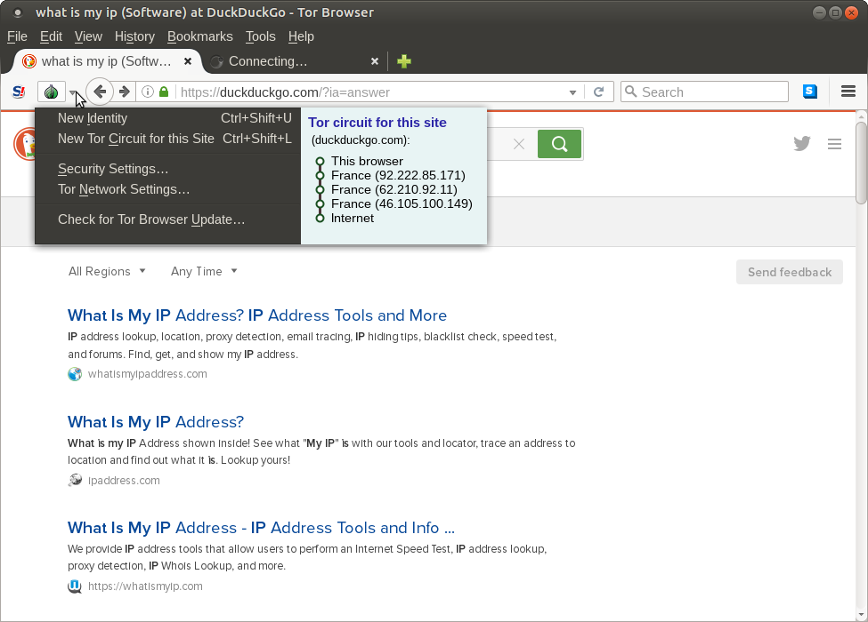
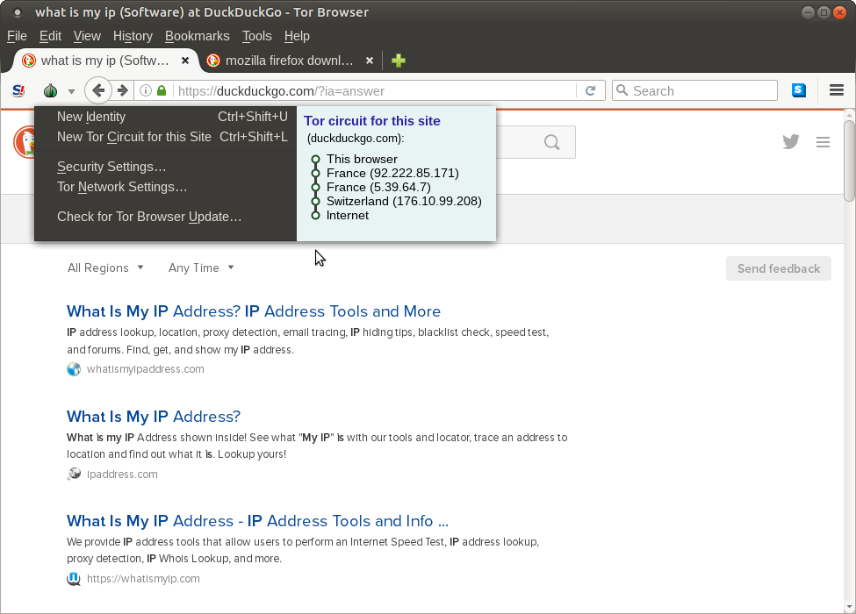
TOR Browser
IP Address...
o

Slide 17
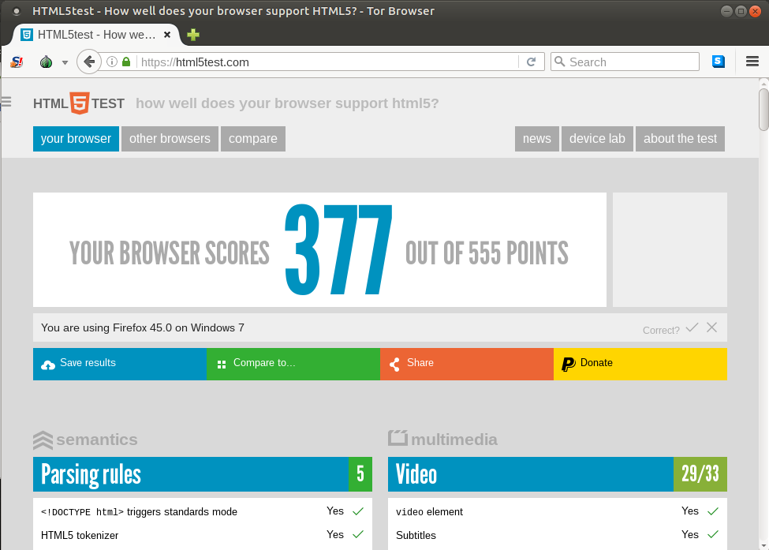
TOR Browser
html5test.com (on Linux Ubuntu-Mate 16.04.01 64-bit)...
Firefox 50.1.0 scores 463

Slide 18
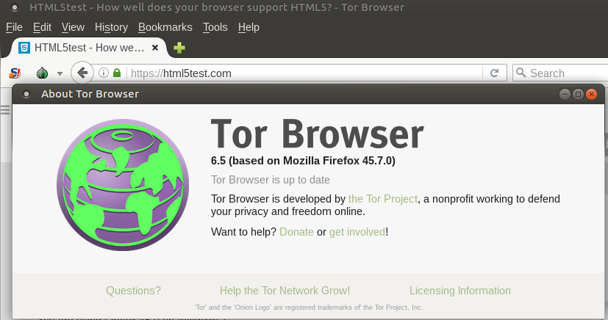
TOR Browser
Browser – based on Mozilla Firefox 45.7.0 (currently 51.0)...

Slide 19
TOR Browser
.onion websites
.onion is a special-use top level domain suffix designating an anonymous hidden service reachable via the Tor network.
See wikipedia for more info...
https://en.wikipedia.org/wiki/.onion

Slide 20
TOR Browser
End.

