Slide 1
Python webbrowser module
Wlug Meeting: 27 Feb 2017
Meeting Theme: Web Browsers
Presentation by: Ian Stewart

Slide 2
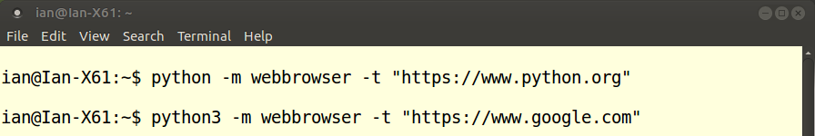
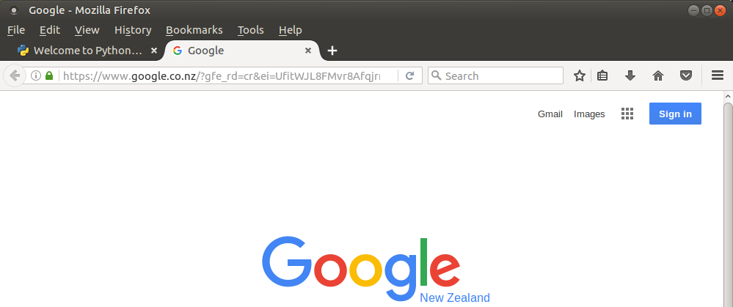
Python webbrowser module
Python2 and 3 include the webbrowser module
Laptop has Mozilla Firefox (default) and Chromium....
1. Launch Firefox and link to python.org
2. Open a new tab and link to google.co.nz

Slide 3
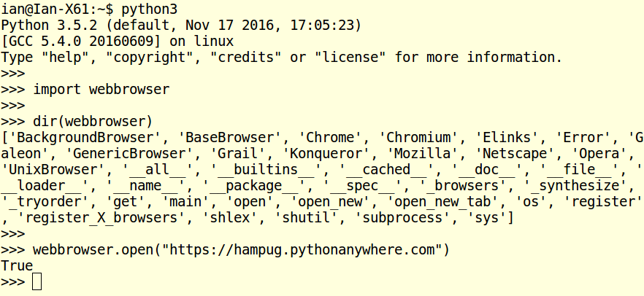
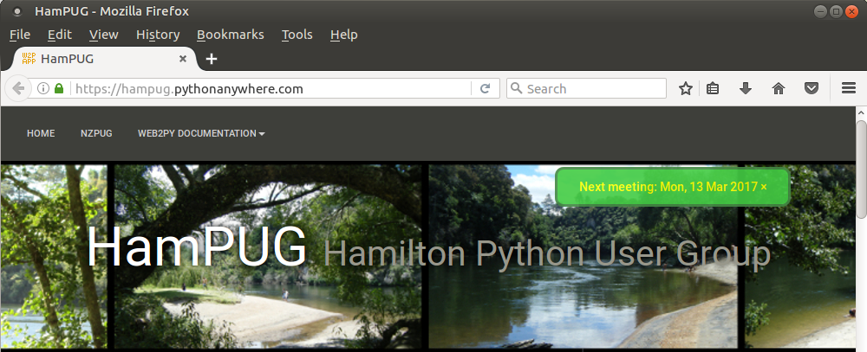
Python webbrowser module
Python2 and 3 importing the webbrowser module

Slide 4
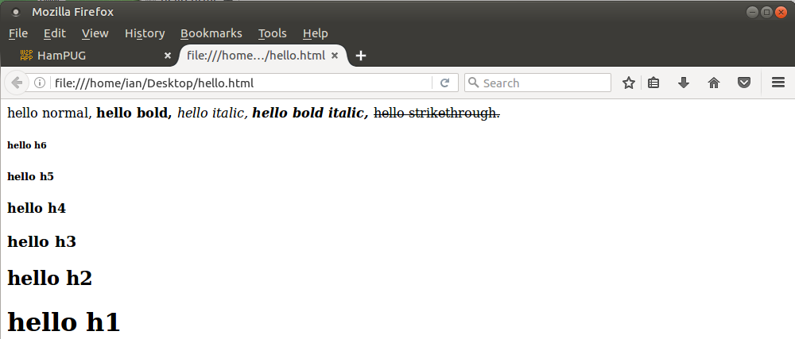
Python webbrowser module
Open local html file...

Slide 5
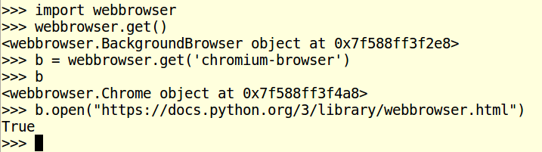
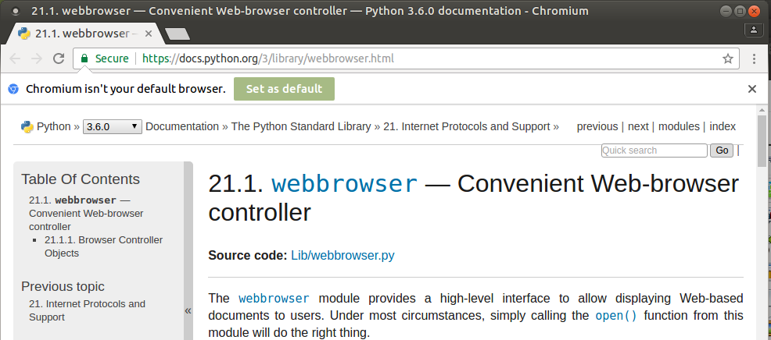
Python webbrowser module
Select the Chromium browser

Slide 6
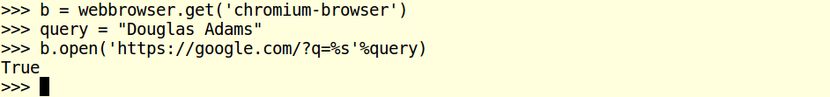
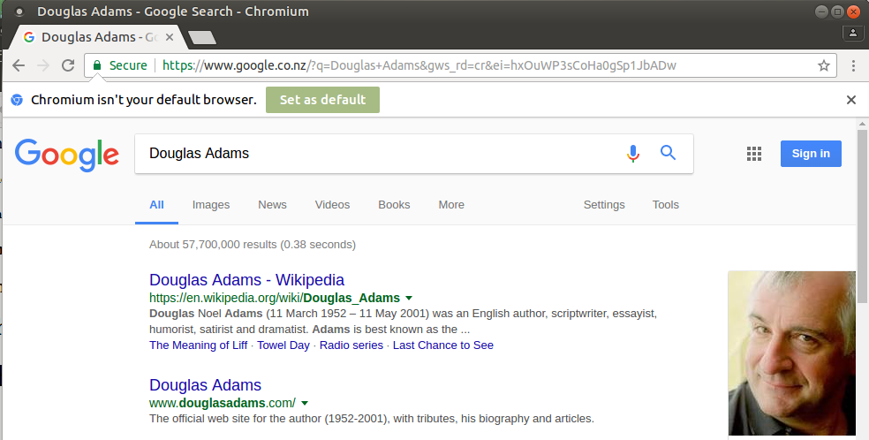
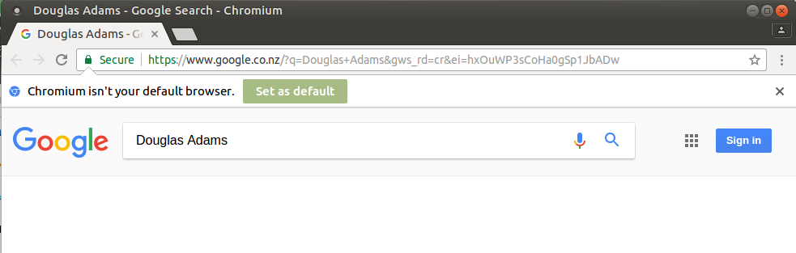
Python webbrowser module
Add a query – Needs the search icon clicked...

Slide 7
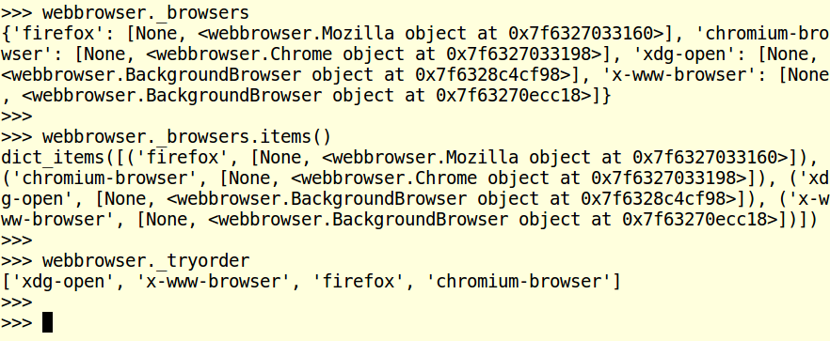
Python webbrowser module
Browsers available...

Slide 8
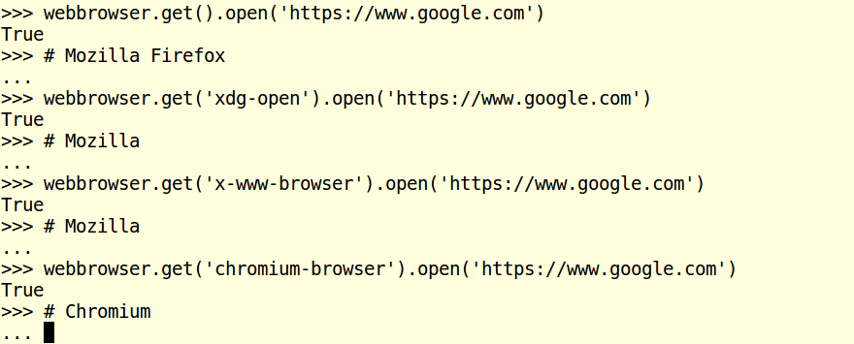
Python webbrowser module
Open Firefox and Chrome...

Slide 9
Python webbrowser module
Why use the python webbrowser module?
Dunno. Any suggestions?
1. Want a cross-platform program to launch whatever is
the default web browser for that platform and to displays
specific information. E.g. On-line help.
2. ?

Slide 10
Python webbrowser module
End

