Slide 1
Raspberry Pi Projects
- for your home -

Slide 2
Overview
Weather station
Heatpump hack
Garage door opener

Slide 3

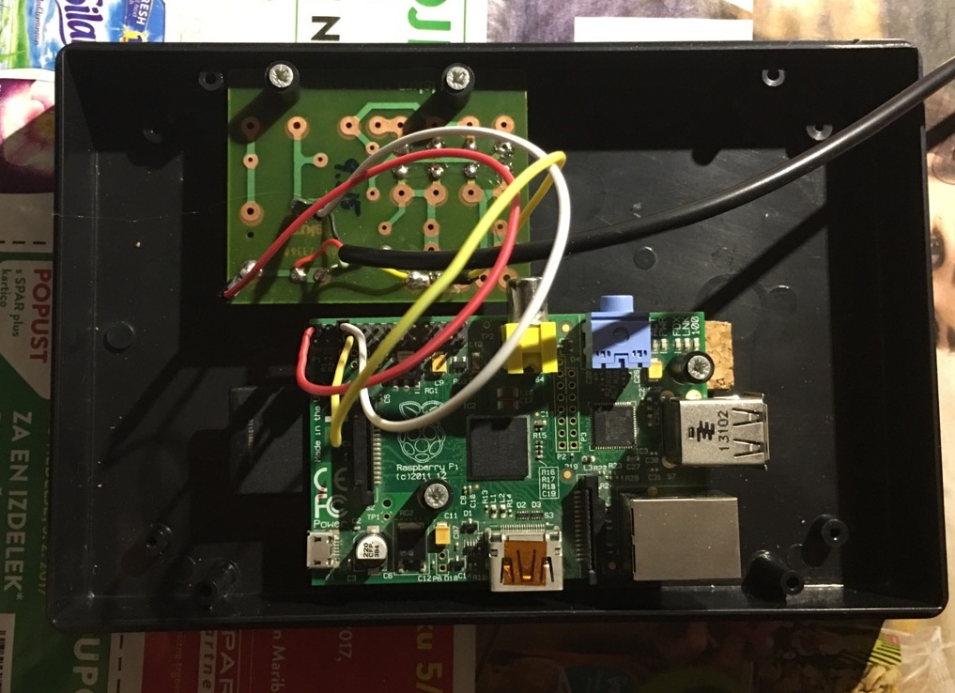
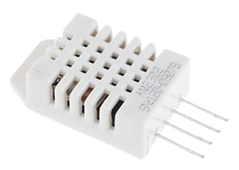
Raspberry Weather
https://www.raspberryweather.com/

Slide 4
Raspberry Weather (2)
Necessary parts
  RPi B
  Adafruit Pi cobbler breakout kit
  Breadboard wire bundle
  Full sized breadboard
  DHT22 or DS18B20 sensor
  Wifi dongle (if necessary)
https://www.raspberryweather.com/necessary-parts/

Slide 5
Raspberry Weather (3)
Sensors
  DHT22: temperature and humidity but not very reliable
  DS18B20: reliable, waterproof, but no humidity
https://www.raspberryweather.com/which-sensor-to-buy/

Slide 6
Raspberry Pi (4)
Software stack
  Apache/nginx
  Wordpress
  Python (for accessing sensors)
Optional
  Android app (id=com.raspberryweather)

Slide 7
Hacking your heatpump
Well, Mitsubishi ones at least
Tutorial
  https://nicegear.co.nz/blog/hacking-a-mitsubishi-heat-pump-air-conditioner/
Code
  https://github.com/hadleyrich/MQMitsi

Slide 8
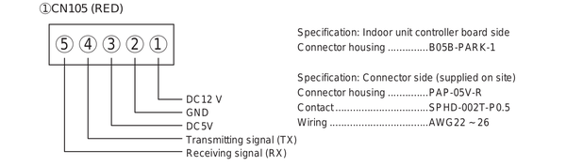
Hacking your heatpump (2)
Communication port CN105
5V TTL UART @ 2400 bps and even parity

Slide 9
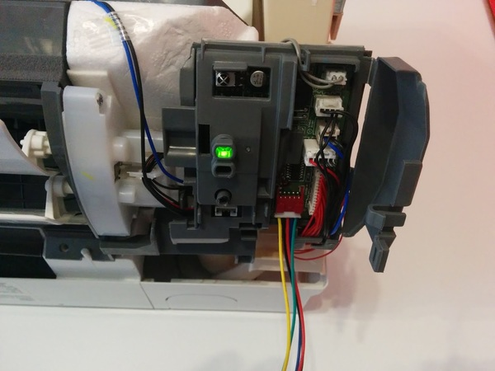
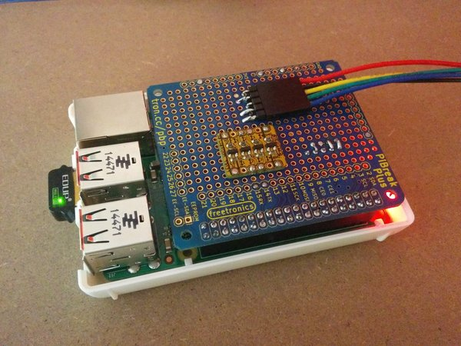
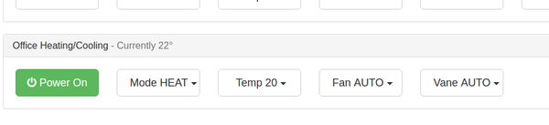
Hacking your heatpump (3)
heatpump
Control interface
RPi breakout board

Slide 10
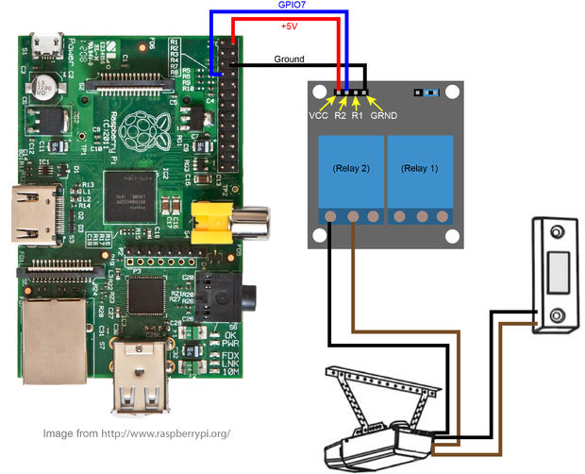
Garage door opener
Found at instructables
http://www.instructables.com/id/Raspberry-Pi-Garage-Door-Opener/
Overview

