Slide 1
home-assistant.io
or
How to keep it local and private

Slide 2
Background
smart homes thanks to IoT
BUT: privacy concerns (must phone home!)
Monitoring
  temperature (regulate AC)
  electricity usage
  cameras

Slide 3
“Private” alternatives?
home-assistant.io
openHAB
see also:
  https://alternativeto.net/software/home-assistant-io/

Slide 4
Installation
images for
  Odroid, RPi, Asus Tinkerboard, Intel NUC, Windos Mac, Linux, and others
RPi only 3 and 4
On RPi 2: use docker or Python venv

Slide 5
Installation (venv)
Download/flash RPi OS on SD card
https://www.raspberrypi.org/software/operating-systems/
Boot up and configure (sudo raspi-config)
Follow home-assistant instructions
use Python 3.8!
5-10min
https://www.home-assistant.io/installation/raspberrypi#install-home-assistant-core

Slide 6
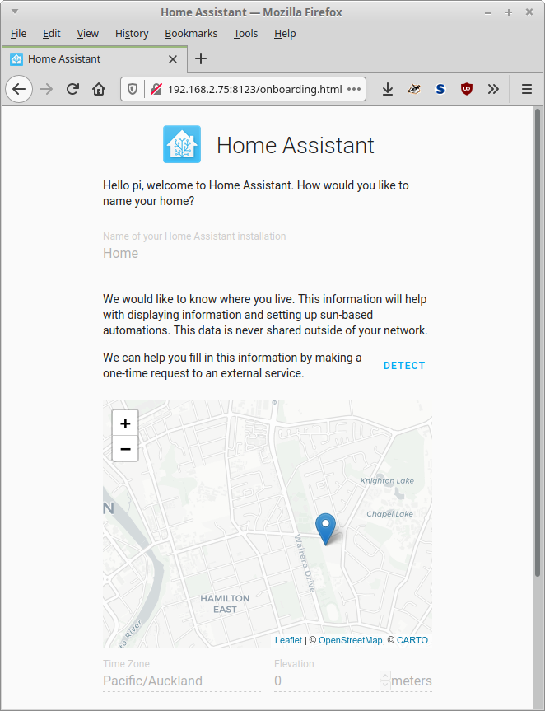
Onboarding
Documentationhttps://www.home-assistant.io/getting-started/onboarding/
http://A.B.C.D:8123/
create admin account
configure location

Slide 7
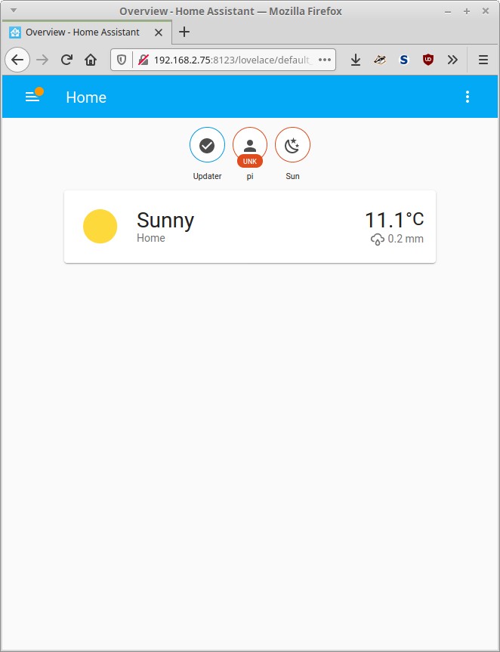
Home screen
After onboarding is done, home assistant scans network to find known devices
Finishes with home screen

Slide 8
Next steps – add devices
tp-link kasa HS110
controlled via Kasa Smart app
BUT: no account required
https://www.tp-link.com/us/support/faq/2707/
Plug in smart plug
Connect to plug’s wifi and follow instructions on app
  Did not work on S7 with Android 9
  Worked on S10 with Android 11
NB: Your Wifi needs to be WPA2-Personal (not mixed!)

Slide 9
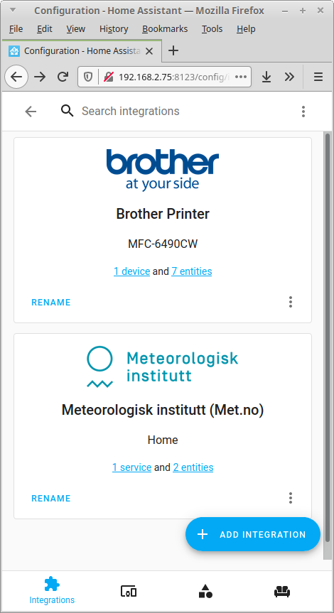
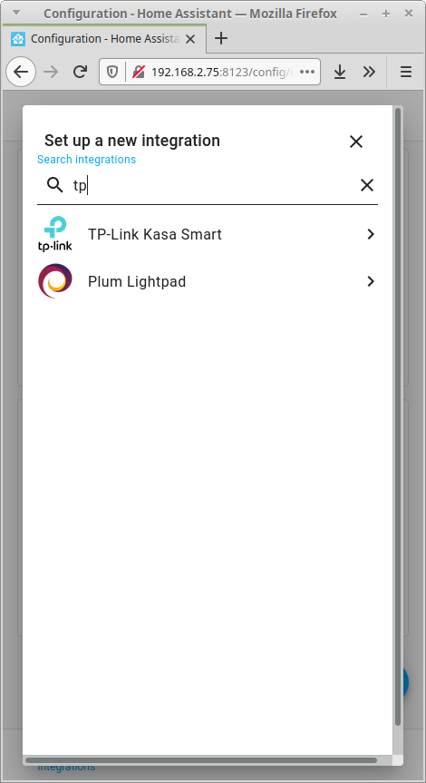
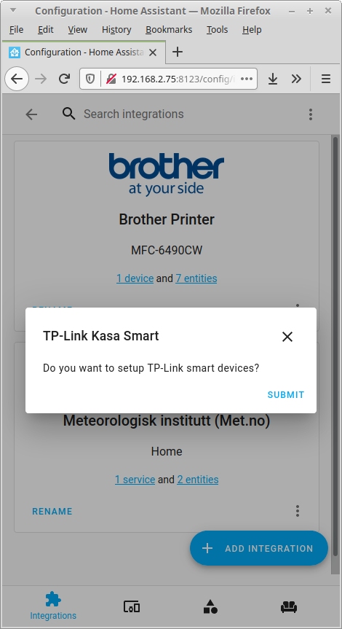
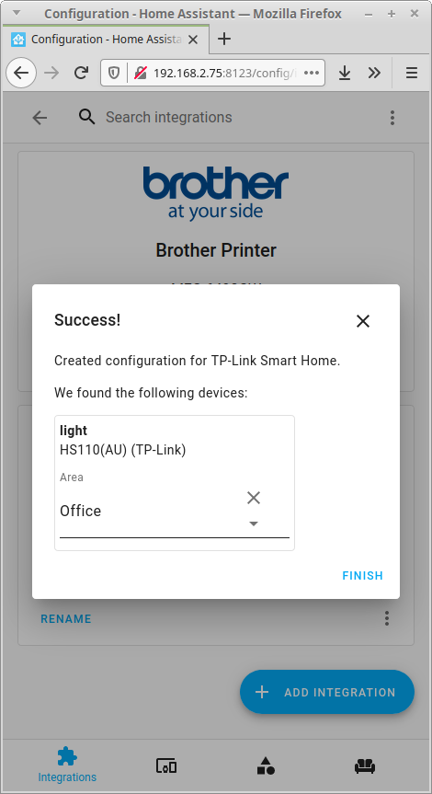
Adding smart plug

Slide 10
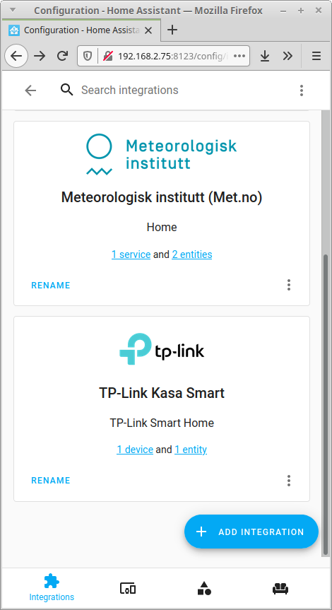
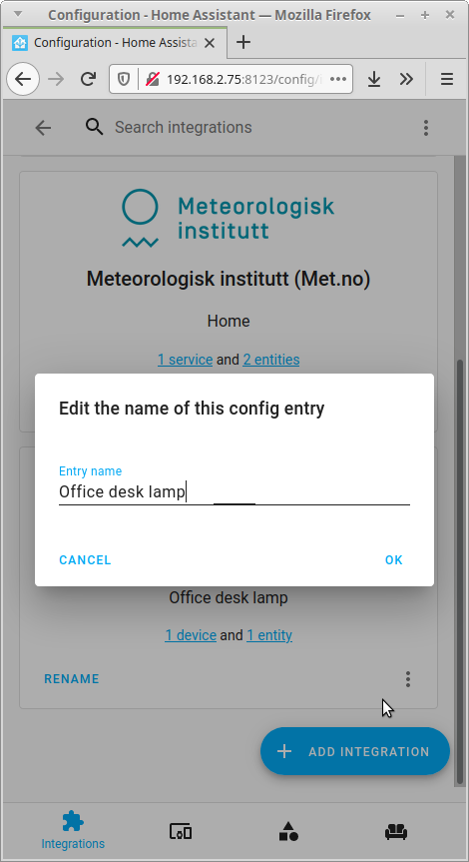

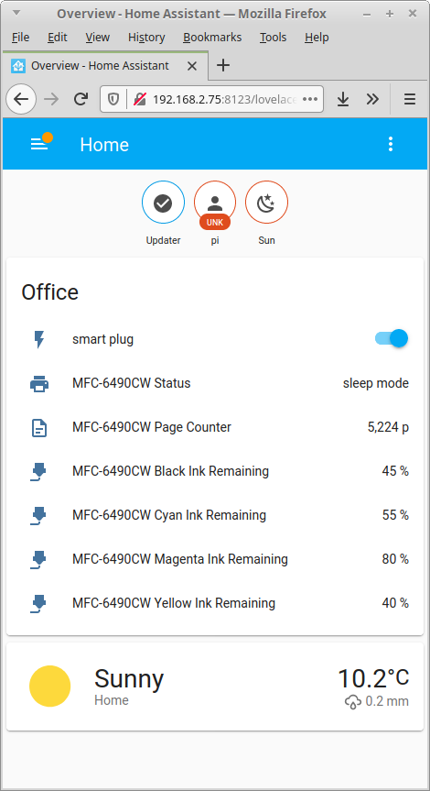
Adding smart plug (2)
Turn
on/off

Slide 11
Fancy stuff
Add automation with triggers
  Out of town: turn on/off lights to simulate that someone is home
  turn on/off lights based on sunset/sunrise
Trigger actions with presence (eg smartphone is home)
  lights on
  music on (integration for kodi)

