Slide 1
Termux
A full-blown shell on Android

Slide 2
What is it?
Termux is an Android terminal emulator and Linux environment app that works directly with no rooting or setup required. A minimal base system is installed automatically - additional packages are available using the APT package manager.
Source: https://termux.com/

Slide 3
What can I use it for?
Command-line tools
Graphical applications - basic X11 environment
  https://wiki.termux.com/wiki/Graphical_Environment
What I use it for
  rsync - for backing up my phone

Slide 4
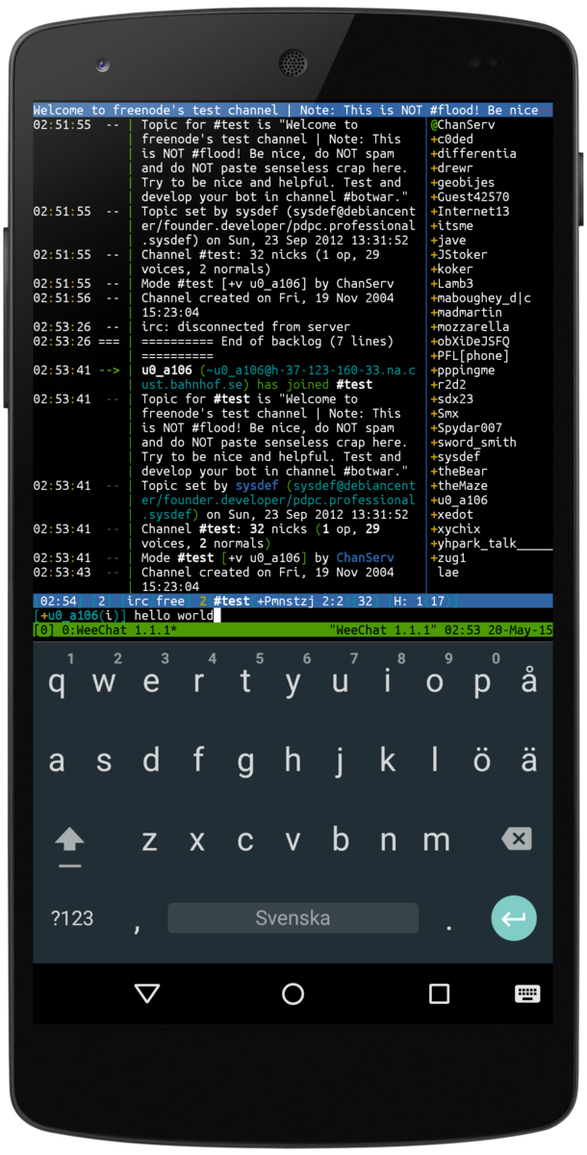
Where can I get it?
Repositories
  Google Play
  F-Droid
Supported Android versions
  5/6
  7 in testing (switch to API 24)
Source: https://github.com/termux/termux-packages

Slide 5
What packages?
Source of available packages can be inspected here
  https://github.com/termux/termux-packages/tree/master/packages
Packages are hosted by JFrog Bintray
  https://bintray.com/

Slide 6
How to manage packages?
Start up of Termux lists:
  packages search <query>
  packages install <package>
  packages upgrade
  packages help

Slide 7
Demo
Let's take it for a test drive...

