Slide 1
Upgrading your Android Phone
Or: how to make bricks

Slide 2
Why?
Manufacturer ended support (if there ever was)
“Pure” Android experience
Minimal Google integration (eg just Play store)
Bored ;-)

Slide 3
What?
Custom ROM (pre-compiled)
  LineageOS (former Cyanogenmod)
  AospExtended ROM
  /e/ (no Google integration at all)
ROM (from source)
  Find device on LineageOS and follow instructions
  Caution
    downloads ~100GB
    build can take a day and then fail
Samsung phones require flashing via heimdall
  (open-source replacement of Samsung’s Odin tool)

Slide 4
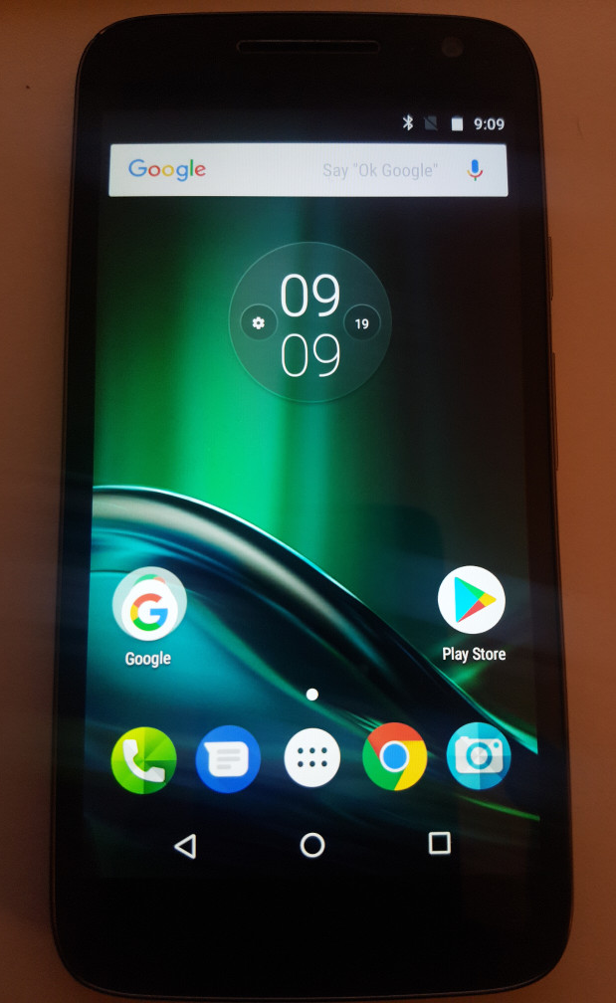
How?
Example
  Moto G4 Play XT1602
Download custom ROM
  /e/
  motostock roms
Custom recovery software
  TWRP
Unlock bootloader and install images via
  adb and fastboot
Other phones, like Samsung, may require
  heimdall

Slide 5
Install heimdall
Download zip
  https://gitlab.com/BenjaminDobell/Heimdall/tree/master
Install requirements
  sudo apt-get install build-essential qt5-default libusb-1.0-0-dev libusb-dev libgl1-mesa-glx libgl1-mesa-dev cmake zlib1g-dev
Compile
  unzip -q Heimdall-master.zip
  cmake .
  make
  sudo make install
Troubleshooting
  how to fix problem with linking to libusb
    https://github.com/Benjamin-Dobell/Heimdall/issues/423
    heimdall/CMakeFiles/heimdall.dir/link.txt
    add -lusb-1.0 to the end
NB: Not required for the Moto G4, but listed here to save you some headache and a few hours...

Slide 6
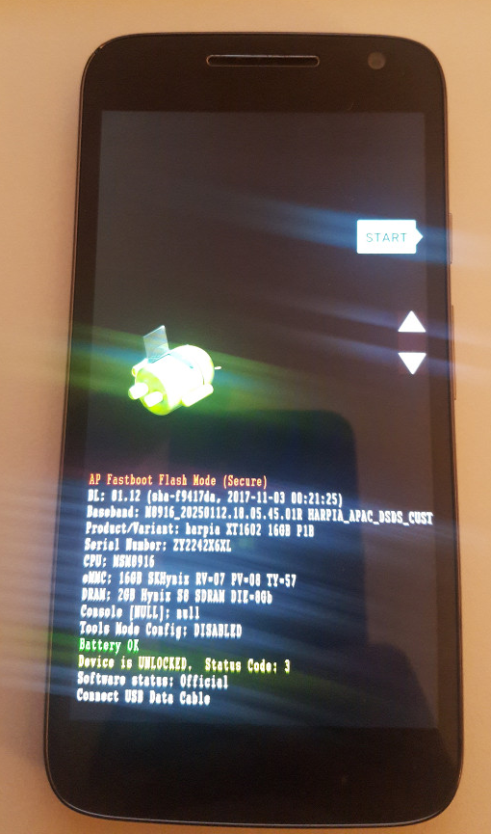
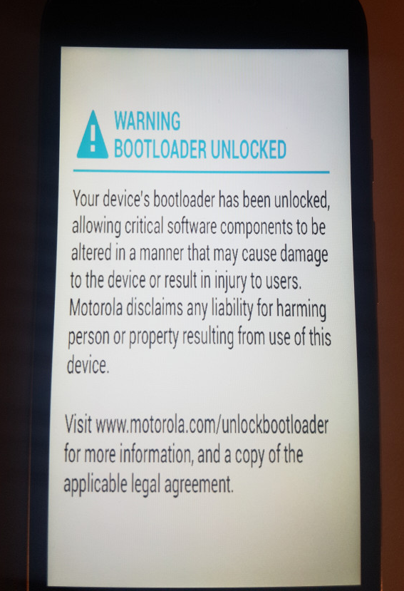
Unlock bootloader
Follow instructions, eg /e/
Unlock bootloader (Motorola instructions)
  adb reboot bootloader
  fastboot devices
    troubleshooting permissions
  fastboot oem get_unlock_data
  paste device ID as one string on Motorola page to receive unlock key XXX in email
  fastboot oem unlock XXX
  Phone is unlocked successfully!
NB: Not every phone will require unlocking the bootloader

Slide 7
Install recovery image
/e/ instructions (“Installing a custom recovery using”)
  download TWRP
  execute commands
    adb reboot bootloader
    fastboot devices
    fastboot flash recovery twrp-x.x.x-x-harpia.img
  reboot into recovery mode to verify installation
    fastboot: Power+VolumeDown, select “Recovery mode”
    adb reboot recovery

Slide 8
Install ROM
/e/ instructions (“Installing /e/ from custom recovery”)
Boot into recovery mode, eg via
  adb reboot recovery
Main menu -> Wipe data
Format data
Go back, Advanced Wipe: Cache + System
Sideload ROM zip
  Advanced -> ADB sideload
  on computer: adb sideload filename.zip
If sideload doesn’t work, try copying it onto SD card
  adb push filename.zip /sdcard/
Once finished, reboot

Slide 9
Install Google Apps
Done via OpenGApps
Different amount of “Googleness”
  pico – bare minimum to get Play store
  nano – pico + functionality not in Play store
  micro – nano + Gmail, Calendar, Google Now
  mini – most popular apps
  full – similar to stock, does not replace non-Google stock-applications
  stock – all Google apps that come with Nexus devices
  super – all Google apps that were ever shipped
Arm or Arm64?

Slide 10
Install OpenGApps
LineageOS instructions
Copy OpenGApps zip on sdcard
  adb push filename.zip /sdcard/
Boot in recovery mode
  adb reboot recovery
choose “install zip” or “Apply update” and navigate to the zipfile copied earlier

Slide 11
If you are lucky,
you are up and running now :-)

