Slide 1

OpenWrt - Re-visited
Waikato Linux Users Group
Ian Stewart
28 February 2022

Slide 2
OpenWrt – “Open Wireless Router”
The OpenWrt Project is a Linux operating system targeting embedded devices.
Instead of trying to create a single, static firmware, OpenWrt provides a fully writable filesystem with package management.
This frees you from the application selection and configuration provided by the vendor and allows you to customize the device through the use of packages to suit any application.
For developers, OpenWrt is the framework to build an application without having to build a complete firmware around it; for users this means the ability for full customization, to use the device in ways never envisioned.

Slide 3
OpenWrt - Re-visited
WLUG presentation on 25 February 2019.
https://github.com/WLUG/meetings/tree/master/2019/2019-02-25
3 x Slides shows. 140 slides
OpenWrt 18.06.1 (19 Aug 2018)
Kernel 4.9.120
BusyBox 1.28.3
Python 3.6.5 (default, 31 Jan 2019, 14:35:22)
root@OpenWrt:/# cat /etc/openwrt_release
DISTRIB_ID='OpenWrt'
DISTRIB_RELEASE='18.06.2'
DISTRIB_REVISION='r7676-cddd7b4c77'
DISTRIB_TARGET='brcm63xx/smp'
DISTRIB_ARCH='mips_mips32'
DISTRIB_DESCRIPTION='OpenWrt 18.06.2 r7676-cddd7b4c77'
DISTRIB_TAINTS=''

Slide 4
OpenWrt - Re-visited
Current stable series: OpenWrt 21.02 released on 25. October 2021.
OpenWrt 21.02.1
Kernel 5.4.154
BusyBox 1.33.1
Python 3.9.10-1
root@OpenWrt:/etc# cat openwrt_release
DISTRIB_ID='OpenWrt'
DISTRIB_RELEASE='21.02.1'
DISTRIB_REVISION='r16325-88151b8303'
DISTRIB_TARGET='bcm63xx/generic'
DISTRIB_ARCH='mips_mips32'
DISTRIB_DESCRIPTION='OpenWrt 21.02.1 r16325-88151b8303'
DISTRIB_TAINTS='''

Slide 5
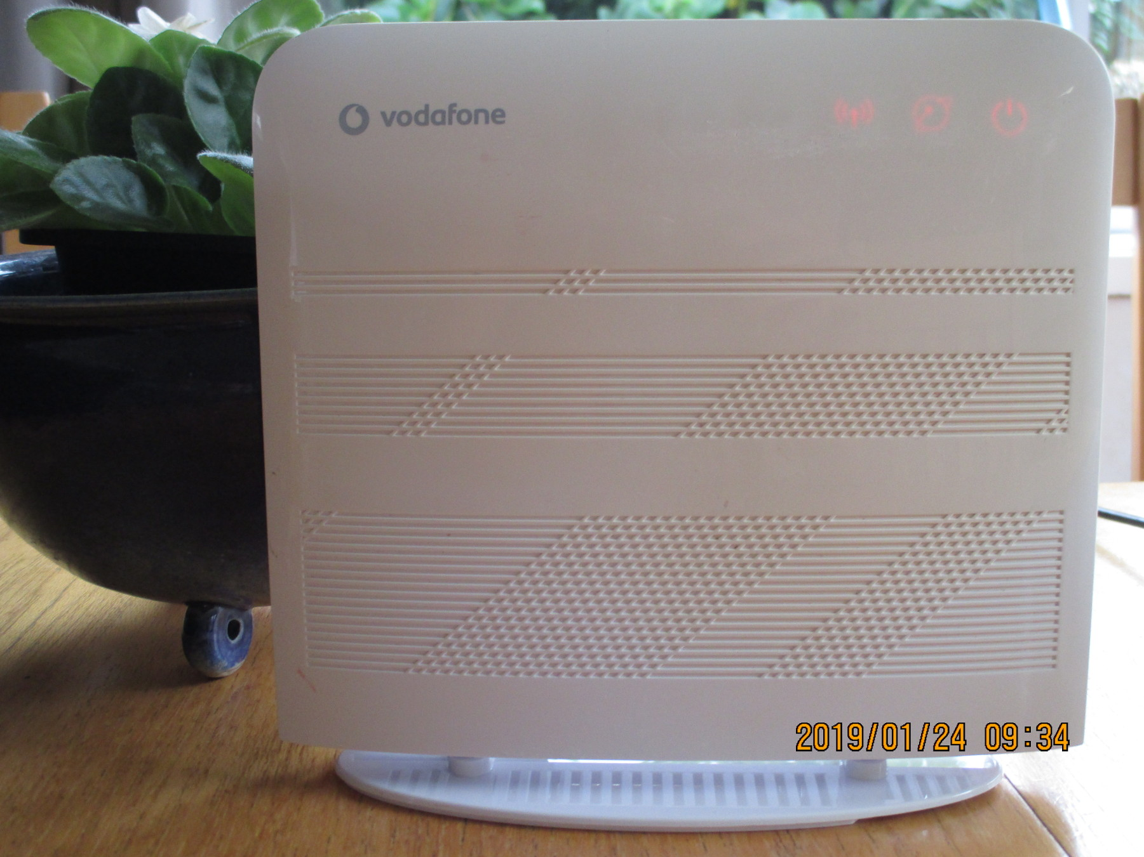
Example: Vodafone / Huawei HG556a

Slide 6
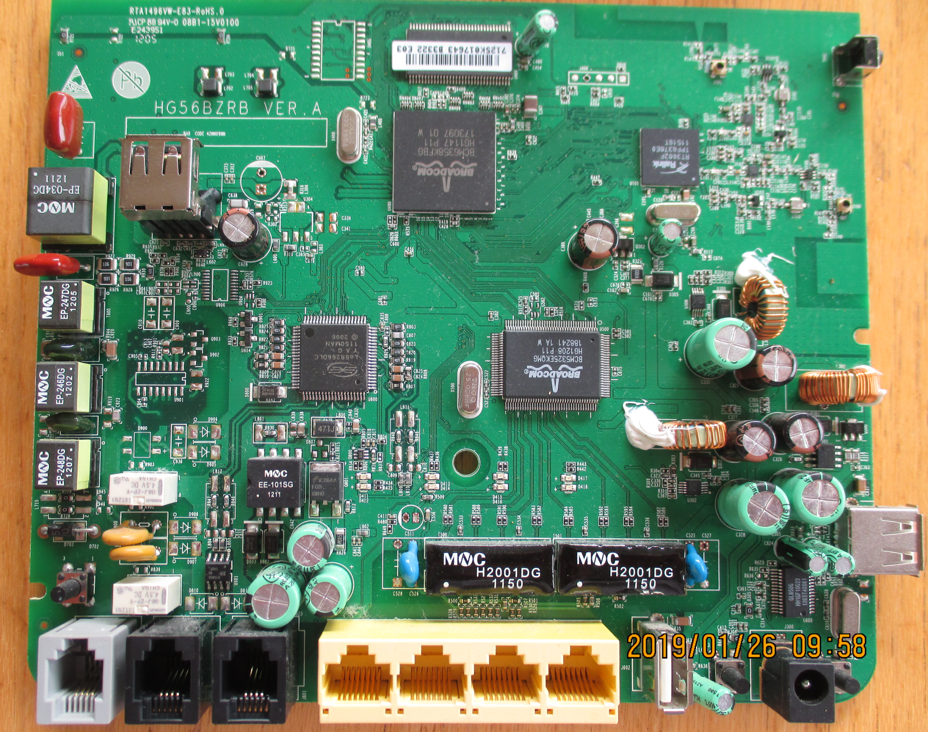
Example: Vodafone / Huawei HG556a C
BCM6358 CPU / ADSL
Console Serial port TTL
Rev C
HG56BZRB VER.A
Wifi: Ralink
Le88266DLC Voice
BCM5325E 10/100 Ethernet Switch

Slide 7
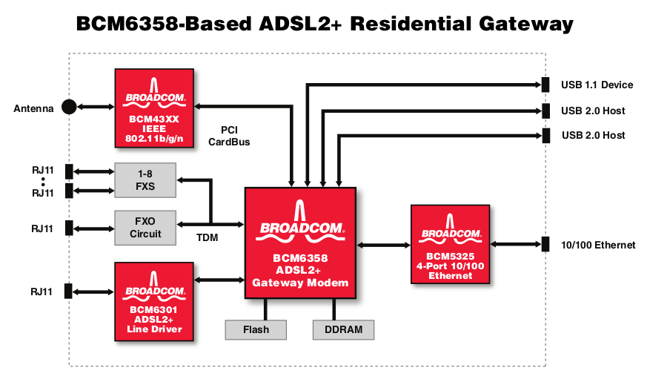
Home Gateway – Broadcom Block Diagram
Wifi
USB to Mobile
Network
CPU
+
ADSL
Modem
Ethernet
Ports
Switch
ADSL
Tx/Rx
Ethernet
Ports
WAN port
Phone
Line

Slide 8




Block Diagram
Internet
Service
Provider
PC
DHCP serves an IP address for the WR.
E.g. 101.100.0.10
BBB
Slides
ISP
Wireless
Router
Managed at:
192.168.1.254
Switch
DHCP serves an IP address for the PC.
E.g. 192.168.1.65

Slide 9
Block Diagram
Internet
Service
Provider
SquashFS
Opkg
Repository
PC
Linux
SquashFS
BBB
Slides
ISP
Wireless
Router
SSH Console
LuCI
Switch
DHCP serves an IP address for the WAN Port.
E.g. 192.168.1.67
Setting Up
OpenWRT
Wireless
Router
PC Manages OpenWrt: SSH, SCP or LuCI into OpenWRT at
192.168.1.1
OpenWrt has access to the internet via ISP WR
1 x WAN Port
3 x LAN Ports

Slide 10
OpenWrt - Installation
See the slide shows from 3 years ago at...
https://github.com/WLUG/meetings/tree/master/2019/2019-02-25
...for details on:
Verifying if your modem is supported by OpenWrt.
Downloading the OpenWrt Squashed file system image to your PC.
Powering on the modem so it goes into Software Update mode.
Booting OpenWrt
SSHing from the PC into the OpenWrt modem
Using a web browser to access OpenWrt’s LuCI web server on the modem.

Slide 11
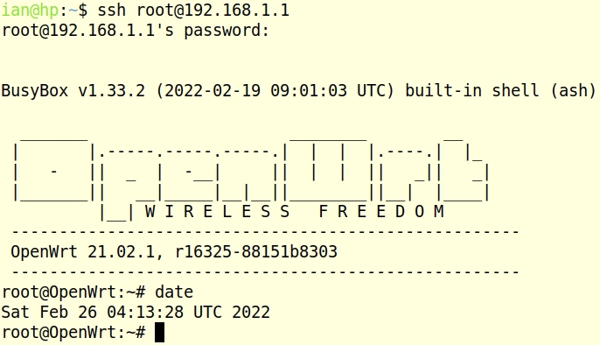
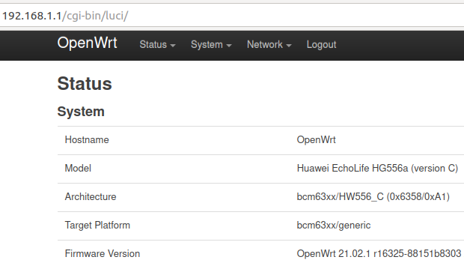
OpenWrt - Management
OpenWrt can be managed completely using SSH and the terminal.
SCP to transfer files from PC to OpenWrt modem.
LuCI WebUI makes many administration tasks easier.
A TTL console port may be connected up to the motherboard.
Recent OpenWrt full releases ship with the LuCI WebUI installed.

Slide 12
Busybox Ash 1/2
alias ash askfirst awk basename bg board_detect brctl break bunzip2 busybox bzcat cat cd chdir chgrp chmod chown chroot clear | cmp command config_generate continue cp crond crontab cut date dbclient dd devstatus df dirname dmesg dnsmasq dropbear dropbearkey du echo | egrep env eval exec exit export expr FALSE fg fgrep find firstboot flock free fsync fw3 fwtool getopts getrandom grep | gunzip gzip halt hash head hexdump history hostapd hotplug-call hwclock id ifconfig ifdown ifstatus ifup init insmod ip ip6tables ip6tables-restore | ip6tables-save ipcalc.sh iptables iptables-restore iptables-save iw iwinfo jffs2mark jffs2reset jobs jshn jsonfilter kill killall kmodloader ldd led.sh less let ln | local lock logd logger login logread ls lsmod lua lua5.1 luci-bwc luci-reload md5sum mkdir mkfifo mknod mkswap mktemp modinfo modprobe

Slide 13
Busybox Ash 2/2
mount mount_root mtd mv nc netifd netmsg netstat nice nslookup ntpd ntpd-hotplug odhcp6c odhcpd odhcpd-update opkg opkg-key passwd pgrep pidof | ping ping6 pivot_root poweroff pppd printf procd ps pwd px5g read readlink readonly reboot reload_config reset return rm rmdir rmmod | route rpcd scp sed seq set sh sha256sum shift signify sleep sort source ssh start-stop-daemon strings swapoff swapon swconfig switch_root | sync sysctl sysupgrade tail tar tee test time times top touch tr traceroute traceroute6 trap TRUE type ubus ubusd uci | uclient-fetch udevtrigger udhcpc uhttpd ulimit umask umount unalias uname uniq unset upgraded uptime urandom_seed urngd usign validate_data vi wait wc | wget which wifi wpa_supplicant wpad xargs xtables-legacy-multi yes zcat

Slide 14
Files in: /etc/config/
root@OpenWrt:/etc/config# ls -l
-rw------- 1 root root 959 Oct 24 09:01 dhcp
-rw------- 1 root root 134 Oct 24 09:01 dropbear
-rw------- 1 root root 4632 Oct 24 09:01 firewall
-rw-r--r-- 1 root root 862 Oct 24 09:01 luci
-rw------- 1 root root 599 Oct 24 14:31 network
-rw------- 1 root root 167 Oct 24 09:01 rpcd
-rw------- 1 root root 623 Oct 24 09:01 system
-rw-r--r-- 1 root root 788 Oct 24 09:01 ucitrack
-rw------- 1 root root 783 Oct 24 09:01 uhttpd
-rw-r--r-- 1 root root 306 Oct 24 11:43 wireless

Slide 15
$ cat /etc/config/network ~ Original
config interface 'loopback' option device 'lo' option proto 'static' option ipaddr '127.0.0.1' option netmask '255.0.0.0' config globals 'globals' option ula_prefix 'fd15:95fb:7907::/48' config device option name 'br-lan' option type 'bridge' list ports 'eth0.1' config interface 'lan' option device 'br-lan' option proto 'static' option ipaddr '192.168.1.1' option netmask '255.255.255.0' option ip6assign '60' | config switch option name 'switch0' option reset '1' option enable_vlan '1' config switch_vlan option device 'switch0' option vlan '1' option ports '0 1 2 3 5t'

Slide 16
$ cat /etc/config/network ~ Suggested
config interface loopback option ifname lo option proto static option ipaddr 127.0.0.1 option netmask 255.0.0.0 config interface lan option type bridge option ifname eth0.1 option proto static option ipaddr 192.168.1.1 option netmask 255.255.255.0 config interface wan option ifname eth0.2 option proto dhcp config switch eth0 option enable 1 option reset 1 option enable_vlan 1 | config switch_vlan option device eth0 option vlan 1 option ports "0 1 2 5t" config switch_vlan option device eth0 option vlan 2 option ports "3 5t"
Suggested config/network
https://openwrt.org/toh/huawei/hg556a#switch_ports_for_vlans

Slide 17
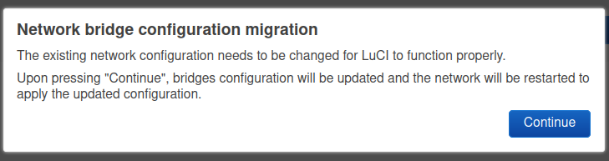
LuCI Network --> Interfaces

Slide 18
$ cat /etc/config/network ~ After LuCI mod
config interface 'loopback' option proto 'static' option ipaddr '127.0.0.1' option netmask '255.0.0.0' option device 'lo' config interface 'lan' option proto 'static' option ipaddr '192.168.1.1' option netmask '255.255.255.0' option device 'br-lan' config interface 'wan' option proto 'dhcp' option device 'eth0.2' config switch 'eth0' option enable '1' option reset '1' option enable_vlan '1' | config switch_vlan option device 'eth0' option vlan '1' option ports '0 1 2 5t' config switch_vlan option device 'eth0' option vlan '2' option ports '3 5t' config device option name 'br-lan' option type 'bridge' list ports 'eth0.1'

Slide 19
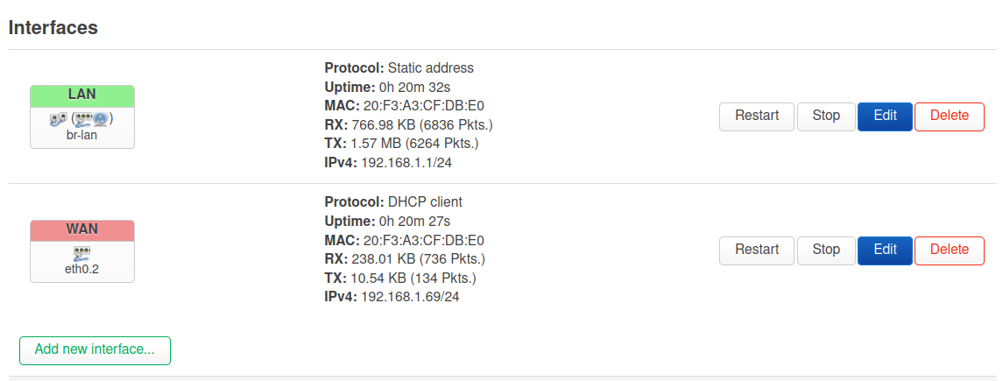
LuCI Network --> Interfaces

Slide 20
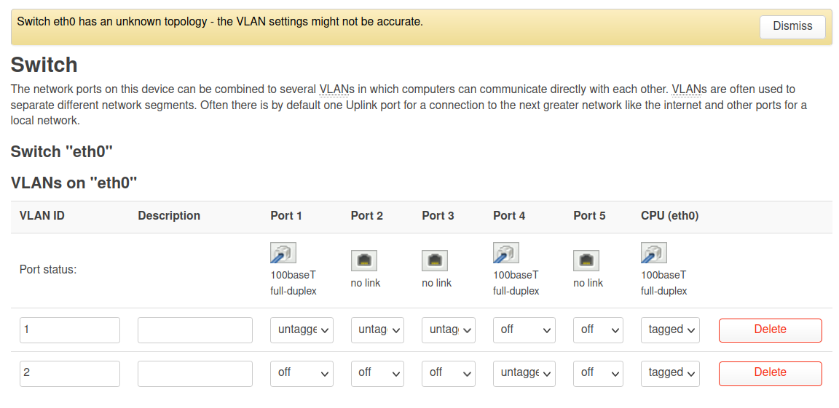
LuCI Network --> Switch

Slide 21
$ cat /etc/config/wireless
config wifi-device 'radio0' option type 'mac80211' option channel '11' option hwmode '11g' option path 'pci0000:00/0000:00:01.0' option htmode 'HT20' config wifi-iface 'default_radio0' option device 'radio0' option network 'lan' option mode 'ap' option ssid 'OpenWrt' option encryption 'none'

Slide 22
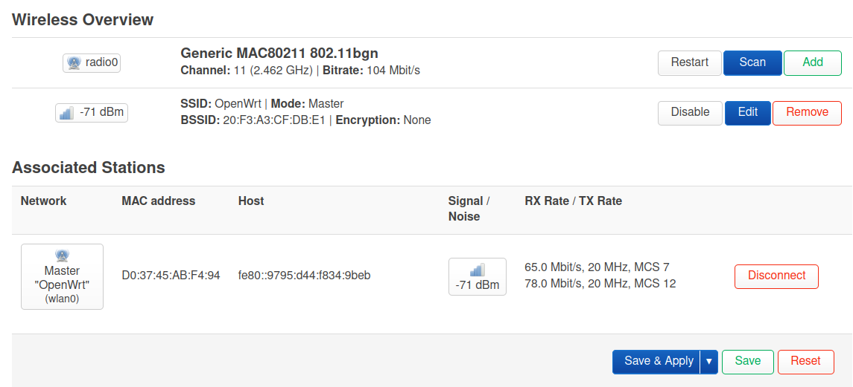
LuCI Network --> Wireless

Slide 23
OpenWrt – Original Network block diagram?
cconfig interface 'loopback'
option device 'lo'
option proto 'static'
option ipaddr '127.0.0.1'
option netmask '255.0.0.0'
config globals 'globals'
option ula_prefix 'fd15:95fb:7907::/48'
config device
option name 'br-lan'
option type 'bridge'
list ports 'eth0.1'
config interface 'lan'
option device 'br-lan'
option proto 'static'
option ipaddr '192.168.1.1'
option netmask '255.255.255.0'
option ip6assign '60
config switch
option name 'switch0'
option reset '1'
option enable_vlan '1'
config switch_vlan
option device 'switch0'
option vlan '1'
option ports '0 1 2 3 5t'
switch_vlan 1
0
1
2
3
5t
br-lan
bridge

Slide 24
OpenWrt – Network block diagram - WAN?
config interface 'loopback'
option proto 'static'
option ipaddr '127.0.0.1'
option netmask '255.0.0.0'
option device 'lo'
config interface 'lan'
option proto 'static'
option ipaddr '192.168.1.1'
option netmask '255.255.255.0'
option device 'br-lan'
config interface 'wan'
option proto 'dhcp'
option device 'eth0.2'
config switch 'eth0'
option enable '1'
option reset '1'
option enable_vlan '1'
config switch_vlan
option device 'eth0'
option vlan '1'
option ports '0 1 2 5t'
config switch_vlan
option device 'eth0'
option vlan '2'
option ports '3 5t'
config device
option name 'br-lan'
option type 'bridge'
list ports 'eth0.1'
switch_vlan 1
0
1
2
switch_vlan 2
3
WAN
5t
5t
Br-lan
bridge

Slide 25
OpenWrt Package Manager - opkg
root@OpenWrt:~# opkg Package Manipulation: update Update list of available packages upgrade <pkgs> Upgrade packages install <pkgs> Install package(s) configure <pkgs> Configure unpacked package(s) remove <pkgs|regexp> Remove package(s) flag <flag> <pkgs> Flag package(s) <flag>=hold|noprune|user|ok|installed|unpacked (one per invocation) Informational Commands: list List available packages list-installed List installed packages list-upgradable List installed and upgradable packages list-changed-conffiles List user modified configuration files files <pkg> List files belonging to <pkg> search <file|regexp> List package providing <file> find <regexp> List packages whose name or description matches <regexp> info [pkg|regexp] Display all info for <pkg> status [pkg|regexp] Display all status for <pkg> download <pkg> Download <pkg> to current directory

Slide 26
opkg update
root@OpenWrt:~# opkg update Downloading https://downloads.openwrt.org/releases/21.02.1/targets/bcm63xx/generic/packages/Packages.gz Updated list of available packages in /var/opkg-lists/openwrt_core Downloading https://downloads.openwrt.org/releases/21.02.1/targets/bcm63xx/generic/packages/Packages.sig Signature check passed. Downloading https://downloads.openwrt.org/releases/21.02.1/packages/mips_mips32/base/Packages.gz Updated list of available packages in /var/opkg-lists/openwrt_base Downloading https://downloads.openwrt.org/releases/21.02.1/packages/mips_mips32/base/Packages.sig Signature check passed. Downloading https://downloads.openwrt.org/releases/21.02.1/packages/mips_mips32/luci/Packages.gz Updated list of available packages in /var/opkg-lists/openwrt_luci Downloading https://downloads.openwrt.org/releases/21.02.1/packages/mips_mips32/luci/Packages.sig Signature check passed. Downloading https://downloads.openwrt.org/releases/21.02.1/packages/mips_mips32/packages/Packages.gz Updated list of available packages in /var/opkg-lists/openwrt_packages Downloading https://downloads.openwrt.org/releases/21.02.1/packages/mips_mips32/packages/Packages.sig Signature check passed. Downloading https://downloads.openwrt.org/releases/21.02.1/packages/mips_mips32/routing/Packages.gz Updated list of available packages in /var/opkg-lists/openwrt_routing Downloading https://downloads.openwrt.org/releases/21.02.1/packages/mips_mips32/routing/Packages.sig Signature check passed. Downloading https://downloads.openwrt.org/releases/21.02.1/packages/mips_mips32/telephony/Packages.gz Updated list of available packages in /var/opkg-lists/openwrt_telephony Downloading https://downloads.openwrt.org/releases/21.02.1/packages/mips_mips32/telephony/Packages.sig Signature check passed.

Slide 27
opkg list-upgadable
root@OpenWrt:~# opkg list-upgradable luci-app-opkg - git-21.079.58598-6639e31 - git-21.312.69848-4745991 iw - 5.9-8fab0c9e-1 - 5.9-8fab0c9e-3 libuci20130104 - 2020-10-06-52bbc99f-5 - 2021-04-14-4b3db117-5 rpcd - 2021-03-11-ccb75178-1 - 2022-02-19-8d26a1ba-1 busybox - 1.33.1-6 - 1.33.2-2 luci-mod-system - git-21.295.66903-8acd0d7 - git-22.019.40321-7a37d02 libustream-wolfssl20201210 - 2020-12-10-68d09243-1 - 2022-01-16-868fd881-1 luci-theme-bootstrap - git-21.298.68362-d24760e - git-22.052.81802-2dba71e wpad-basic-wolfssl - 2020-06-08-5a8b3662-35 - 2020-06-08-5a8b3662-39 netifd - 2021-07-26-440eb064-1 - 2021-10-30-8f82742c-1 procd - 2021-02-23-37eed131-1 - 2021-03-08-2cfc26f8-1 luci-mod-status - git-21.295.66779-853a128 - git-22.046.85784-0ac2542 luci-app-firewall - git-21.295.66767-8eceb63 - git-22.046.85957-59c3392 uci - 2020-10-06-52bbc99f-5 - 2021-04-14-4b3db117-5 rpcd-mod-file - 2021-03-11-ccb75178-1 - 2022-02-19-8d26a1ba-1 luci-base - git-21.295.67054-13df80d - git-22.052.50801-31a27f3 rt2800-pci-firmware - 20201118-3 - 20211216-1 rpcd-mod-iwinfo - 2021-03-11-ccb75178-1 - 2022-02-19-8d26a1ba-1 luci-mod-network - git-21.295.67048-4d3de0e - git-22.046.85061-dd54dce hostapd-common - 2020-06-08-5a8b3662-35 - 2020-06-08-5a8b3662-39 wireless-regdb - 2021.04.21-1 - 2021.08.28-1

Slide 28
opkg upgade
root@OpenWrt:~# opkg upgrade procd Upgrading procd on root from 2021-02-23-37eed131-1 to 2021-03-08-2cfc26f8-1... Downloading https://downloads.openwrt.org/releases/21.02.1/packages/mips_mips32/base/procd_2021-03-08-2cfc26f8-1_mips_mips32.ipk Configuring procd. root@OpenWrt:~# opkg upgrade luci-mod-status Upgrading luci-mod-status on root from git-21.295.66779-853a128 to git-22.046.85784-0ac2542... Downloading https://downloads.openwrt.org/releases/21.02.1/packages/mips_mips32/luci/luci-mod-status_git-22.046.85784-0ac2542_mips_mips32.ipk Configuring luci-mod-status.

Slide 29
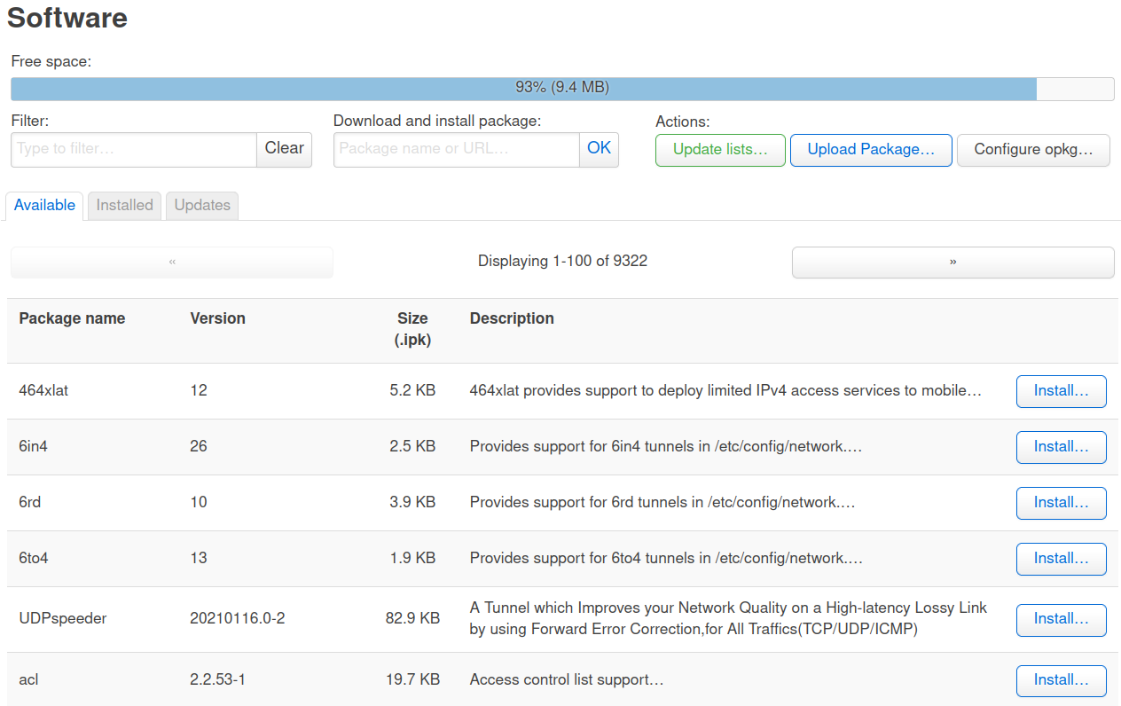
LuCI Software – All packages
9322 Packages

Slide 30
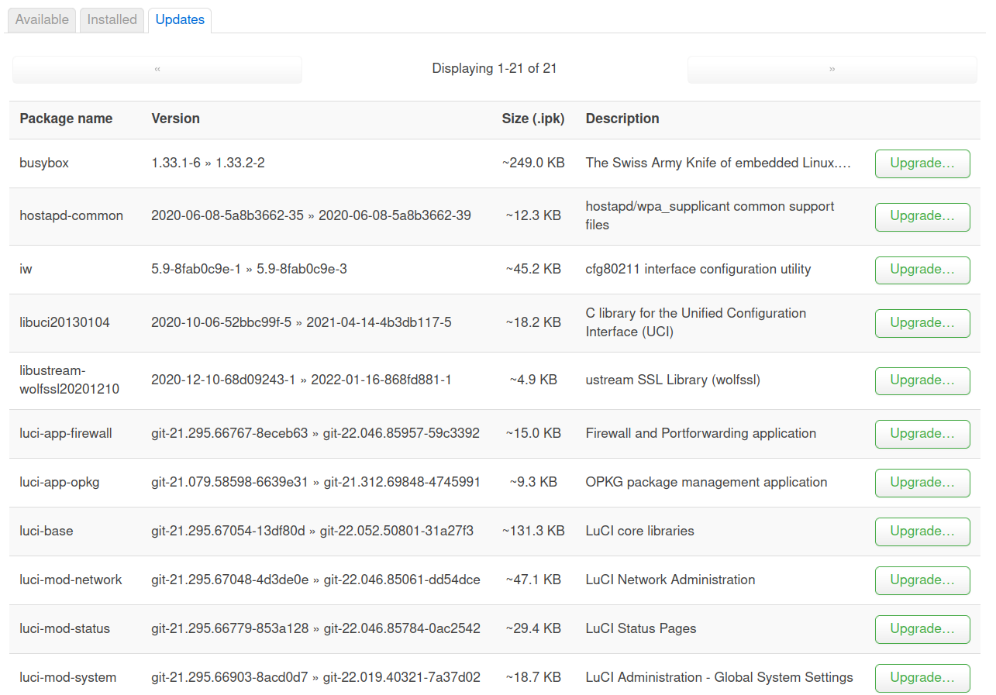
LuCI Software - Updates
21 Update Packages

Slide 31
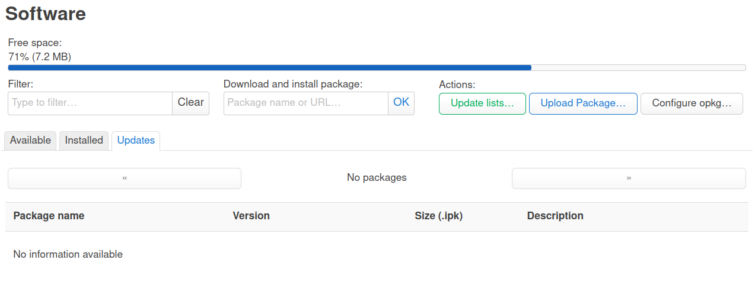
LuCI Software – Updates complete
was 93% now 71%

Slide 32
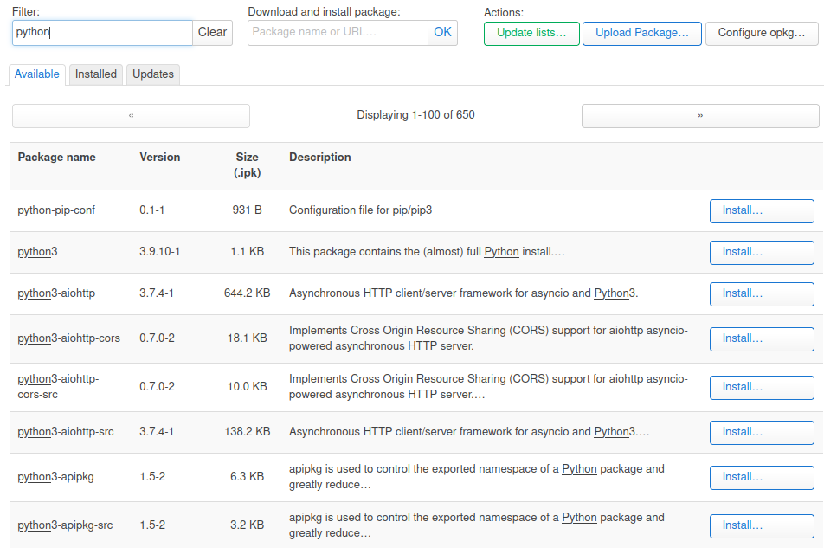
LuCI Software – Python
650 Python packages

Slide 33
opkg Python
root@OpenWrt:~# opkg list-installed | grep python libpython3-3.9 - 3.9.10-1 python3-base - 3.9.10-1 python3-light - 3.9.10-1 python3-urllib - 3.9.10-1 root@OpenWrt:~# root@OpenWrt:~# python Python 3.9.10 (main, Feb 19 2022, 09:01:03) [GCC 8.4.0] on linux Type "help", "copyright", "credits" or "license" for more information. >>> help("modules") Traceback (most recent call last): File "<stdin>", line 1, in <module> File "/usr/lib/python3.9/_sitebuiltins.py", line 102, in __call__ ModuleNotFoundError: No module named 'pydoc' >>> import sys >>> sys.version '3.9.10 (main, Feb 19 2022, 09:01:03) \n[GCC 8.4.0]' >>>
4 Python packages
Need to install
python3-pydoc

Slide 34
OpenWrt - Demo
Demo
SSH into OpenWrt
Browser view of LuCI server.

