Slide 1
matrix.org
open network for secure, decentralized communication
Peter Reutemann

Slide 2
Who?
Matrix.org is an open initiative which acts as a neutral and independent custodian of the Matrix standard. As of Sept 2017 we are finally in the process of incorporating it as a dedicated non-profit entity (most likely a limited by guarantee UK private company called the Matrix.org Foundation).
source: https://matrix.org/docs/guides/faq.html#who-and-how

Slide 3
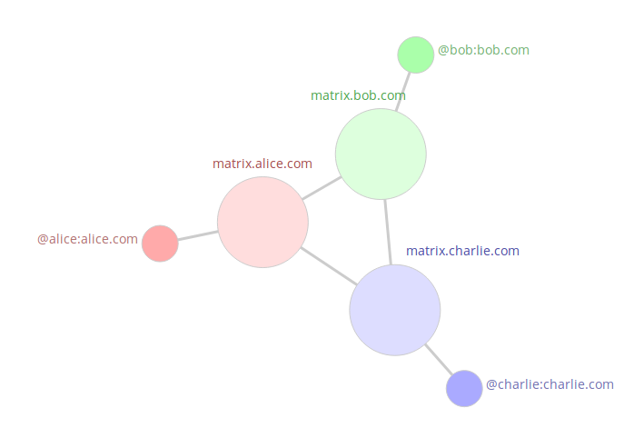
What?
RESTful HTTP/JSON APIs
Open specification
End-to-end encryption
WebRTC VoIP/Video calling
Group conversation
Trusted federation of identity servers
TLS by default
sources: https://matrix.org/blog/home/ and https://matrix.org/docs/guides/faq.html#concept

Slide 4
How to use?
Many clients available
  Desktop (Linux, OSX, Windows)
  Mobile (Android, iOS, Ubuntu Touch)
Reference home server (Python)
Example SDKs (react, JS, Android, iOS)
More details
https://matrix.org/docs/projects/clients-matrix

Slide 5
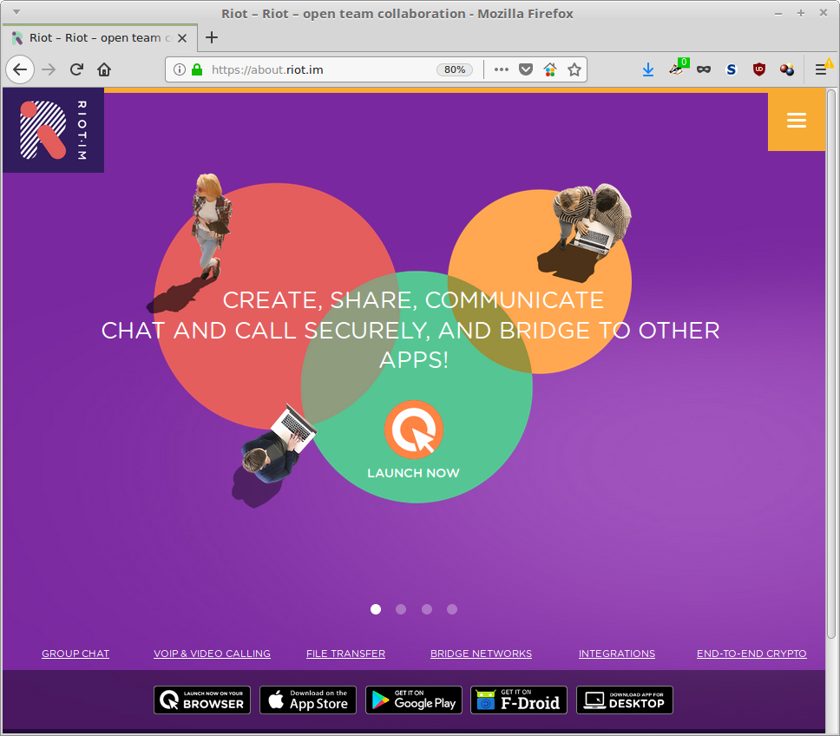
Example: riot.im

Slide 6
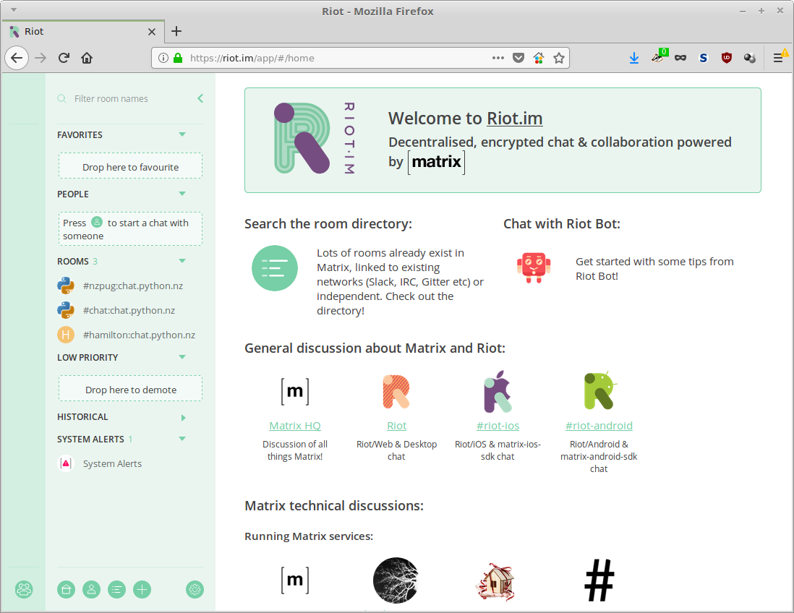
riot.im - web

Slide 7
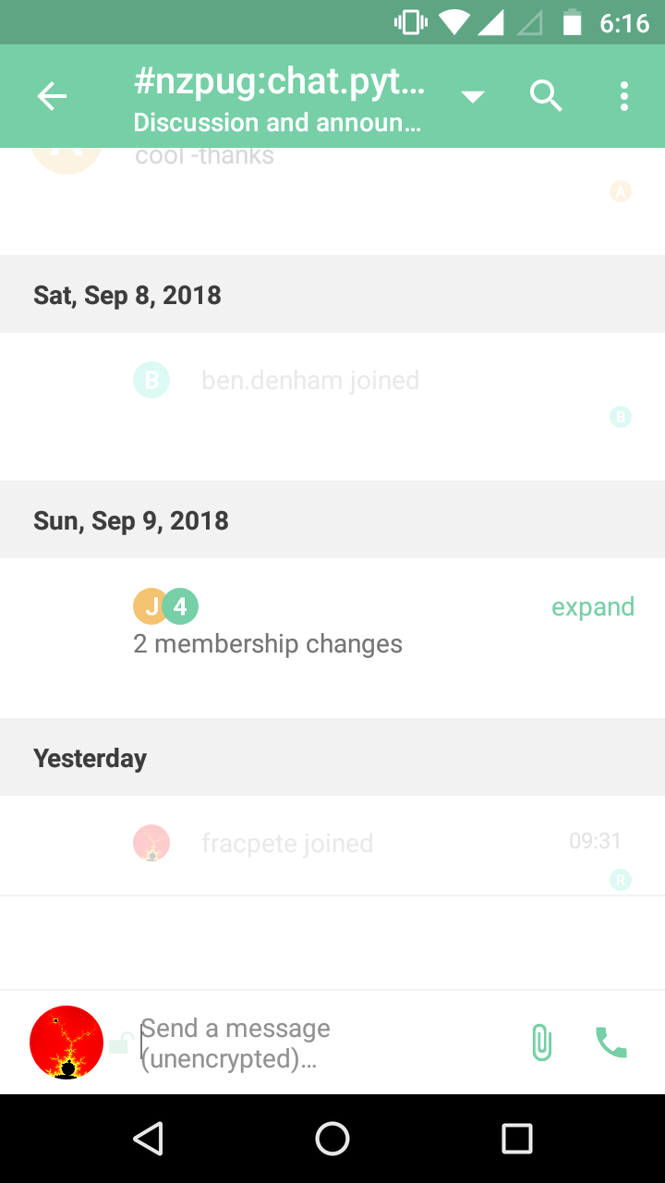
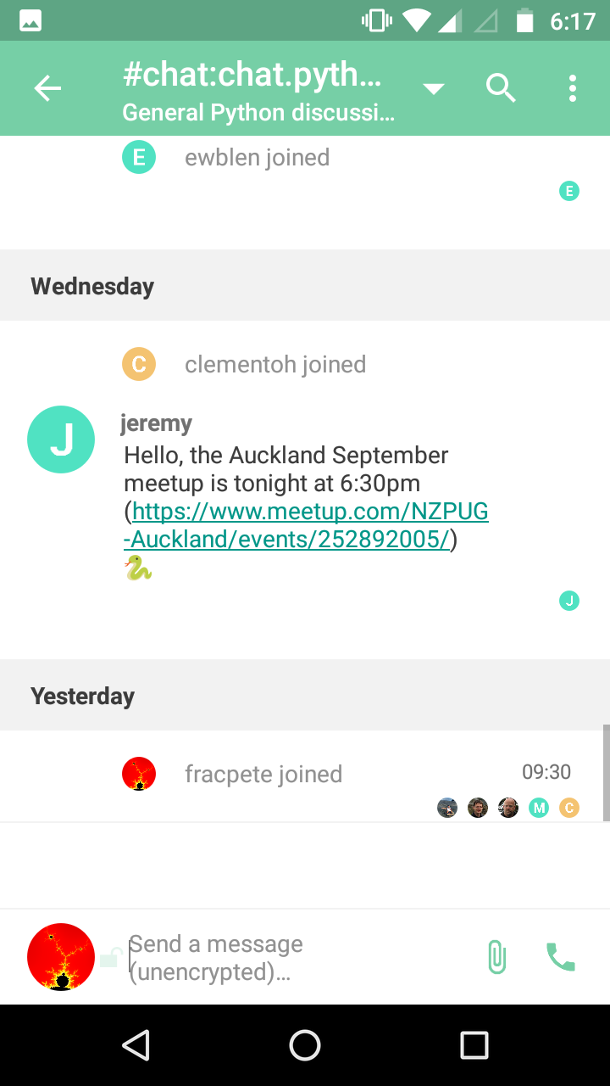
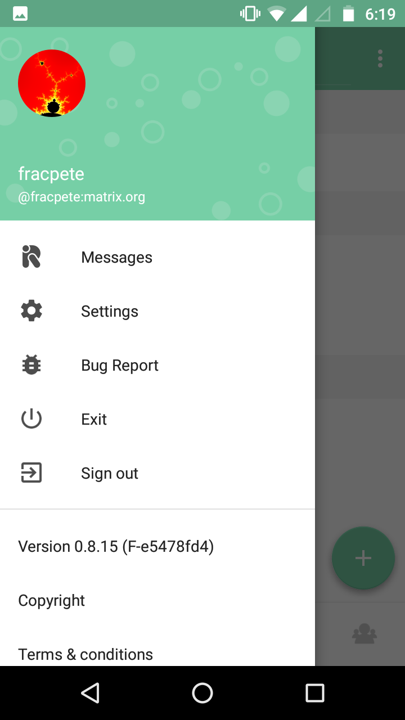
riot.im - Android

Slide 8
Matrix vs Slack?
When comparing Slack vs Matrix, the Slant community recommends Matrix for most people.
In the question“What is the best chat software?” Matrix is ranked 2nd while Slack is ranked 4th.
The most important reason people chose Matrix is:
  Matrix has bridges to IRC (freenode, moznet, oftc, snoonet etc), Slack, Gitter, Rocket.Chat, XMPP, SMS, SIP and others. The point is to 'matrix' all the different networks out there into one single decentralised network.
source: https://www.slant.co/versus/4553/12764/~slack_vs_matrix

Slide 9
What now?
Run your own server
Reference server Synapse runs on Linux and OSX (even RPi)
Instructions for Synapse
  https://github.com/matrix-org/synapse#synapse-installation

