Slide 1
OpenBalena
Open-source IoT Fleet Management

Slide 2
Outline
Why?
What?
How?
And?

Slide 3
Why?
Manage 100s/1000s of IoT devices
Automate updates
Speed up provisioning
Remote access
Focus on software/services rather than fleet management
Faster to market

Slide 4

What?
  https://www.balena.io/open/
  Only CLI compared to BalenaCloud
  AGPLv3 licensed

Slide 5
How?
  Uses Docker
  Light-weight images using BalenaOS
  Images based on Yocto-Linux
  Supports multiple devices
    RPis
    BeagleBone/Board
    NVidia Jetsons
    Intel Edison/NUC
    MS Surface
    Generic aarch64, x86_64
    ...

Slide 6
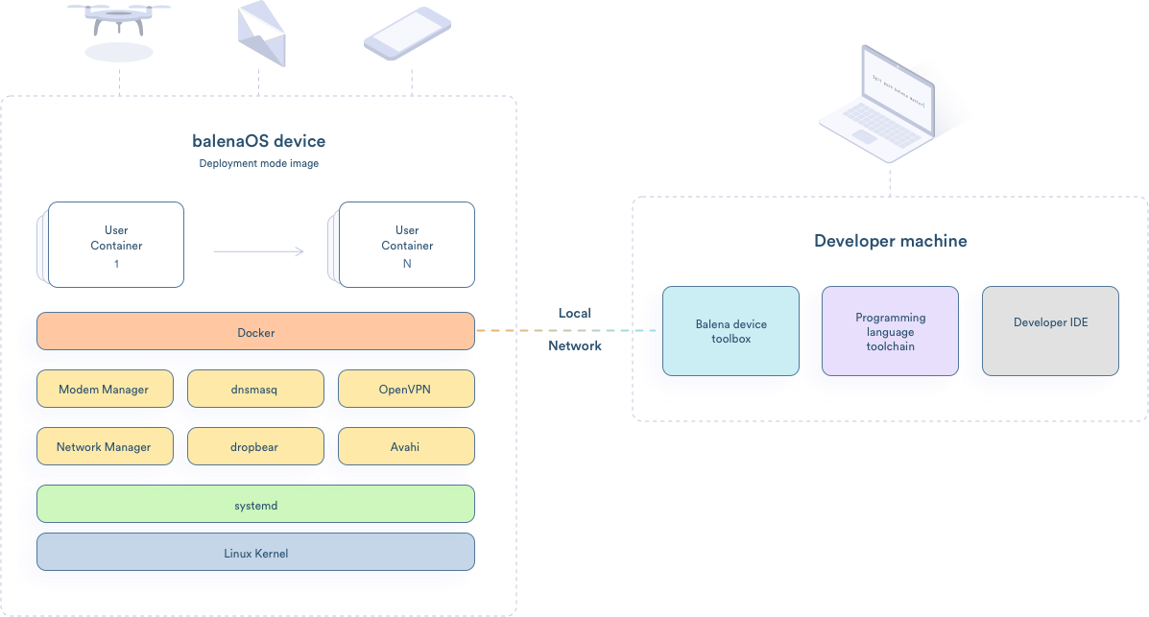
How?
Source: https://www.balena.io/os/

Slide 7
And?
Sort of...
Get started example
  https://www.balena.io/open/docs/getting-started/
  Requires x86_64 (aarch64 didn't work)
  Ubuntu 18.04 (Arch Linux didn't work)
  Slightly oudated docs: app/apps -> fleet/fleets
  Requires DNS for endpoints:
    api, registry, vpn, s3, tunnel

Slide 8
Local setup
RPi4 (192.168.2.150)
  running bind9
    openbalena.local
    Slingshot DNS servers as forwarders
  dhcpcd.conf
    static IP address/router/DNS
Router
  uses RPi4 as DNS server

Slide 9
Local setup
VirtualBox with Ubuntu 18.04
  bridged network interface
  runs OpenBalena server
  /etc/hosts with local endpoints
    {api|registry|vpn|s3|tunnel}.openbalena.local

Slide 10
Create fleet
Copy ca.crt onto machine with balena CLI
point NODE_EXTRA_CA_CERTS env variable to ca.crt
point CLI to correct domain:
  create ~/.balenarc.yml
  insert domain:
  balenaUrl: 'openbalena.local'
log into balena
create fleet
  balena fleet create <fleetname>

Slide 11
Add device
Spare RPi2
Download image archive for RPi2 and unzip it
Use balena CLI to provision image
  balena os configure <img> --fleet <fleetname>
Copy image onto SD card using dd
Re-mount SD card
  open resin-boot partition
  open config.json file
  insert custom DNS servers and save file:
  "dnsServers": "192.168.2.150 8.8.8.8",

Slide 12
Add device
Insert SD card in device
Boot device
...but doesn't register with server API???
Potential reason (from journalctl):
  RPi has no HW clock, set to Sept 20
  TLS/SSL fails to due certificate not yet valid
  Few seconds later NTP corrects time

Slide 13
What works?
Balena CLI scan finds (local) device
Balena CLI can ssh into device
Re-joining device via Balena CLI join command supposedly succeeds, but device still doesn't show up
Tried NVidia Jetson images but fail to provision image ("Unsupported filesystem.")

Slide 14
What next?
Using proper public DNS names
Using cloud instance for server
Maybe trialing paid-for service (which uses the open-source components under the hood) to further evaluate

