Slide 1
Ubuntu 22.04 (2022.April)
Long Term Support (LTS) release.
Waikato Linux Users Group
Ian Stewart
27 Jun 2022

Slide 2
Latest Release
Latest release: 21 April 2022
Version: 22.04 (LTS)
Code name: Jammy Jellyfish
Platforms: x86-64, ARM64, RISC-V, ppc64le, s390x, ARMhf
Kernel: Linux 5.15. Debian 11/bullseye.
Default: Gnome Desktop. Server, IoT, Cloud.
Flavours: Kubuntu, Lubuntu, Budgie, Kylin, MATE, Studio, Xubuntu.
Website: https://ubuntu.com
General support until: April 2027
Security Support until: April 2032
Package Format: Debian
Package Managers: Advanced Package Tool (APT), Ubuntu Software (GUI)
Developer: Canonical Ltd.
Release notes: https://discourse.ubuntu.com/t/jammy-jellyfish-release-notes/24668

Slide 3
History
4.10 (2004, October) Initial Release. 17 years ago.
LTS every two years, Interim releases every 6 months.
LTS likely to have 5+ point releases. Initial then, .1 to .4
22.04 is the 36th release (six months) 9th LTS release (2 years).
8 July 2005, Mark Shuttleworth and Canonical Ltd. announced the creation of the Ubuntu Foundation.
Ubuntu is currently funded by Canonical Ltd.

Slide 4
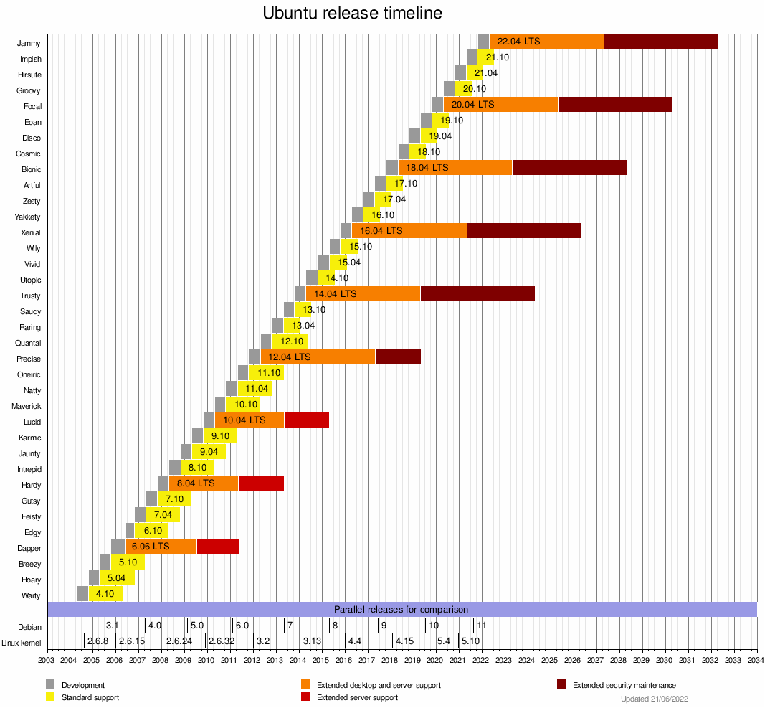
History

Slide 5
Download image.
Download 22.04 image.
https://ubuntu.com/download
FSMG mirror: https://mirror.fsmg.org.nz/ubuntu-releases/ 20Gps
https://fsmg.org.nz/pages/statistics.html
https://fsmg.org.nz/pages/sponsors.html
REANNZ provide FSMG with rackspace and connectivity in two data centres.
Wellington and Hamilton mirror sites.
ISO or Torrent.

Slide 6
Minimum system requirements for Ubuntu 22.04
Desktop:
Dual Core Processor (2 Ghz)
4 GB Physical RAM
25 GB or more Disk Space
Bootable Media
Server:
1 GHz CPU
1 GiB RAM (system memory)
2.5 GB hard drive
Bootable Media

Slide 7
22.04 Features:
Best suited for enterprise-class-deployments.
It can be installed and run on all major architectures like x86-64, ARM v7, ARM64, POWER8, POWER9, IBM s390x (LinuxONE) and RISC-V
Long Term Kernel 5.15
Updated:
  OpenSSL 3.0
  QEMU (v6.2)
  libvirt (v8.0)
  PHP (v8.1)
  Ruby (v3.0)
  GCC (V11.2)
  Python (v3.10.1)
  MySQL (v8.0.28)
  OpenLDAP (v.2.5.11)
  Samba 4.15.

Slide 8
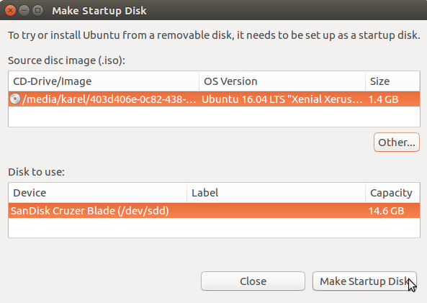
Burn to USB. Try Live.
Using dd
$ cd Downloads
$ dd if=ubuntu-22.04-desktop-amd64.iso of=/dev/sdX bs=4M status=progress && sync
Using Startup Disk creator
Control Centre --> Startup Disk Creator
https://askubuntu.com/questions/287064/how-do-i-make-a-bootable-ubuntu-usb

Slide 9
Online upgrade
22.04. Initial “.0” release 23 April 2022. No on-line upgrade.
Upon release of 22.04.1 On-line upgrade prompting begins.
Example: 20.04.1 released. 8 Aug 2020. (3 months after “.0”).
Intervention: Password, Confirm proceed, ... Confirm reboot.
Example of Point releases:
20.04.4 released Feb 2022.
5th consolidation of updates release.
No Point release tracking for Jammy Jellyfish at this stage. E.g.
https://discourse.ubuntu.com/t/focal-fossa-20-04-1-lts-point-release-status-tracking/17604

Slide 10
Switch presentations to Part 2, for 22.04 installation examples.

Slide 11
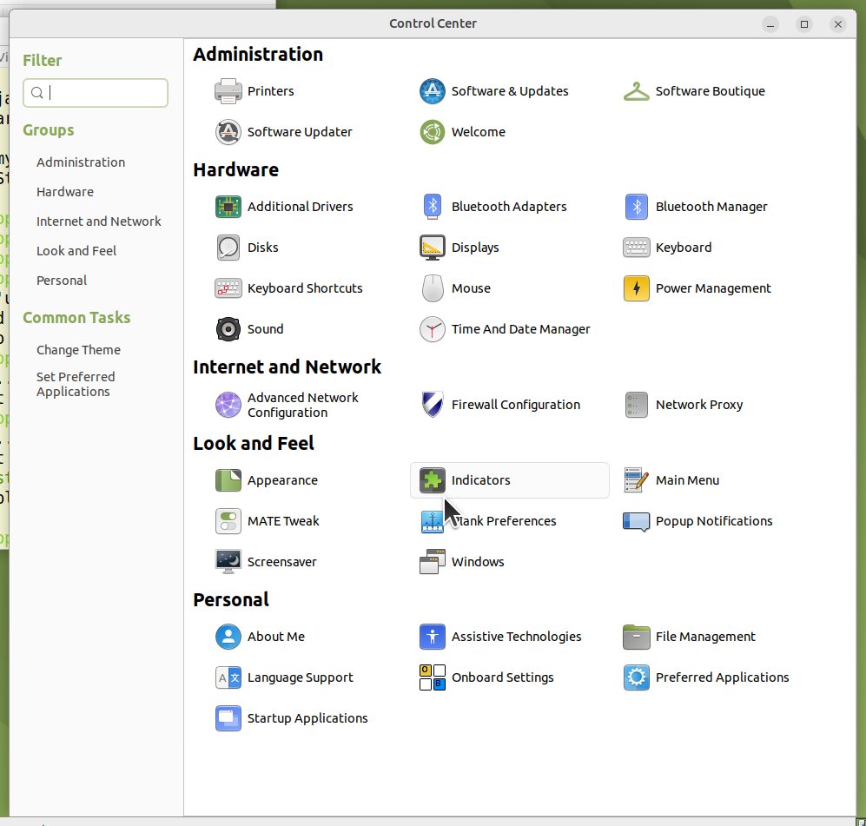
MATE Aside
Control Centre
Anything missing?

Slide 12
Add gnome-system-tools for users-admin application
ian@laptop:~$ user
useradd userdel usermod users
ian@laptop:~$ sudo apt install gnome-system-tools
Reading package lists... Done
Building dependency tree... Done
Reading state information... Done
The following additional packages will be installed:
liboobs-1-5 system-tools-backends
Suggested packages:
ntp
The following NEW packages will be installed:
gnome-system-tools liboobs-1-5 system-tools-backends
0 upgraded, 3 newly installed, 0 to remove and 0 not upgraded.
Need to get 3,826 kB of archives.
After this operation, 10.6 MB of additional disk space will be used.
Do you want to continue? [Y/n] y
ian@laptop:~$ user
useradd userdel usermod users users-admin

Slide 13
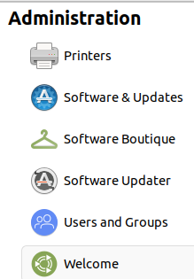
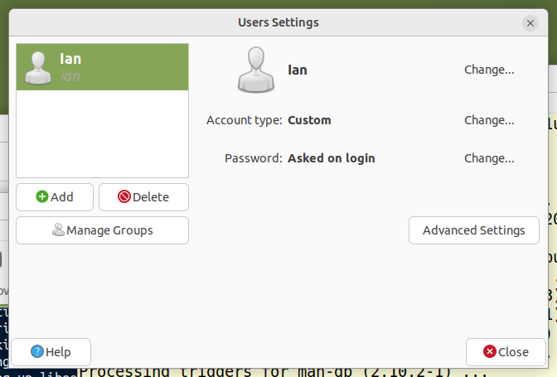
Control Centre now has “Users and Groups”
Note: No “Guest” account, ...but it has returned.

Slide 14
Remove “Guest” account.
$ cat /etc/lightdm/lightdm.conf.d/91-arctica-greeter-guest-session.conf
[LightDM]
# Override default guest-account script by Arctica Greeters guest
# account script.
guest-account-script=arctica-greeter-guest-account-script
[Seat:*]
# disable guest sessions (a guest session requires a valid default
# user-session parameter, see below)
allow-guest=true
# Change to disable guest - Ian 2022-06-27
#greeter-allow-guest=true
greeter-allow-guest=false
Additional Note on Control Centre: No “Startup Disk Creator”.

Slide 15
Display Grub menu.
ian@laptop:/etc/default$ cat grub
# If you change this file, run 'update-grub' afterwards to update
# /boot/grub/grub.cfg.
# For full documentation of the options in this file, see:
# info -f grub -n 'Simple configuration'
GRUB_DEFAULT=0
# Changes by Ian 2022-06-21
#GRUB_TIMEOUT_STYLE=hidden
GRUB_TIMEOUT_STYLE=menu
#GRUB_TIMEOUT=0
GRUB_TIMEOUT=3
GRUB_DISTRIBUTOR=`lsb_release -i -s 2> /dev/null || echo Debian`
GRUB_CMDLINE_LINUX_DEFAULT="quiet splash"
GRUB_CMDLINE_LINUX=""

Slide 16
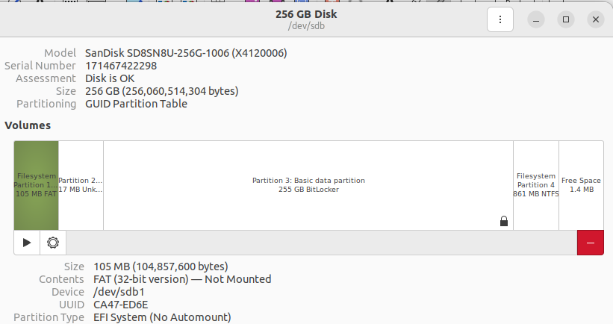
UEFI Install
Shipped Drive. 256GB M2. Windows SSD. GUID Partition Table
Partitions: EFI, Reserved, Basic Data, Recovery.

Slide 17
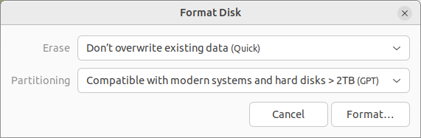
UEFI Install
Adding new SSD for Linux installation.
Change blank SSD from:
Master Boot Record (MBR)
to:
Globally Unique Identifier (GUID) Partition Table (GPT)
So BIOS doesn’t use “legacy” mode.

Slide 18
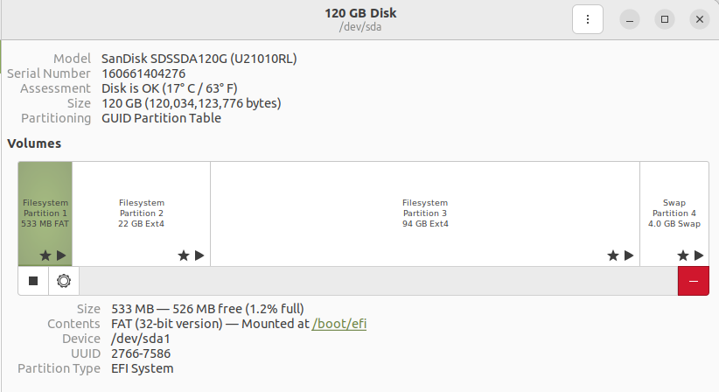
UEFI Install
Added Drive. 120GB Sata 3 Linux SSD. GUID Partition Table
Partitions: EFI, Ext4 /, Ext4 /home, Swap

Slide 19
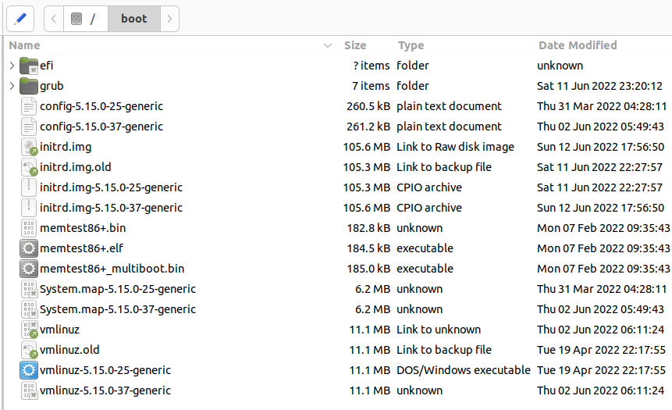
UEFI Install
Partition 1 Mounted at /boot/efi

Slide 20
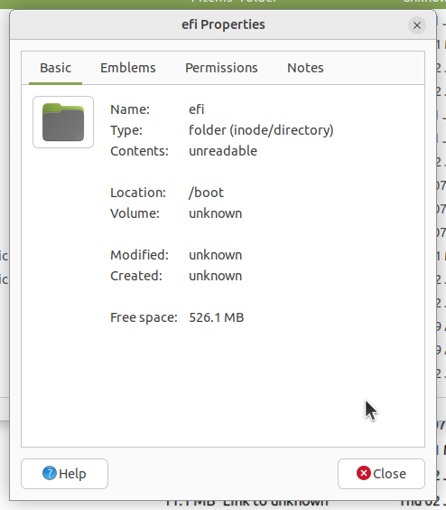
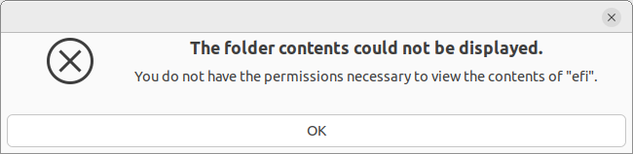
UEFI Install
Partition 1 Mounted at /boot/efi

Slide 21
UEFI Install
Partition 1 Mounted at /boot/efi
root@ProBook:/boot/efi# ls
EFI 'System Volume Information'
root@ProBook:/boot/efi# tree *
EFI
├── BOOT
│ ├── BOOTX64.EFI
│ ├── fbx64.efi
│ └── mmx64.efi
└── ubuntu
├── BOOTX64.CSV
├── grub.cfg
├── grubx64.efi
├── mmx64.efi
└── shimx64.efi
System Volume Information
./EFI/BOOT:
-rwx------ 1 root root 955656 Jun 11 21:41 BOOTX64.EFI
-rwx------ 1 root root 85672 Jun 11 21:41 fbx64.efi
-rwx------ 1 root root 856232 Jun 11 21:41 mmx64.efi
./EFI/ubuntu:
-rwx------ 1 root root 108 Jun 11 21:41 BOOTX64.CSV
-rwx------ 1 root root 126 Jun 11 21:41 grub.cfg
-rwx------ 1 root root 1742728 Jun 11 21:41 grubx64.efi
-rwx------ 1 root root 856232 Jun 11 21:41 mmx64.efi
-rwx------ 1 root root 955656 Jun 11 21:41 shimx64.efi

Slide 22
UEFI Install
Partition 1 Mounted at /boot/efi
root@ProBook:/boot/efi# tree -h
[4.0K] .
├── [4.0K] EFI
│ ├── [4.0K] BOOT
│ │ ├── [933K] BOOTX64.EFI
│ │ ├── [ 84K] fbx64.efi
│ │ └── [836K] mmx64.efi
│ └── [4.0K] ubuntu
│ ├── [ 108] BOOTX64.CSV
│ ├── [ 126] grub.cfg
│ ├── [1.7M] grubx64.efi
│ ├── [836K] mmx64.efi
│ └── [933K] shimx64.efi
└── [4.0K] System Volume Information

Slide 23
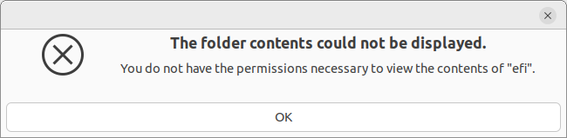
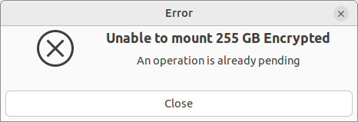
UEFI Install
Try to examine M2 Windows drive
Try to examine M2 Windows drive.
Use sudo, but drive not visible

Slide 24
UEFI Install
Try to examine M2 Windows drive
root@ProBook:/boot/efi/EFI/ubuntu# lsblk -f
NAME FSTYPE FSVER LABEL UUID FSAVAIL FSUSE% MOUNTPOINTS
loop0 squashfs 4.0 0 100% /snap/bare/5
loop1 squashfs 4.0 0 100% /snap/core18/2409
loop2 squashfs 4.0 0 100% /snap/core20/1405
loop3 squashfs 4.0 0 100% /snap/core20/1518
loop4 squashfs 4.0 0 100% /snap/firefox/1232
loop5 squashfs 4.0 0 100% /snap/firefox/1443
loop6 squashfs 4.0 0 100% /snap/gnome-3-38-2004/106
loop7 squashfs 4.0 0 100% /snap/gnome-3-38-2004/99
loop8 squashfs 4.0 0 100% /snap/gtk-common-themes/1534
loop9 squashfs 4.0 0 100% /snap/snapd/15177
loop10 squashfs 4.0 0 100% /snap/snapd/16010
loop11 squashfs 4.0 0 100% /snap/snapd-desktop-integration/10
loop12 squashfs 4.0 0 100% /snap/snapd-desktop-integration/14
loop13 squashfs 4.0 0 100% /snap/software-boutique/57
loop14 squashfs 4.0 0 100% /snap/ubuntu-mate-welcome/709
loop15 squashfs 4.0 0 100% /snap/zoom-client/170
sda
├─sda1 vfat FAT32 2766-7586 501.7M 1% /boot/efi
├─sda2 ext4 1.0 34ab40ce-9234-471e-8422-92123215df93 9.9G 44% /
├─sda3 ext4 1.0 44015b24-2a93-4813-b89c-06879d692ff6 25.8G 65% /home
└─sda4 swap 1 ed765d00-1815-427b-a075-f95e2d4e6e0f [SWAP]
sdb
├─sdb1 vfat FAT32 CA47-ED6E
├─sdb2
├─sdb3 BitLocker 2
└─sdb4 ntfs CA44B44A44B43AD1
sr0

Slide 25
UEFI Install
/etc/default/grub
ian@ProBook:/etc/default$ cat grub
# If you change this file, run 'update-grub' afterwards to update
# /boot/grub/grub.cfg.
# For full documentation of the options in this file, see:
# info -f grub -n 'Simple configuration'
GRUB_DEFAULT=0
# Set by Ian to menu
#GRUB_TIMEOUT_STYLE=hidden
GRUB_TIMEOUT_STYLE=menu
# Changed by Ian to 3 was 0
GRUB_TIMEOUT=3
GRUB_DISTRIBUTOR=`lsb_release -i -s 2> /dev/null || echo Debian`
GRUB_CMDLINE_LINUX_DEFAULT="quiet splash"
GRUB_CMDLINE_LINUX=""
# Add by Ian to see if it finds Windows disk
GRUB_DISABLE_OS_PROBER=false

Slide 26
UEFI Install
Grub menu at boot time
Grub menu will appear if you press “shift” during loading grub if you boot with BIOS.
When your system loots using UEFI press “Esc”.

Slide 27
UEFI Install
Which boot, UEFI or MBR?
Bash “test” command checks file types and compares values.
“-d” for file exists and is a directory
test -d /sys/firmware/efi && echo efi || echo bios
Returns either: efi or bios

Slide 28
Questions...

