Slide 1
Ubuntu 22.04 – Part 2
Desktop Installation.
Waikato Linux Users Group
Ian Stewart
27 Jun 2022

Slide 2
PC firmware Boot Menu.
USB stick option to boot UEFI or Legacy version of Ubuntu

Slide 3
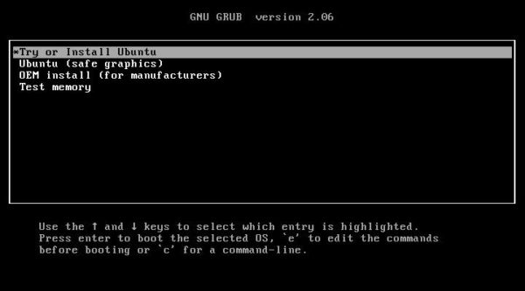
Grub Menu

Slide 4
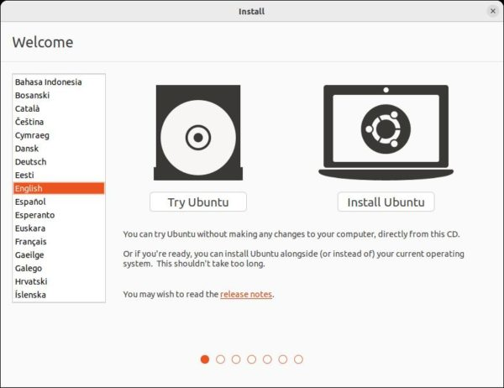
Try / Install?

Slide 5
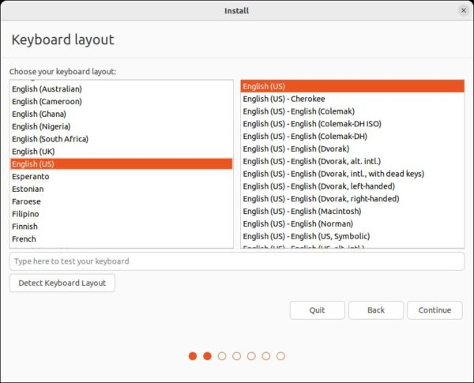
Keyboard?

Slide 6
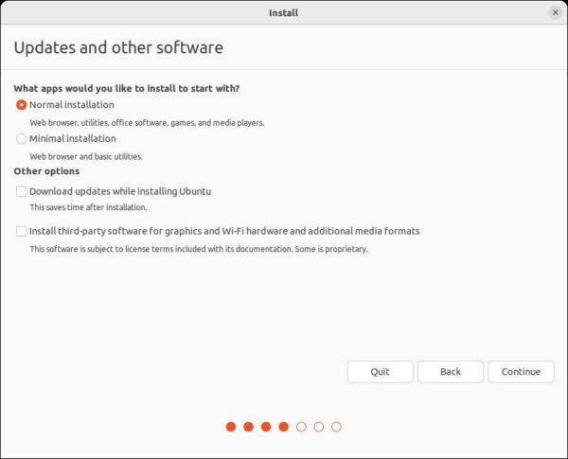
Normal / Minimal? Download Updates? Install 3rd party software?

Slide 7
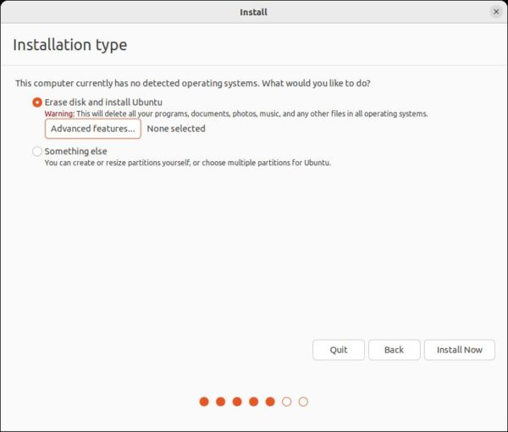
Installation type?

Slide 8
Something Else.
If you choose “Something else” in the previous screen. It will bring you into the partition table.
Create the following partitions using the free disk spaces (or remove and re-use unused spaces):
EFI – 100 ~ 500 MB. (optional for old legacy BIOS without secure boot)
Swap area – as large as RAM (optional if you have large RAM. And, a swap-file can take the job after installation)
/boot Ext4 partition – 500 ~ 1000MB (optional, but required for LVM or disk encryption)
Ext4 mounted at “/” – 20GB + the bigger the better (required)

Slide 9
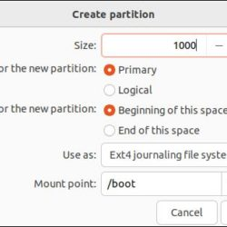
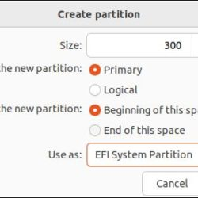
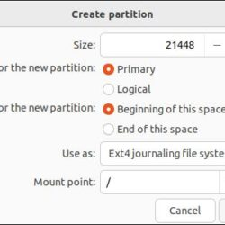
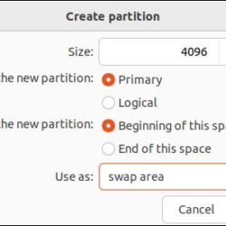
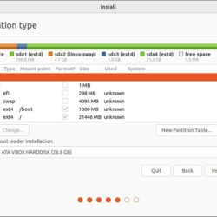
Something Else. Partitions: /boot, EFI, Ext4, Swap

Slide 10
Examples of partition combinations:
EFI + Ext4 mounted at “/”
EFI + Swap + Ext4 mounted at “/”
EFI + Ext4 mounted at “/” + separated “/boot” partition
EFI + Swap + Ext4 mounted at “/” + separated “/boot” partition
Ext4 mounted at “/” (for legacy boot only)
Ext4 mounted at “/” + separated “/boot” partition (for legacy boot only)
Swap + Ext4 mounted at “/” (for legacy boot only)
Swap + Ext4 mounted at “/” + separated “/boot” partition (for legacy boot only)
EFI + Ext4 mounted at “/” (Encrypted) + separated “/boot” partition (no swap and /boot is required)
https://ubuntuhandbook.org/index.php/2022/04/install-ubuntu-2204-step-by-step/

Slide 11
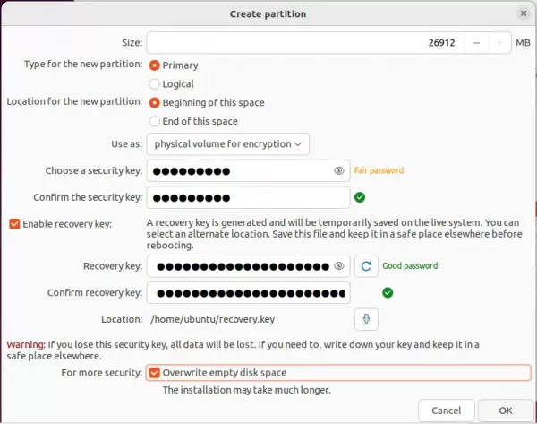
Encrypted Partition

Slide 12
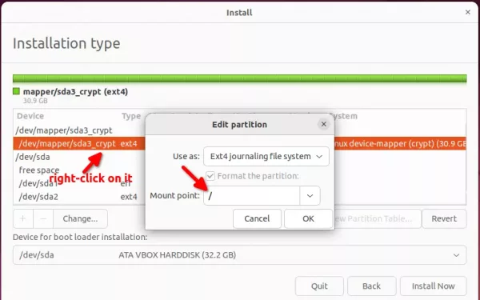
Adding Mount point for Encrypted partition

Slide 13
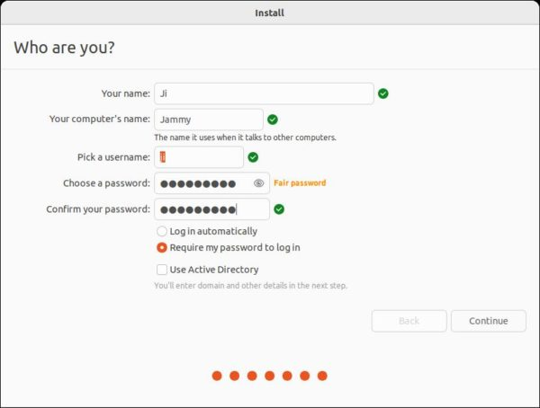
Setup Account

Slide 14
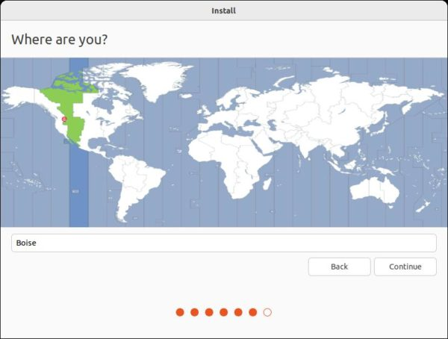
Location – Time Zone.

Slide 15
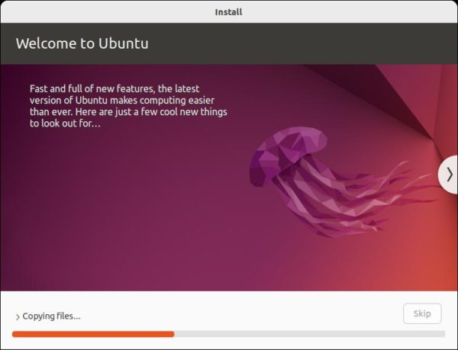
Slide show while installation proceeds.

Slide 16
On completing installation:
reboot. (Remove USB stick)
sudo apt update
sudo apt dist-upgrade
reboot

Slide 17
Ubuntu 22.04 Part 2
Server Installation.
From firmware menu, Boot USB stick with Ubuntu Server image:
https://www.linuxtechi.com/install-ubuntu-server-22-04-step-by-step/

Slide 18
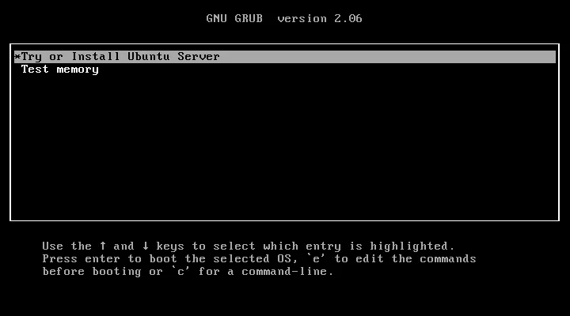
On completing installation:

Slide 19
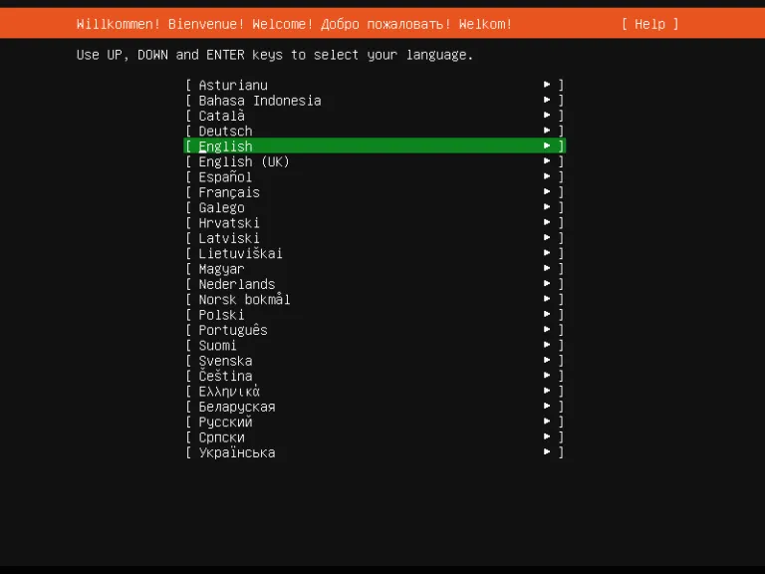
Language

Slide 20
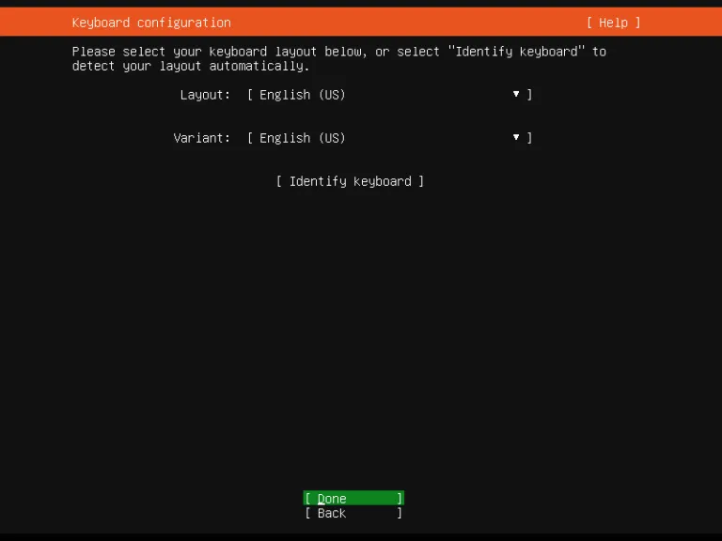
Keyboard

Slide 21
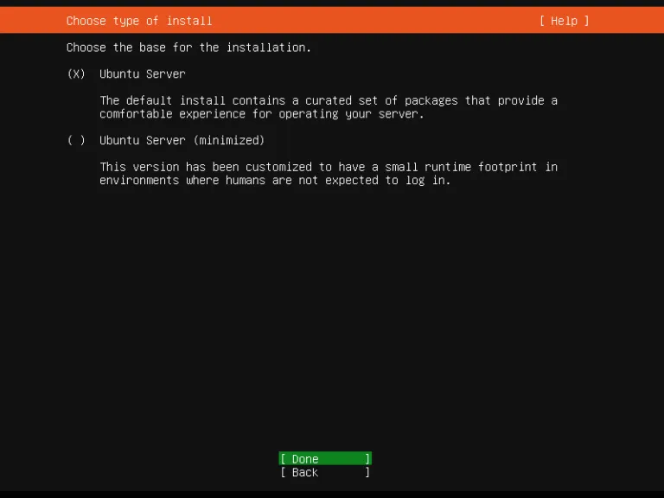
Server Base?

Slide 22
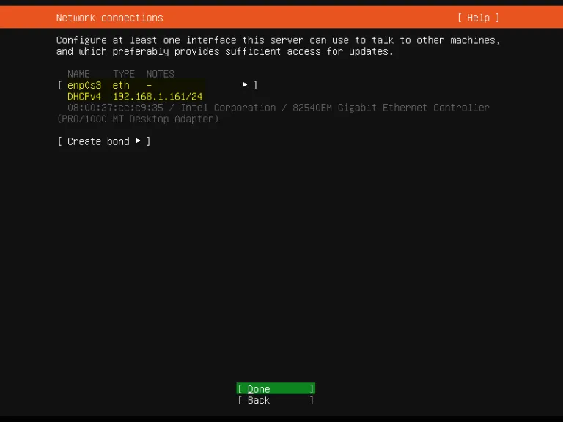
Network

Slide 23
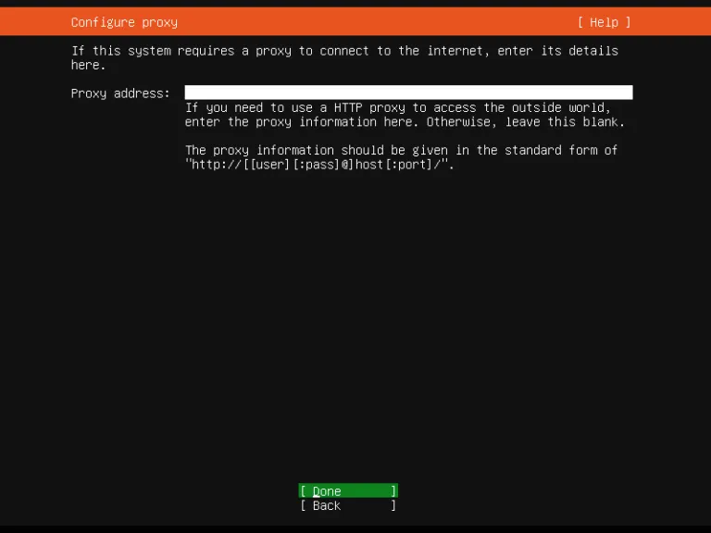
Proxy

Slide 24
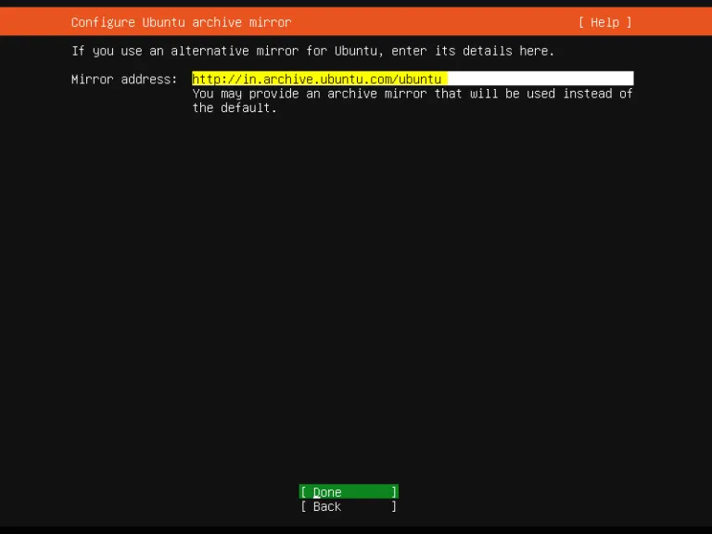
Mirror

Slide 25
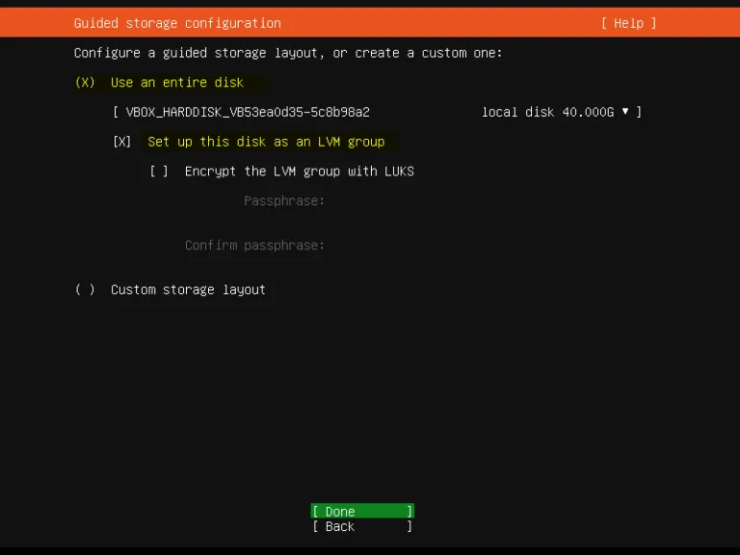
Storage

Slide 26
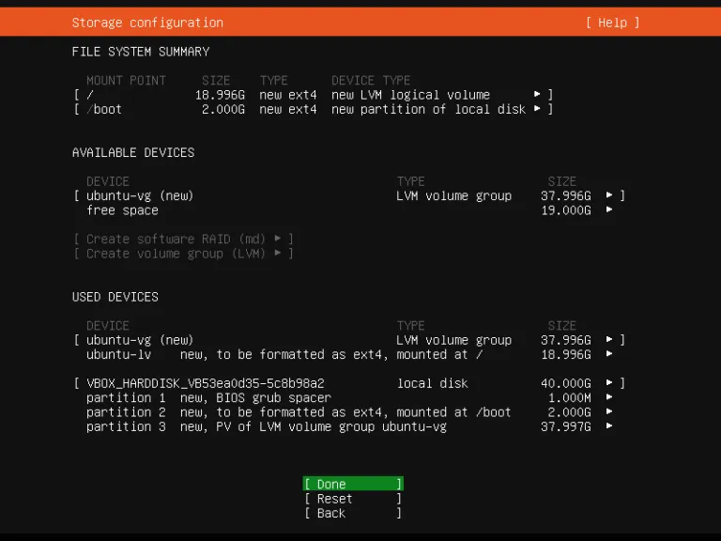
Storage

Slide 27
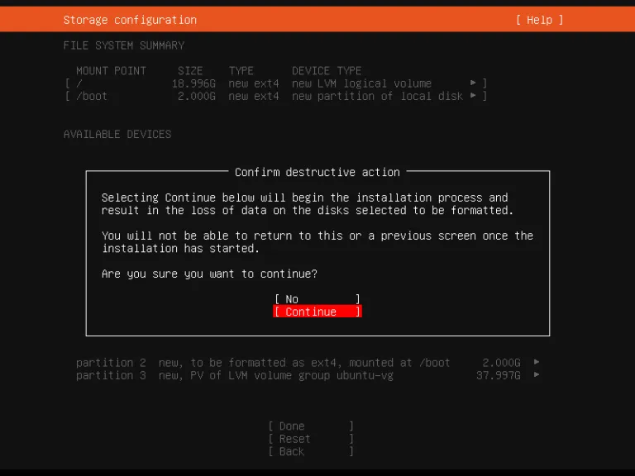
Storage

Slide 28
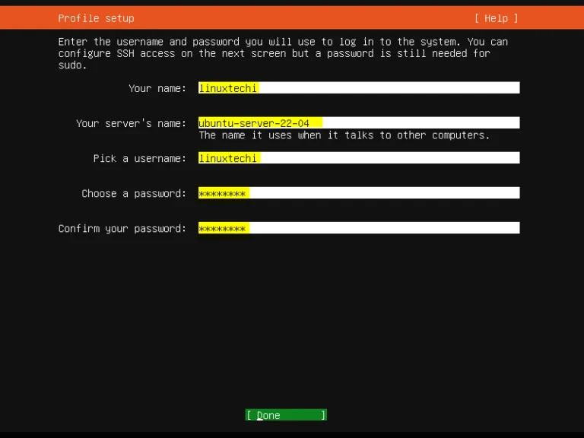
Profile / Account

Slide 29
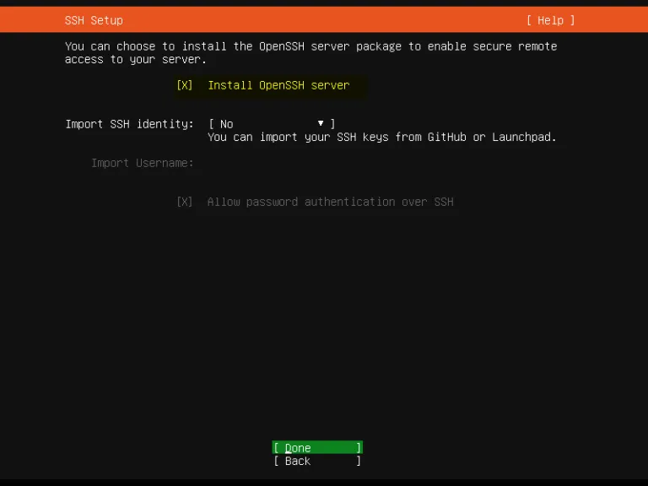
SSH

Slide 30
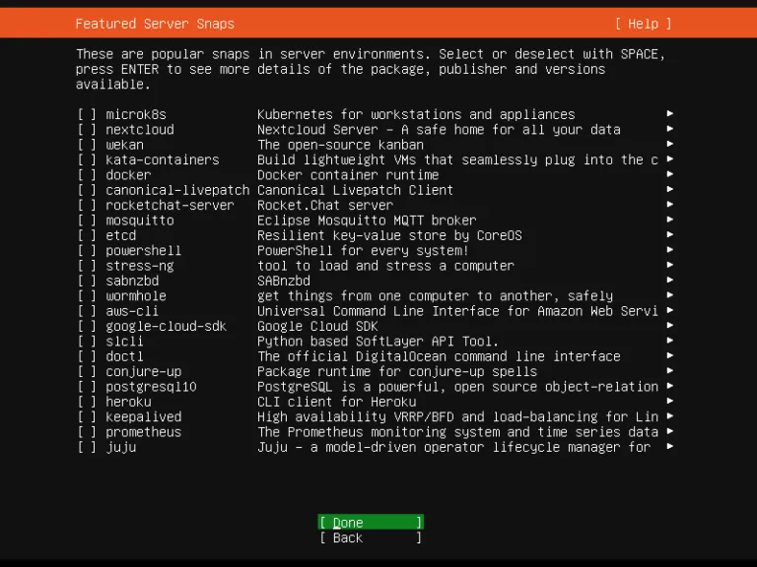
Server Snaps

Slide 31
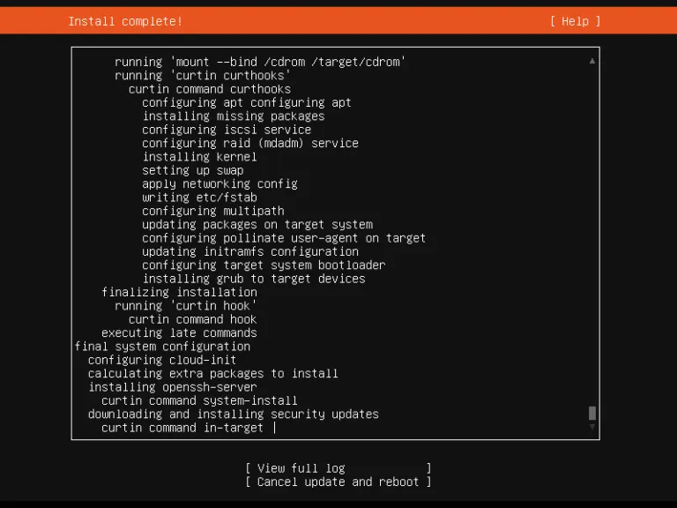
Copying and Installation completed

Slide 32
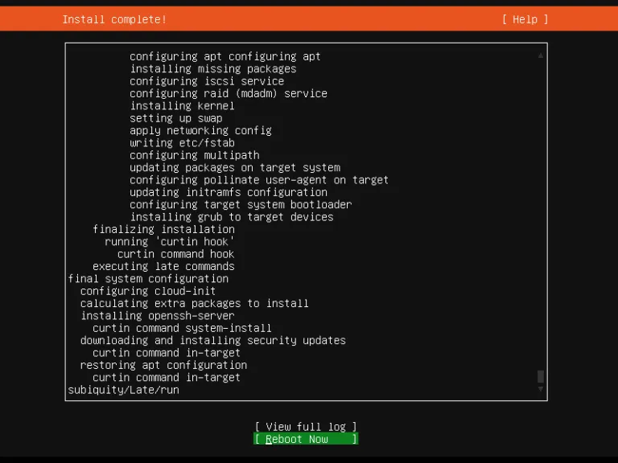
Reboot

Slide 33
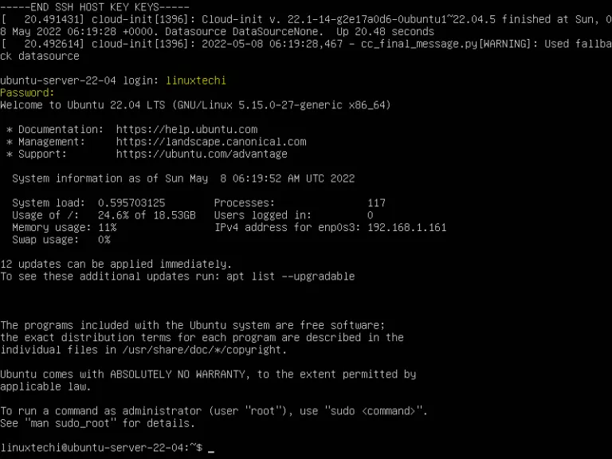
Login

Slide 34
End

