Slide 1
Yubikey
One Time Password Generator

Slide 2
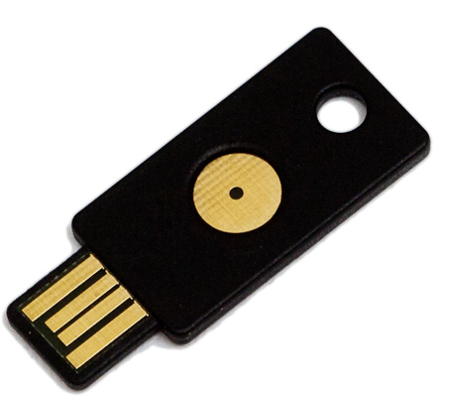
What is it?
Usb port powered
Recognised as a keyboard
Yubico provides authentication server
Can set up your own authentication server and can use both
www.yubico.com
Some variants on the hardware profile.

Slide 3

Lastpass
Password generator
Emphasis on generating unique passwords for every website
Client works as add in to browser
Passwords can still be accessed without browser add in or access to the internet.

Slide 4
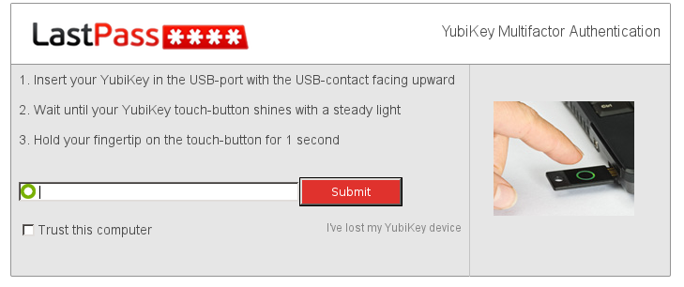
Lastpass + Yubikey
Premium account required. US$12/year
Required Yubikey + Master Password to unlock password vault.
Can configure individual computers not to require yubikey and/or master password

Slide 5
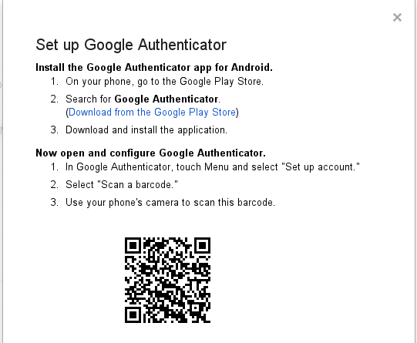
Google + Yubikey
Yubikey has two 'slots' for storing password.
Comes preconfigured with slot 1 able to authenticate to the Yubikey server.
This slot 1 is overwriteable.

Slide 6
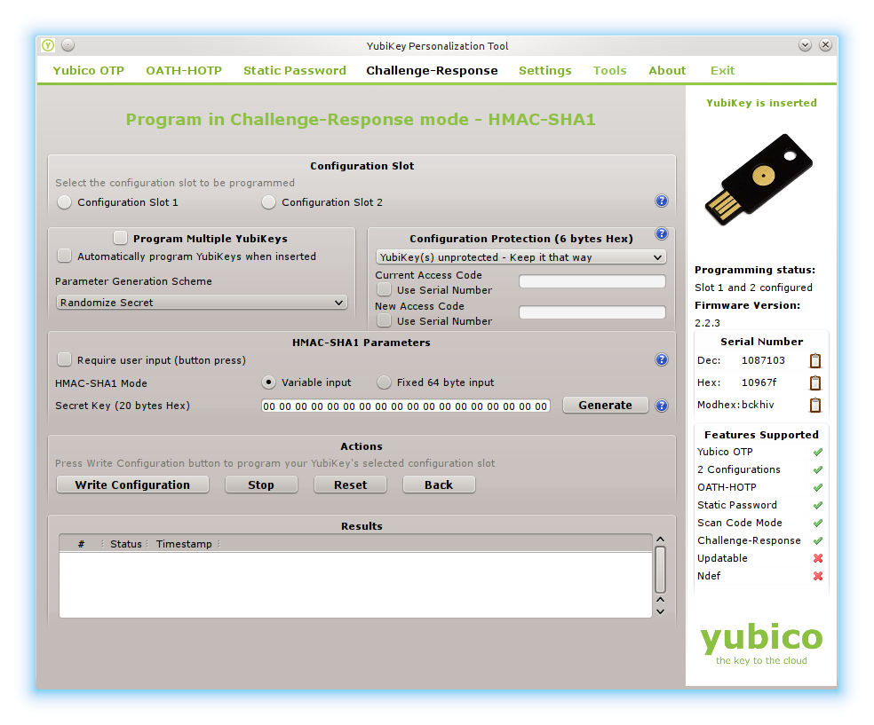
Google and Yubikey
Process of taking a code from google.
Convert it to hex
Writing to slot 2
Utility program generates the 6 digit number required for two step authentication
Windows Gui program

Slide 7
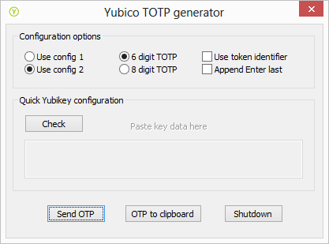
Windows TOTP Utility

Slide 8
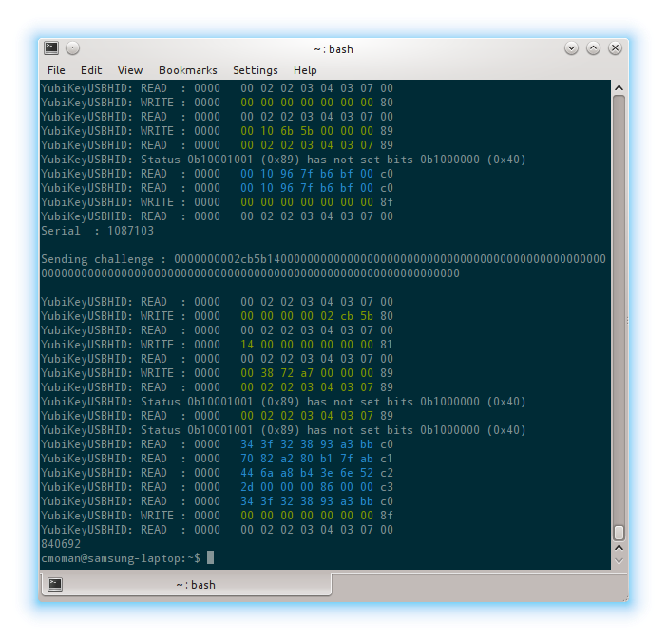
Linux TOTP utility
Github has a few useful projects.
But only suits for YubikeyNeo
Yubiath-desktop
Might write my own utility for linux by forking yubiath-desktop. Based on PySide and Python
python-yubico

Slide 9
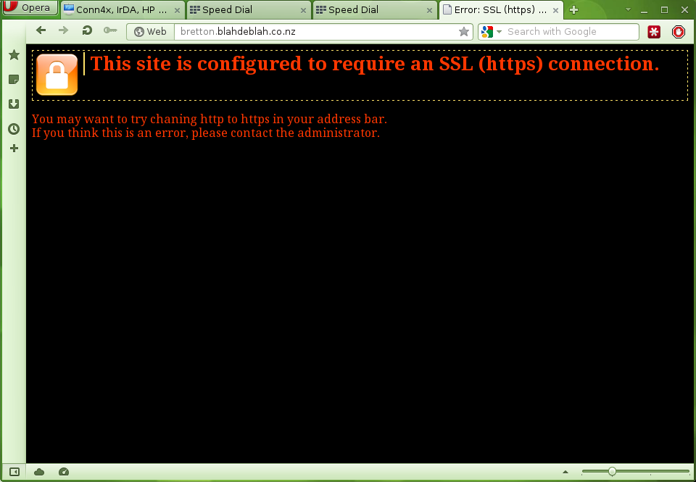
Apache and Yubikey
Authentication module available
Debian and Rasbian already have it available via apt-get.
libapache2-mod-authn-yubikey
Use https to encrypt the session.

Slide 10
Configuring apache
Ccasdfasdfas
sudo htpasswd -csb /usr/local/apache/passwd/yubikeyUsers Ccasdfasdfas cmoman:password

Slide 11
Virtual host file
AuthType Basic
AuthBasicProvider yubikey
AuthName "Please Log In using your YubiKey"
AuthYubiKeyTimeout 43200
AuthYubiKeyTmpFile /tmp/ykTmpDb
AuthYubiKeyUserFile /usr/local/apache/passwd/yubikeyUsers
AuthYubiKeyExternalErrorPage Off
Require valid-user

Slide 12
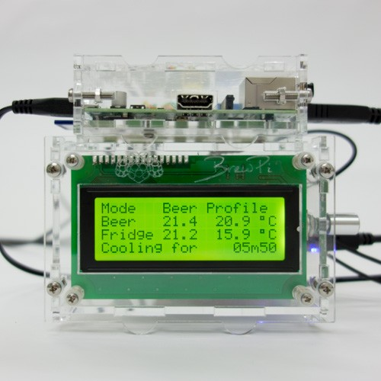
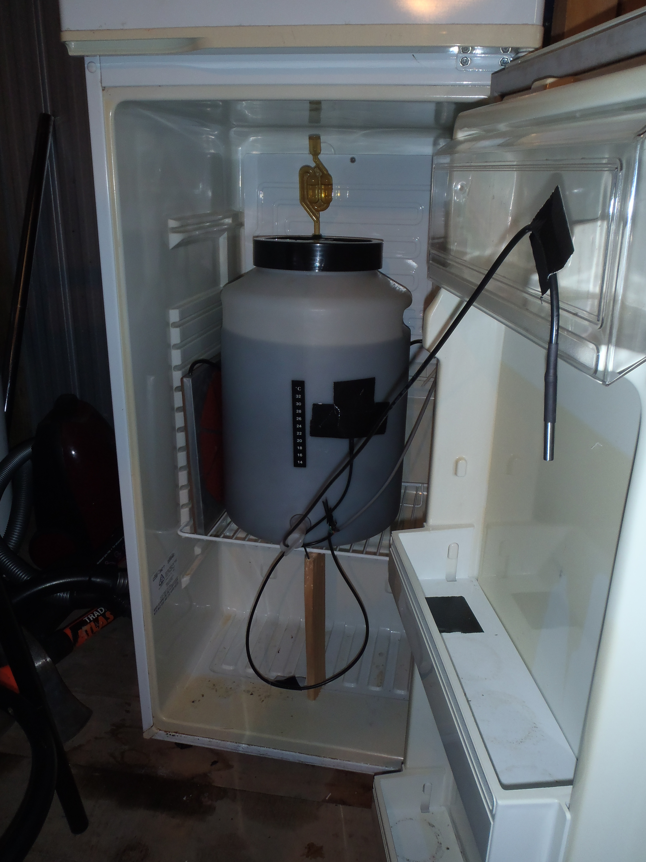
Rasberry Pi as a brew controller
Www.brewpi.com

Slide 13
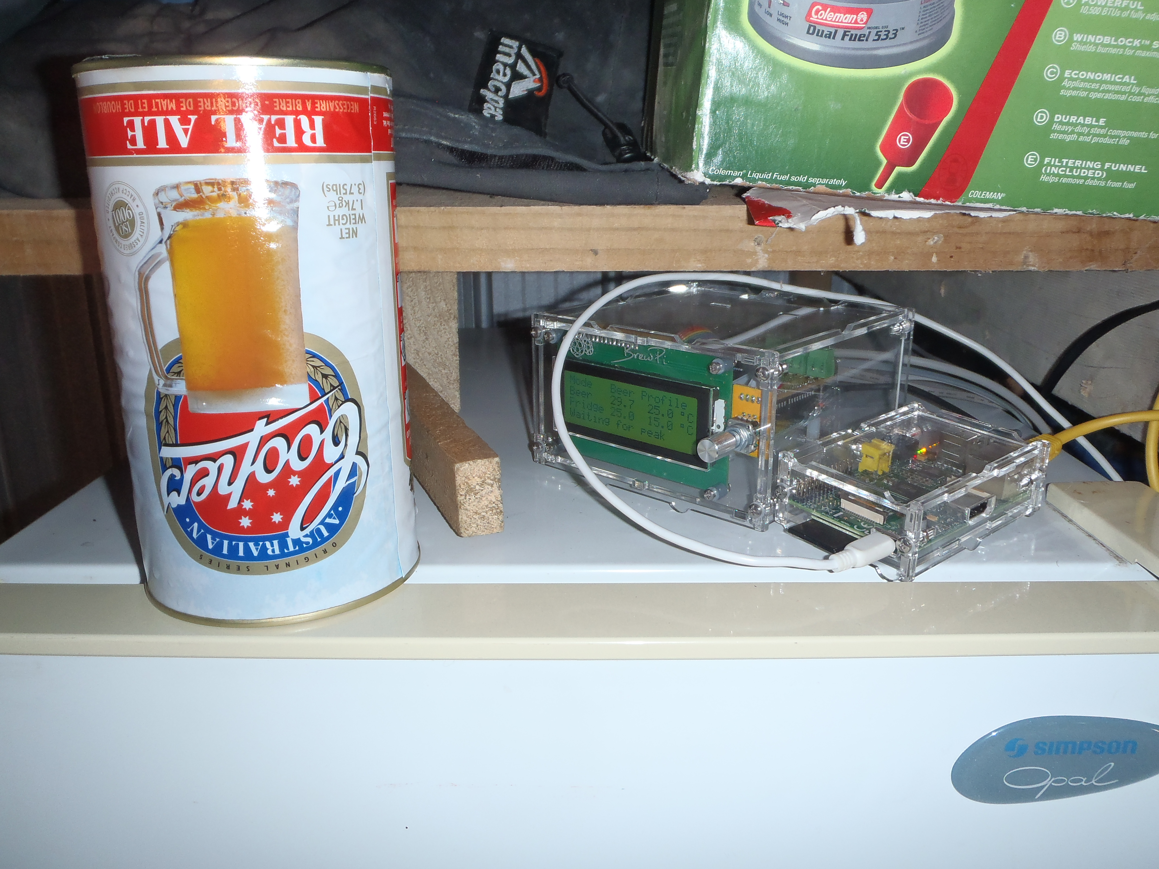

Raspberry Pi and fridge

Slide 14
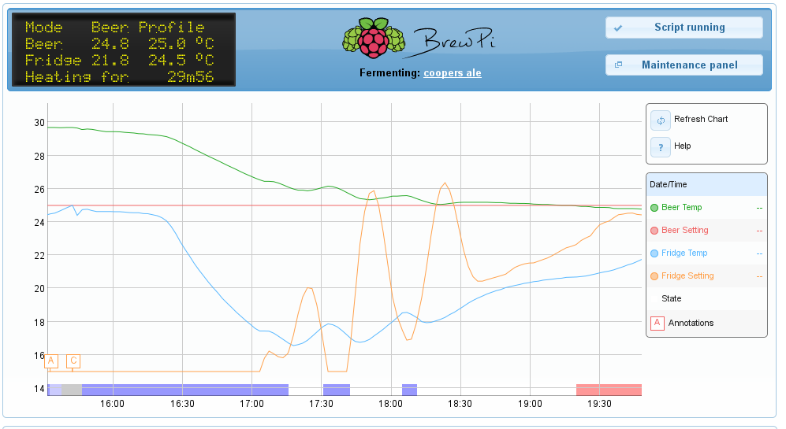
Beginning of a brew

Slide 15
Lots of third party tools being developed, many of them open source
http://opensource.yubico.com/
https://xtranet.lookabox.com/wiki/docs:yubikey:apache2
http://www.coffeecrew.org/software/yubikey-apache-plugin/installation/
http://www.yubico.com/2013/05/browserid-yubikey/

