Slide 1
Syncthing
Peer-to-peer, continuous file synchronization

Slide 2
What?
Syncthing is a continuous file synchronization program. It synchronizes files between two or more computers in real time, safely protected from prying eyes. Your data is your data alone and you deserve to choose where it is stored, whether it is shared with some third party, and how it's transmitted over the internet.
-- source: https://syncthing.net/

Slide 3
Sounds like...
BitTorrent/Resilio Sync
Both use p2p to sync
BT:
  proprietary protocol
  closed source
ST
  open/documented protocol
  open source (https://github.com/syncthing/)

Slide 4
Backup tool?
Syncthing is not a great backup application because all changes to your files (modifications, deletions, etc.) will be propagated to all your devices. You can enable versioning, but we encourage you to use other tools to keep your data safe from your (or our) mistakes.
-- source: FAQ: Is Syncthing my ideal backup application?

Slide 5
Use cases
Bi-directional syncing required (rsync is unidirectional)
Large, binary files, which are not great for version control like git
Example: syncing photos/videos from phone(s) to laptop

Slide 6
How?
Private. None of your data is ever stored anywhere else other than on your computers. There is no central server that might be compromised, legally or illegally.
Encrypted. All communication is secured using TLS. The encryption used includes perfect forward secrecy to prevent any eavesdropper from ever gaining access to your data.
Authenticated. Every device is identified by a strong cryptographic certificate. Only devices you have explicitly allowed can connect to your other devices.
-- source: https://syncthing.net/

Slide 7
Setup?
Download/install Syncthing client
Start Syncthing client on hosts (each host has unique ID)
Define
  Directories to sync (and what direction)
  What hosts to sync with
  Bonus on Android: only sync when on specified WiFi
Uses public discovery server

Slide 8
Whoah!
How is a public discovery server secure?
  IDs are not sensitive (SHA-256 TLS hash)
  ID links to IP, but cannot be used to establish connection (both devices need to know each other’s ID)
  source: FAQ: Should I keep my device IDs secret?
But
  You can run your own discovery server as well
  documentation

Slide 9
Let’s try it
Hosts
  Android 11 phone (termux, sshd 8022)
  Raspberry Pi (Rasbian)
  Laptop (EndeavourOS)

Slide 10
Start up syncthing
Install Syncthing app on phone
Start Syncthing on RPi
Log into web interface: a.b.c.d:8384
Configure web interface user

Slide 11
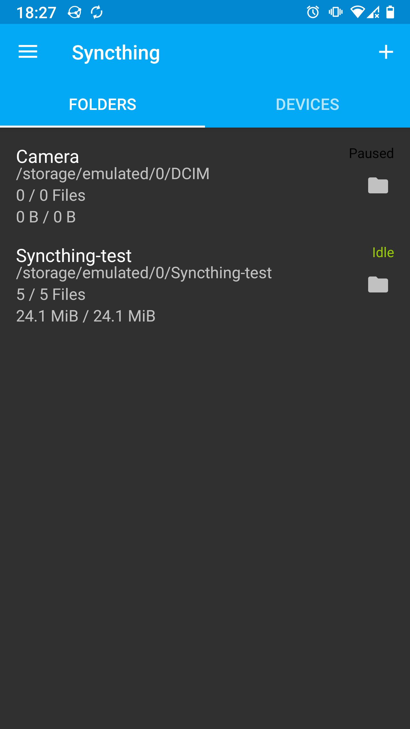
Let’s share
Add a folder on the phone
Add some dummy files

Slide 12
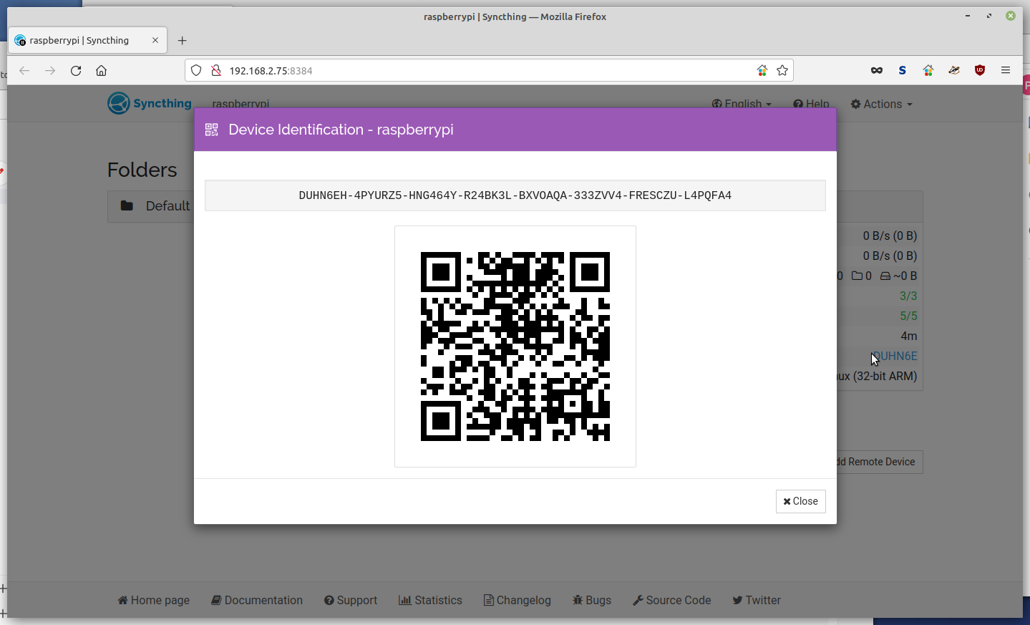
Let’s share
RPi interface: Actions -> Show ID

Slide 13
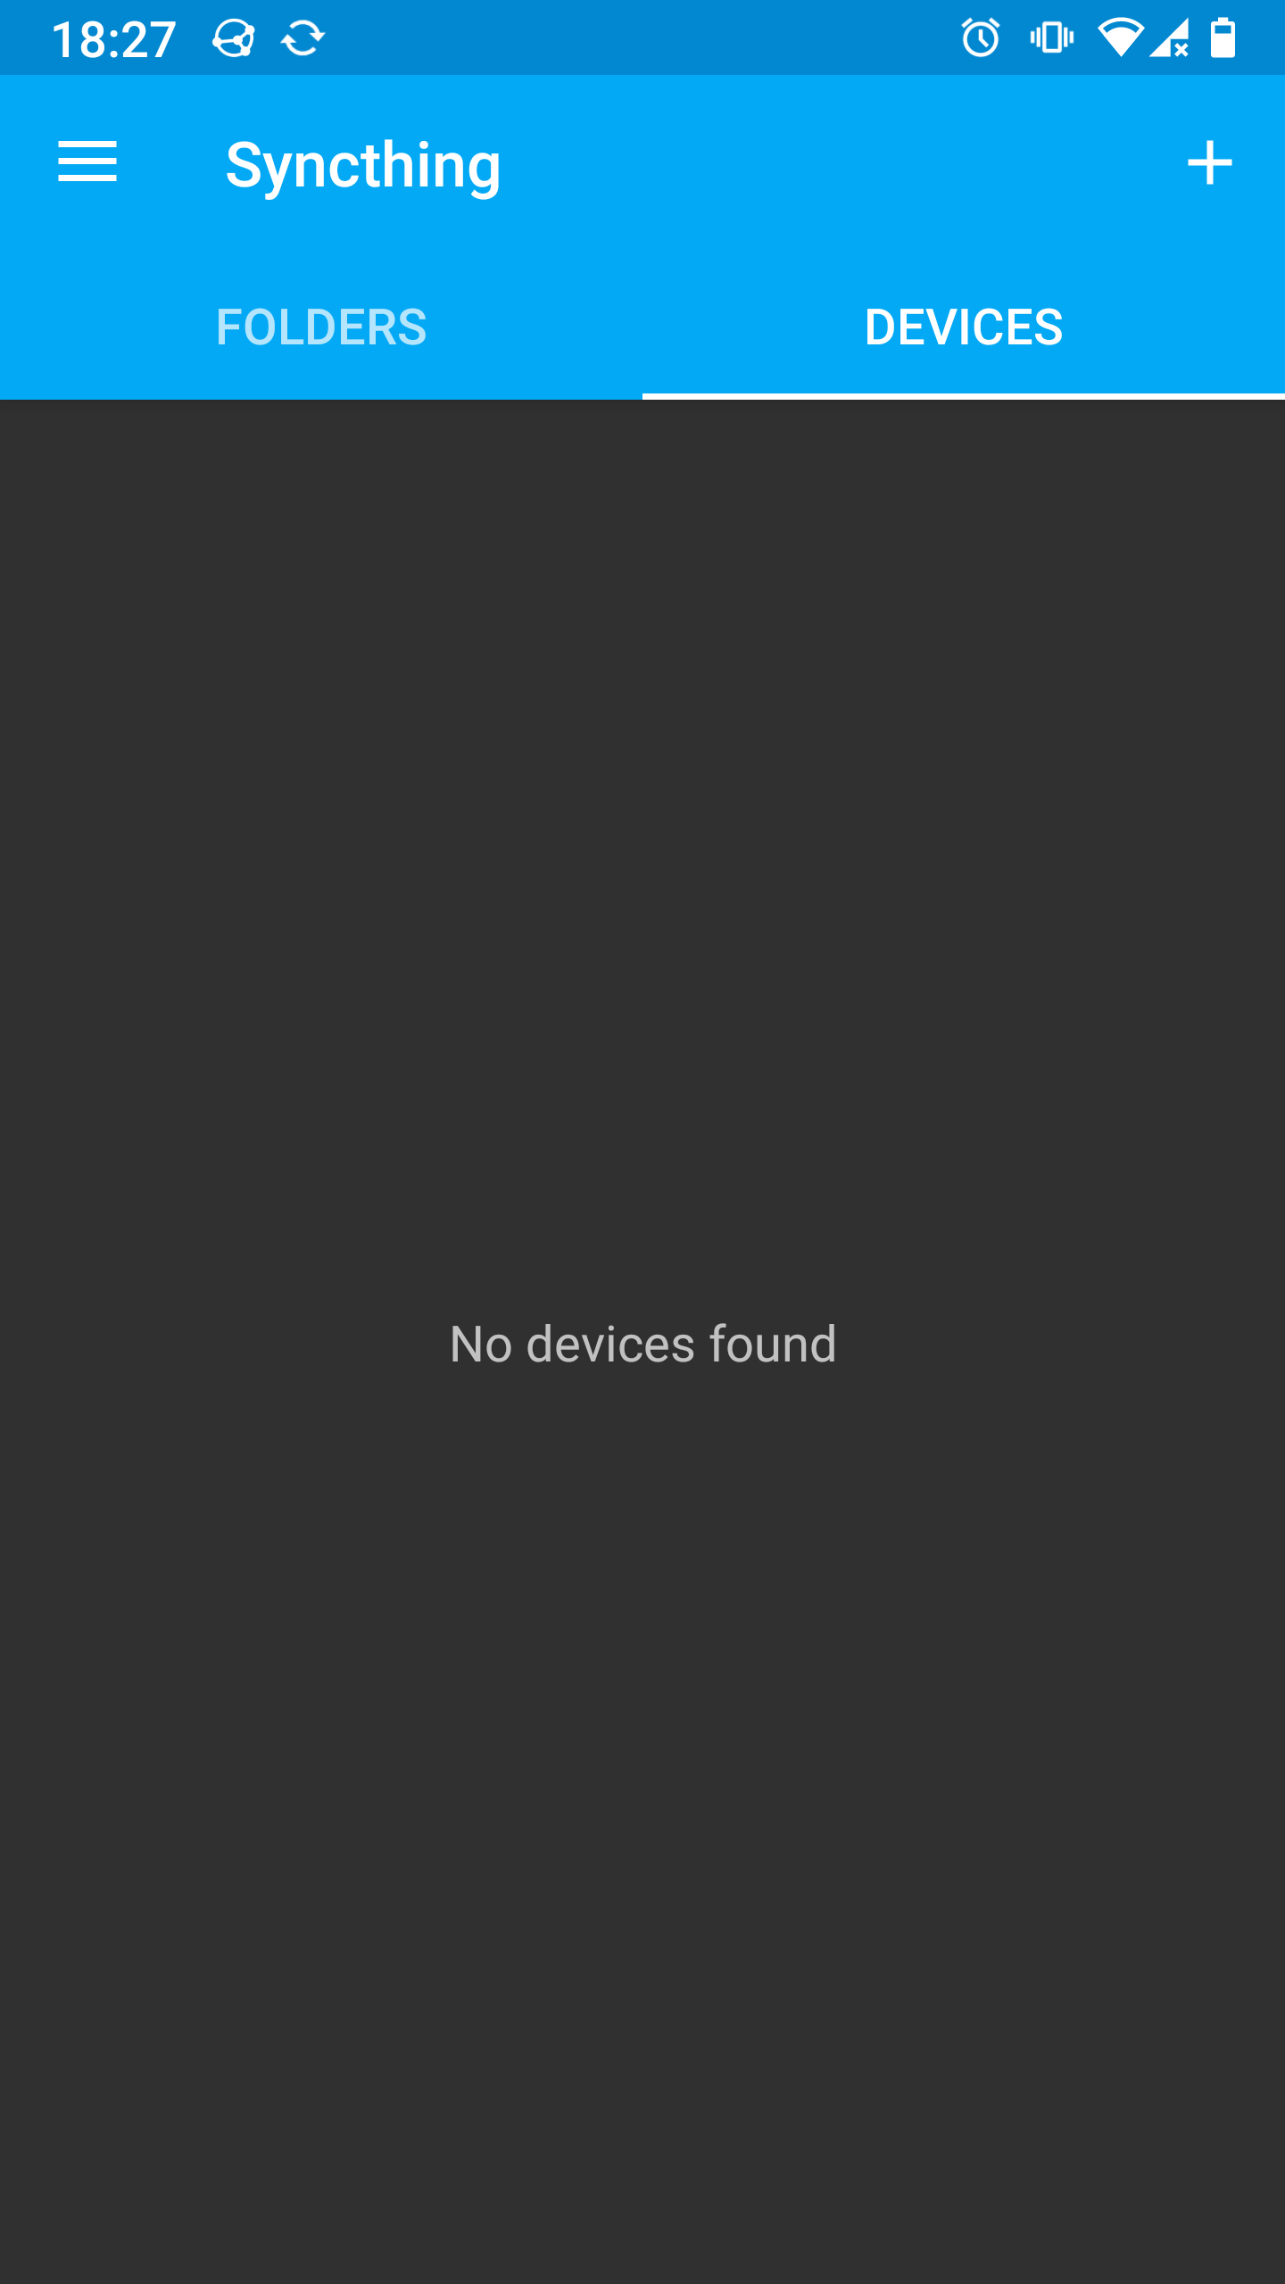
Add device
Scan with phone

Slide 14
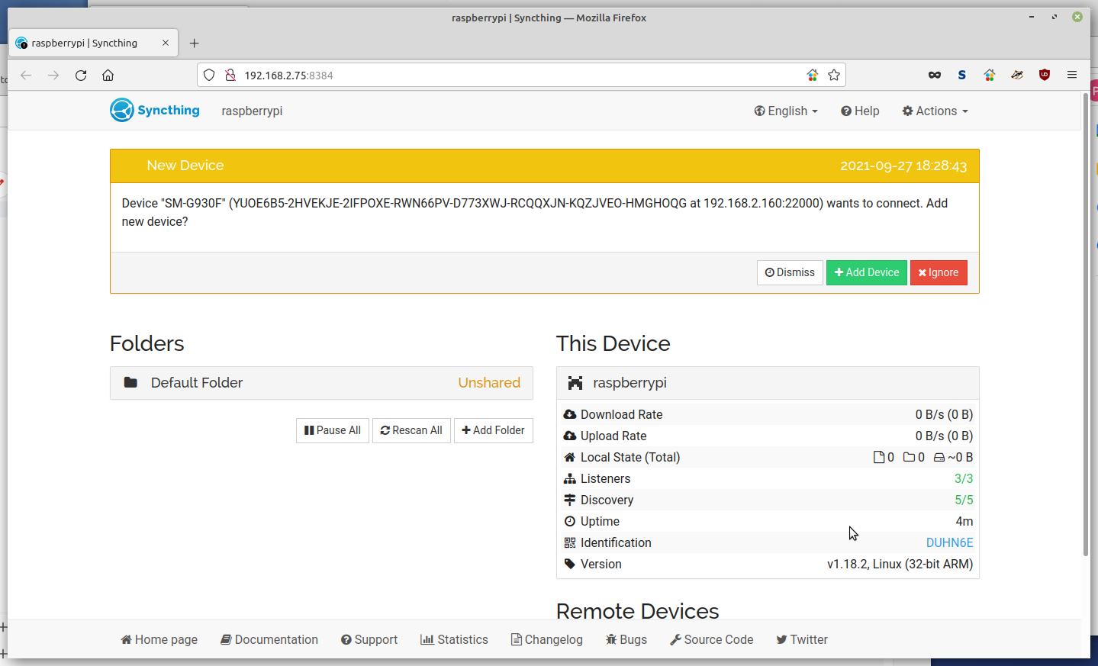
Accept request

Slide 15
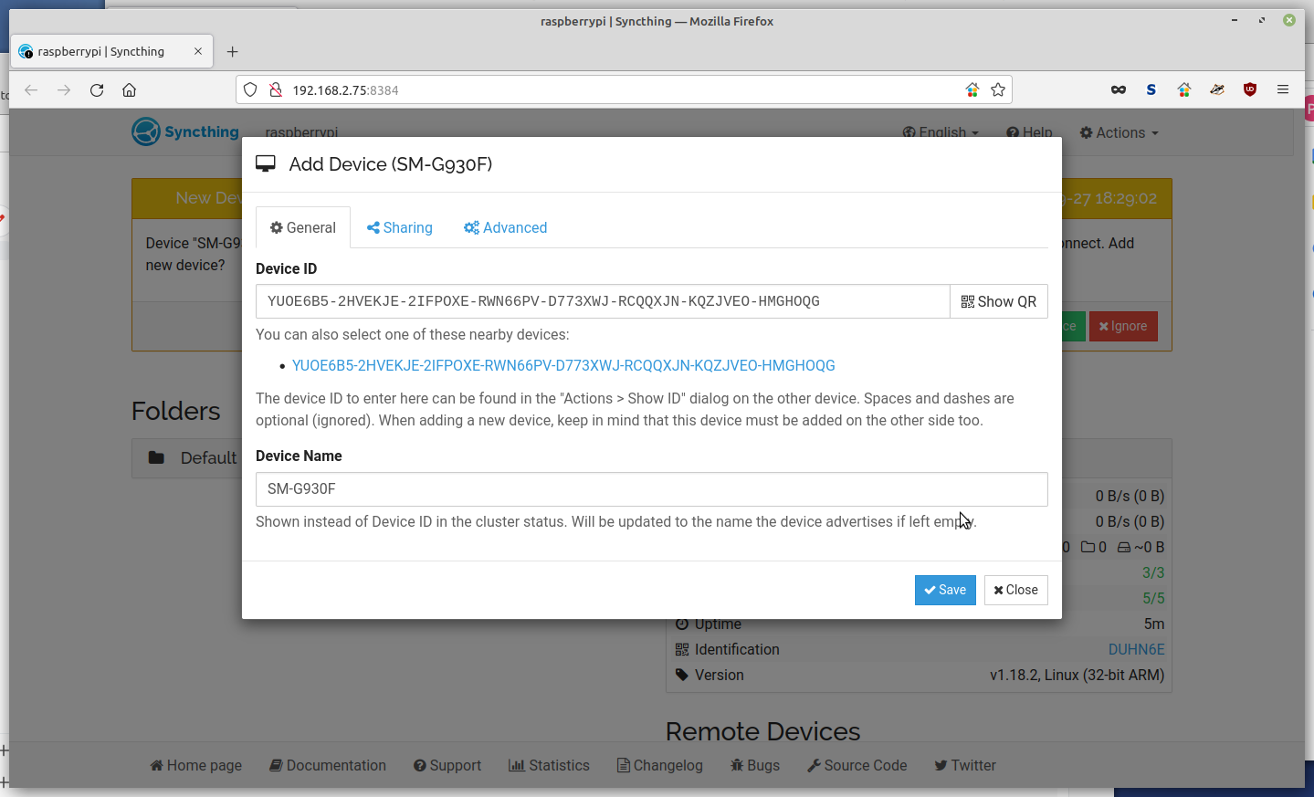
Device details

Slide 16
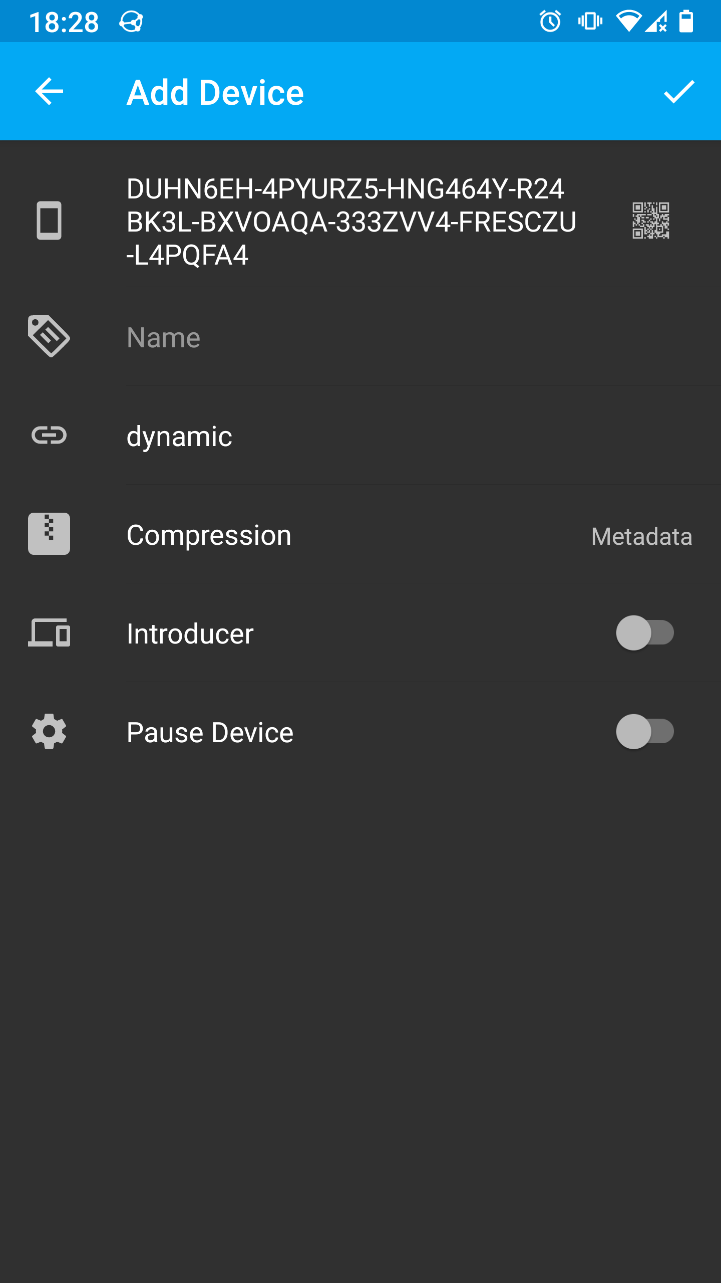
Configure device

Slide 17

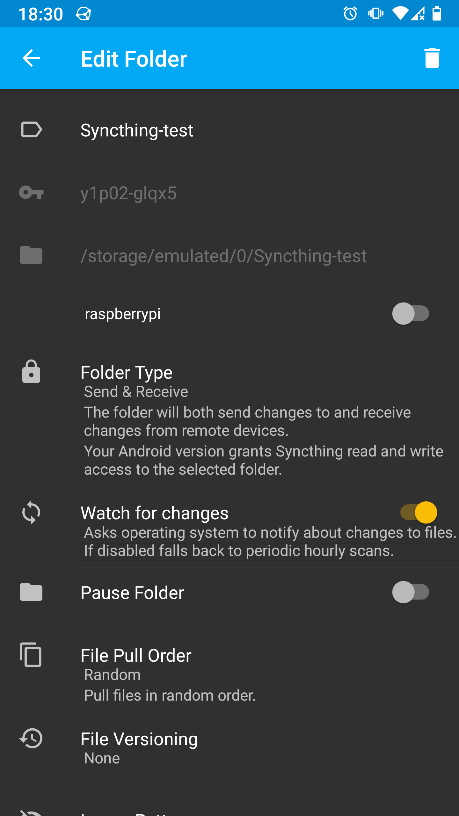
Start sharing

Slide 18
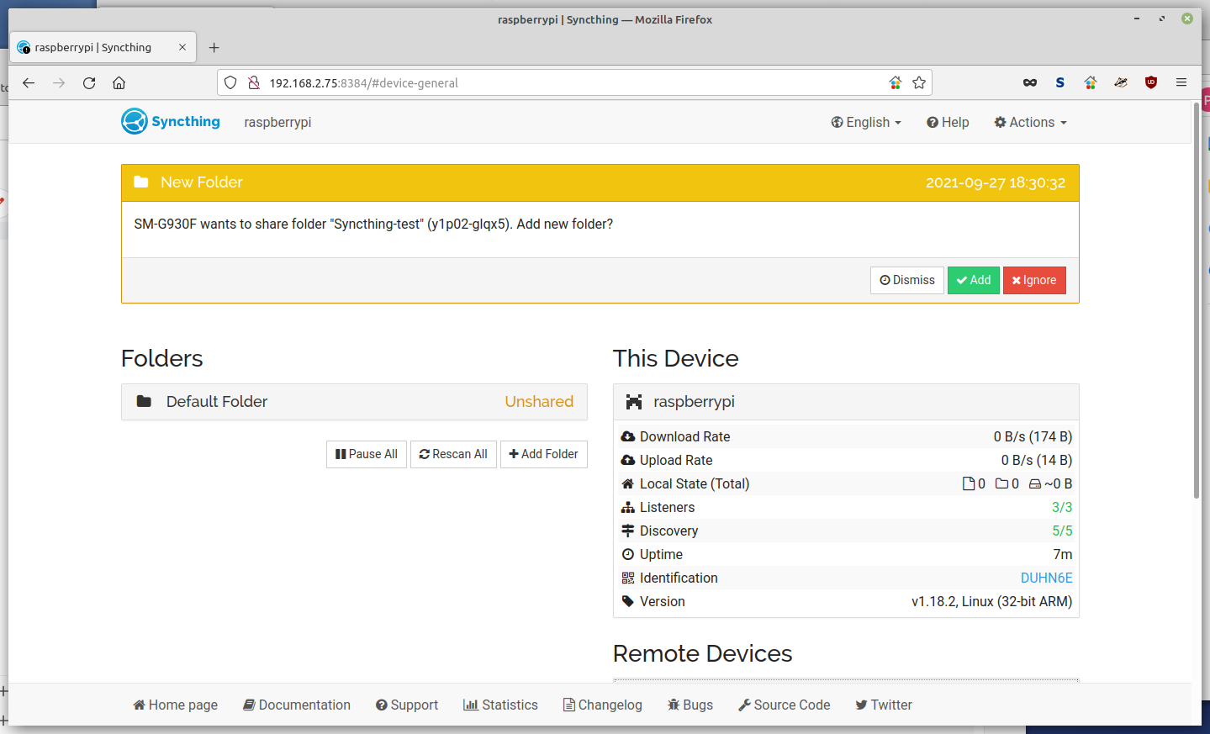
Add folder

Slide 19
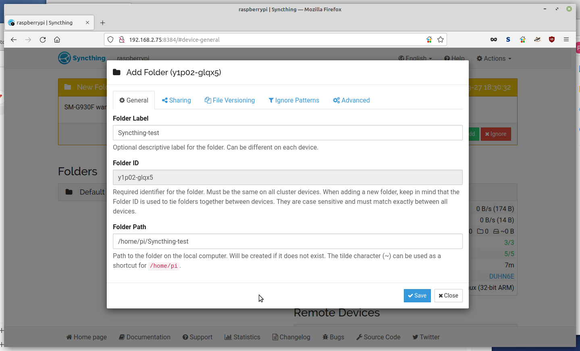
Add folder

Slide 20
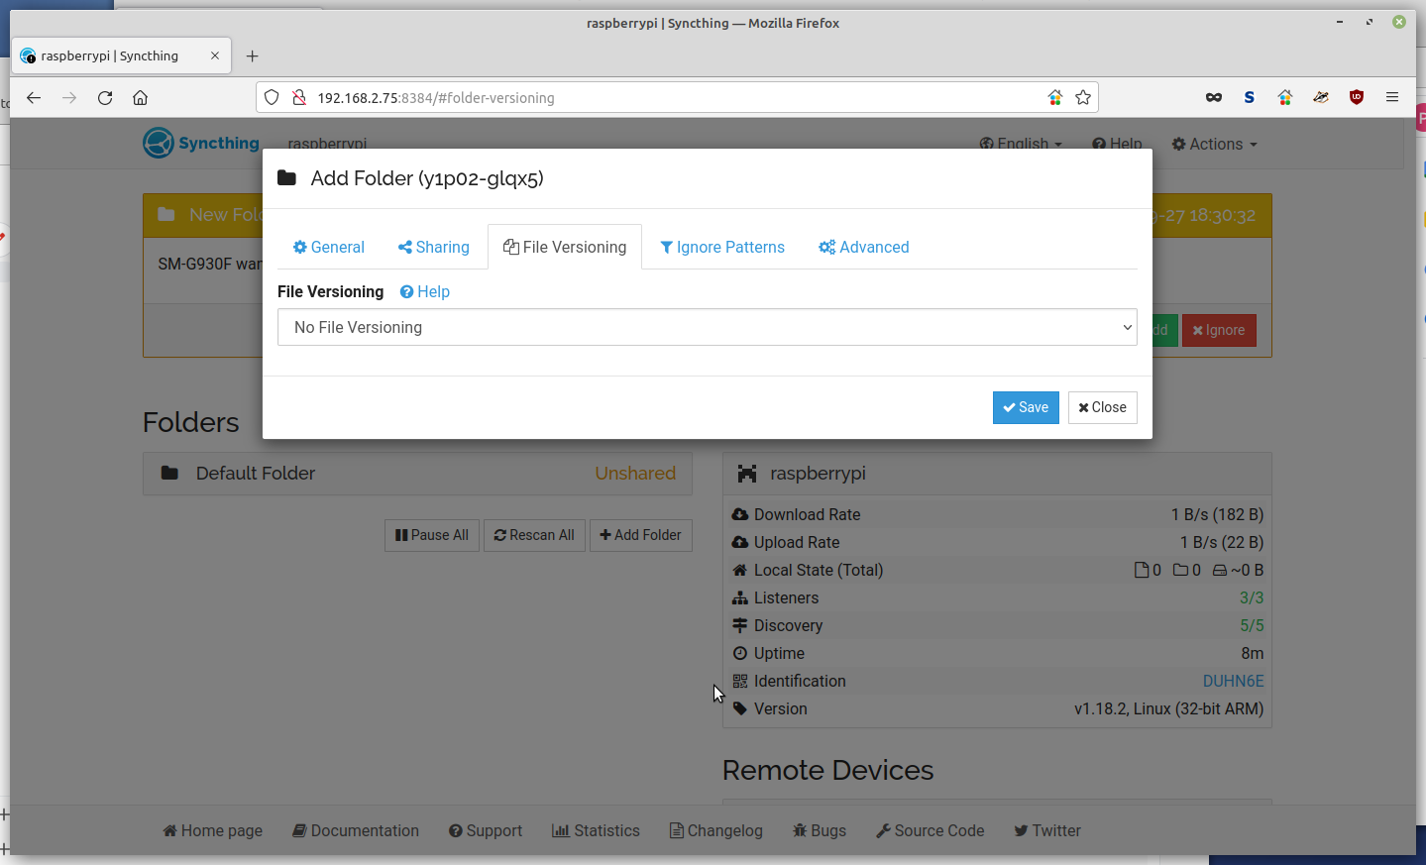
File versioning?

Slide 21
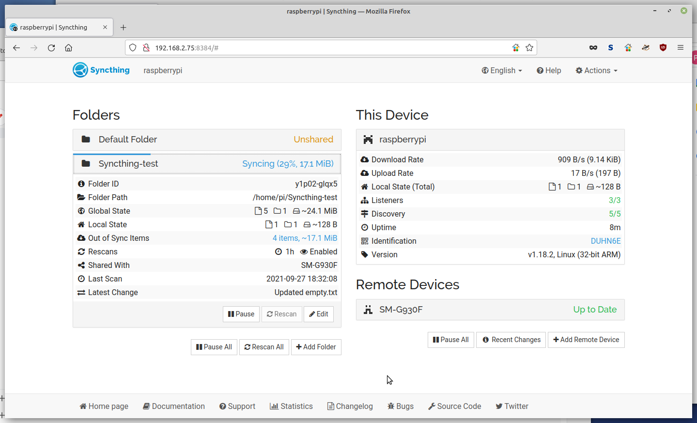
Syncing

