Slide 1
rsync frontends
making life easier for non-power users

Slide 2
Tools
Grsync
Lucky backup
Back in time
Unison

Slide 3
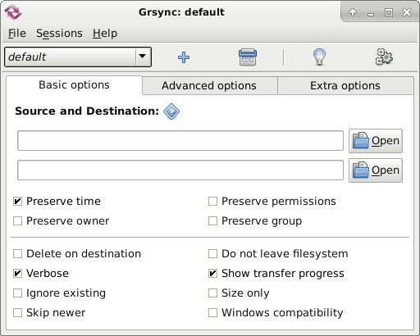
Grsync
GTK interface to rsync
Multi-session support
Basic/adv. Options
Allows simulation
Pre/post commands

Slide 4
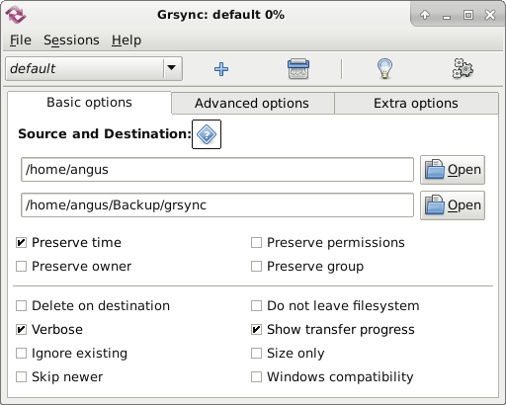
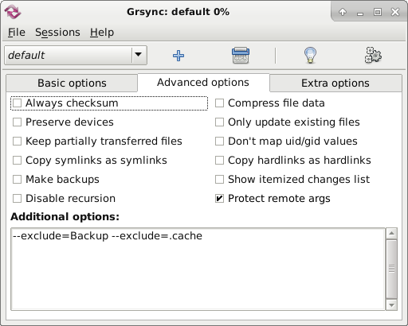
Grsync (2)

Slide 5
Lucky backup
Doesn’t work in Debian/XFCE out-of-the-box:
  Failed to execute command "su-to-root -X -c /usr/bin/luckybackup"
Install gksu
Modify .desktop file
  /usr/share/applications/luckybackup-gnome-su.desktop
Change “Exec” entry to
  Exec=gksu /usr/bin/luckybackup

Slide 6
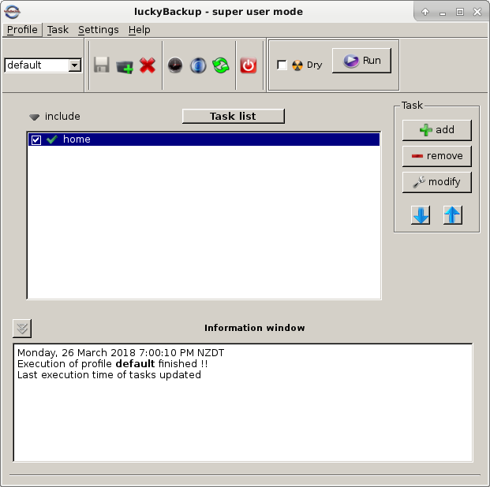
Lucky backup (2)
Multi-profile
Each profile multi-task
Local/remote
Allows simulation
Cronjob option

Slide 7
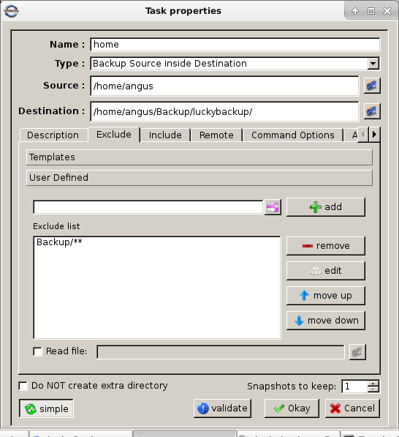
Lucky backup (3)

Slide 8
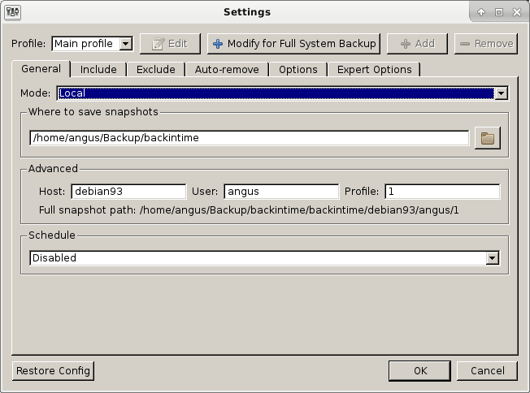
Back in time
“Actual” backup
Multi-profile
Local/remote backup
Root or local user
Cronjob option
Encryption via EncFS
EncFS security audit

Slide 9
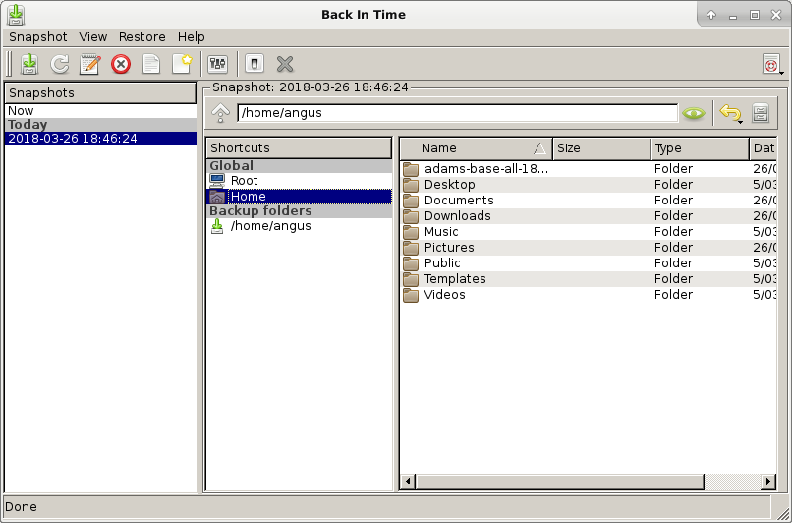
Back in time (2)

Slide 10
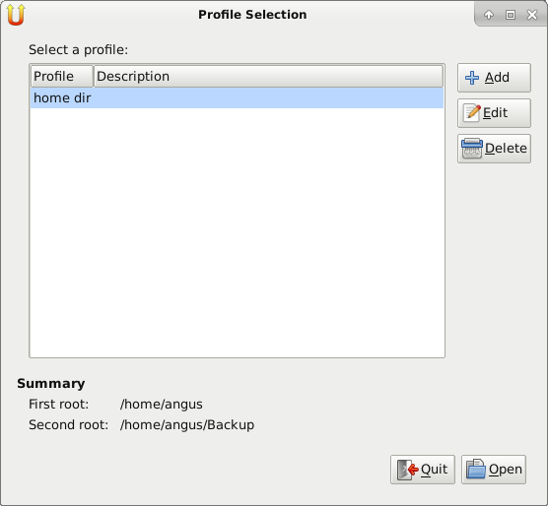
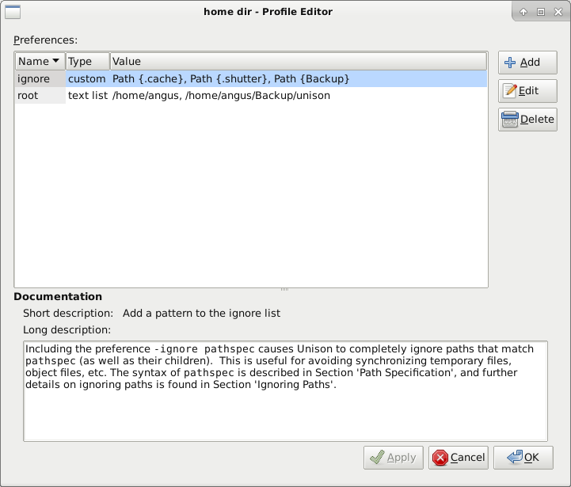
Unison
Multi-profile
Profile wizard
Local/remote
Excludes via
“Preferences”

Slide 11
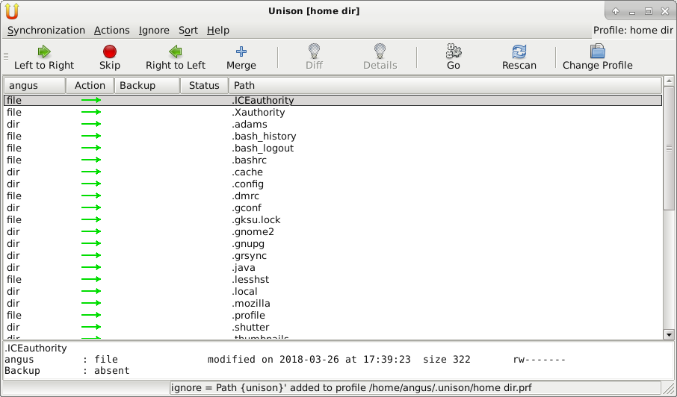
Unison (2)
“Excludes”

Slide 12
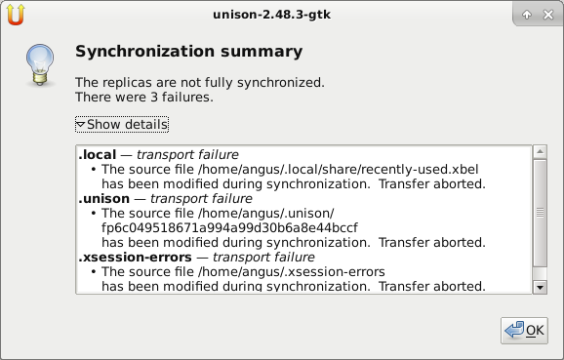
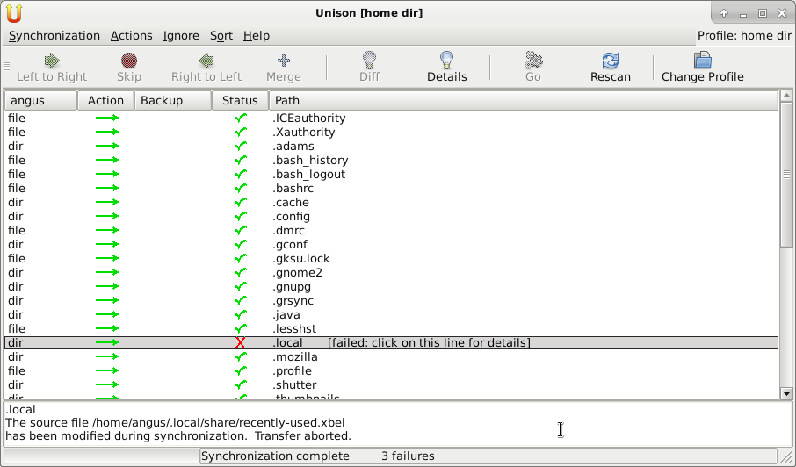
Unison (3)
Error(s) during sync:

