Slide 1
Docker
containerizing applications

Slide 2
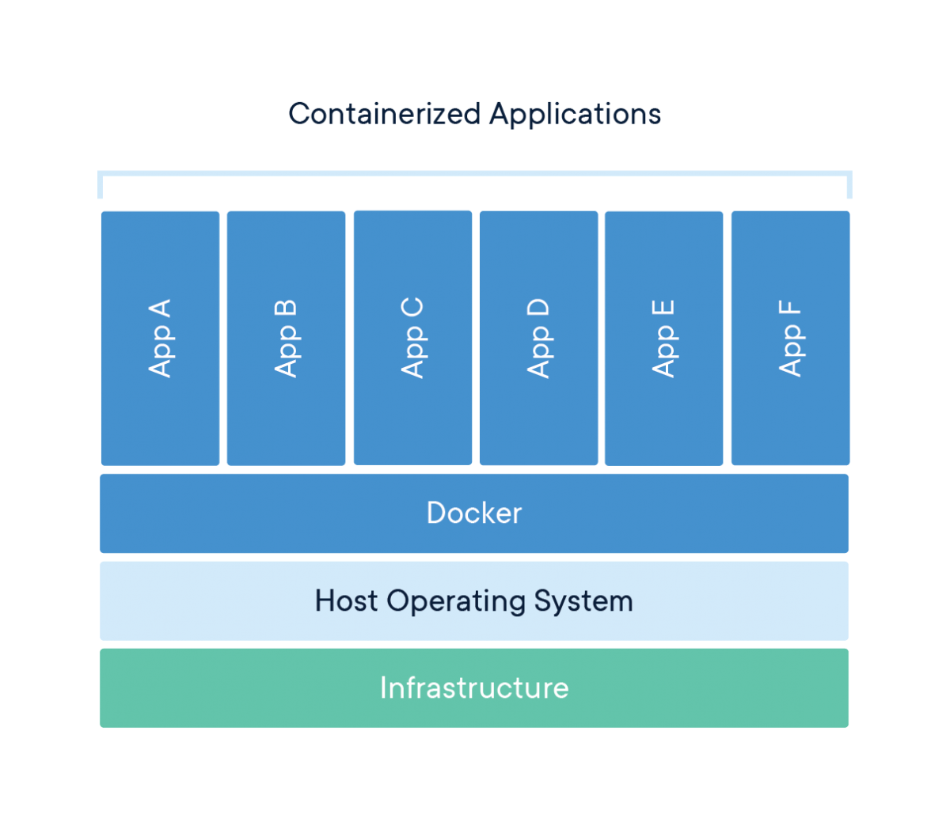
What is docker?
“Docker is a set of platform as a service (PaaS) products that use OS-level virtualization to deliver software in packages called containers. Containers are isolated from one another and bundle their own software, libraries and configuration files; they can communicate with each other through well-defined channels. All containers are run by a single operating system kernel and therefore use fewer resources than virtual machines.”
-- source: WikiPedia
source: docker.com

Slide 3
How does it work?
Dockerfile
Image
Container
build
run

Slide 4
How does it work?
Dockerfile
Image Registry (“publish image”)
Container
build
push
run

Slide 5
How does it work?
Registry (“published image”)
Image
Container
pull
run

Slide 6
Using docker
Using existing images
docker run <image[:version]>
docker run hello-world
Output
Unable to find image 'hello-world:latest' locally
latest: Pulling from library/hello-world
0e03bdcc26d7: Pull complete
Digest: sha256:49a1c8800c94df04e9658809b006fd8a686cab8028d33cfba2cc049724254202
Status: Downloaded newer image for hello-world:latest
Hello from Docker!
...

Slide 7
Using docker
Listing images
docker image ls
REPOSITORY TAG IMAGE ID CREATED SIZE
hello-world latest bf756fb1ae65 6 months ago 13.3kB
Listing containers
docker ps (only running ones)
docker ps -a (all)
CONTAINER ID IMAGE COMMAND CREATED STATUS PORTS NAMES
4e3eeed5cb9a hello-world "/hello" 4 min ago Exited (0) 4 min ago sleepy_haibt

Slide 8
Using docker
Stop containers
docker stop $(docker ps -a -q)
Remove containers
docker rm $(docker ps -a -q)
Prune everything
docker system prune -a

Slide 9
Dockerfile
# Use the official image as a parent image
FROM node:current-slim
# Set the working directory
WORKDIR /usr/src/app
# Copy the file from your host to your current location
COPY package.json .
# Run the command inside your image filesystem
RUN npm install
# Add metadata to image to describe which port the container is listening on
EXPOSE 8080
# Run the specified command within the container
CMD [ "npm", "start" ]
# Copy the rest of your app's code from your host to your image filesystem
COPY . .
source: Sample Dockerfile
Reference

Slide 10
Mapping
Mapping directories
  volumes
    -v/--volume /local/dir:/container/dir:ro
  bind volumes
    --mount type=bind source=/local/dir,target=/cont/dir,readonly
  “volume” combines everything in one expression, “mount” uses key-value pairs (more verbose)
Mapping ports
  container networking
    -p [HOST_IP:]HOST_PORT:CONT_PORT[/PROTOCOL]
    -p 8080:80
    -p 192.168.1.100:8080:80/tcp -p 192.168.1.100:8080:80/udp

Slide 11
nginx example
Images available at
  https://hub.docker.com/_/nginx/
HTML files in /local/dir/html
Run as daemon (“-d”) on port 8080 on host
command-line
docker run \
-v /local/dir/html:/usr/share/nginx/html \
-p 8080:80 -d nginx[:latest]

Slide 12
Interactive containers
Containers can be run interactively using -it (--interactive –tty)
Can be confusing what container you are in
use custom /etc/bash.bashrc
generate them with docker-banner-gen

Slide 13
Interactive containers
Example
_____ _____ ___ _ _ ____ _
|_ _| ___| / _ \| |__ (_) _ \ ___| |_
| | | |_ | | | | '_ \| | | | |/ _ \ __|
| | | _| | |_| | |_) | | |_| | __/ |_
|_| |_| \___/|_.__// |____/ \___|\__|
|__/
1.14.0_2019-08-31
WARNING: You are running this container as root, which can cause new files in
mounted volumes to be created as the root user on your host machine.
To avoid this, run the container by specifying your user's userid:
$ docker run -u $(id -u):$(id -g) args...
tf-objdet / >

Slide 14
Pitfalls
docker hashes the commands
  layer doesn’t get regenerated if hash hasn’t changed – “pip install NAME” won’t trigger a rebuild without version number change!
temporary files from a command need to get removed as part of that command to reduce size of layer
  apt/pip require cleaning
  RUN apt-get update && \
  apt-get install -y --no-install-recommends vim &&\
  pip install Cython && \
  rm -Rf /root/.cache/pip && \
  rm -rf /var/lib/apt/lists/*

Slide 15
Pitfalls
containers run (usually) as root, files generated in volumes will have root/root as user/group
  run as different user: -u UID:GID
  as current user: -u $(id -u):$(id -g)
“docker login” (for private registries) stores passwords in base64
  credentials stores

