Slide 1

NixOS
The Purely Functional Linux Distribution

Slide 2
Basics
declarative
  {
  boot.loader.grub.device = "/dev/sda";
  fileSystems."/".device = "/dev/sda1";
  services.sshd.enable = true;
  }
  nixos-rebuild switch <-- downloads, compiles etc
reliable
  atomic upgrades and rollbacks
  nixos-rebuild switch --rollback
  nix package manager
  nix-env --upgrade <pkg>
  nix-env --rollback
  nix-env --uninstall
devops-friendly
  NixOps, NixOS cloud deployment tool (eg EC2)

Slide 3
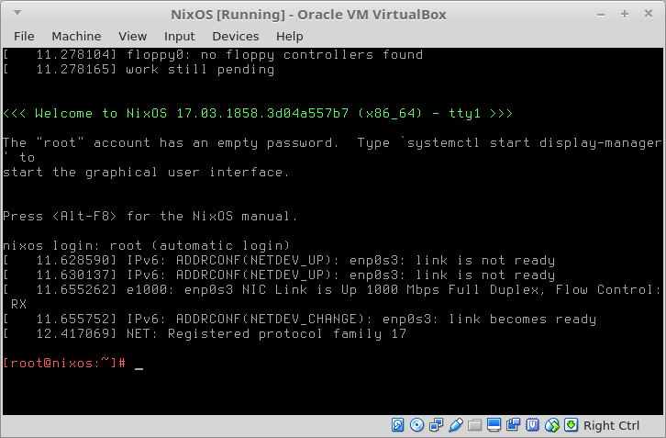
Screenshots
systemctl start display-manager

Slide 4
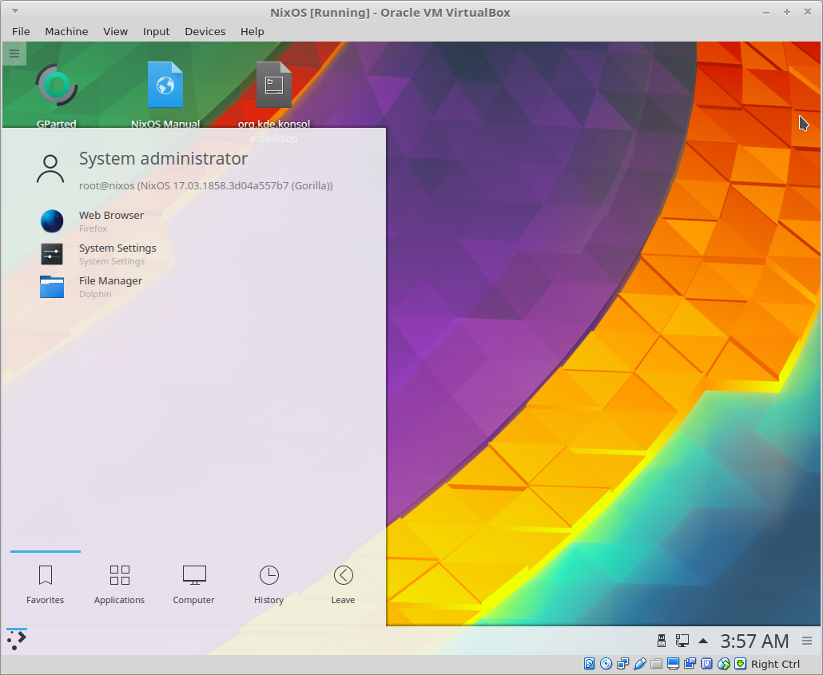


Slide 5
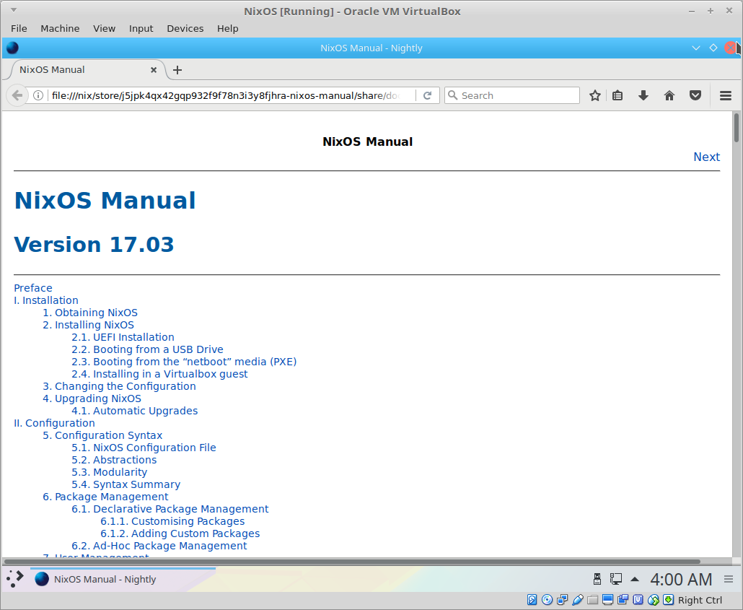
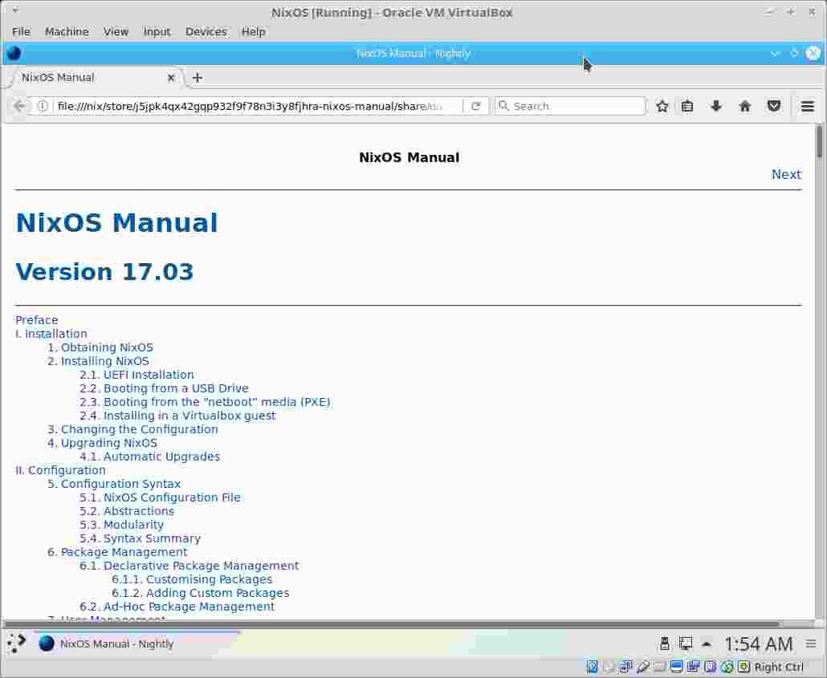

Slide 6
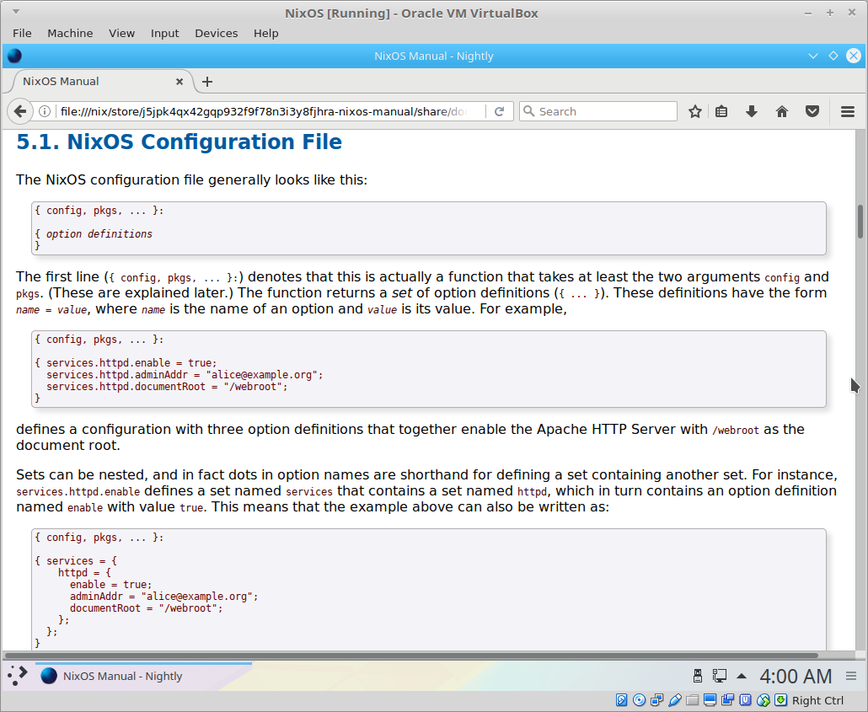
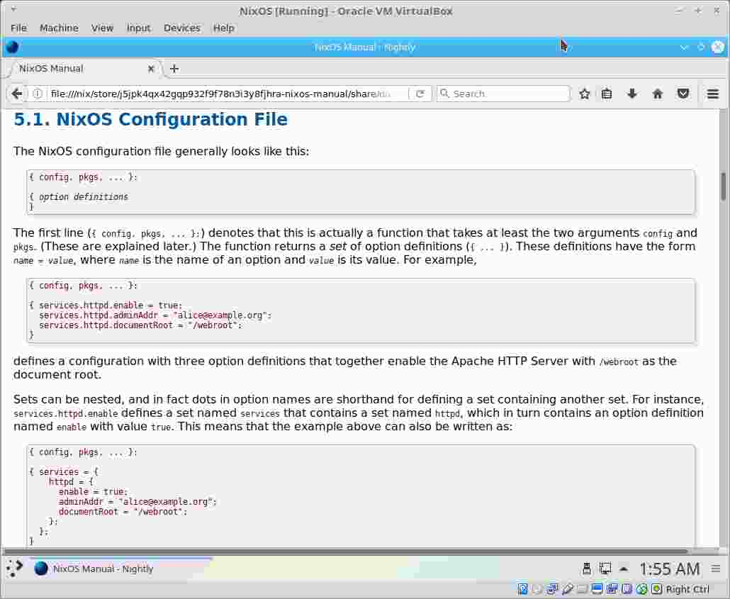

Slide 7
