Slide 1
Linux Security Tools

Slide 2
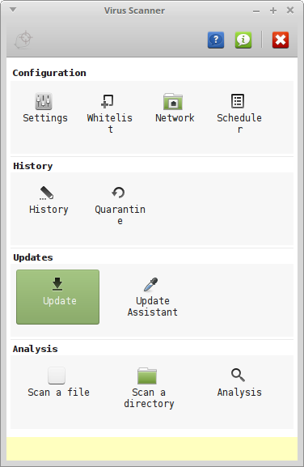
clamav
“Antivirus”
sudo apt-get install clamav clamtk
start ClamTK from menu

Slide 3

Sophos
“Antivirus”
URL
https://www.sophos.com/en-us/products/free-tools/sophos-antivirus-for-linux.aspx
requires first/last/email registration

Slide 4
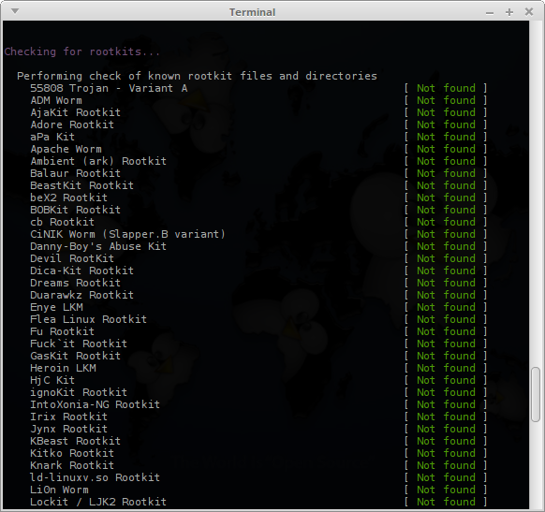
rkhunter
“Rootkit detection”
sudo apt-get install rkhunter
execute
sudo rkhunter --check

Slide 5
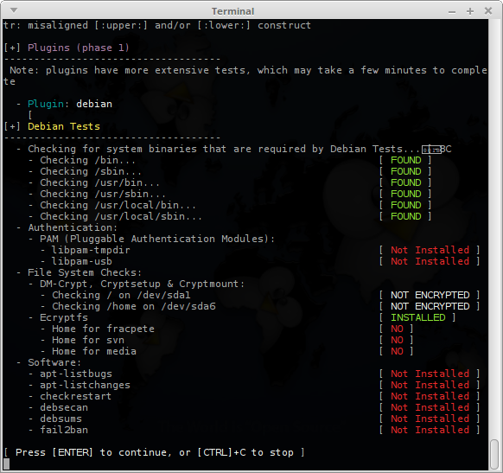
Lynis
“system and security audit”
sudo apt-get install lynis
run
sudo lynis --checkall

