Slide 1
Bye bye X11
Wayland and Mir

Slide 2
Why drop X11?
Code base is 3 decades old
Lots of tweaks, added features -> messy
Security issues (design-wise)
Dead code
Replacements
  Wayland
  Mir (Ubuntu's fork of Wayland -> Unity8)

Slide 3
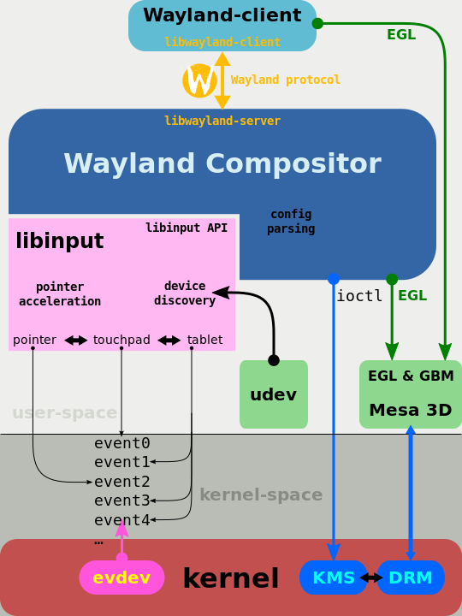
Wayland
Wayland (display server protocol) - 1.11.0 stable
Weston reference implementation (in C)
MIT license
Project page
http://wayland.freedesktop.org/
Testing
  RebeccaBlack OS
  https://sourceforge.net/projects/rebeccablackos/
  Fedora
  gnome-session --session gnome-wayland
  Others: Sailfish OS, Enlightenment
EGL
interface between Khronos rendering APIs (such as
OpenGL, OpenGL ES or OpenVG) and the underlying native platform
windowing system (from https://en.wikipedia.org/wiki/EGL_(API))

Slide 4
Mir
Fork of Wayland
Project page
https://launchpad.net/mir
GPLv3
built on EGL as well, other parts from Android (input stack, protocol buffers)
  may have lower overheads, richer input like touch
Base for Ubuntu Unity8, written in C++, Qt5
Mir - http://unity.ubuntu.com/mir/installing_prebuilt_on_pc.html
  sudo apt-get update
  sudo apt-get install mir-demos ubuntu-desktop-mir
Unity8 - https://wiki.ubuntu.com/Unity8Desktop
  sudo apt install unity8-desktop-session

