Slide 1

WorldTour
Emina Abazovic, Amina Gabeljic, Julia Meyr

Slide 2

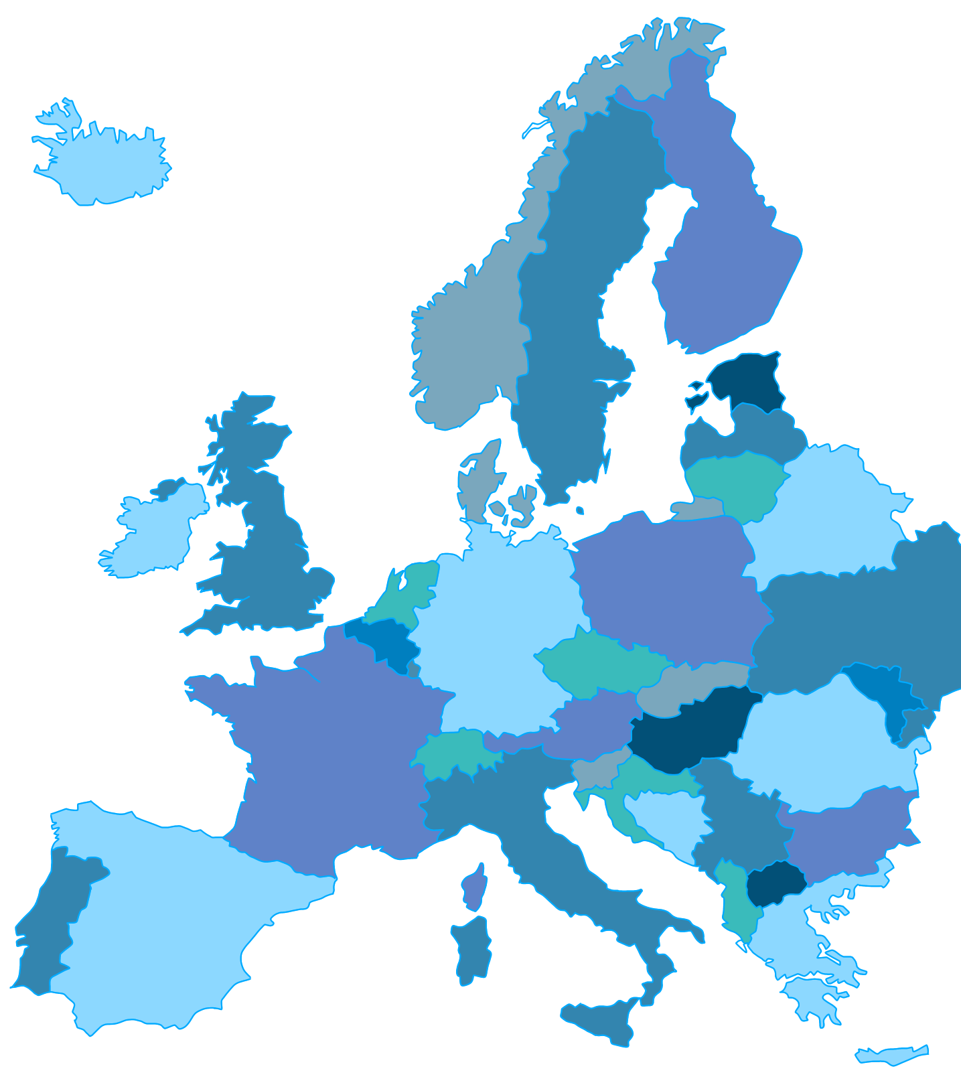
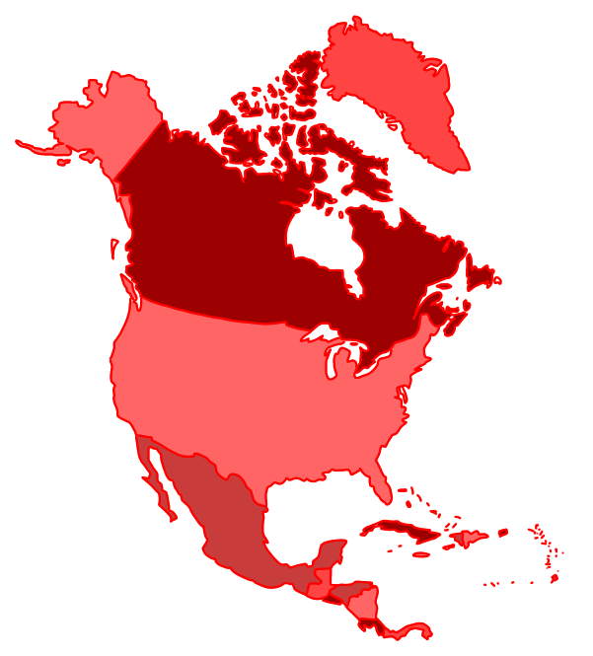
Our team – Emina Abazovic
Websites + Map Coordinates:
Europe North America
Capital City Quiz + Server
Map/Images Designs

Slide 3

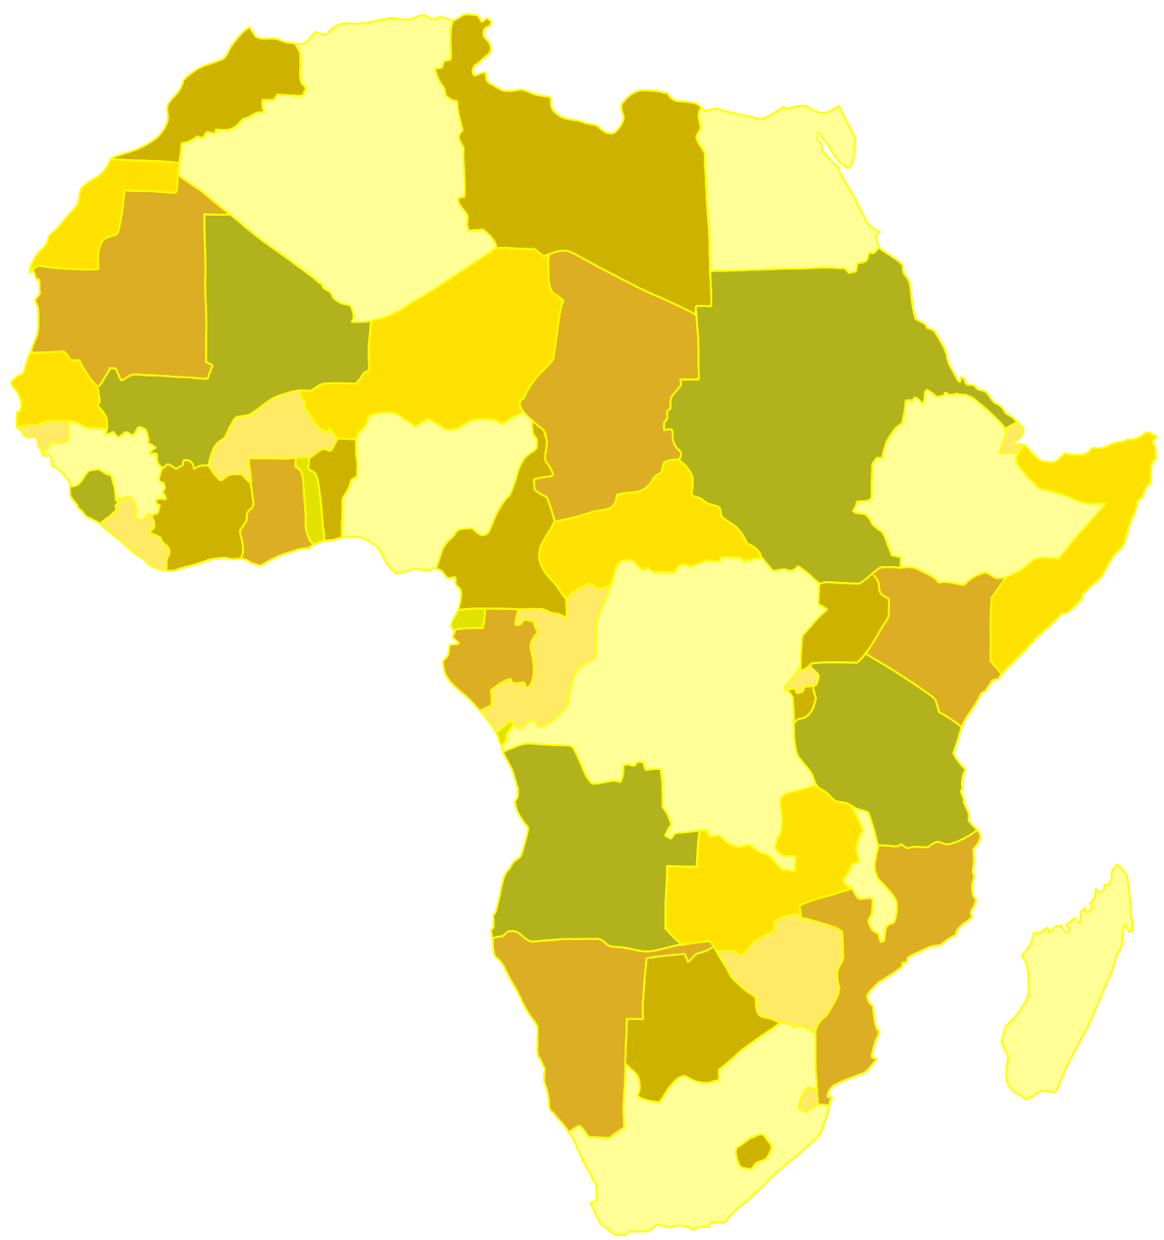
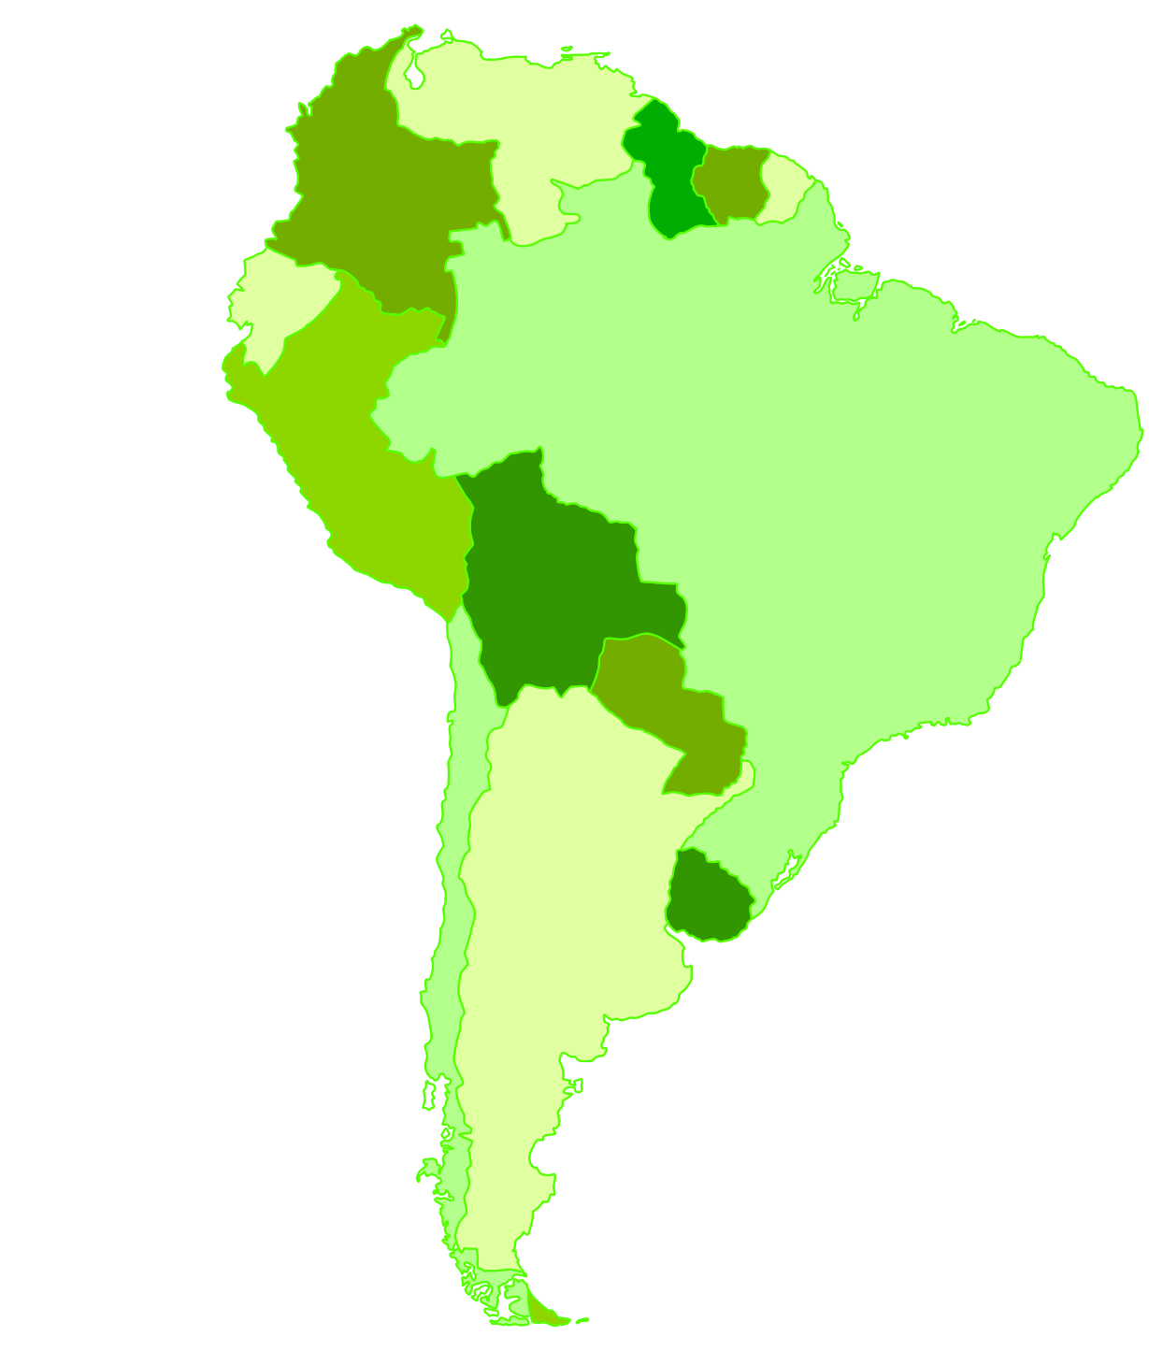
Our team – Amina Gabeljic
Websites + Map Coordinates :
Africa South America
World In Data + Historical Simulation
Website Design

Slide 4

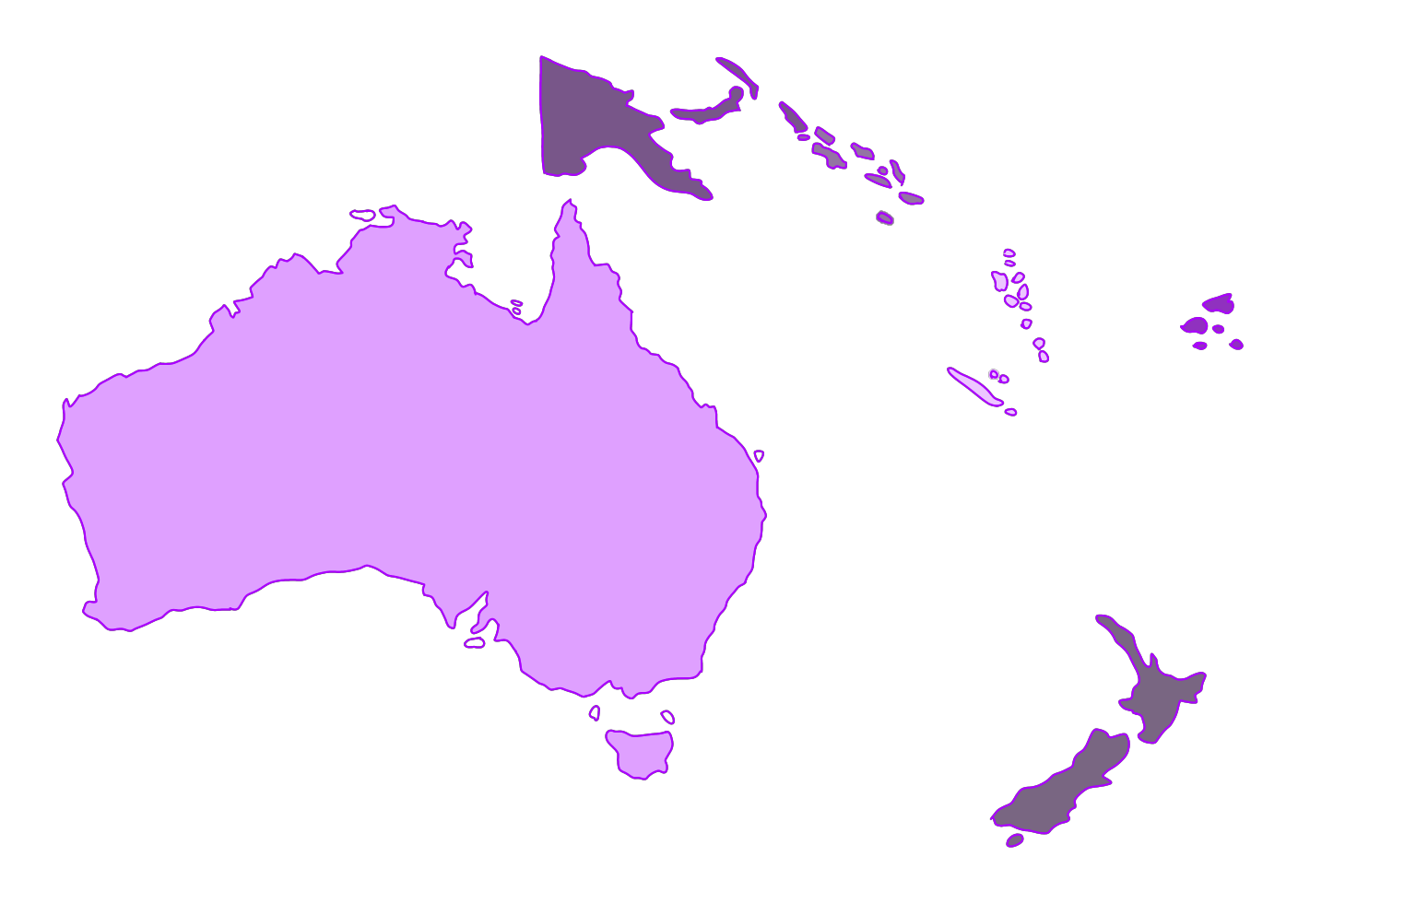
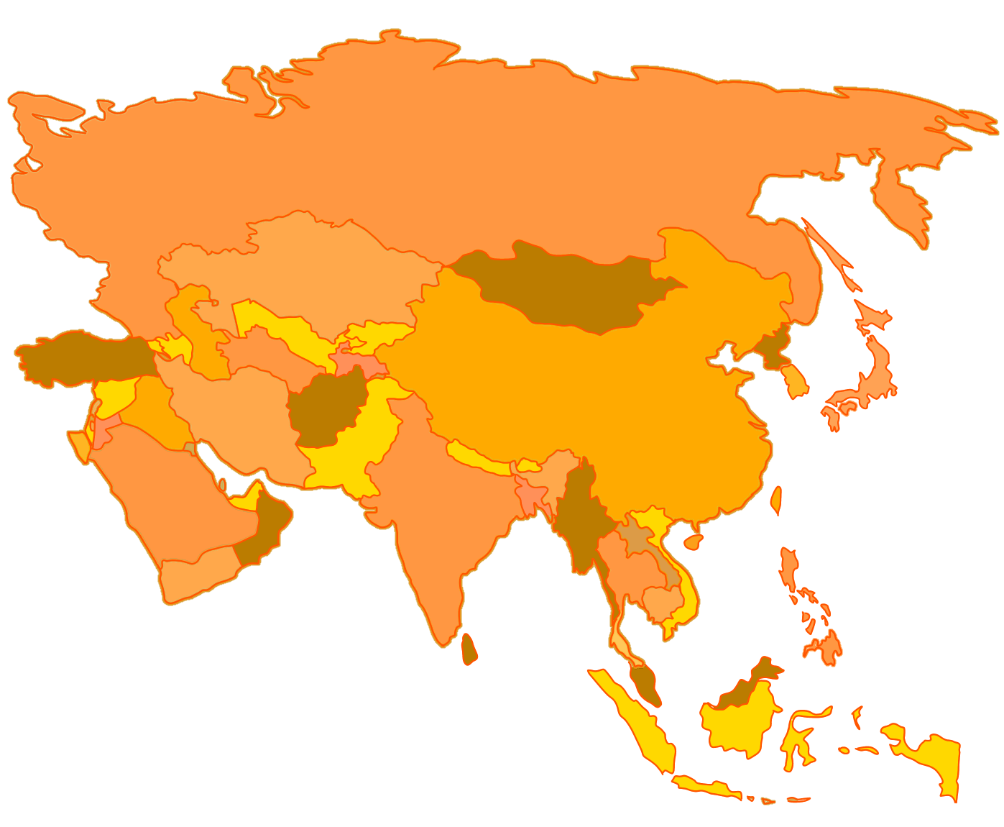
Our team – Julia Meyr (leader)
Websites + Map Coordinates :
Australia Asia
Flag Quiz
Website Design
Details

Slide 5
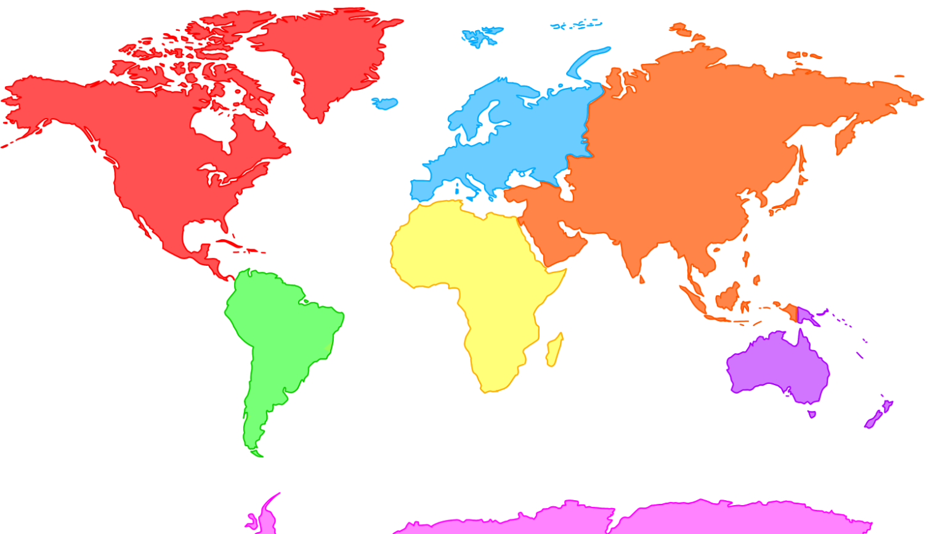
What is „WorldTour“?
2D-map of the world
Map of every continent
Website of every country
Videos
Recipes
Special sights
Culture
Location
Facts
playful ways to strengthen knowledge
Quizzes
World In Data

Slide 6
Motivation
Make information easier to access for
Students
Presenations
Travel enthusiasts
Give people better knowedge about our world
Test your knowledge
Get information
Help people to decide their next holiday destination

Slide 7
Code-Snipet: Capital City Quiz

Slide 8
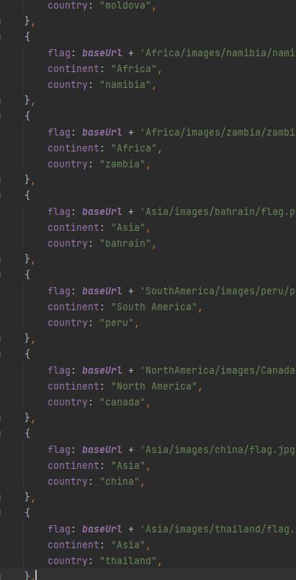
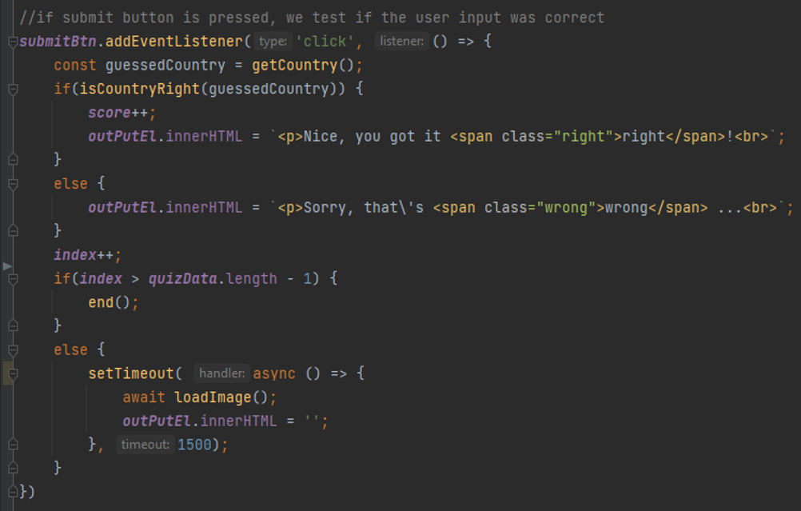
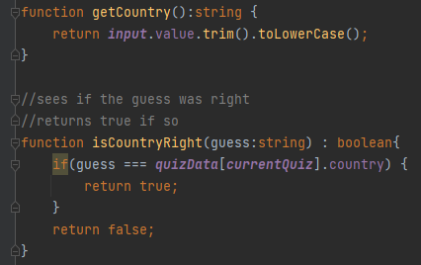
Code-Snipet: Flag Quiz

Slide 9
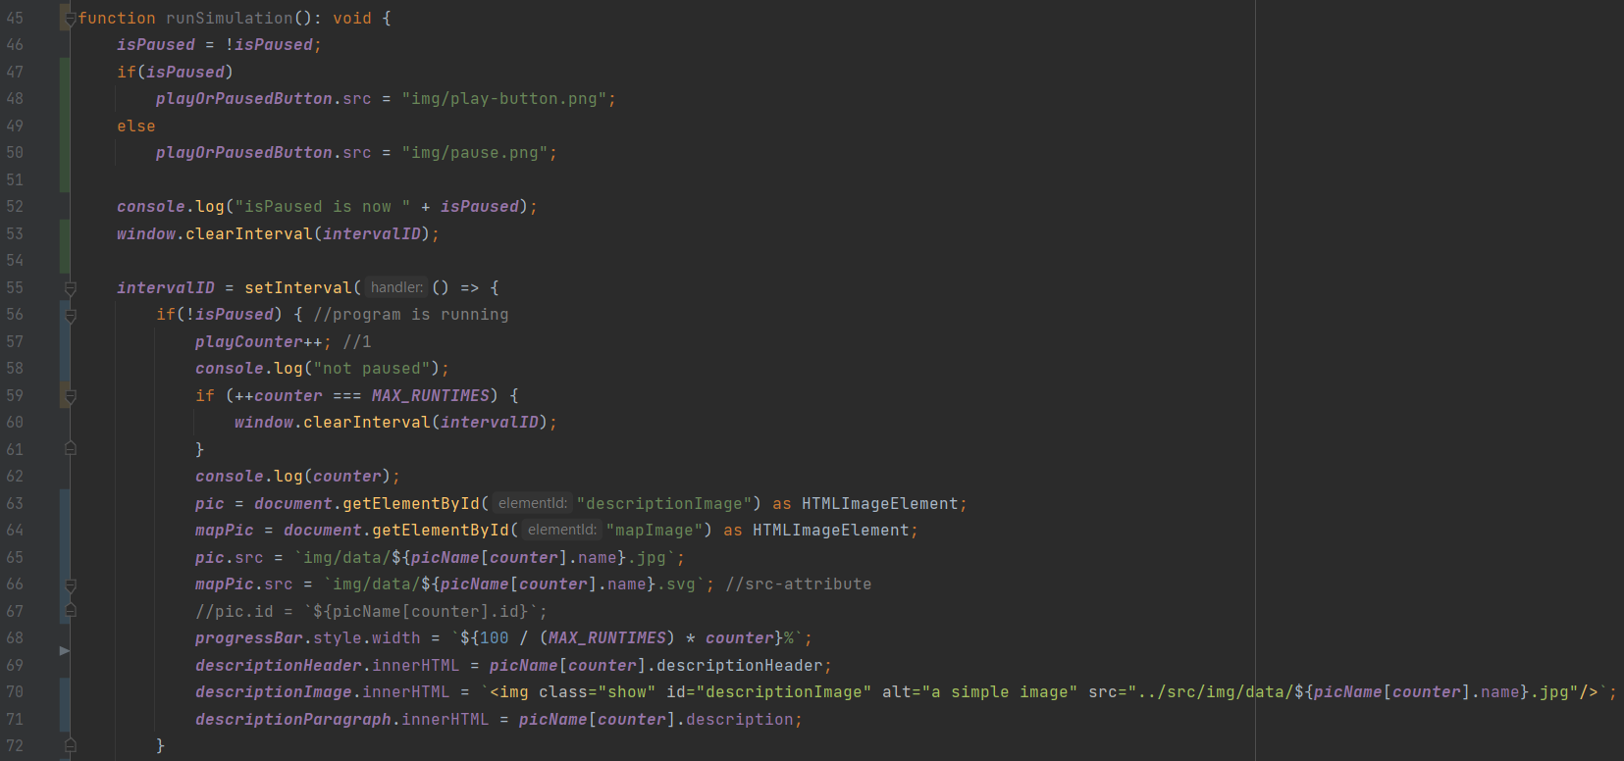
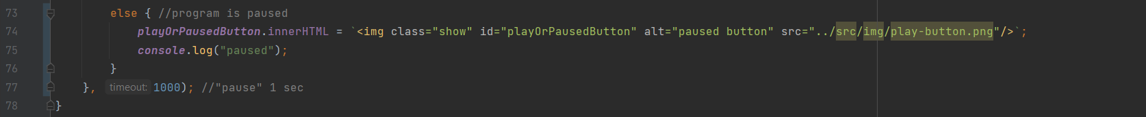
Code-Snipet: World In Data / Historical Simulation

Slide 10
