Slide 1

Expert Team on Metadata Standards
Kick-off meeting
Tom Kralidis (Chair)
Jörg Klausen (Vice-chair)
Enrico Fucile (Secretariat)
2020-10-01

Slide 2
Agenda
Welcome! Round table and introductions
SC-IMT presentation
ET-Metadata Overview
TT-WISMD Overview
TT-WIGOSMD Overview
WMO Metadata standards and update procedures
Architecture of participation (meetings, GitHub, etc.)
AOB
https://community.wmo.int/meetings/et-metadata-meeting-01-oct-2020

Slide 3
Round table
Name and affiliation
Role in your organization
Experience in WMO metadata standards and/or relevant areas

Slide 4

WMO Structure
Congress
Regional Association I
Financial Advisory Committee
Hydrological Assembly
Regional Association II
Executive Council
Infrastructure Commission
Audit Committee
Flood Forecasting Initiative Advisory Group
Regional Association III
WMO-IATA WICAP Governing Board
Services Commission
Technical Coordination Committee
Regional Association IV
Policy Advisory Committee
Research Board
Regional Association V
Joint WMO-IOC Collaborative Board
PHORS
Regional Association VI
Capacity Development Panel
Hydrological Coordination Panel
Scientific Advisory Panel
Climate Coordination Panel
Decision-making body
Regional implementation body
Technical body
Advisory body
Coordination body

Slide 5
Infrastructure Commission
Expert Teams
Standing Committees
Study Groups
WIGOS Tools (ET-WT)
Joint on Earth Observing Systems and Monitoring Networks (JET-EOSDE)
Cryosphere Observation from Space (ET-COS)
Hydrological Monitoring (ET-HYDMON)
Space Systems and Utilization (ET-SSU)
Radio-Frequency Coordination (ET-RFC)
Data Issues and Policies (SG-DIP)
Earth Observing Systems and Monitoring Networks (SC-ON)
Editorial Board (EdBd)
Quality, Traceability and Calibration (ET-QTC)
Surface and Sub-surface Measurement (ET-SSM)
Upper-Air Measurement (ET-UAM)
Transitioning to Modern Measurement (ET-TTM)
Radiation References (ET-RR)
Measurement Uncertainty (ET-MU)
Operational Weather Radar (ET-OWR)
Upper-Air Instrument Intercomparison (TT-UAII)
Ocean Observations and Infrastructure Systems (SG-OOIS)
Measurements, Instrumentation and Traceability (SC-MINT)
Management Group
Coordinator on Satellite Matters (C-SAT)
Coordinator on engagement and partnership (C-ENG)
Coordinator hydrology in earth system modelling (C-HESM)
Cryosphere Crosscutting Functions (SG-CRYO)
WIS2 Architecture and Transition (ET-W2AT)
WIS2 Regional Associations Engagement (ET-W2RAE)
WIS2 WMO Programmes Engagement (ET-W2WPE)
Operations and Monitoring (ET-OM)
Infrastructure and Security (ET-IS)
Information Management (ET-IM)
Data Standards (ET-Data)
Metadata (ET-Metadata)
Audit and Certification (ET-AC)
Information Management and Technology (SC-IMT)
Implementation of the Global Basic Observing Network (SG-GBON)
Earth System Implementation (JET-ESI)
Operational Weather Forecasting System (ET-OWFS)
Operational Climate Prediction System (ET-OCPS)
Emergency Response Activities (ET-ERA)
Expert Team on the development of the Guide on GDPFS (ET-Guide)
Data Processing for Applied Earth System Modelling and Prediction (SC-ESMP)
WMO/INFCOM-IOC/UNESCO- UNEP-ISC Global Climate Observing System (JSG-GCOS)

Slide 6
Services Commission
Expert Teams
Standing Committees
Study Groups
ETC (Personnel)
MHS (Hazards)
CCV (Climate change impacts)
VSA (Volcanic)
+ Coordinators
Services for Aviation (SC-AVI)
Integrated Health Services (SG-HEA)
AAS (Services)
ASC (Science)
DRG (Drought)
ARM (Risk Mgt)
ACD (Cap Dev)
+ TTs TBA
Integrated Energy Services (SG-ENE)
Services for Agriculture (SC-AGR)
Integrated Urban Services (SG-URB)
CMA (Monitoring)
DRC (Requirements)
CSISO (Services & Ops)
TCISB (Services toolkit)
CDC (Cap Dev)
CCP coordination(?)
Climate Services (SC-CLI)
Management Group
(Five additional experts)
Informal ad hoc groups (as needed)
Hydrological Services (SC-HYD)
Emergency Response
Maritime Safety
MO Requirements
Cap Dev & competencies
+ TT Cost Recovery
+ Met Area Coordinators
JCB coordination(?)
Marine Meteorological and Oceanographic Services (SC-MMO)
CHE (Cataloguing Hazardous Events)
GMAS WCM (Humanitarian)
MIE (Interoperability)
MTG (Tech guides)
GSD (PWS)
Disaster Risk Reduction and Public Services (SC-DRR)

Slide 7
Teams Definitions
 | Definition | Established by | Selection of leadership and membership | Type of activity | Governance and reporting | Duration | Typical size
Expert Team¹ (ET) | A group of experts selected from the Expert Network to work on a set of specific tasks | Standing Committee of a technical commission | Chair of Standing Committee proposals to president of technical commission for approval | Deliverables from the work programme of a Standing Committee | Oversight by parent Standing Committee. Chairs of Expert Teams submit reports and updates to the chair of the parent standing committee | Time bound (TC intersessional period) | 5 to 10
Task Team (TT, can be joint between bodies) | An ad-hoc group of experts selected from the Expert Network to deliver on a specific time-bound task | Any technical commission body and/or Research Board | Chair of technical commission and/or Research Board body(ies) proposals to president of technical commission and/or Chair of Research Board for approval | Specific activities as allocated by one or more technical commission bodies and/or Research Board | Oversight by designated parent technical commission body or Research Board. Chairs/Leads of Task Teams submit reports and updates to the chair/lead/president of the relevant technical commission body(ies) and/or Research Board | Time bound (shorter than TC intersessional period) | 2 to 15

Slide 8
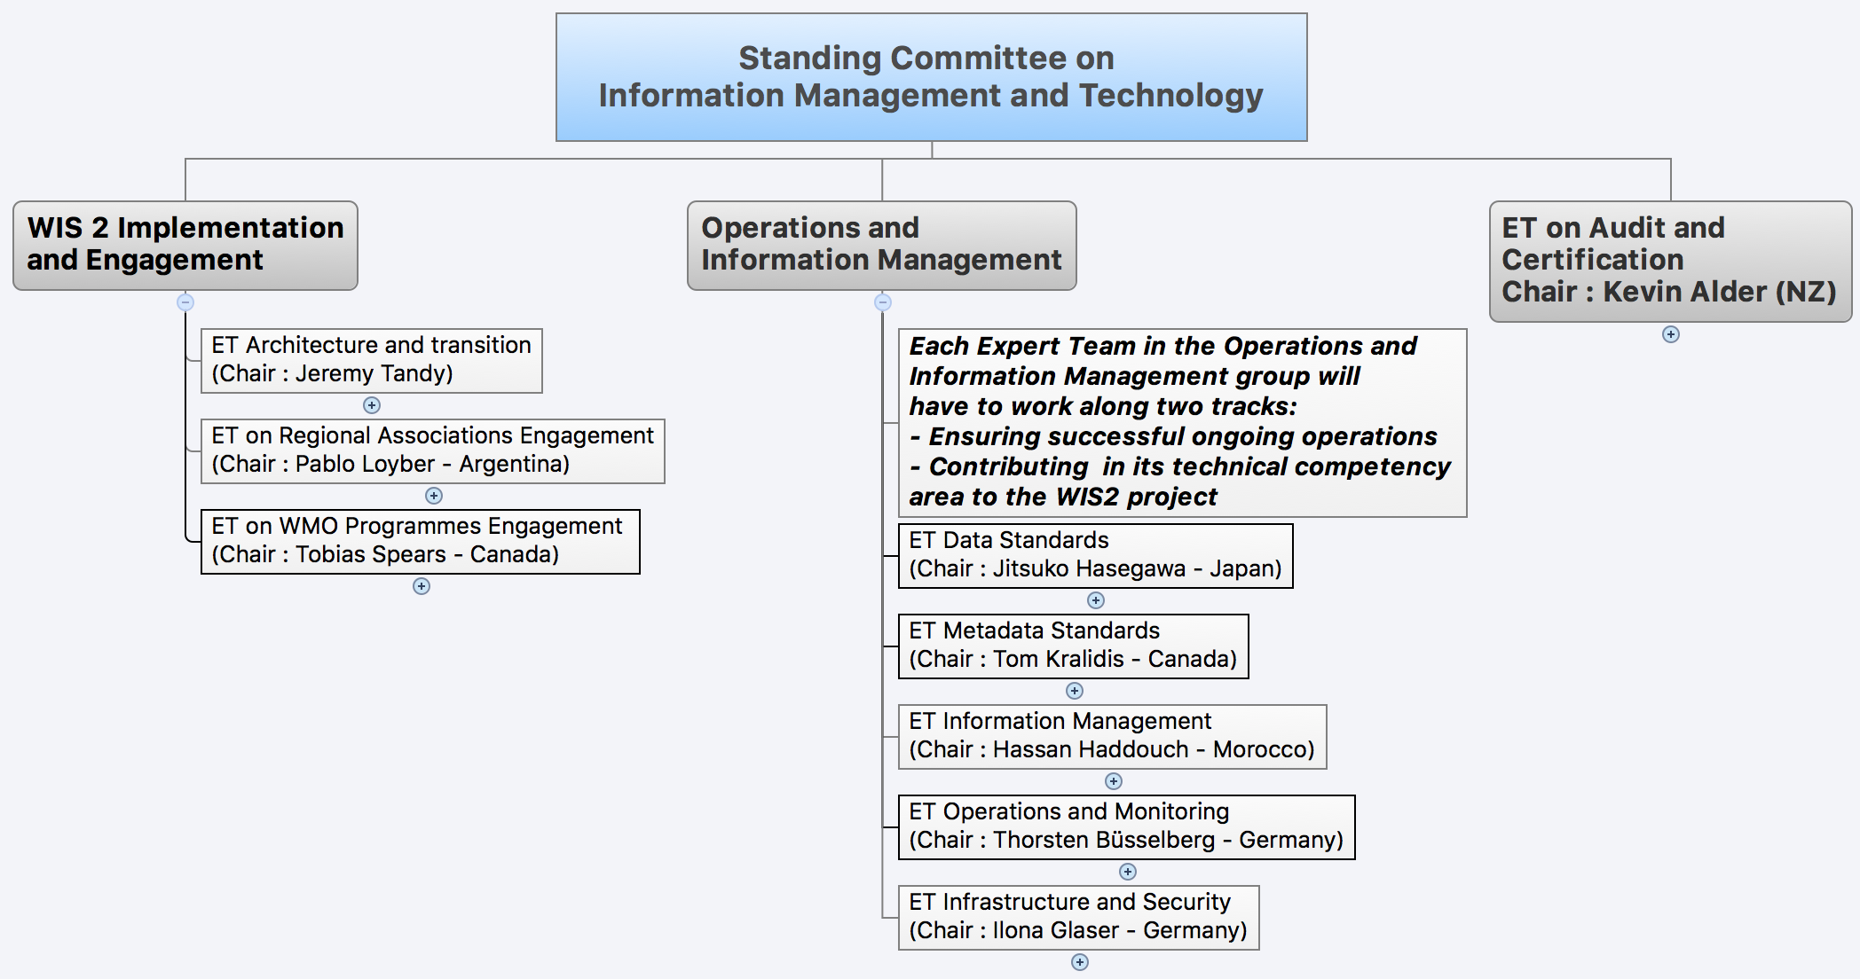
SC – IMT Structure
Notes:
A total of 22 Members : Chairs of SC-IMT and ET, members from all regions and program. 9 female and 13 male. From 3 to 5 members per regional association

Slide 9
SC-IMT Work Arrangements
SC-IMT works in a project control fashion
SC-IMT is the project, ETs are assigned work packages
SC-IMT: Project Board / direction setting
ETs: suppliers
SC-IMT areas
WIS 2 Implementation and Engagement
Operations and Information Management
ET on Audit and Certification

Slide 10
ET-Metadata Overview
Who are we?

Slide 11
ET-Metadata Membership
Name | Why / Role | Country
Mr Tom KRALIDIS | Chair (RA IV) | Canada
Mr Jörg KLAUSEN | Vice-Chair (RA VI) | Switzerland
Mr Guillaume AUBERT | Member (RA VI) | EUMETSAT
Mr Gao CHEN | Member (RA IV) | USA
Ms Lara FERRIGHI | Member (RA VI) | Norway
Ms Marta GUTIERREZ | Member (RA VI) | ECMWF
Ms Hanane KAMIL | Member (RA I) | Morocco
Mr Rainer MAERZ | Member (RA VI) | Germany
Mr Jan OSUSKY | Member (RA VI) | HMEI
Ms Julia SIELAND | Member (RA VI) | Germany
Ms Wang YING | Member (RA II) | China
WMO Secretariat
Ms Anna MILAN | WMO Secretariat
Mr Enrico FUCILE | WMO Secretariat
https://community.wmo.int/governance/commission-membership/commission-observation-infrastructures-and-information-systems-infcom/commission-infrastructure-national-representatives/infcom-management-group/standing-committee-information-management-and-technology-sc-imt/et-metadata

Slide 12
ET-Metadata Task Teams
Name | Why / Role | Country
Task Team on WIS Metadata (TT-WISMD)
Mr Tom KRALIDIS | Lead | Canada
Mr Guillaume AUBERT | Member (RA VI) | EUMETSAT
Ms Marta GUTIERREZ | Member (RA VI) | ECMWF
Ms Hanane KAMIL | Member (RA I) | Morocco
Mr Jan OSUSKY | Member (RA VI) | HMEI
Ms Julia SIELAND | Member (RA VI) | Germany
Task Team on WIGOS Metadata (TT-WIGOSMD)
Mr Jörg KLAUSEN | Lead | Switzerland
Mr Gao CHEN | Member (RA IV) | USA
Ms Lara FERRIGHI | Member (RA VI) | Norway
Mr Rainer MAERZ | Member (RA VI) | Germany
Ms Wang YING | Member (RA II) | China
WMO Secretariat
Ms Anna MILAN
Mr Enrico FUCILE

Slide 13
Terms of Reference and priority activities
What we do?

Slide 14
ET-Metadata Terms of Reference (ToR)
Review and further develop WMO standards for metadata and data exchange based on the W3C, OGC, and ISO TC211 19100 series of international standards (including XML) to meet the needs of Members, WIS, WIGOS, WMO Programmes and partner organizations such as ICAO,
Coordinate with WMO Programmes to identify best practices and standards in creating metadata that will enable users from outside the originator’s community to discover and identify that the data are relevant to them and develop recommended practices to achieve this end,
Contribute to the review of and recommend updates to the Manual on Codes (WMO No. 306) and the Manual on the WMO Information System (WMO-No 1060) and associated reference and guidance material as required, publishing these in suitable electronic forms for human and automated use,
Review and update the procedures for maintaining and developing the WMO Core Metadata Profile, WMO Logical Data Model (METCE), WIGOS Metadata Standard and other WMO standards for metadata and data exchange based on the W3C, OGC and ISO TC211 19100 series of international standards,
Propose to relevant bodies (ISO, OGC, W3C) changes to their respective standards that are required to meet the needs of WMO Members,
Lead the identification of tools to facilitate the metadata management lifecycle and assess and evaluate tools to allow users to create, publish, harvest and discover metadata, giving priority to tools for automated harvesting and editing. Prepare best practices and guidelines and cookbooks to support implementation,
Lead the implementation of a metadata quality assessment framework in order to recommend improved, relevant metadata for useful search and discovery and support the Expert Team on Operation and Monitoring on its implementation,
Facilitate search requirements, standards and related capabilities in the context of WMO discovery metadata search. Provide recommendations on addressable and actionable metadata linkages in support of shifting from a service-oriented architecture to a resource-oriented architecture; provide recommendations on mass market integration to lower the barrier and extend the reach of WMO data/metadata to mainstream search engines, as well as aligning with service discovery as needed,
Identify implementation issues requiring the urgent consideration of the SC-IMT.

Slide 15
ET-Metadata Task Teams
Task Team on WIS Metadata (TT-WISMD)
Develop and maintain WIS metadata code lists
Develop and maintain Key Performance Indicators (KPIs) and scoring guide
Develop and maintain quality assessment framework
Support WIS 2.0 search pilot
Task Team on WIGOS Metadata (TT-WIGOSMD)
Develop and maintain WIGOS metadata code lists
Develop and maintain Key Performance Indicators (KPIs)
Evolve WIGOS metadata model and representation
Cross cutting tasks
Evolve technical architecture/strategy of standards integration
Develop best practices and guidance materials for metadata management
WIS 2.0 transition/support
codes.wmo.int and associated Manuals

Slide 16
TT-WISMD Terms of Reference (ToR)
Develop and maintain WIS metadata codelists.
Develop and maintain WIS metadata key performance indicators (KPIs) to support a reporting mechanism.
Develop and maintain WIS metadata KPI scoring guide to provide a means of evaluating WIS metadata.
Research and identify tools for management of WIS metadata (editors, publishers, search clients/servers).
Develop and maintain tools to validate and score WIS metadata using the KPI rubric as a quality assessment framework.
Support WIS 2.0 discovery/search pilot to demonstrate harvesting, search of WIS metadata across GISCs.
Provide best practices cookbook on WIS metadata creation and transition to WIS 2.0.
Interact with TT-WIGOSMD to explore the merging of WIS and WIGOS Metadata Standards into one WMO Metadata Standard.
Regularly report to ET-Metadata on status and progress.

Slide 17
TT-WIGOS Terms of Reference (ToR)
Develop and maintain WIGOS metadata code lists for the WMO Manual on Codes.
Review and evolve the WIGOS metadata model based on ISO, OGC and W3C standards with a specific focus on documenting data quality and provenance.
Evolve the WIGOS Metadata Representation, exploring simplified XML, BUFR and alternative serializations.
Evolve and consolidate the documentation of the WIGOS Metadata Standard and contribute to the WIGOS Guide.
Develop and maintain WIGOS metadata key performance indicators (KPIs) to assess the completeness/quality of WIGOS metadata records.
Interact with TT-WIGOS Tools on documenting best practices for WIGOS metadata creation and use with WIGOS tools such as OSCAR.
Interact with TT-WISMD to explore the merging of WIS and WIGOS Metadata Standards into one WMO Metadata Standard.
Regularly report to ET-Metadata on status and progress.
Specifically, merge the existing WIGOS Metadata Standard document (WMO 1092) and the WIGOS Metadata Specification into a single reference document.

Slide 18
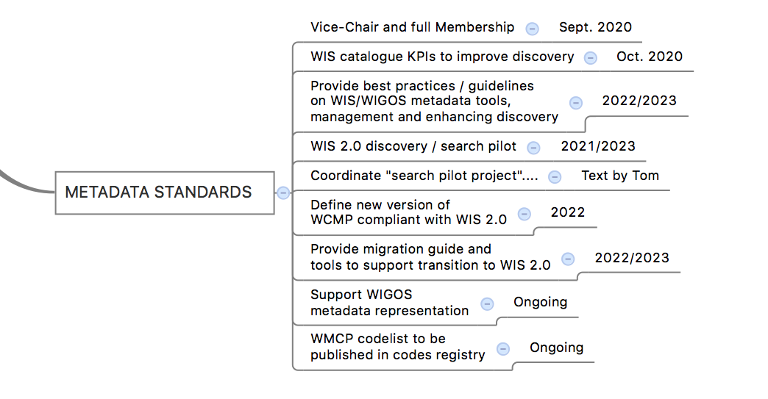
ET-Metadata Workplan

Slide 19
ET-Metadata Deliverables
WIS Metadata development and maintenance
WIS Metadata
WIGOS Metadata
KPIs for WIS Discovery Metadata
WMO Metadata quality assessment framework
Scoring rubric for WIS Discovery Metadata
WIS 2.0 search pilot
WIS 2.0 compliant Discovery Metadata
Best practices, guidelines on tools for WMO Metadata lifecycle

Slide 20
Linkages
TT-WISMD / TT-WIGOSMD cross cutting tasks
WIS 2.0
Metadata / search coordination
Transition
ET-OM (KPI implementation support)
ET-Data code lists (Common Code Tables)
ET-ACDM (WIGOS Metadata)
TT-WIGOS Tools

Slide 21
Manual on Codes and amendment procedure

Slide 22
WIS Metadata Standards
Standard | Sources | Publication | Related
WMO Core Metadata Profile and Code lists | GitHub | Manual on the WMO Information System (WMO-No. 1060) Part 1 Part 2 | Guide to the WMO Information System (WMO-No. 1061)

Slide 23
WIGOS Standards
Standard | Sources | Publication | Related
WIGOS Metadata Standard and Code lists | Metadata model and schemas Code lists | Manual on the WMO Integrated Global Observing System (WMO-No. 1160) WIGOS Metadata Standard (WMO-No. 1192) | Guide to the WMO Integrated Global Observing System (WMO-No. 1165) Common Code Tables https://github.com/wmo-im/cct

Slide 24
Amendment of Manuals
World Meteorological Congress functions
(d) To determine regulations prescribing the procedures of the various bodies of the Organization, in particular the General, Technical, Financial and Staff Regulations;
Three procedures for amending Manuals
Complex procedure
Standard procedure
Simple procedure (fast-track)

Slide 25
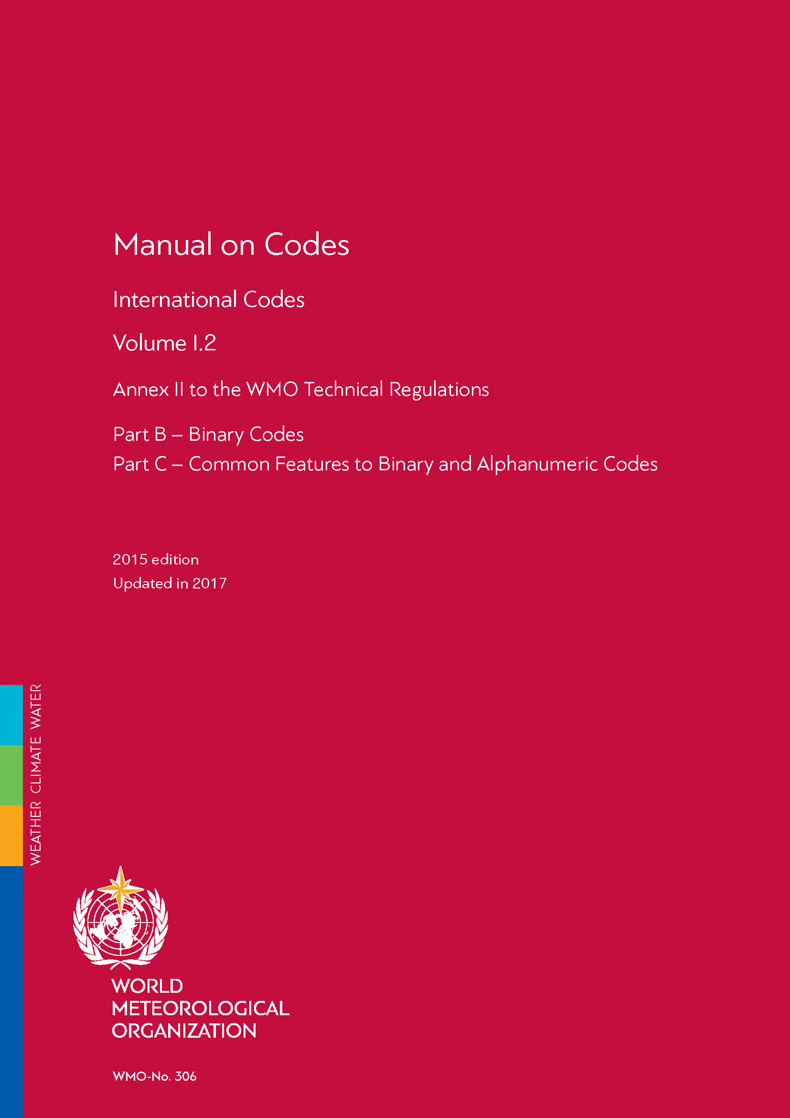
Amendment of Manuals Complex procedure
Expert Team
Draft proposal
SC-IMT
Endorse and
Submit proposal
INFCOM
Session
Approve and recommend
Requirement
Adopts amendments
Congress

Slide 26
Amendment of Manuals Standard procedure
Expert Team
SC- IMT Chair
INFCOM Pres.
Consultation with SERCOM
Members
Draft proposal
Approve and
Submit proposal for comments
Agree
Requirement
Informed
Adopts amendments
Executive Council

Slide 27
Amendment of Manuals Simple procedure (fast-track)
Expert Team
SC-IMT Chair
National Focal Points
Draft proposal
Approve and
Submit proposal for comments
Agree
President of INFCOM
Requirement
Approve
Adopts
amendments
President of WMO

Slide 28
Schedule and 2020-2021 milestones
How we work?

Slide 29
Architecture of participation
How we work?

Slide 30
GitHub
Repositories are found under https://github.com/wmo-im
Team members are strongly suggested to use GitHub, not emails, for any discussions to ensure transparency and openness and to keep records of team activity

Slide 31
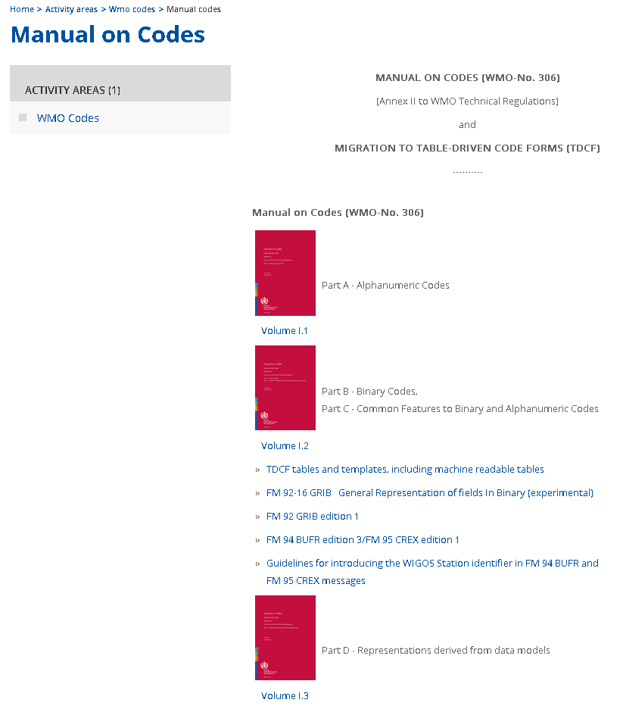
GitHub is our working area
GitHub is our WORKING area; information on GitHub is not considered authoritative or normative
Authoritative source is the WMO Manual on Codes
https://community.wmo.int/activity-areas/wmo-codes/manual-codes#Codes

Slide 32
ET-Metadata GitHub Repositories
WIGOS code tables
https://github.com/wmo-im/wmds
WIGOS metadata standard
https://github.com/wmo-im/wmdr
WMO Core Metadata Profile
https://github.com/wmo-im/wmcp
https://github.com/wmo-im/wmcp-docs (TBD)

Slide 33
Invitation to GitHub
Please ensure you have a GitHub account
Send your GitHub username to WMO Secretariat (Anna Milan: amilan@wmo.int)
Please ensure to use your full name in your Public profile
Update via https://github.com/settings/profile
Introductory sessions of the platform will be conducted by the Secretariat for different time zones. Date/time TBA

Slide 34
Meetings
MS Teams
ET-Metadata
Is 11h UTC a suitable time for everyone?
TT-WISMD and TT-WIGOSMD
Kick-off meetings (TBD)

Slide 35
Document Management
ET-Metadata
Document management
TT-WISMD
Document management
TT-WIGOSMD
Document management

Slide 36
AOB

Slide 37

Thank you
Merci

