Slide 1
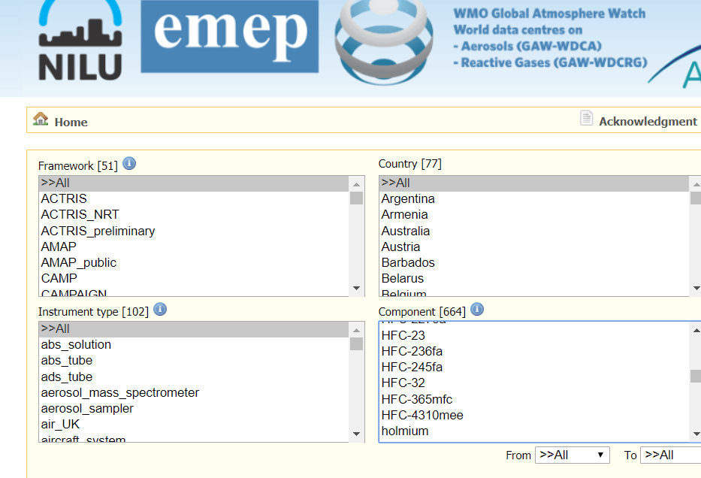

Slide 2
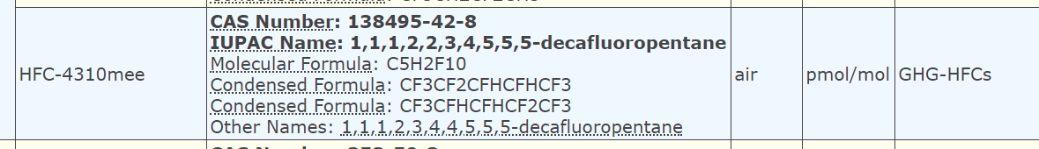

Slide 3
Mapping of EBAS metadata to WMDR
Currently using WMDR 1.0RC9.

Slide 4
Mapping is an issue
Code table not working http://codes.wmo.int/wmdr
Currently the latest version of the codes lists are on GitHub: https://github.com/wmo-im/wmds/tree/master/tables_en
We need to map metadata from CF standard/EBAS IUPAC names to WMO codes.
We need to map:
Obseved variables
Units
Program affiliation
And other potential metadata elements

Slide 5
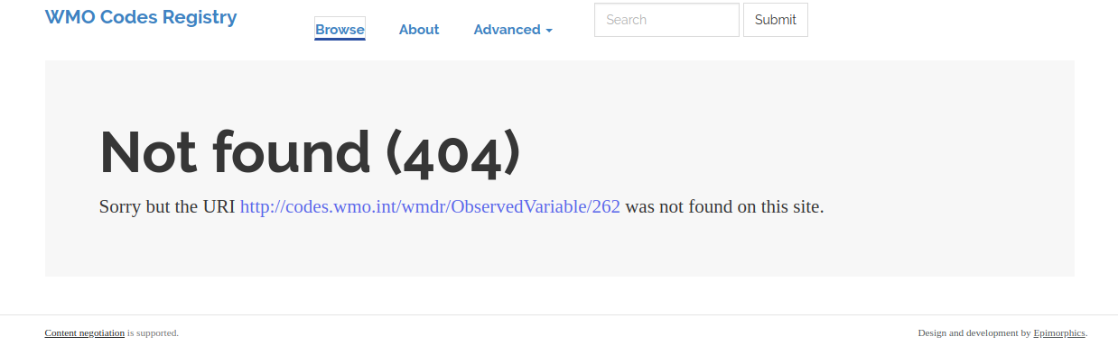
WMO code lists
Examples from latest release candidate not working
<om:observedProperty xlink:href="http://codes.wmo.int/wmdr/ObservedVariable/262"/>

Slide 6
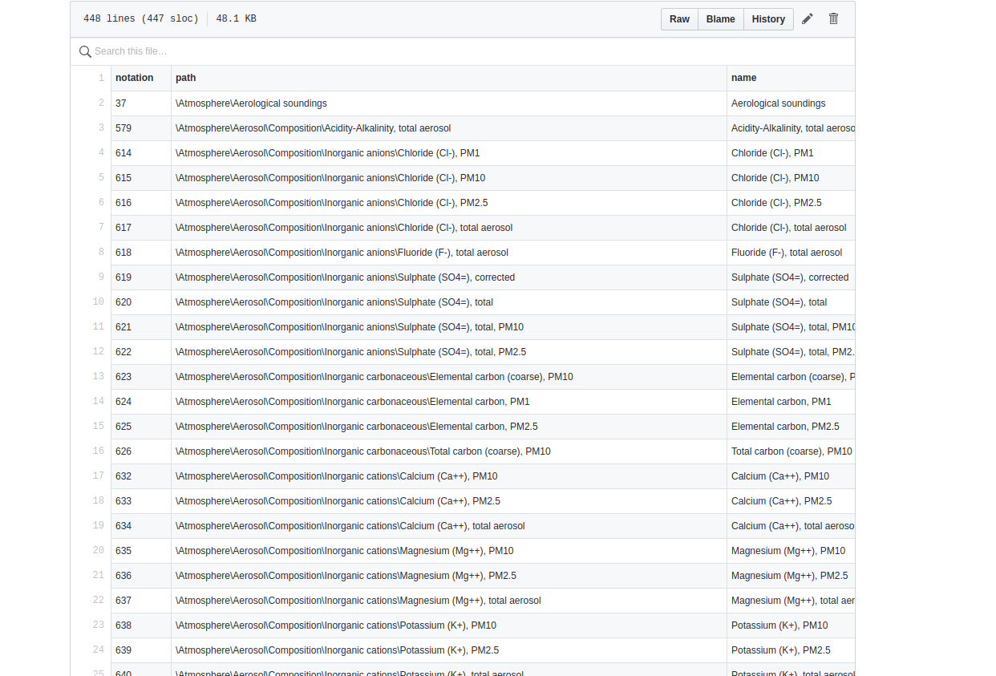
How do we refer to the code list
https://github.com/wmo-im/wmds/blob/master/tables_en/1-01-01.csv

Slide 7
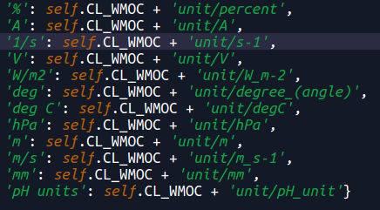
WMO codes found

Slide 8
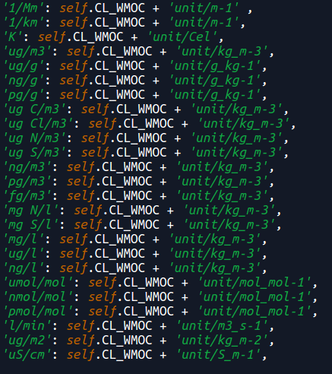
Same base unit, OK, or create new unit in WMO codes?

Slide 9
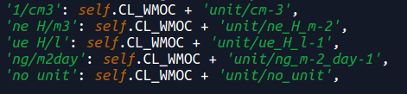
WMO codes not found, just made up some names

Slide 10
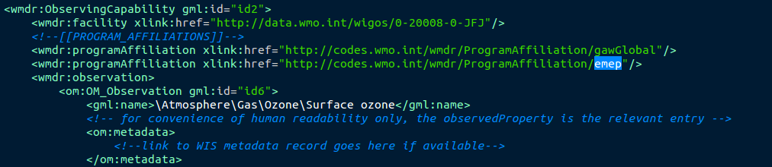
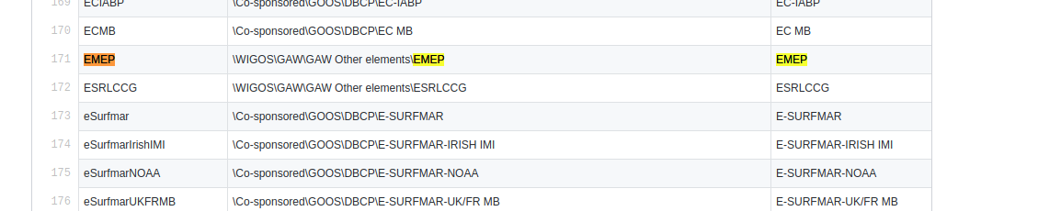
Example WIGOS metadata record vs. Code table on github

Slide 11
Tool not in synch with how fast we conduct the mapping (https://github.com/wmo-im/wmds/blob/master/tables_en/1-01-01.csv)
{"id":40073,"xmlStatus":"SUCCESS_WITH_WARNINGS","logs":"The list below is organized by section header and shows exceptions/issues – if any – that may have resulted from the processing of the XML (NB: Section headers are always displayed).\n# ObservingCapability of facility with identifier \"0-20008-0-SMR\"\nREF_5: ReferenceType for \"OM_Observation/programAffiliation/programAffiliation xlink:href\" with URL \"http://codes.wmo.int/wmdr/ProgramAffiliation/GAW-WDCA_NRT\" could not be found. Information for \"OM_Observation/programAffiliation\" is discarded.\nREF_5: ReferenceType for \"OM_Observation/programAffiliation/programAffiliation xlink:href\" with URL \"http://codes.wmo.int/wmdr/ProgramAffiliation/NOAA-ESRL_NRT\" could not be found. Information for \"OM_Observation/programAffiliation\" is discarded.\n"}ror@RORLUX:~/repos/validate$

Slide 12
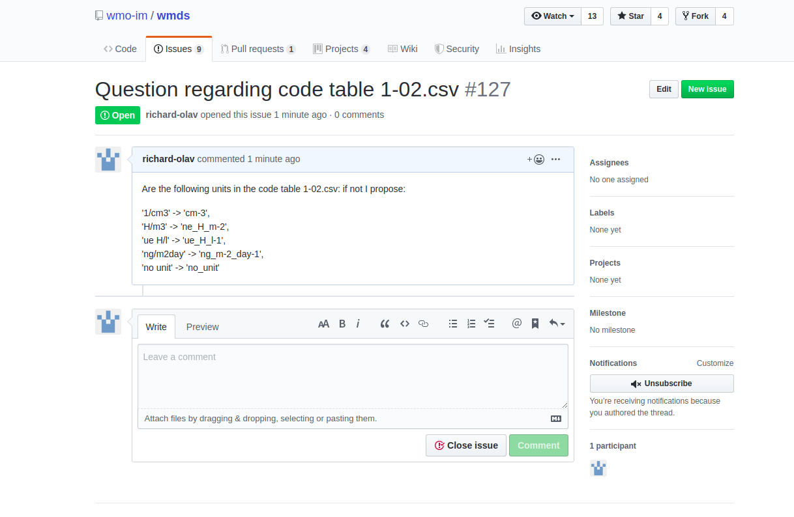
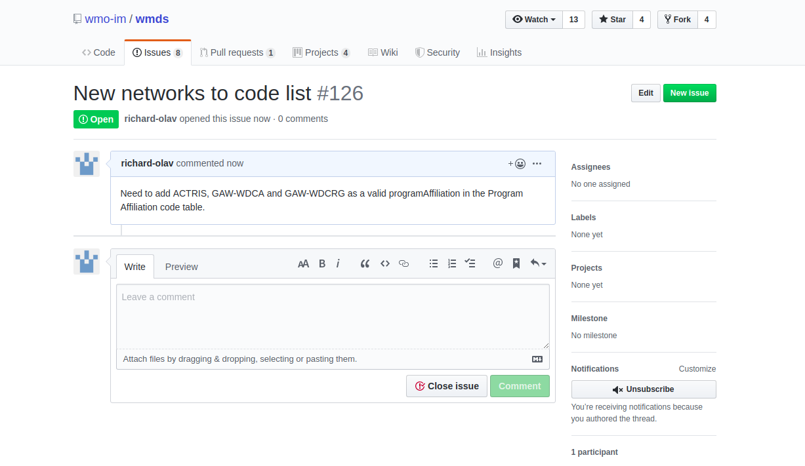
Raising issues for adding missing metadata elements (will take time, need to decide how to best solve this)

Slide 13
CF vs. WMO codes
Is there any work done with harmonization of WMO codes and the CF standard?
The CF standard seems more mature, and is widely adopted in ACTRIS and WIS among other infrastructures
Maybe some automated procedure to map CF standard names -> WMO codes

Slide 14
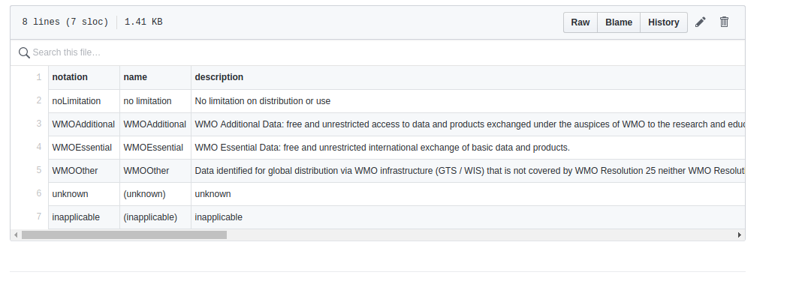
Should we include licensing and not only WMO data policies?

Slide 15
Currently
Working on submitting a small subset of EBAS metadata via the APIs and M2M access of WIGOS data/metadata:
https://oscardepl.meteoswiss.ch/surface/rest/api/wmd/upload
Setting up new version of the metadata server that is validating according to the latest version WMDR 1.0RC9.
Need to fix examples in the latest release candidate (https://github.com/wmo-im/wmdr/releases/tag/v1.0RC9), not complying to the latest version of the wmdr schema.

Slide 16
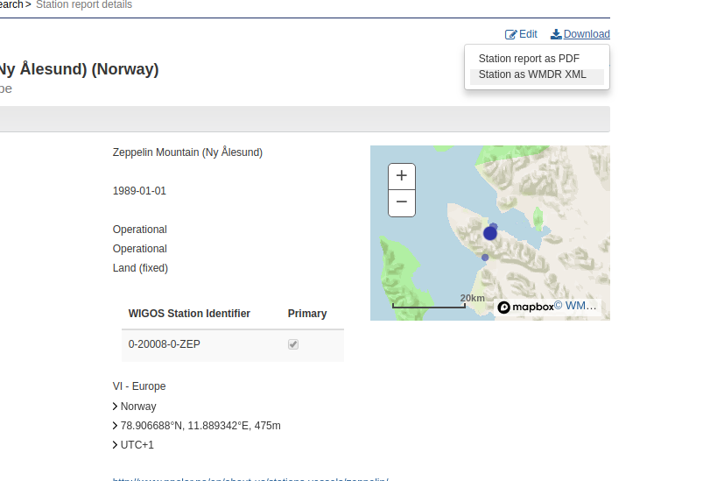
Both examples from the latest release candidate and the downloadable WMDR xml from OSCAR, does not validate for the OSCAR M2M tool. It would be usefull to have a updated example of WIGOS observational metadata. Since EBAS WMDR metadata now validates according to schema but not according to the M2M tool.
ror@RORLUX:~/Desktop/wmdr-1.0RC9/examples$ curl -X POST -d "@/home/ror/repos/validate/wmdr_example_observations_0-20000-0-06730.xml" https://oscardepl.wmo.int/surface/rest/api/wmd/upload --header "Content-Type:text/xml" --header "X-WMO-WMDR-Token:bb7a7e38-6be5-40d6-9362-34fc76639e69"
{"id":40102,"xmlStatus":"SUCCESS_WITH_WARNINGS","logs":"The list below is organized by section header and shows exceptions/issues – if any – that may have resulted from the processing of the XML (NB: Section headers are always displayed).\n# ObservingCapability of facility with identifier \"0-20000-0-06730\"\nREF_5: ReferenceType for \"Deployment/applicationArea\" with URL \"\" could not be found. Information for \"Deployment/applicationArea\" is discarded.\nREF_5: ReferenceType for \"Reporting/uom\" with URL \"http://codes.wmo.int/common/unit/ppbv\" could not be found. Information for \"Reporting/uom\" is discarded.\nREF_5: ReferenceType for \"Reporting/uom\" with URL \"http://codes.wmo.int/common/unit/ppbv\" could not be found. Information for \"Reporting/uom\" is discarded.\n"}ror@RORLUX:~/Desktop/wmdr-1.0RC9/examples$

