Slide 1
Introduction & Overview of WP 3 (Data Federation & Uptake)
+++
J. Klausen, Julian Meyer-Arnek
MeteoSwiss
ET-WDC Telecon, 2017-03-14

Slide 2
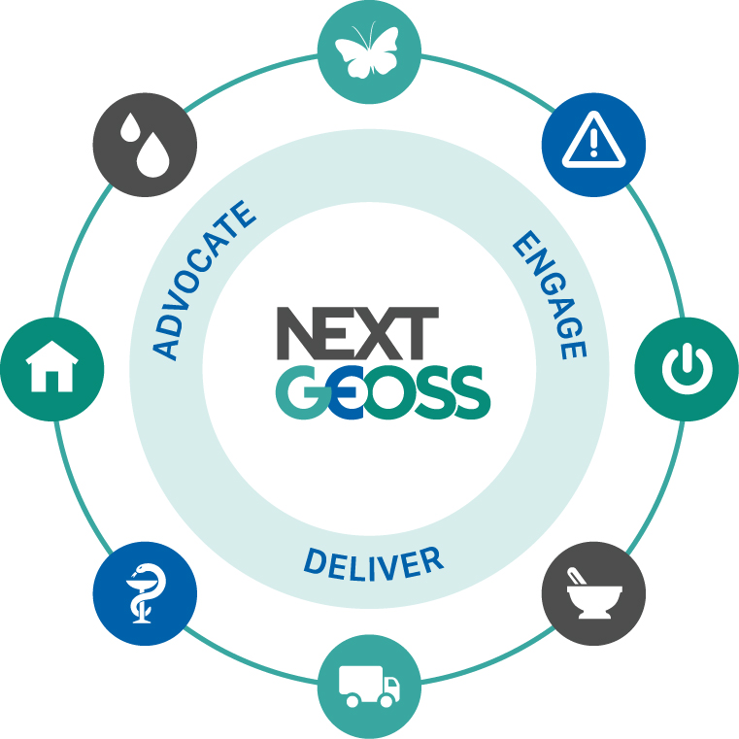
Project objectives
NextGEOSS Objectives
1. Engage communities
promoting innovative GEOSS powered applications from Europe
2. Deliver the next generation data hub
and Earth Observation exploitation for innovation and business
3. Advocate GEOSS as a sustainable European approach
for Earth Observation data distribution and exploitation
NextGEOSS is an opportunity for GAW to begin to realize the vision of a «Federated GAW Data Infrastructure»

Slide 3
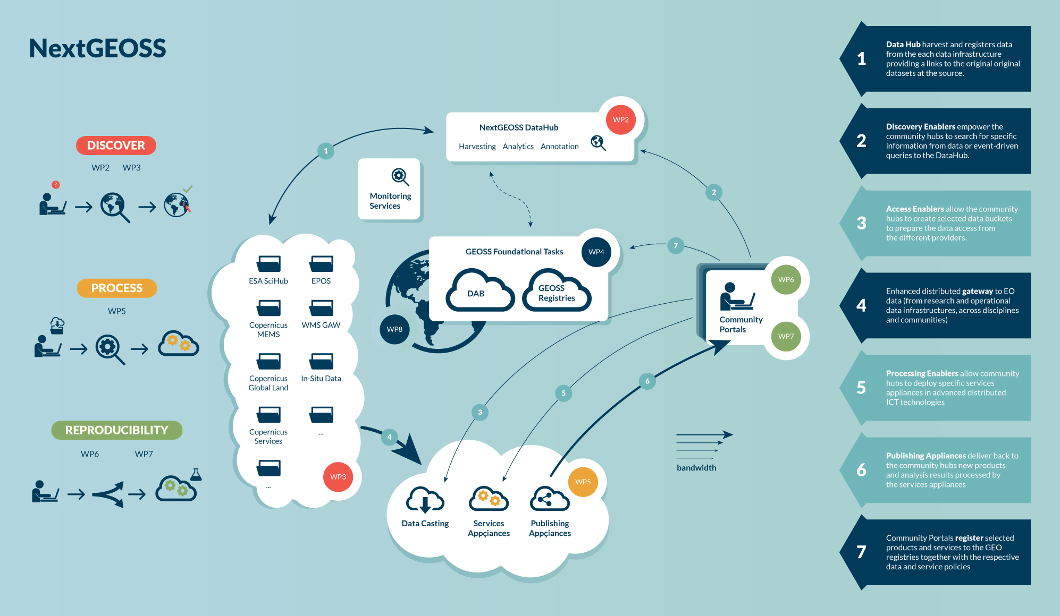
Global Picture
Metadata Interface
Data Access Interface
Notes:
Use this type of slide for images

Slide 4
Main tasks WP3
Access to Copernicus Sentinel data (Task 3.1)
Land (Task 3.2)
Marine (Task 3.3)
Atmosphere (Task 3.4)
Citizen Observatories (Task 3.5)
Commercial Providers (Task 3.6)
DLR + NOA
VITO
CLS
MeteoSwiss + WMO + NILU + ARMINES + DLR
OGC + BLB
DLR + DMI
Notes:
Important players in the European context are brought together:
Connecting with Copernicus Collaborative Ground Segments, brought about by DLR and NOA, as well as with Copernicus Land, Marine and Atmosphere.
The involvement in the data sources tasks of WP3 of the some of the main players in the establishment and supply of these services, such as DLR, VITO, ALTA, MeteoSwiss, WMO, NILU and EURODYN, together with the citizen observatories brought about by OGCE and BLB and commercial data providers including DLR and DMI, represent a very significative component of the European EO landscape. Additionally, further sources are expected to be engaged in NextGEOSS through the engagement efforts lead by OGCE in WP4, and supported by the majority of the project partners.

Slide 5


Main expected achievements
National weather services
WDCRG
WDCA
OSCAR
WOUDC
…
WDCGG
…
…
…
NDACC
…
Adapted from Jörg Klausen, MeteoSchweiz

Slide 6
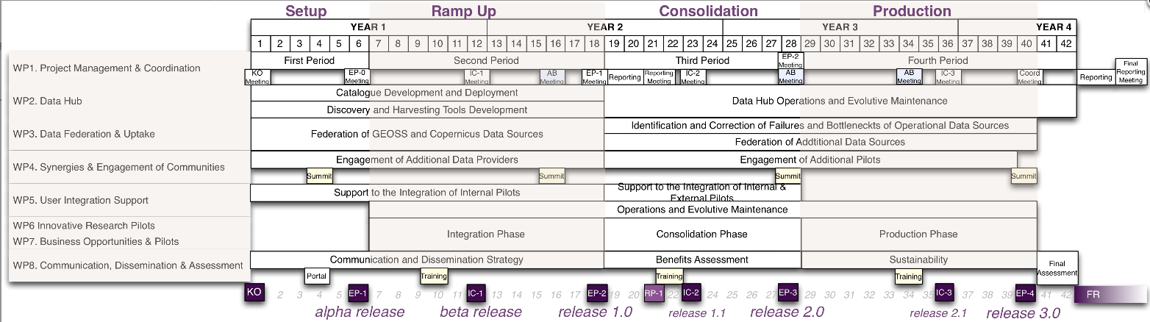
Timeline

Slide 7
The GAW Perspective

Slide 8
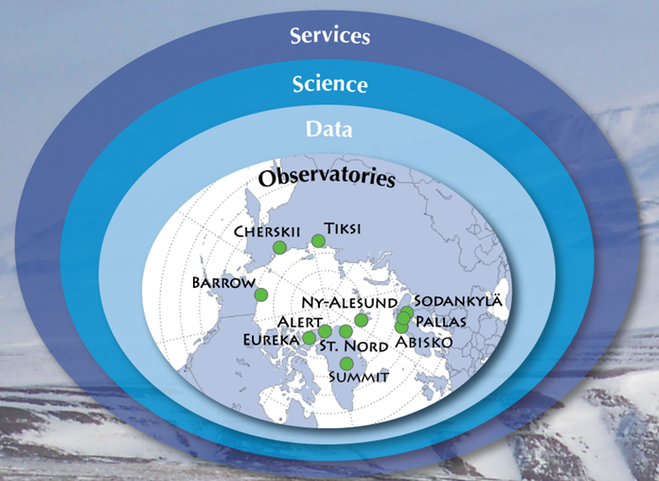
NextGAW
Standardize discovery, access and retrieval
Standardize exchange formats
Understand observations
Combine observations & models
Develop products
Standardize metadata formats
Standardize data formats
Standardize observing techniques
Provide data quality objectives

Slide 9
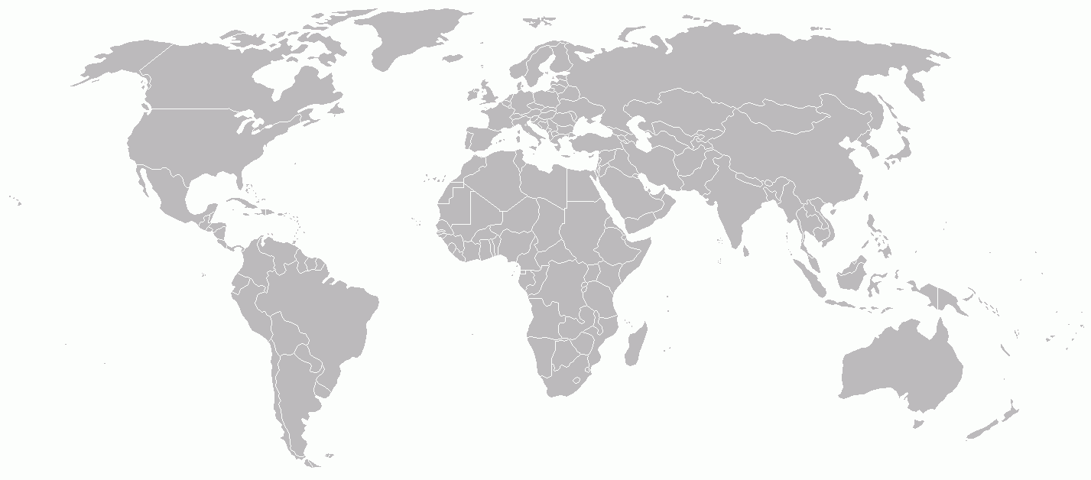


Virtual “GAW Data” Centre
Providers
WOUDC Ozone/UV
Users
WRDC
Radiation
WDCPC
Precip Chem
WDCGG
Greenhouse Gases
WDCA
Aerosols
WDCRG
Reactive Gases
WDC-RSAT
Satellites
IDAF
IMPROVE
MPLNET
NADP
NOAA/ESRL/GMD
SHADOZ
SKYNET
TCCON
[Satellite archives]
…
AD-Net
AGAGE
ALINE
BSRN
CAPMoN
CASTNET
CDIAC
EANET
EBAS (NILU)
EARLINET
Data & Metadata Submission
Data & Metadata Dissemination
Virtual “GAW Data” Centre

Slide 10

Federated GAW data architecture (II)
n.r.t. data submission
5
Inst
WDC
CDC
WDC
CDC
serve metadata
web service request
1
WDC
CDC
2
3
operator
delayed mode data submission
?
retrieve data + metadata
6
query
for data
GAWSIS
4
user

Slide 11
Tentative road map for metadata
Migrate GAWSIS from Empa to MeteoSwiss, integration with OSCAR/Surface, by mid-April 2016
Extend GAWSIS API to be compliant with WIGOS Metadata Standard (WMDS)
Draft specification for OGC-compliant XML schema, by mid-April ‘16
Review by WMO expert teams, by mid-May ‘16
Test API in context of OSCAR/Surface
Pilot projects with DWD, MeteoSwiss, BoM?, UKMO?
Connect GAW WDCs
First, use existing sources, by mid-July ‘16
Later, use GAWSIS API (requires changes at WDCs), by mid ‘17
Connect GAW Contributing Data Centers (GAW CDCs), by end ‘17

Slide 12
Tentative road map for data
ET-WDC + GAW CDC managers to agree on data exchange specification, by mid 2017
Implement web services at WDCs, CDCs to make data available in this format (amongst others); alternatively, implement a central harvester and pre-processor web service
Test beds at WDCA, WDC-RSAT, WOUDC, by mid 2018
Adoption by WDCGG, WRDC, CDCs asap

