Slide 1

Introduction of EANET (Acid Deposition Monitoring Network in East Asia):
Cooperation with WMO/GAW and new data base
Keiichi Sato
Network Center for EANET
Data Management Department, Asia Center for Air Pollution Research
E-mail for data inquiry: eanetdata@acap.asia
1
Notes:
1

Slide 2
Progress of the cooperation between
EANET and WMO/GAW
2
Notes:
2

Slide 3
Relationship between EANET and WMO
EANET has been closely related with WMO for a long time.
WMO officer participated in EANET meetings as an observer and workshops organized by the EANET Network Center and Secretariat.
Some experts involved in EANET activities have contributed to WMO/GAW as a member of SAGs for Precipitation Chemistry and Reactive Gases.
WMO/GAW acknowledged cooperative partner networks of precipitation chemistry measurement including EANET.
The Network Center (NC) and some laboratories in EANET member countries are participating laboratory inter-comparisons of wet deposition samples.
3

Slide 4
Timeline until signing LoA
November, 2017 | The revised draft of the LoA according to comments received by 19th Intergovernmental Meeting of EANET (IG19) was circulated to the National Focal Points.
January, 2018 | Secretariat compiled the comments and suggestions from participating countries. Clean draft (with comments provided as attachment) was circulated to participating countries.
February, 2018 | NC consulted with WMO for comments on the draft LoA.
April, 2018 | There was no more comments from the participating countries and no content changes on the draft LoA.
August, 2018 | LoA was signed by the Chairperson of IG19 and the Deputy Secretary General of WMO.
4

Slide 5
List of items for cooperation (described in LoA)
[Atmospheric composition]
SO₂, O₃, NO, NO₂, HNO₃, HCl, NH₃, PM₁₀, PM_{2.5},
Components in TSP (SO₄²⁻, NO₃⁻, Cl⁻, NH₄⁺, Na⁺, Mg²⁺,
K⁺ and Ca²⁺).
[Precipitation chemistry]
Precipitation amount, pH, conductivity, and concentrations
of SO₄²⁻, NO₃⁻, Cl⁻, NH₄⁺, Na⁺, Mg²⁺, K⁺ and Ca²⁺.
[Meta data]
Site location (Latitude, Longitude, Height), Characteristics
of sites (Remote, Rural, Urban), Monitoring items, Sampling
interval of each items, Monitoring duration, Monitoring
Instruments.
5

Slide 6
Activities of EANET within the framework cooperation
(described in LoA)
Assign to the stations of the EANET the status of "GAW Contributing Station" in appropriate GAW/WMO databases, web pages, and other publications
Provide information for all stations in EANET for WMO/GAW
Provide the GAW Station Information System (GAWSIS) with a list of sites from the relevant networks and relevant metadata
Maintain current metadata descriptions on the EANET website that may be used in GAWSIS
Establish a link from the EANET website to the homepage of the WMO/GAW World Data Centre for Reactive Gases and Precipitation Chemistry as well as to GAWSIS
Allow WMO/GAW to freely use of EANET data followed by the data disclosure policy of EANET described in the Detailed Mechanism of the Procedures on Data and Information Disclosure (EANET/SAC 3/6/2_rev).
6

Slide 7
Activities of WMO/GAW within the framework cooperation
(described in LoA)
Run the network according to the principles shown in Guidelines for Acid Deposition Monitoring in East Asia, Technical Manuals and related EANET policies and publications
Establish links from GAWSIS and the WMO/GAW World Data Center for Reactive Gases and Precipitation Chemistry to the data archive of the EANET network
Collect EANET data and products for uses intended for WMO/GAW products, such as assessments and bulletins
Acknowledge EANET, where appropriate, for the contribution to the WMO/GAW Programme, including on its web pages
Allow EANET to freely use of WMO/GAW data followed by the data disclosure policy of WMO
7

Slide 8
Draft work plan of cooperation with WMO/GAW in 2018/19
Provide list of all current operating atmospheric monitoring stations of EANET for the WMO/GAW
Provide necessary information on atmospheric monitoring stations of EANET for the GAW Station Information System (GAWSIS)
Discuss and exchange information on monitoring database
- The NC is currently developing a new data downloading
system for EANET website by considering the database
format to increase user-friendliness.
Provide link to the World Data Centers (WDCs) homepage and GAWSIS at EANET website
- The NC and the Secretariat is currently revamping the
EANET website.
Start discussions on a joint event in the 10th International Conference on Acid Deposition
8

Slide 9
New EANET data request registration
and download system
9
Notes:
9

Slide 10
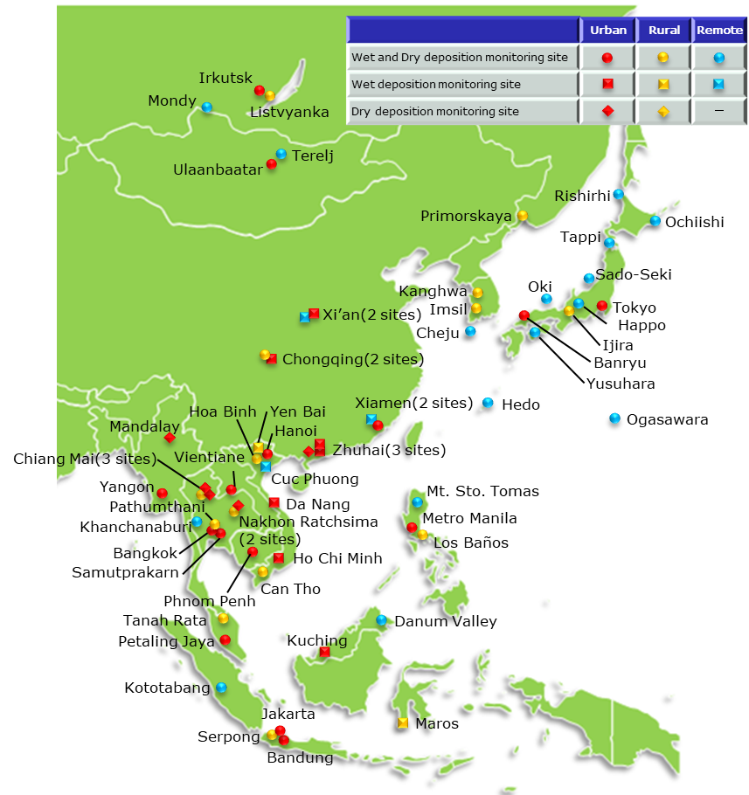
Characteristics of EANET data (1): Spatial and temporal coverage
Atmospheric
sites in 2017
13 EANET countries reported atmospheric monitoring (wet,
air concentration) data in 2017.
The number of atmospheric monitoring sites are 62 sites, including 27 urban, 16 rural, and 19 remote sites.
Soil and vegetation monitoring and monitoring on inland aquatic environment are conducted at 31 plots in 10 countries and 19 lakes/rivers in 11 countries, respectively.
Most of the ecological monitoring sites are corresponded to the deposition monitoring sites.
Historical data since 2000 are included. Historical record of EANET monitoring site name is shown in Web page.
10
Notes:
10

Slide 11
Characteristics of EANET data (2): Time resolution
Monitoring items | Subitems | Time resolution
Wet deposition | Precipitation chemistry | Daily, Weekly
Dry deposition (Air concentration) | Automatic air monitor | Hourly, Daily, Monthly
 | Manual monitor (Filterpack, Passive sampler) | Weekly, Bi-weekly, Monthly
Soil & Vegetation | Soil chemistry | Once in 3 or 5 years
 | Observation of tree decline | Once a year
Inland aquatic | Inland water chemistry | 2, 3, 4, 5 or 6 times/year
Catchment | Stream water chemistry Water discharge | Bi-weekly
[Example of hourly data use]
Comparison of diurnal O3 conc. between observation and model at EANET sites
Spring
Summer
Autumn
Winter
Li et al., Atmos. Chem. Phys. Discuss., https://doi.org/10.5194/acp-2018-1283 (2019)
11
Notes:
11

Slide 12
Characteristics of EANET data (3): QA/QC
Each monitoring station should follow monitoring guidelines to obtain reliable data that can be comparable among the countries of the East Asian region and with other networks.
Guidelines for Acid Deposition Monitoring in East Asia
QA/QC Guidebook For EANET
[published in 2016]
<Contents>
Development of National QA/QC Program
Management of records, monitoring procedures
Preparation of standard operating procedures (SOPs)
Preparation of National Monitoring Plan (NMP)
Site/Laboratory Audit
Technical Manual for Wet Dep.
[revised in 2010]
Technical Manual for Dry Dep. Flux Est. [published in 2010]
Technical Manual for Air Conc. Monitoring [published in 2013]
Technical Manual for S&V
[published in 2000]
Technical Manual for IAE
[revised in 2010]
Guideline for Catchment-scale
[published in 2010]
12
Notes:
12

Slide 13
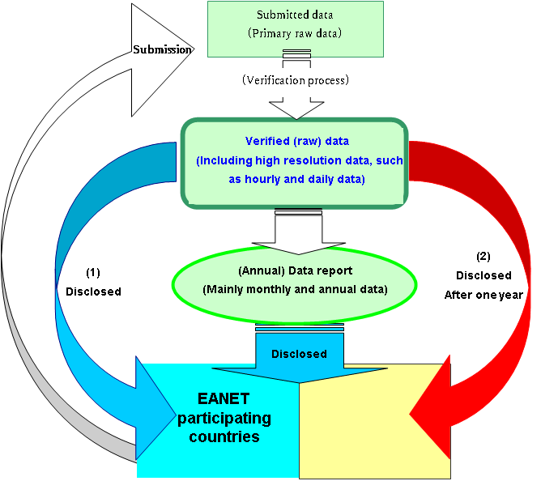
Procedures on EANET data disclosure
Disclosure of “Verified (raw) data”
For the EANET participating
countries
“Verified (raw) data” would be
disclosed immediately for
the National Focal Points
after verification and
endorsement by SAC,
and disclosed for scientists
upon their requests.
(2) For outside of EANET
“Verified (raw) data” would be
disclosed one year after
confirmation/evaluation by SAC.
13
Notes:
13

Slide 14
New EANET raw data request procedure
Data user
Network Center (ACAP)
Input online registration form for EANET raw data request at Website
Submit information
Receive information on requester
Automatic confirmation
Internal check
Receive ID and PW for raw dataset
archive
E-mail automatic delivery
Approve for
data request
Input access
permission data
Download via Internet
Receive raw data
Raw dataset
archive
14
Notes:
14

Slide 15
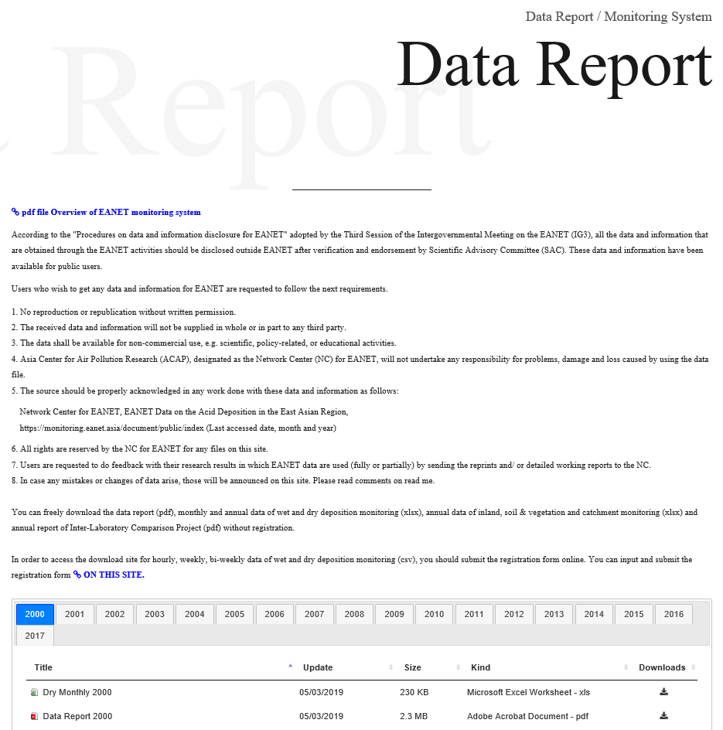
Data report and Interlaboratory report in new EANET Web page
https://monitoring.eanet.asia/document/public/index
Files can be downloaded without ID & PW.
Note for data usage
Overview of EANET monitoring system
Data Report
→ pdf format
Monthly and annual data of
wet and dry deposition
→ xlsx format
All data of soil and vegetation,
inland and catchment
→ xlsx format
Inter-Laboratory Comparison
Project Report
→ pdf format
15
Notes:
15

Slide 16
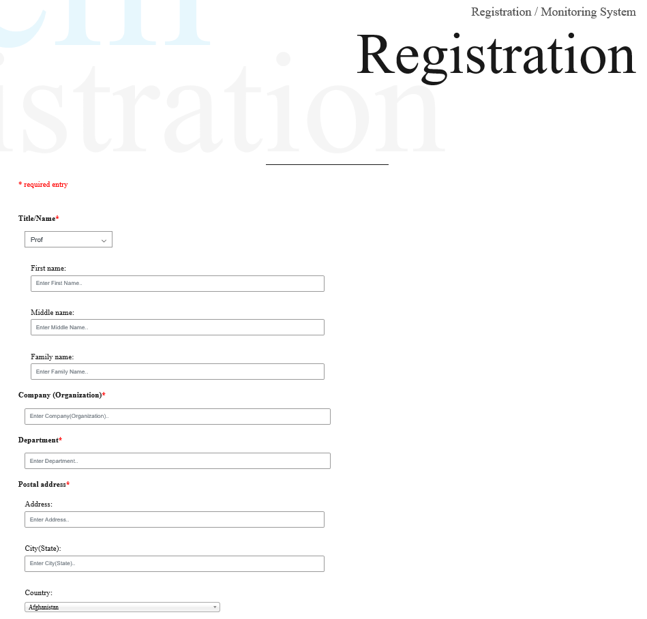
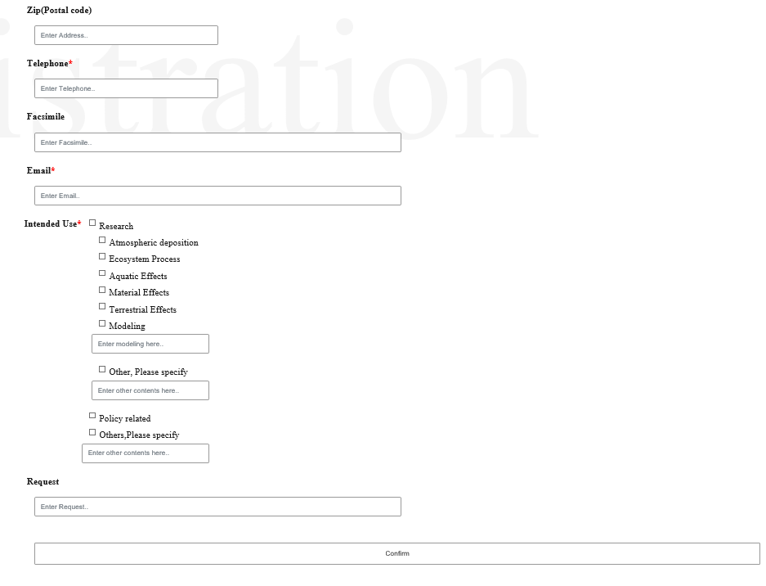
Online registration form for EANET raw data request
https://monitoring.eanet.asia/document/register/index
The registration form should be submitted online, in order to download the following data.
Hourly, weekly, bi-weekly data of wet and dry deposition monitoring
→ csv format
The data user should input information on register (shown left) and submit.
After approval, ID and
PW for data archive
access will be sent by
E-mail.
16
Notes:
16

Slide 17
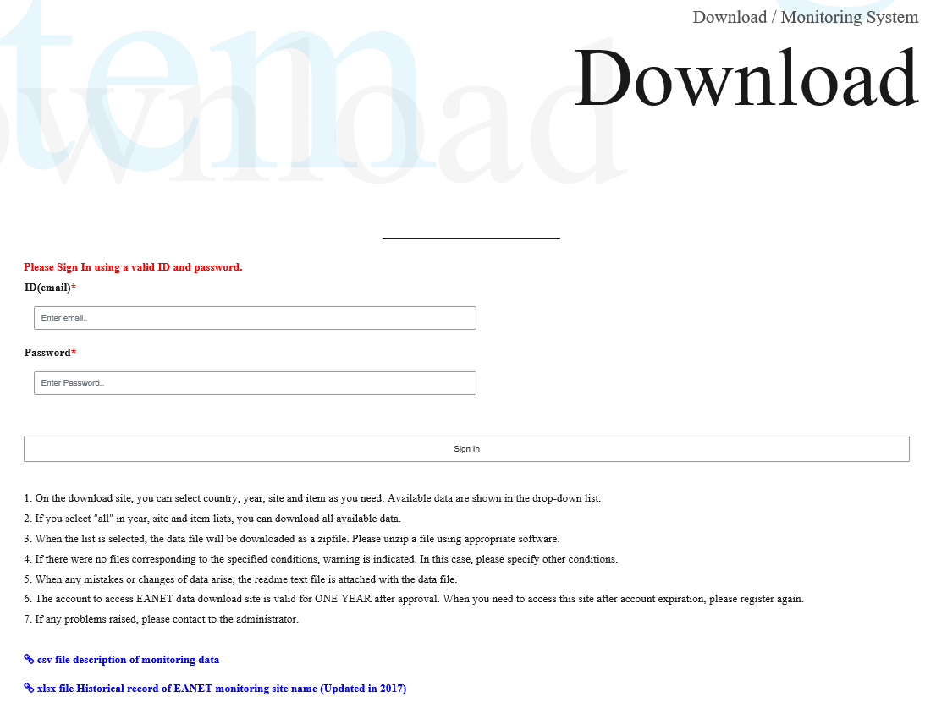
Sign in page for EANET raw data archive
https://monitoring.eanet.asia/document/signin
Input ID and PW
(Valid for one year, after that you must re-register.）
Note for data download
Description of monitoring data file
17
Historical record of EANET monitoring site name
Notes:
17

Slide 18
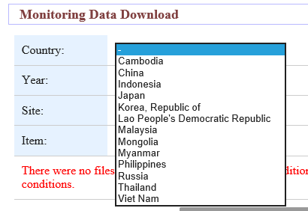
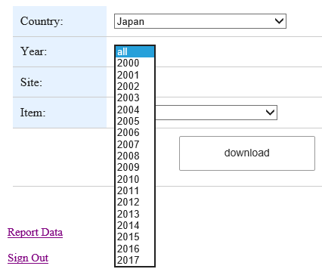
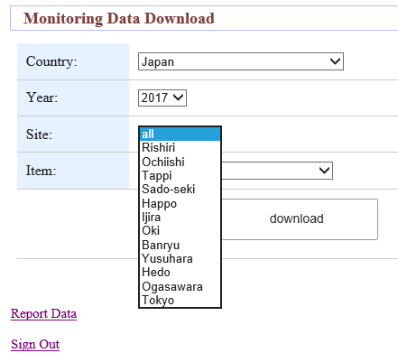
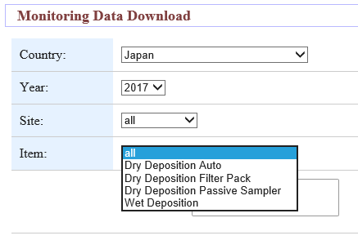
Download page for EANET raw data archive
Choose pull down menu to download.
Select
menu and
click download
18
Notes:
18

Slide 19
Request for acknowledgement of EANET data source and sending reprints and/or reports
The source should be properly acknowledged in any work done with EANET data and information as follows:
Network Center for EANET, EANET Data on the Acid Deposition
in the East Asian Region,
https://monitoring.eanet.asia/document/public/index (Last accessed date, month and year)
Users are requested to do feedback with their research results in which EANET data are used (fully or partially) by sending the reprints and/or detailed working reports to the Network Center.
19
Notes:
19

