Slide 1
Atmospheric Composition Variable Standard Name Recommendations
Morgan Silverman, Gao Chen, Michael Shook, and many others

Slide 2
Why Are Atmospheric Composition Variable Standard Names Needed?
In airborne field studies, variable names are given by the PIs to characterize the physical phenomena or to represent the quantity that is being measured (e.g., O₃, H₂O).
PIs often add additional information to their variable names to identify units and/or instruments used (e.g. O3_ppbv, DLH_H2O_ppmv).
Each data set needs its own identity (i.e. different variable names to distinguish between measurements)
Particularly important for ASCII files (majority of in-situ airborne atmospheric composition data files)
Having a unique identity can create problems for data users to search across missions or understand the variables.
Common to have multiple instruments measure mission critical variables in the same campaign (NO2_MixingRatio_LIF, NO2_MixingRatio).
Across different campaigns, the same variable is repeatedly measured, but given different names.

Slide 3
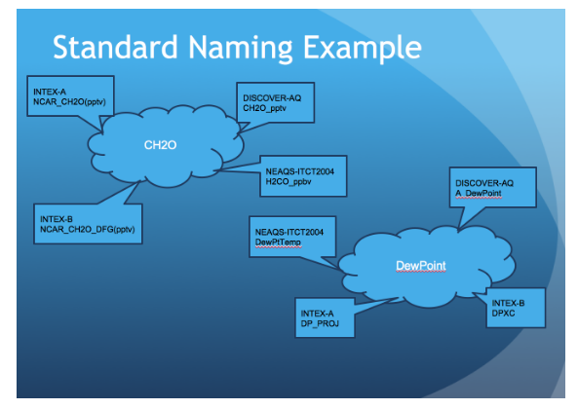
Why Are Atmospheric Composition Variable Standard Names Needed?

Slide 4
Proposed Atmospheric Composition Variable Standard Names
Constructed using controlled vocabulary with four parts separated underscores: MeasurementCategory, CoreName, MeasurementMode, DescriptiveAttributes.
Standard Name = MeasurementCategory_CoreName_MeasurementMode_DescriptiveAttributes
This structure is similar to that of the Climate and Forecast Metadata Convention (CF) and the Geoscience Standard Names (GSN) ontology.
It is designed to support data discovery, distribution, and use, by accurately describing all variables from different measurements/instruments while using a consistent format for interoperability.
Notes:
For data discovery, the MeasurementCategory and CoreName can be used to conduct a broad search to identify all measurements of the same physical quantity from different instruments and/or field studies. The DescriptiveAttributes can then be used to narrow down the search for data of interest. As discussed in later sections, the number and nature of DescriptiveAttributes are dependent on the type of measurement.

Slide 5
Proposed Atmospheric Composition Variable Standard Names
Standard Name = MeasurementCategory_CoreName_MeasurementMode_DescriptiveAttributes
MeasurementCategory: Broadly groups all measurement standard names into 1 of 12 categories (Gas, AerComp, AerMP, AerOpt, CldComp, CldMP, CldOpt, Met, GasJValue, AquJValue, Platform, Rad) and provides uniqueness when using only CoreNames could be ambiguous. The number and types of DescriptiveAttributes are fixed for each measurement category
CoreName: Basic identification of the physical quantity being reported.
MeasurementMode: Refers to the sampling technique of the measurement, similar to EVDC’s attribute.
DescriptiveAttributes: Provides measurement and/or data reporting information relevant for data use, particularly when comparing results obtained with other methods of observations. The number and types of descriptive attributes are measurement-dependent.

Slide 6
Trace Gas Example
Standard Name = MeasurementCategory_CoreName_MeasurementMode_DescriptiveAttributes
Gas_CoreName_MeasurementMode_MeasurementSpecificity_Reporting
Controlled Vocabulary:
MeasurementMode = InSitu, VertColumn, SlantColumn, Profile
MeasurementSpecificity = S (single species), M (multiple species), NA
Reporting = DVMR, AVMR, DMF, AMF, ConcSTP, ConcAMB, CNDAMB, d13C, d14C, d2H, d18O
Example: In-situ measurement of CO2 gas reported in molar fraction with respect to dry air: Gas_CO2_InSitu_S_DMF
Example: In-situ measurement of total reactive nitrogen species reported in volumetric mixing ratio with respect to ambient air: Gas_NOy_InSitu_M_AVMR

Slide 7
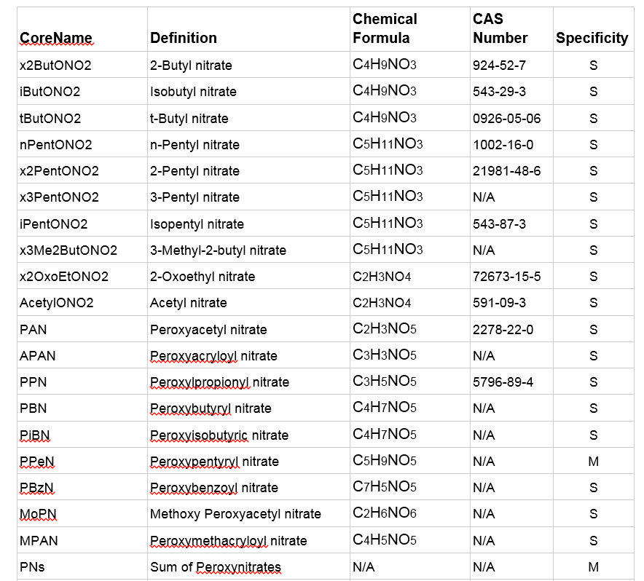
Trace Gas CoreName Example

Slide 8
Aerosol Example – Microphysical Properties
Standard Name = MeasurementCategory_CoreName_MeasurementMode_DescriptiveAttributes
AerMP_CoreName_MeasurementMode_MeasurementRH_SizingTechnique_SizeRange_Reporting
Controlled Vocabulary:
MeasurementMode = InSitu, VertColumn, SlantCol, Profl
MeasurementRH = RHd, RHa, RHsp
SizingTechnique = Mobility, Optical, Aerodynamic, Imaging, Kelvin, None
SizeRange = Nucl, Accu, Coarse, Bulk, PM1, PMx, XtoY
Reporting = STP, AMB, None
Example: In-situ measurement of aerosol number size distribution reported at reduced relative humidity derived from an aerodynamic sizing technique for coarse-mode aerosols at standard temperature and pressure: AerMP_NumSizeDist_InSitu_RHd_Aerodynamic_Coarse_STP

Slide 9
Aerosol Example – Chemical Composition
Standard Name = MeasurementCategory_CoreName_MeasurementMode_DescriptiveAttributes
AerComp_CoreName_MeasurementMode_SizingTechnique_SizeRange_
Reporting
Controlled Vocabulary:
MeasurementMode = InSitu, VertColumn, SlantCol, Profl
SizingTechnique = Aerodynamic, VacuumAerodynamic, LII, None
SizeRange = Nucl, Accu, Coarse, Bulk, PM1, PMx, XtoY
Reporting = MassSTP, MassAMB, MassFrac, NumFrac, NumConcSTP, NumConcAMB
Example: In-situ measurement of organic aerosols derived using a vacuum aerodynamic technique for accumulation-mode aerosols reported as mass concentration at standard temperature and pressure: AerComp_OrganicAerosol_InSitu_VacuumAerodynamic_Accu_MassSTP
Example of an in-situ measurement of bulk sea salt particles reporting in number fraction: AerComp_Seasalt_InSitu_None_Bulk_NumFrac

Slide 10
Aerosol Example – Optical Properties
Standard Name = MeasurementCategory_CoreName_MeasurementMode_DescriptiveAttributes
AerOpt_CoreName_MeasurementMode_WL_ MeasurementRH _SizeRange_Reporting
Controlled Vocabulary:
MeasurementMode = InSitu, VertColumn, SlantCol, Profl
WL = UV, Blue, Green, Red, IR, BluetoRed
MeasurementRH = RHd, RHa, RHsp
SizeRange = Nucl, Accu, Coarse, Bulk, PM1, PMx, XtoY
Reporting = STP, AMB, None
Example: In-situ measurement of absorption measured at a red wavelength under reduced humidity conditions with a bulk aerosol size range reported in ambient conditions: AerOpt_Absorption_InSitu_red_RHd_Bulk_AMB

Slide 11
Cloud Example – Microphysical Properties
Standard Name = MeasurementCategory_CoreName_MeasurementMode_DescriptiveAttributes
CldMP_CoreName_MeasurementMode_SizingTechnique_SizeRange_
Reporting
Controlled Vocabulary:
MeasurementMode = InSitu, VertColumn, SlantCol, Profl
SizingTechnique = Imagin, Optical, None
SizeRange = Drop, Precip, Bulk, None
Reporting = STP, AMB, None
Example: In-situ measurement of cloud particle number size distribution derived from an optical sizing technique measuring droplets being reported at ambient conditions: CldMicro_NumSizeDist_InSitu_Optical_Drop_AMB

Slide 12
Cloud Example – Macrophysical Properties
Standard Name = MeasurementCategory_CoreName_MeasurementMode_DescriptiveAttributes
CldMacro_CoreName_MeasurementMode_None
Controlled Vocabulary:
MeasurementMode = InSitu, VertColumn, SlantCol, Profl
Example: In-situ measurement of cloud top height: CldMacro_CTH_Profl_None

Slide 13
Cloud Example – Chemical Composition
Standard Name = MeasurementCategory_CoreName_MeasurementMode_DescriptiveAttributes
CldComp_CoreName_MeasurementMode_SizingTechnique_SizeRange_
Reporting
Controlled Vocabulary:
MeasurementMode = InSitu, VertColumn, SlantCol, Profl
SizingTechnique = Imaging, Optical, None
SizeRange = Drop, Precip, Bulk
Reporting = MassSTP, MassAMB
Example: In-situ measurement of the mass concentration of sodium derived from a chemical technique measuring droplets reported at ambient conditions: CldComp_Sodium_InSitu_None_Bulk_MassAMB

Slide 14
Cloud Example – Optical Properties
Standard Name = MeasurementCategory_CoreName_MeasurementMode_DescriptiveAttributes
CldOpt_CoreName_MeasurementMode_WL
Controlled Vocabulary:
MeasurementMode = InSitu, VertColumn, SlantCol, Profl
WL = UV, Blue, Green, Red, IR, BluetoRed
Example: In-situ measurement of cloud particle extinction coefficient measured in the blue wavelength: CldOpt_Extinction_InSitu_blue

Slide 15
Meteorology Example
Standard Name = MeasurementCategory_CoreName_MeasurementMode_DescriptiveAttributes
Met_CoreName_MeasurementMode_None
Controlled Vocabulary:
MeasurementMode = InSitu, VertColumn, SlantCol, Profile
Example: In-situ measurement of static air temperature: Met_StaticTemperature_InSitu_None

Slide 16
Platform/Navigation Example
Standard Name = MeasurementCategory_CoreName_MeasurementMode_DescriptiveAttributes
Platform_CoreName_MeasurementMode_None
Controlled Vocabulary:
MeasurementMode = InSitu
Example: In-situ measurement for aircraft Yaw angle: Platform_YawAngle_InSitu_None

Slide 17
Photolysis Rate Example
Standard Name = MeasurementCategory_CoreName_MeasurementMode_DescriptiveAttributes
MeasurementCategory_CoreName_MeasurementMode_MeasurementDirection_SpectralCoverage_Products
Controlled Vocabulary:
MeasurementCategory = GasJvalue, AquJvalue
MeasurementMode = InSitu
MeasurementDirection = Downwelling, Upwelling, or Total
SpectralCoverage = Partial, Full
Example: Photolysis rate coefficient for reaction NO2 + hν → NO + O(3P) derived from total actinic flux measurement: GasJvalue_jNO2_InSitu_Total_Full_NO2-O3P
Example: Photolysis rate coefficient for reaction CHBr3 + hν → products derived from downwelling actinic flux measurement: GasJvalue_jCHBr3_InSitu_Downwelling_Full_NoProductsSpecified

Slide 18
Radiation Example
Standard Name = MeasurementCategory_CoreName_MeasurementMode_DescriptiveAttributes
Rad_CoreName_MeasurementMode_WLMode
Controlled Vocabulary:
MeasurementMode = InSitu
WLMode = BB (broadband), SP (spectral), SC (specified channels)
Example: In-situ measurement of Downwelling Diffuse Broadband Solar Irradiance between 0.2 and 3.6 micron: Rad_IrradianceDownwellingDiffuse_InSitu_BB

Slide 19
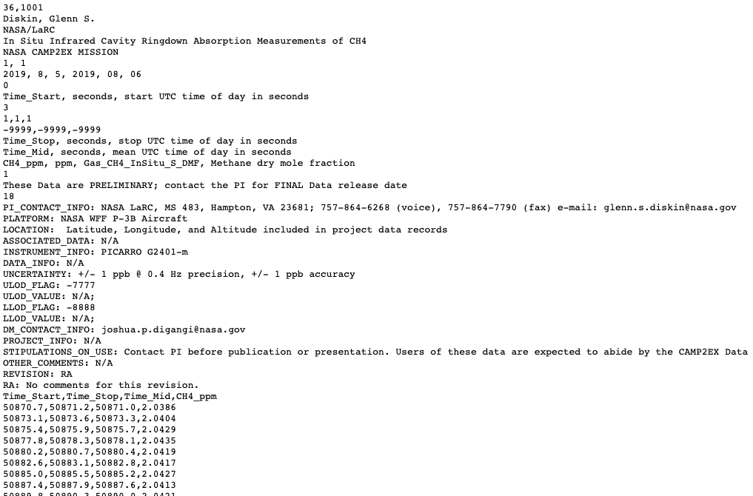
CAMP²Ex ICARTT File – Trace Gas

Slide 20
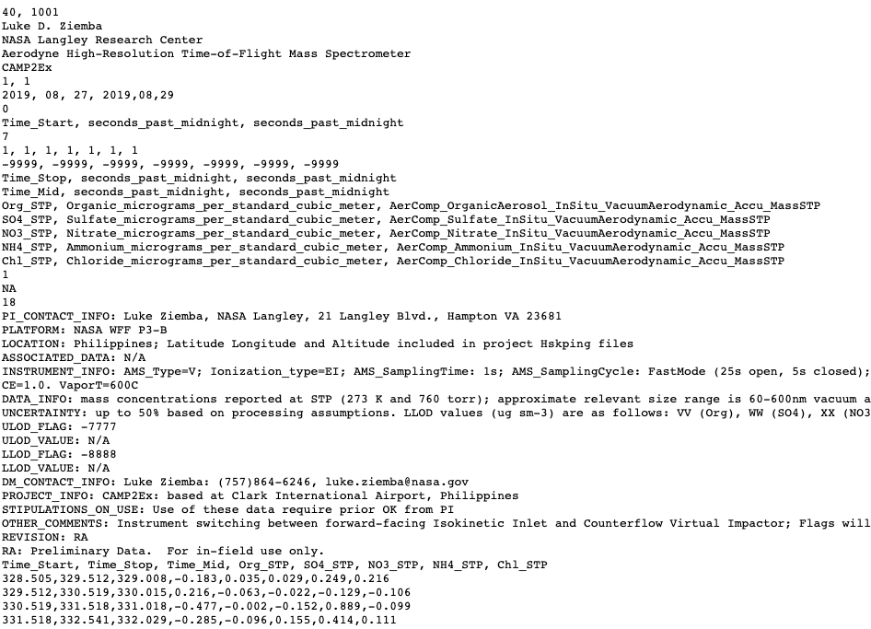
CAMP²Ex ICARTT File – Aerosol Composition

Slide 21
Maintenance Plan
Stay relevant to the measurement and user communities
Update/modify CoreNames and DescriptiveAttributes after each major field study
Connect to modeling community, e.g., AeroCom, HTAP, and CCMP
Create translation to CF and other standards
Easy but controlled process for new CoreNames
Collect new names from data providers
Review through literature search and peer comments
Keep close working relation with GCMD

