Slide 1
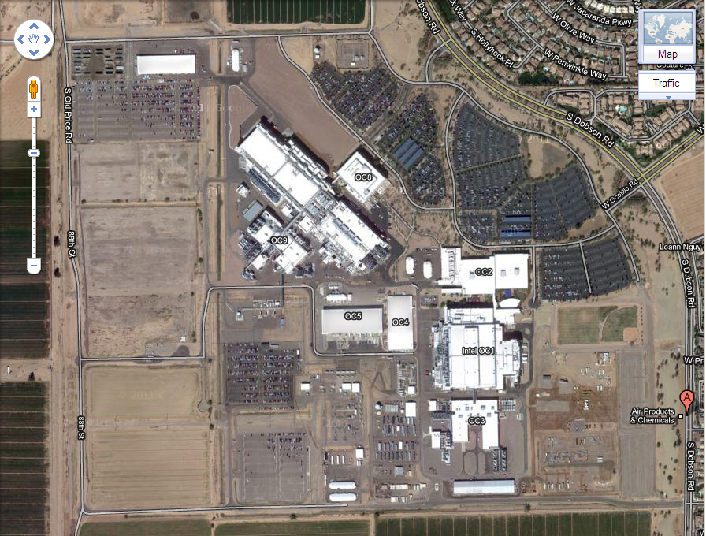
Access from Dobson Road at intersection of Chaparral Street

