Slide 1
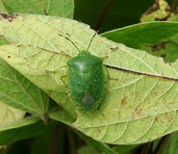

SAMBUG by
Werner Mostert
Keagan Thompson
Kale-ab Tessera
Abrie van Aardt
Michelle Swanepoel

Slide 2
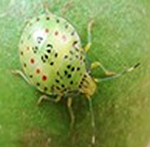
The Client
Barry Christie
Subtrop Technical Manager
Subtrop:
Subtrop is responsible for general and financial administration of the Macadamia Nut and Avocado Growers’ Association.

Slide 3
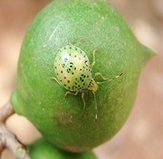
SAMBUG Components
Android App
Web Interface
Back-End

Slide 4
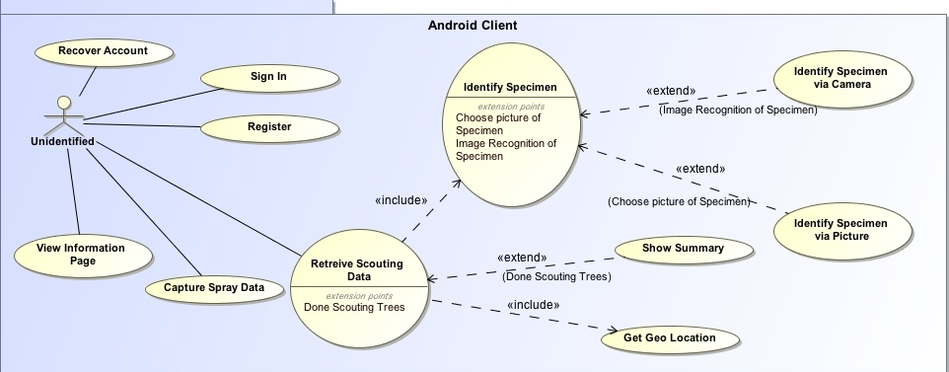
Android App Domain Model

Slide 5
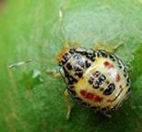
Use Case Explanations
Recover Account
If a user forgets his log-in details, the user should be able to recover his login information using email verification.
Sign In
A user should be able to sign in with his credentials
Register
A user should be able to register as a technical advisor
A user should be able to register as a grower

Slide 6
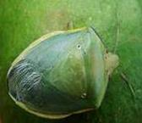
Use Case Explanations Contd
View Information Page
A user should be able to view a page describing the various individual species and how to identify them.
Capture Spray Data
When a grower sprays an orchard, he should be able to enter the fact that a specific orchard was sprayed.

Slide 7
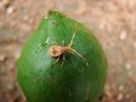
Use Case Explanations Contd
Retrieve Scouting Data
A user should be able to enter data related to a scouting, upon which stage classification should happen.
Extension Points:
Choose Specimen from Image Gallery
A user identifies a specific species of stinkbug by intuitively choosing an image most similar.
Recognize Specimen via Recognition
A user identifies a specific species of stinkbug by using the cellphone’s camera to classify it.
Get Geo Location
The geographic location should be captured

Slide 8
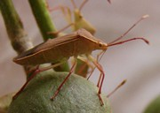
Use Case Explanations Contd
Show Summary
After a scouting, a summary of the total scouting data should be displayed

Slide 9
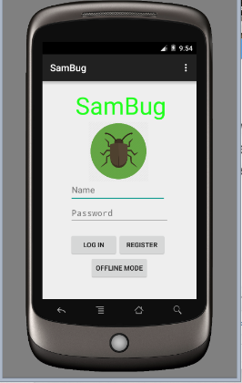
Android App - Login

Slide 10
Android App- Menu

Slide 11
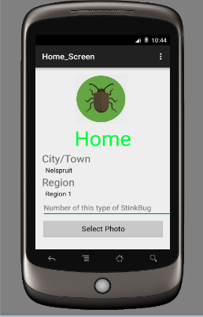
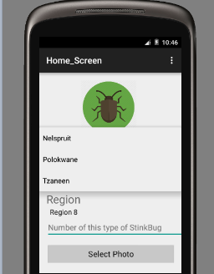
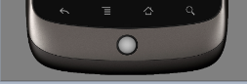
Android App- Enter Scouting Data

Slide 12
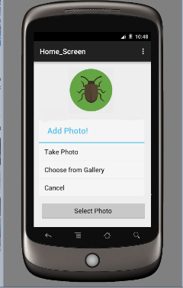
Android App- Enter Scouting Data Contd

Slide 13
Android App- View Scouting Data

Slide 14

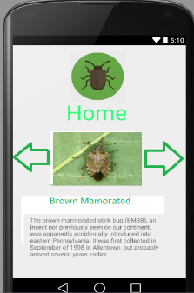

Android App- Bug Information

Slide 15
Android App- Web Interface

Slide 16
Android App- Logout

Slide 17
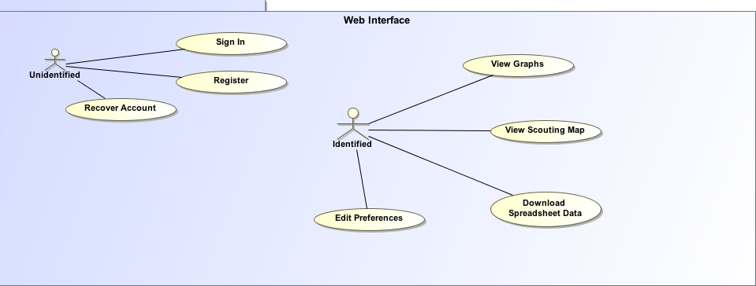
Web Interface Domain Model

Slide 18
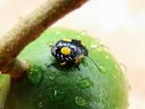
Use Case Explanations
Recover Account
If a user forgets his log-in details, the user should be able to recover his login information using email verification.
Sign In
A user should be able to sign in with his credentials
Register
A user should be able to register as a technical advisor
A user should be able to register as a grower

Slide 19
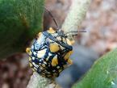
Use Case Explanations Contd
View Graphs
A user should be able to see historical data of scoutings done in the form of a graph, which is dynamically constructed.
View Scouting Map
A map with marks of scouting location should be able to be viewed.
Download Spreadsheet Data
A user should be able to download the historical data in the form of a spreadsheet.

Slide 20
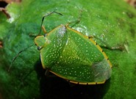
Use Case Explanations Contd
Edit Preferences
At the very least, a grower should be able to select if his historical data should be available to other growers.

Slide 21
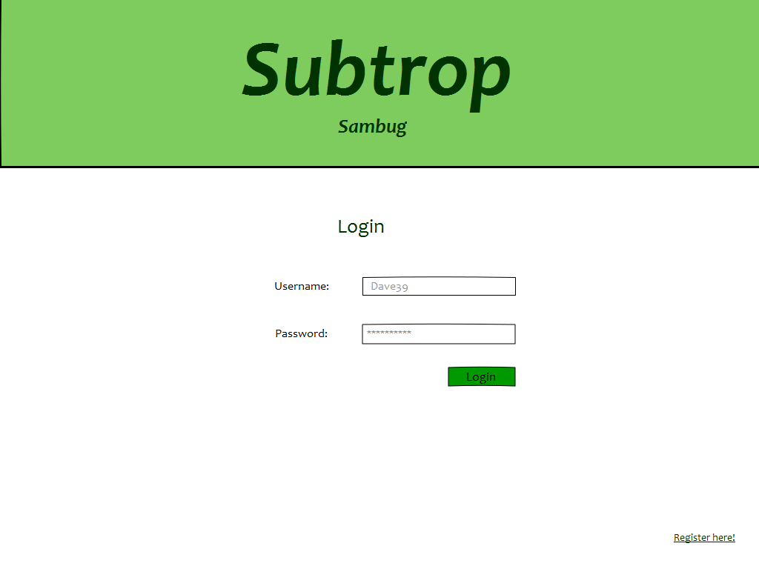
Web Layout - Login

Slide 22
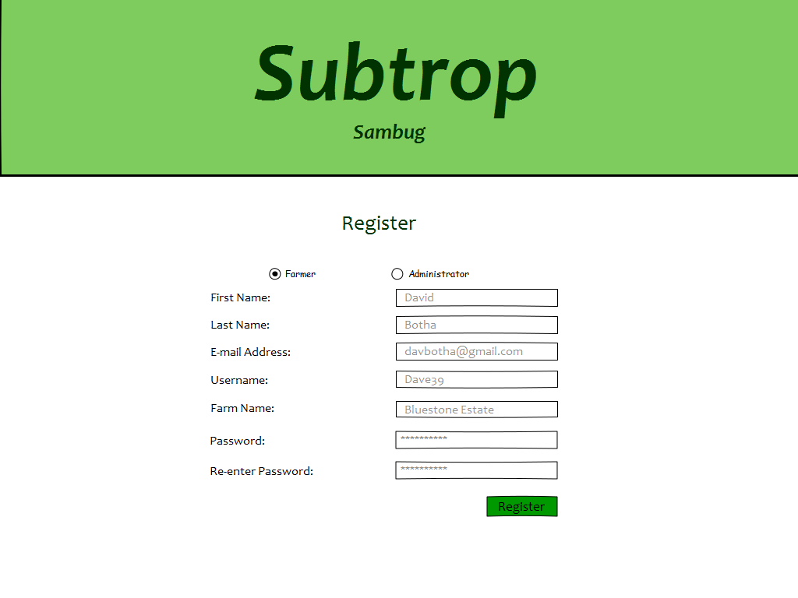
Web Layout – Register

Slide 23
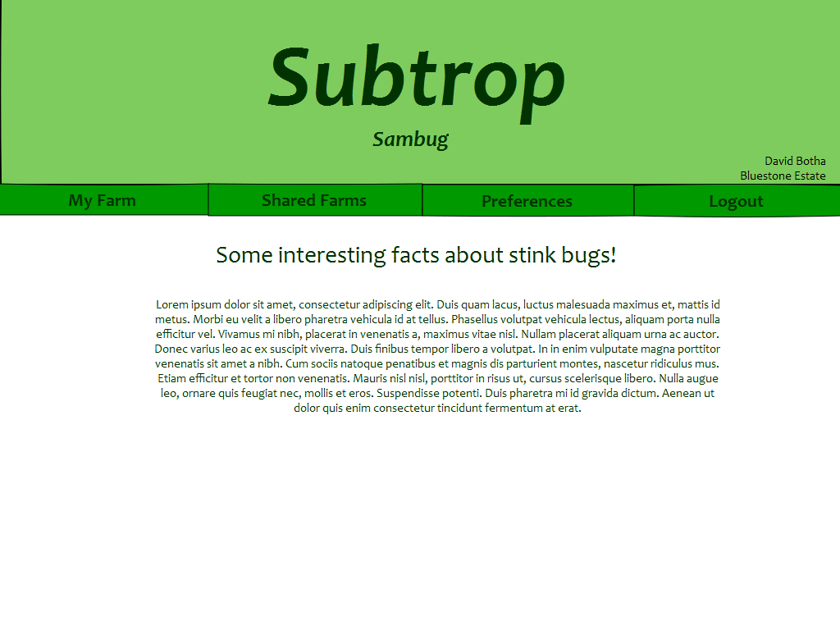
Web Layout - Home

Slide 24
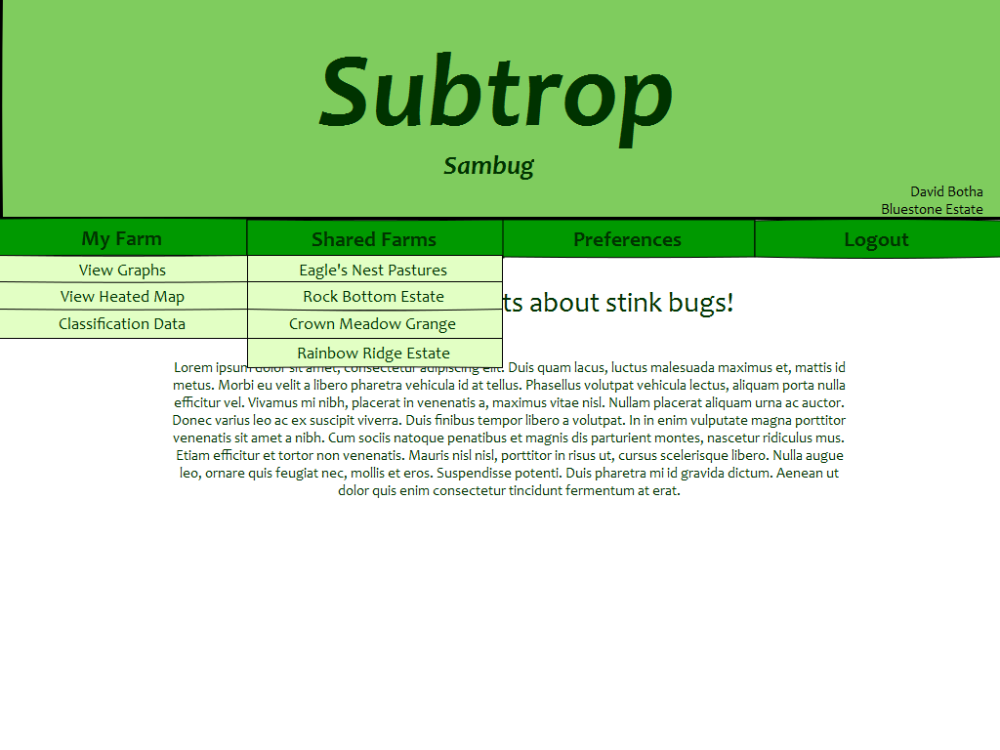
Web Layout - Dropdowns

Slide 25
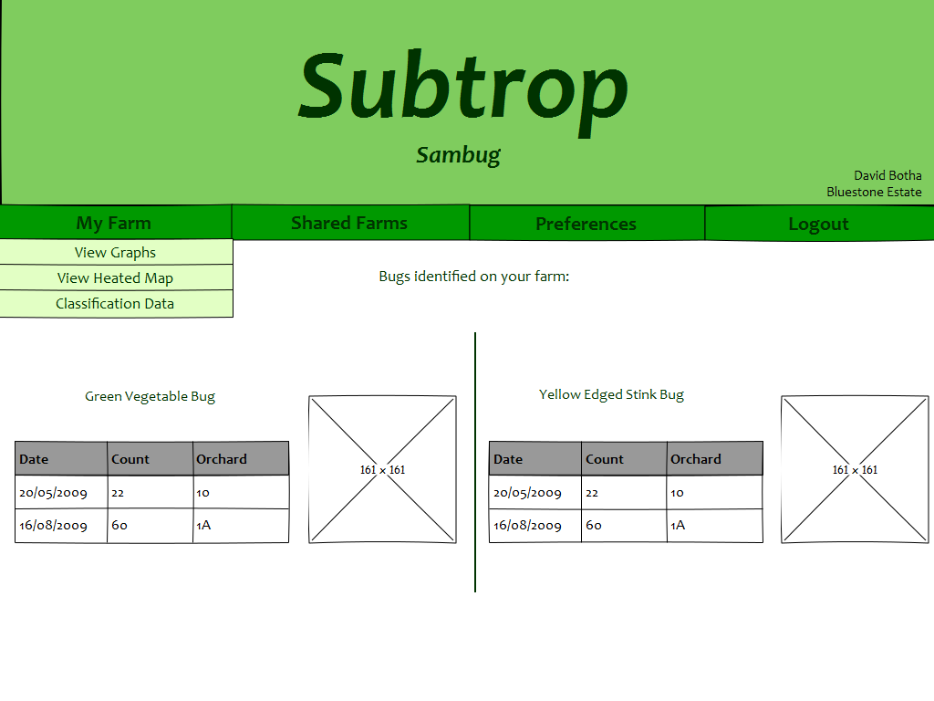
Web Layout - Classification

Slide 26
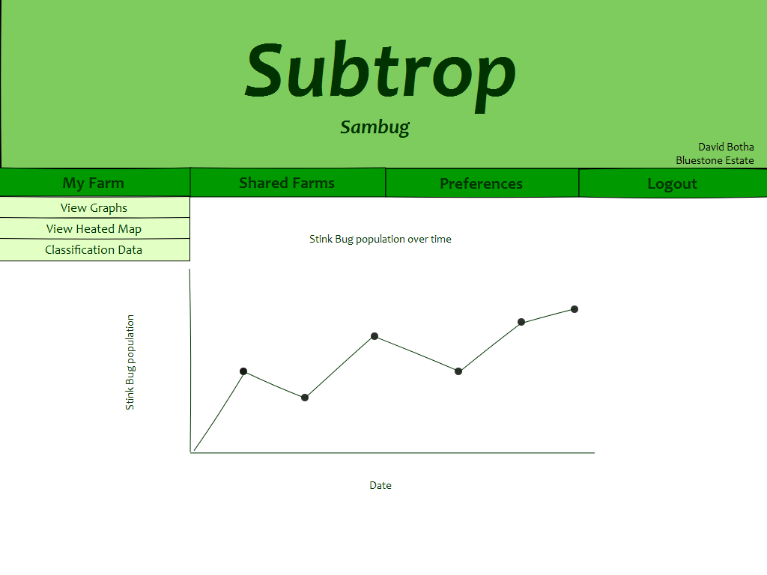
Web Layout - Graphs

Slide 27
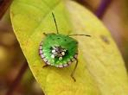
Back End
Hosting:
We are currently investigating various IaaS (Infrastructure as a Service) providers. This will depend on the technologies identified.
Technologies:
We have decided to use the following technologies:
Android Studio for Android development
Bootstrap for as a front-end framework.
MySQL relational database

Slide 28
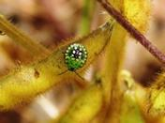
Back End
Other Technologies:
Other technologies we are considering:
NodeJS
ASP .NET MVC5 using Visual Studio
PHP
JSP
Image Recognition and Classification
We are in the process of identifying the best way to implement this functionality
We have contacted various experts in Artificial Intelligence regarding this matter

Slide 29

Conclusion
Our Motto: Everything will work out in the end. If it hasn't worked out, we are not at the end.

