Slide 1
PROJECT Jewelry Production Order

Slide 2
Contents of this template
1. Aim of the Project
2. Project Team Members
3. Project Architecture
4. Database Diagram
5. Use case Diagram

Slide 3
Aim of the project
01.
This project will enable customers to place orders for jewelry products from our company without the need to visit our premises in person.
With a user-friendly interface and experienced staff, we aim to enhance the overall experience of our customers.

Slide 4
Team List Members
02.
Lương Quang Huy – SE182352
Lương Hoàng Bảo –SE185036
Ngô Xuân Hạnh Nhi – SE192260
Vũ Minh Đức –SE185065
Nguyễn Huy Thiên Hòa –SE18

Slide 5
03.
Project Architecture

Slide 6
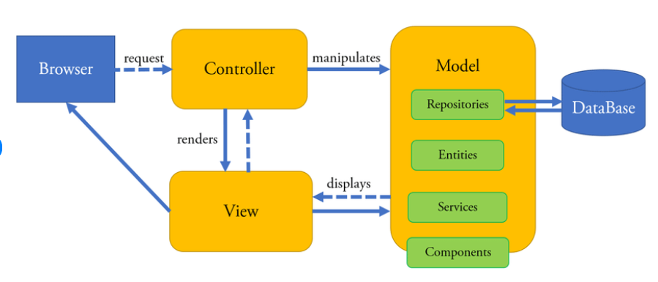
MVC Architecture

Slide 7
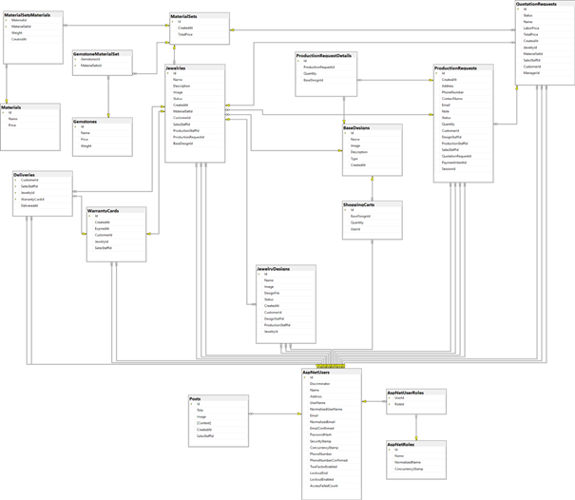
04.
DB Diagram

Slide 8
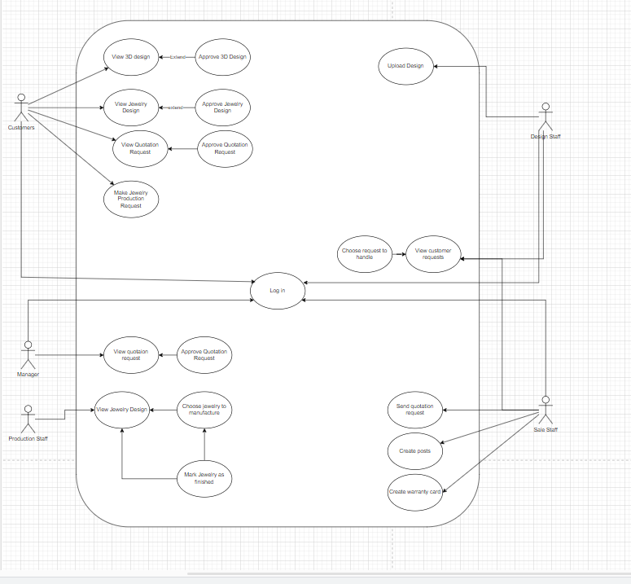
Use case Diagram

Slide 9
Thank you for your Attention
Do you have any questions?

