Slide 1
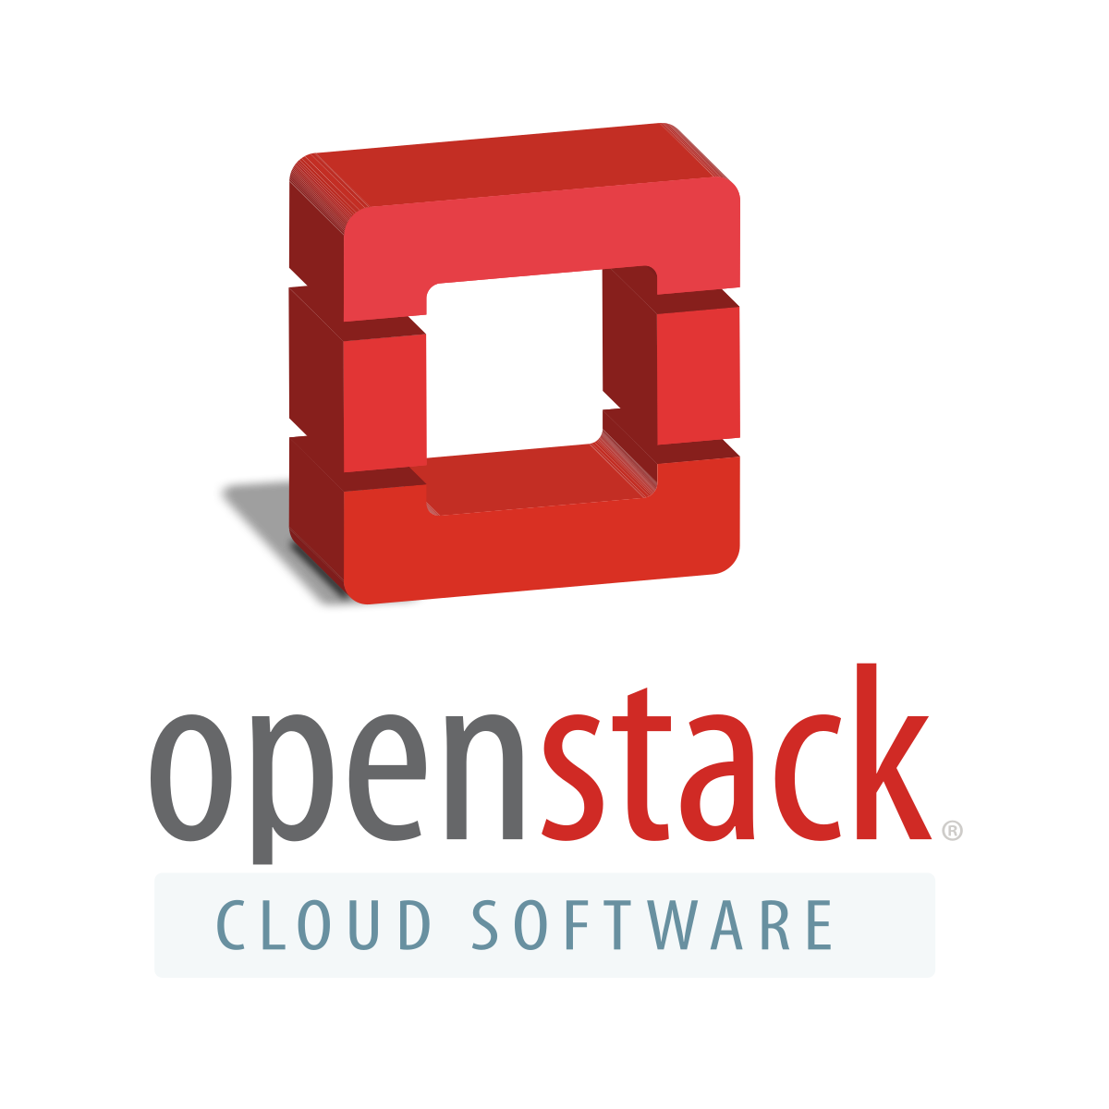
Install Openstack on Ubuntu
M10607515 陳韋廷
M10607504 徐偉晉

Slide 2
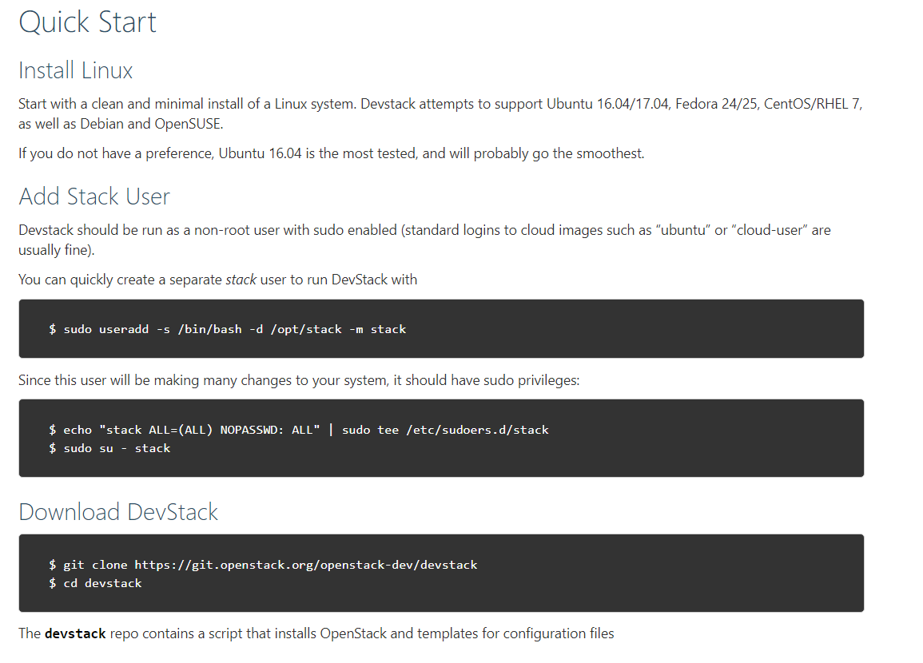
Installation Step
Openstack website
https://docs.openstack.org/devstack/latest/

Slide 3
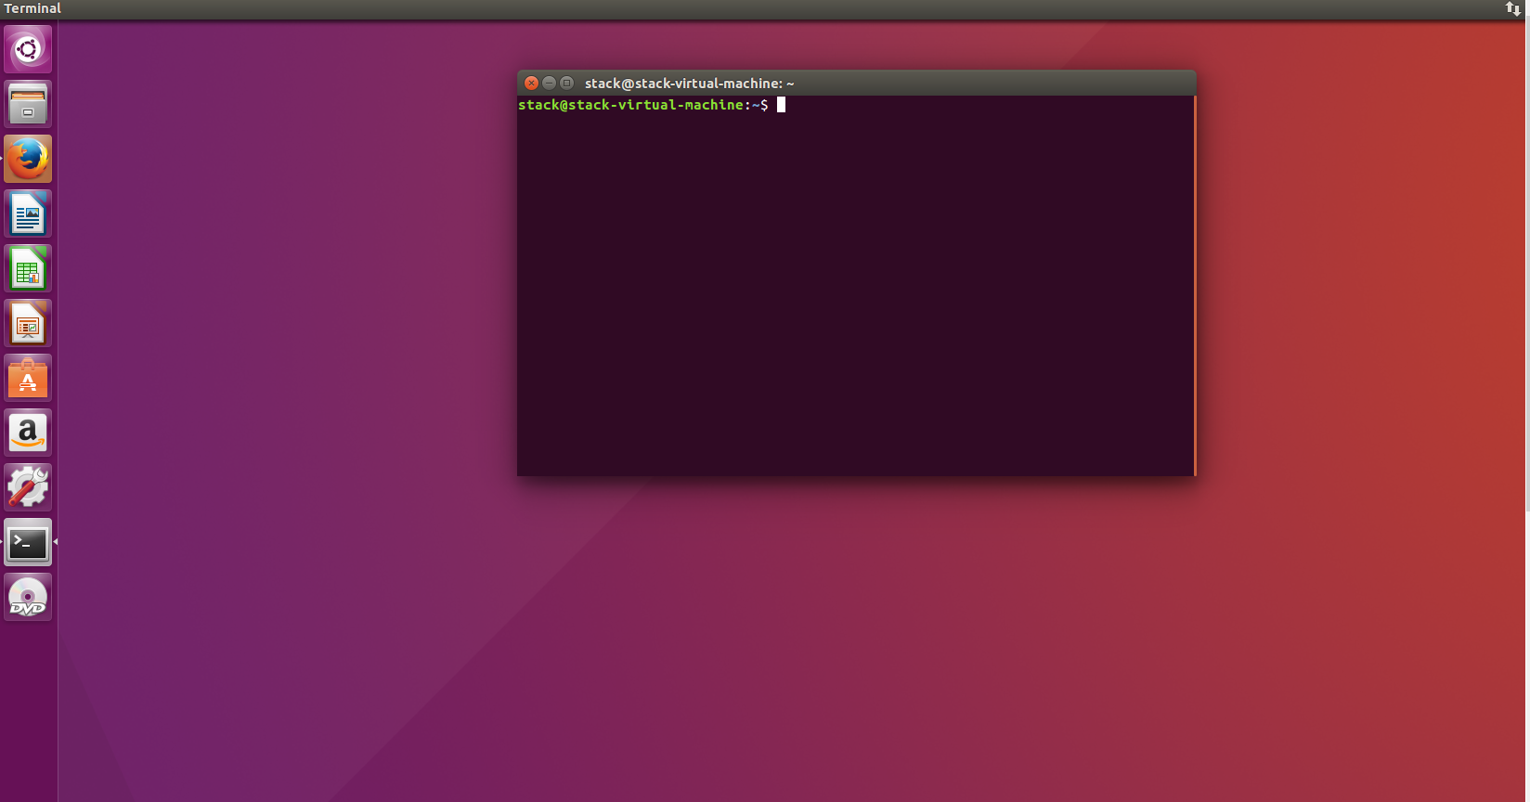
Installation Step
Open terminal in Ubuntu

Slide 4
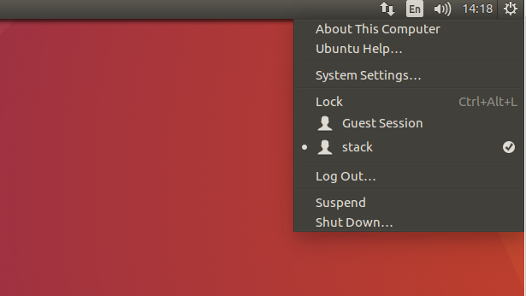
Installation Step
You can quickly create a news user called stack to run DevStack.
execution command :
$ sudo useradd -s /bin/bash -d /opt/stack -m stack
Initially, we will add stack user which means I can skip this step.

Slide 5
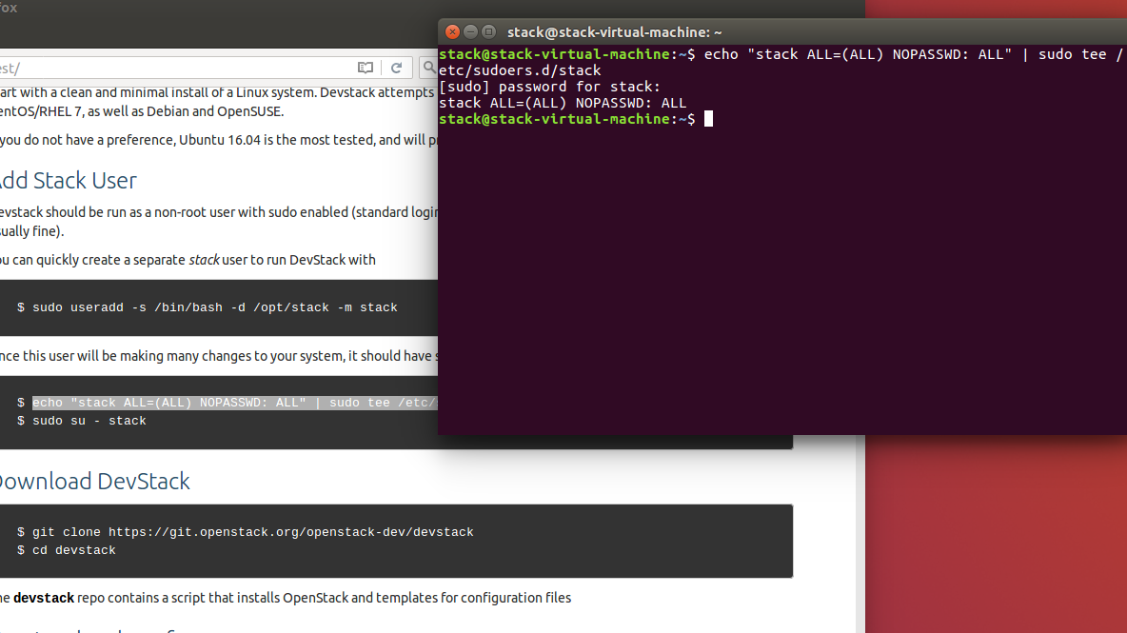
Installation Step
The stack user will do something to change your system , so we should give the privilege to this user :
execution command :
$ echo "stack ALL=(ALL) NOPASSWD: ALL" | sudo tee /etc/sudoers.d/stack

Slide 6
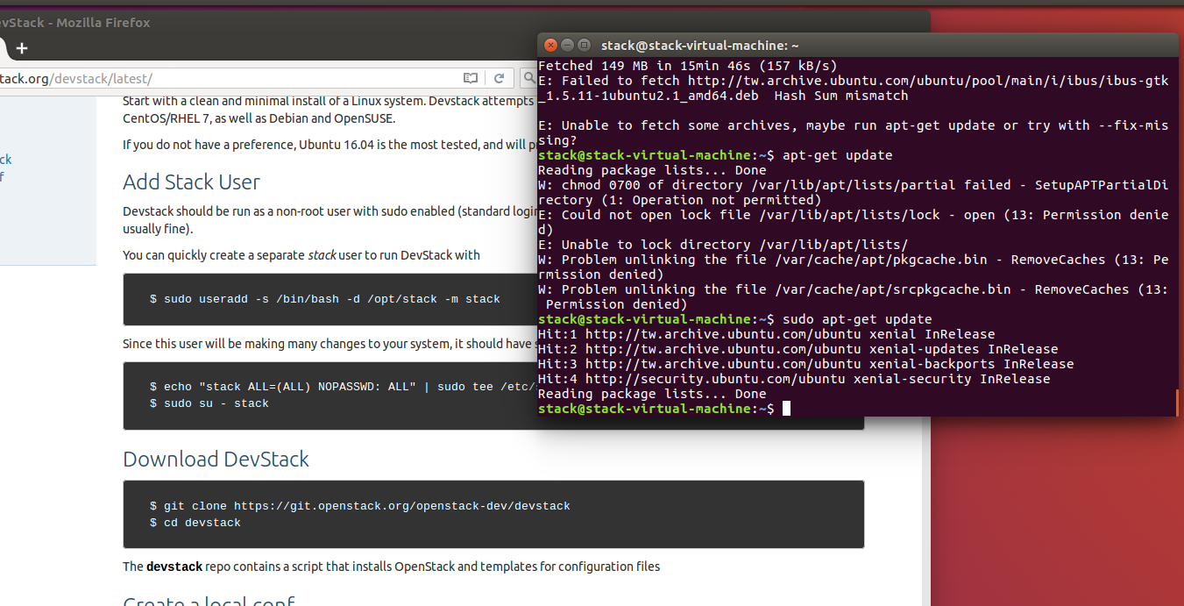
Installation Step
execution command :
Sudo apt-get update

Slide 7
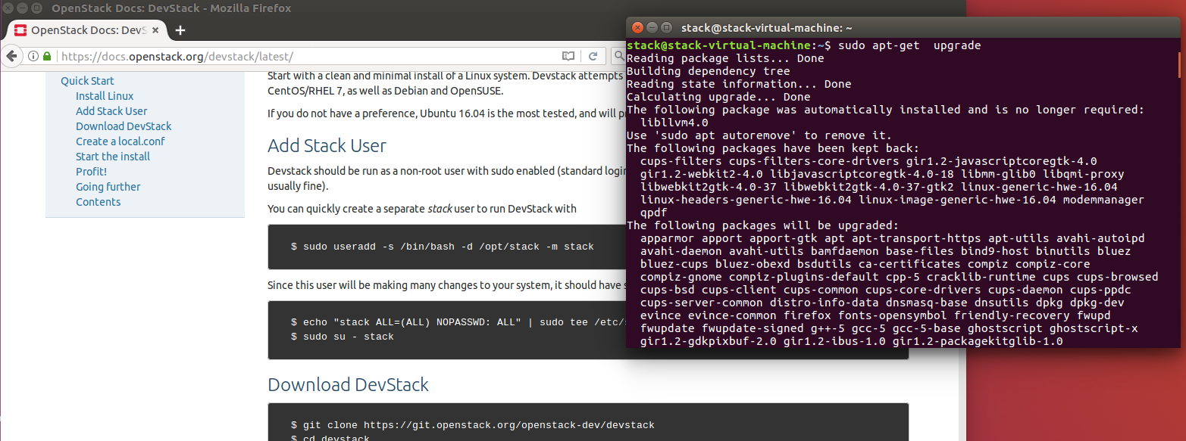
Installation Step
execution command :
Sudo apt-get upgrade

Slide 8
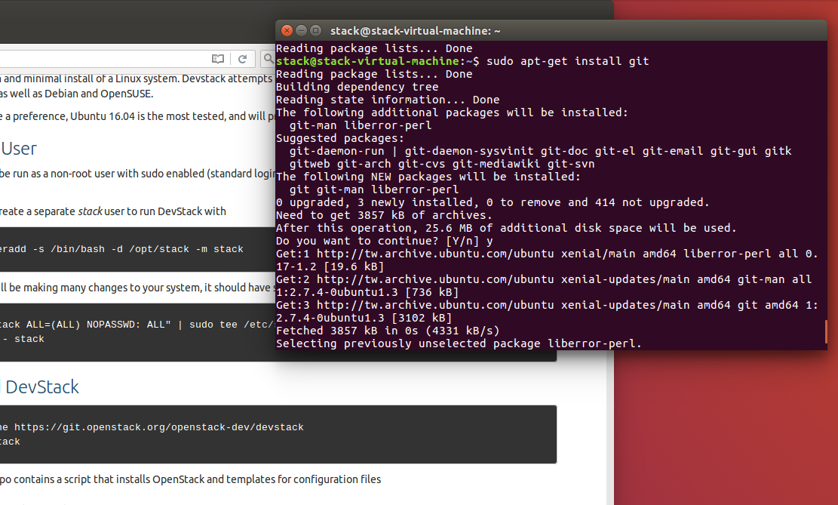
Installation Step
execution command :
Sudo apt-get install git

Slide 9
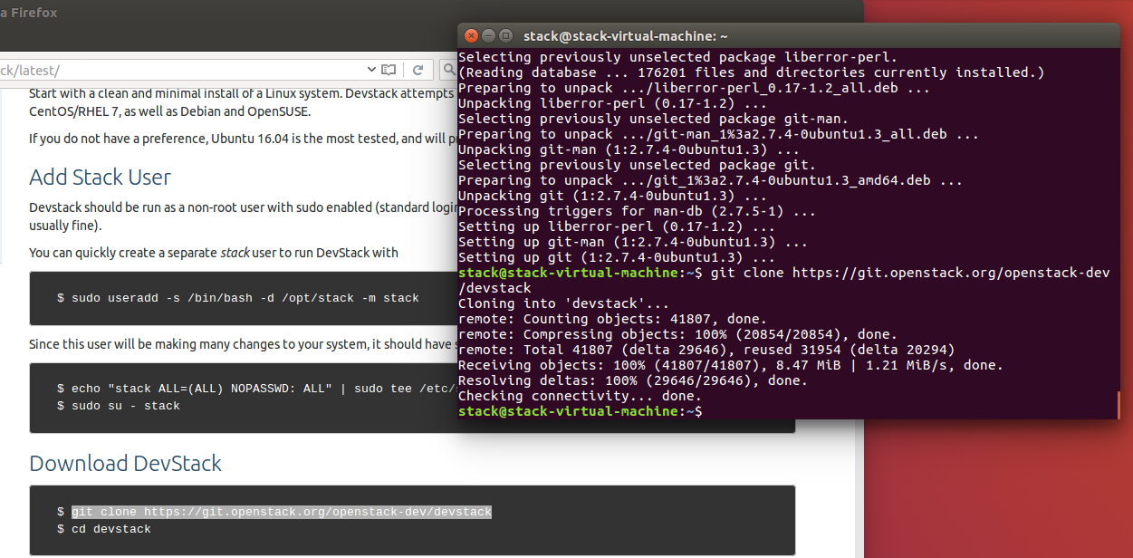
Installation Step
Download the Devstack from Openstack website.
execution command :
$ git clone https://git.openstack.org/openstack-dev/devstack

Slide 10
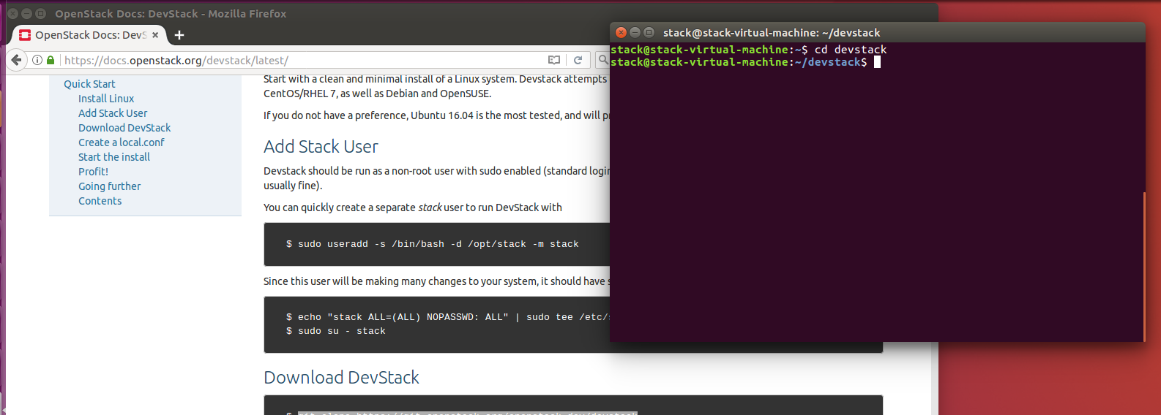
Installation Step
If the devstack has downloaded , you should find this document
execution command :
cd devstack

Slide 11
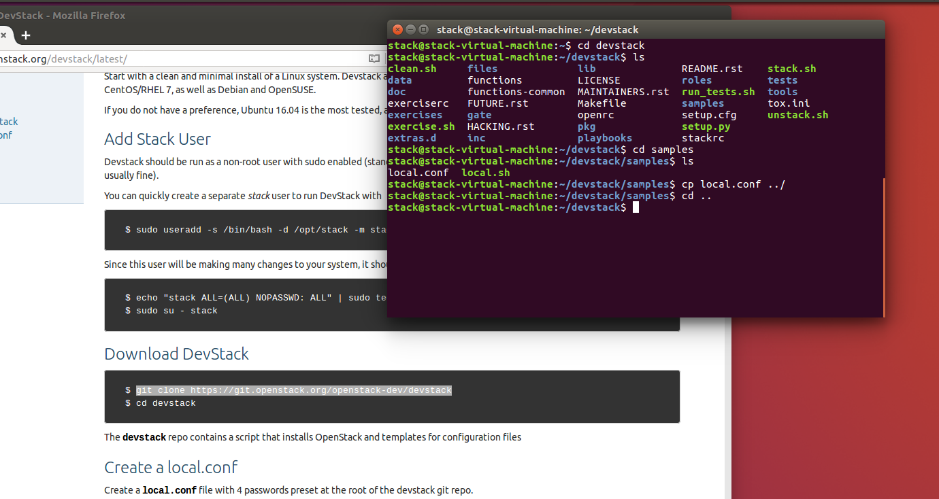
Installation Step
Find local.conf in the samples file and copy it into devstack file
execution command :
cp local.conf ../

Slide 12
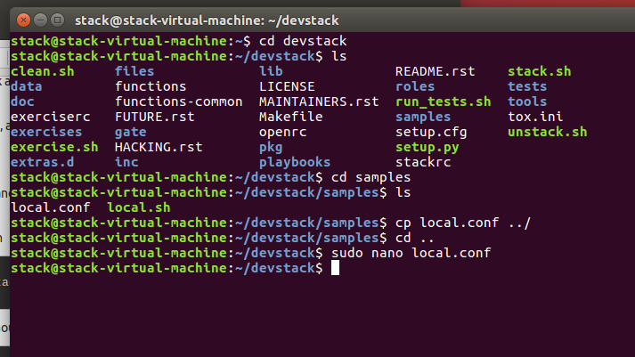
Installation Step
Modify the local.conf file in the devstack.
execution command :
sudo nano local.conf

Slide 13
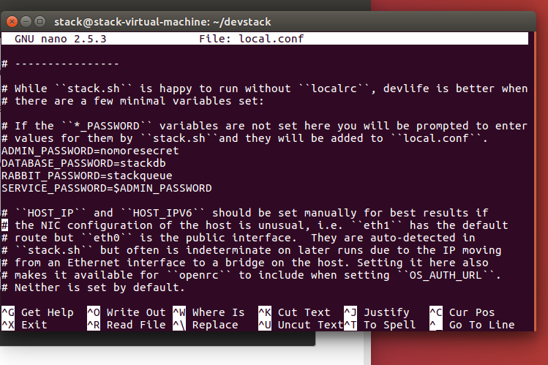
Installation Step
Create a local.conf file with 4
passwords and change the
password what you want.
Four password can be change by the stack user

Slide 14
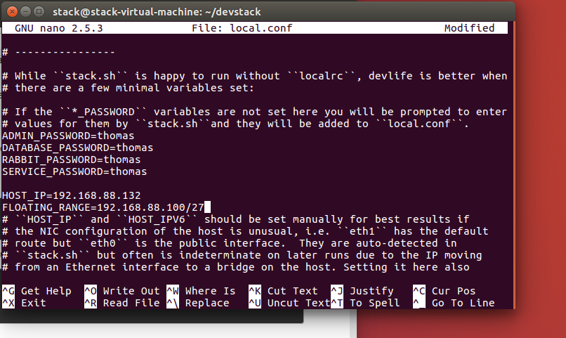
Installation Step
Add host ip address and floating ip address range
HOST_IP=192.168.X.X
FLOATING_RANGE=192.168.X.X/YOUR RANGE
Finally , we can press Ctrl + X and yes after you already finished to modify and add it.
Use ipconfig to check your host_ip

Slide 15
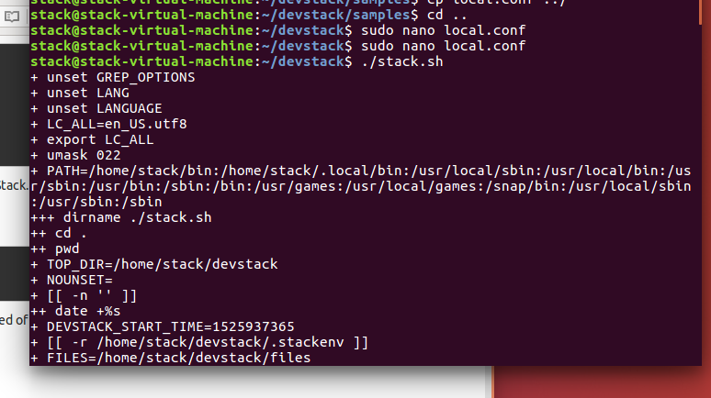
Installation Step
Start installing openstack
execution command :
$ ./stack.sh
This installation will take a 30-60 minutes, which depending on the speed of your internet.
The devstack will install keystone, glance, nova, cinder, neutron, and horizon.

Slide 16
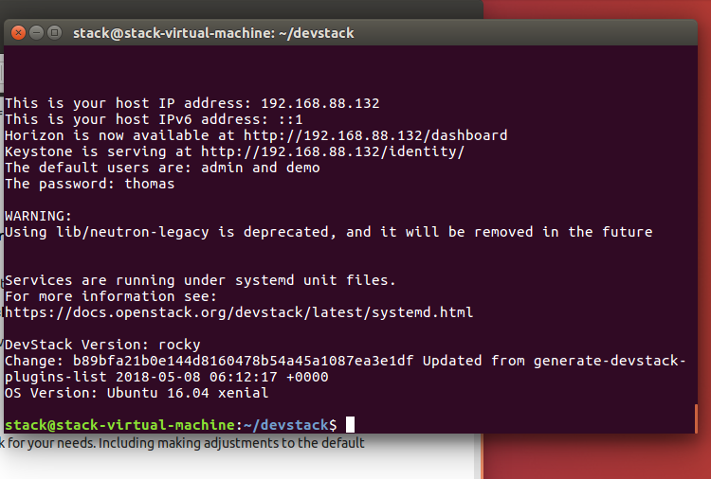
Installation Step
The terminal show this following photo after fininshing to install devstack.

Slide 17
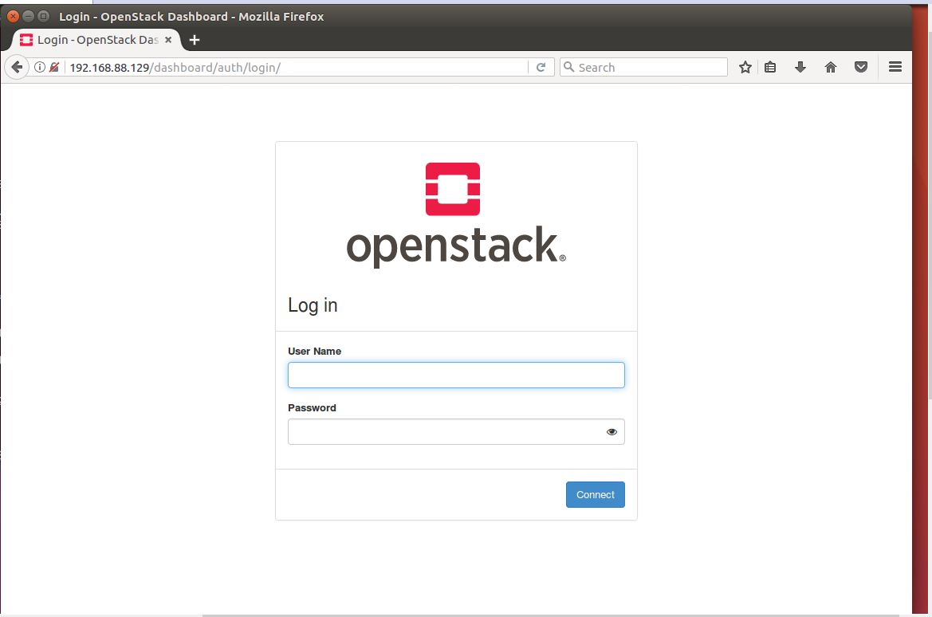
Installation Step
Open your browser and type your localhost
Enter your account and password
Enter http://192.168.X.X into horizon dashboard

Slide 18
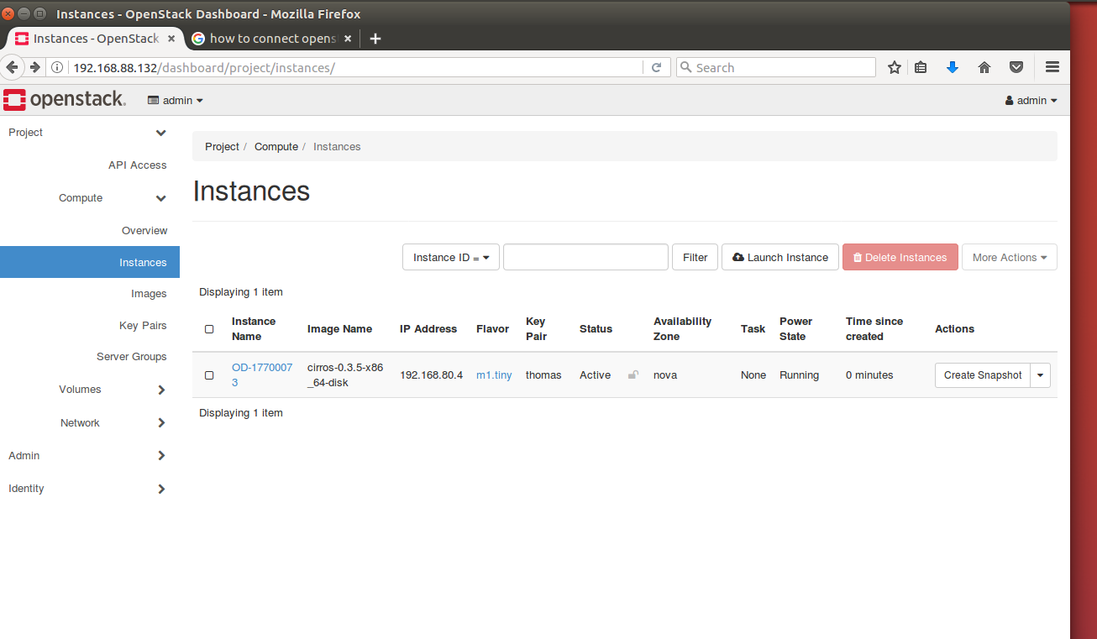
Installation Step
Set up the private ip and router
Building your instance

Slide 19
The end

