Slide 1
nf-core/quantms notes
Weinong Han
08/03/2022

Slide 2
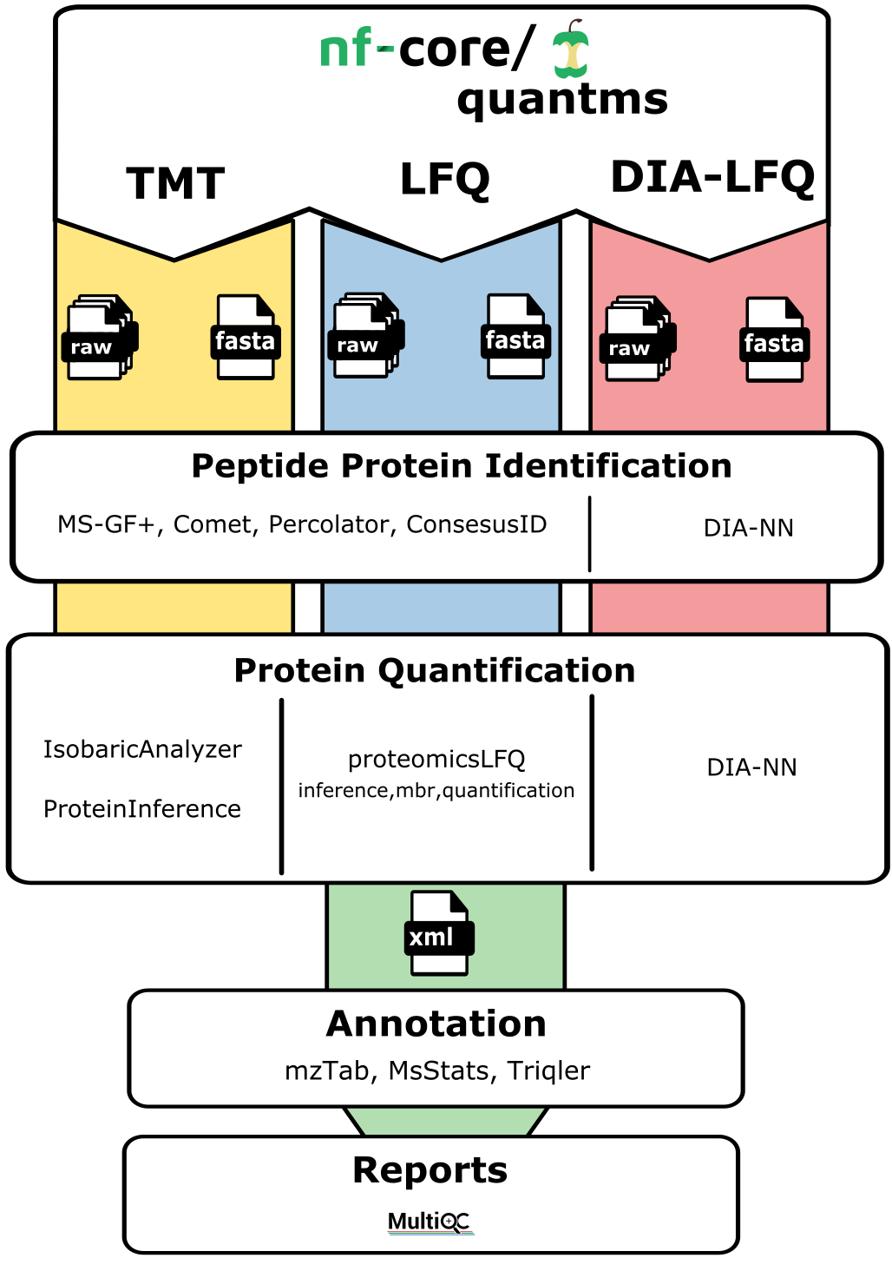
nf-core/quantms
Analysis pipeline for Quantitative Mass Spectrometry (MS)
Identification of peptides or modfication and quantification of proteins

Slide 3
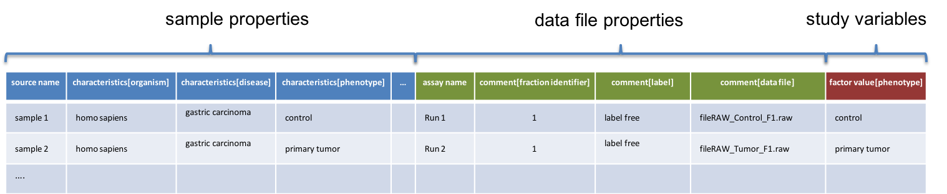
Formats in Quantms-Input Formats
Input formats:
SDRF: experimental design
Input is specified by using a path or URI to a PRIDE Sample to Data Relation Format file(SDFR)
Input files will be downloaded and cached from the URIs specified in the SDRF file
Spectra Data(RAW or mzML)
preferably in mzML or RAW files only for Thermo-Fisher Instruments and converted to mzMLRAW
local input spectra files loaded instead of from SDRF or Experimental Design file and then set –
root_dir and –local_input_type (default mzML) parameters.
Protein databases(Fasta)
Protein databases in fasta form and most common ones from UNIPROT and ENSEMBLE or created
by translating transcripts.

Slide 4
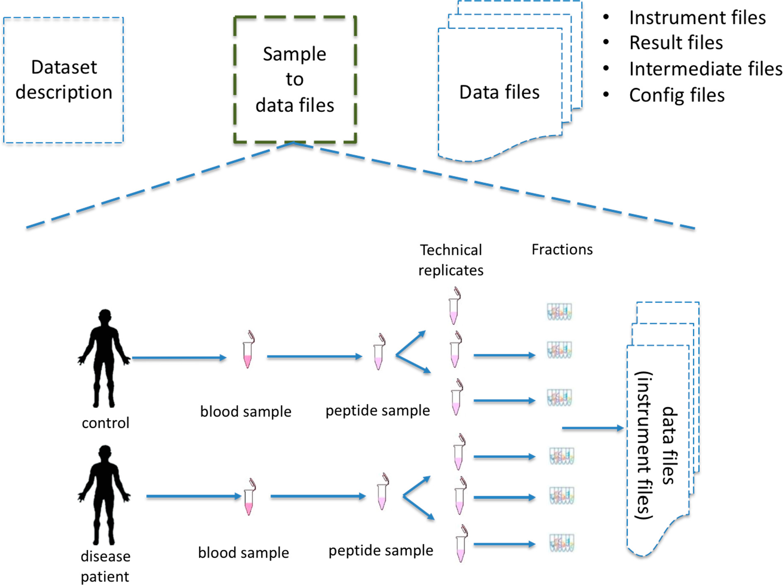
The Sample to Data Relationship Format (SDRF)
Sample metadata.
The data files metadata
The relation between the samples and data files, especially the instrument MS data. (Experimental Design)
Dai, C., Füllgrabe, A., Pfeuffer, J. et al. Nat Commun 12, 5854 (2021). https://doi.org/10.1038/s41467-021-26111-3

Slide 5
source name
Sample accession
factor value[phenotype]
necrotic tissue
normal
assay name
Data file accession
Label free experiment with no fractions
Run 1
Sample 1
Technical replicates
01.raw
Sample 1
necrotic tissue
biological replicate 1
Run 2
02.raw
Run 3
Sample 2
Technical replicates
03.raw
Sample 2
necrotic tissue
biological replicate 2
necrotic tissue
Run 4
04.raw
Run 5
Sample 3
Technical replicates
05.raw
Sample 3
normal tissue
biological replicate 1
Run 6
06.raw
Run 7
07.raw
Sample 4
Sample 4
Technical replicates
normal tissue
biological replicate 2
Run 8
08.raw
normal tissue
Sample properties
Data file properties
Study variables
source name | characteristics [organism] | … | characteristics [disease] | characteristic [phenotype] | characteristics [biological replicate] | assay name | comment [fraction identifier] | comment [label] | comment [technical replicate] | … | comment [data file] | factor value [phenotype]
Sample 1 | homo sapiens | … | liver cancer | necrotic tissue | 1 | Run 1 | 1 | AC=MS:1002038;NT=label free sample | 1 | … | 01.raw | necrotic tissue
Sample 1 | homo sapiens | … | liver cancer | necrotic tissue | 1 | Run 2 | 1 | AC=MS:1002038;NT=label free sample | 2 | … | 02.raw | necrotic tissue
Sample 2 | homo sapiens | … | liver cancer | necrotic tissue | 2 | Run 3 | 1 | AC=MS:1002038;NT=label free sample | 1 | … | 03.raw | necrotic tissue
Sample 2 | homo sapiens | … | liver cancer | necrotic tissue | 2 | Run 4 | 1 | AC=MS:1002038;NT=label free sample | 2 | … | 04.raw | necrotic tissue
Sample 3 | homo sapiens | … | liver cancer | normal | 1 | Run 5 | 1 | AC=MS:1002038;NT=label free sample | 1 | … | 05.raw | normal
Sample 3 | homo sapiens | … | liver cancer | normal | 1 | Run 6 | 1 | AC=MS:1002038;NT=label free sample | 2 | … | 06.raw | normal
Sample 4 | homo sapiens | … | liver cancer | normal | 2 | Run 7 | 1 | AC=MS:1002038;NT=label free sample | 1 | … | 07.Raw | normal
Sample 4 | homo sapiens | … | liver cancer | normal | 2 | Run 8 | 1 | AC=MS:1002038;NT=label free sample | 2 | … | 08.raw | normal

Slide 6
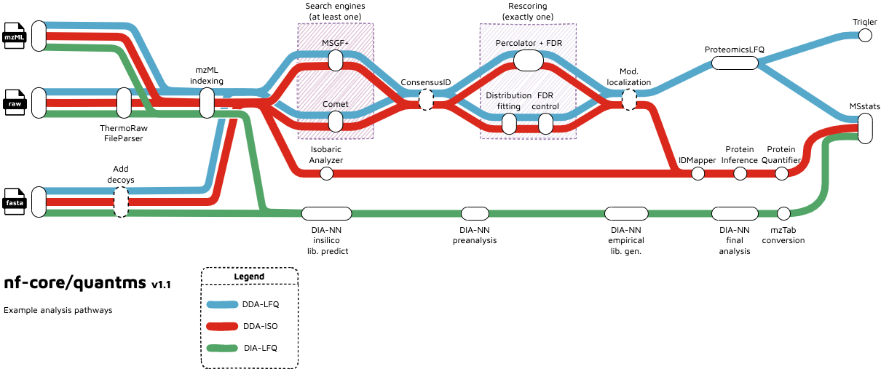
quantms: cloud-based to reanalyze proteomics data

Slide 7
Different Quantification Strategies
Depends on
the acquisition strategy on the mass spectrometer
a. data-independent acquisition(DIA) strategies: SWATH, highly-reproducible
b. data-dependent acquisition(DDA): well-proven, sensitive
How/if the peptides were labeled with special reagents or isotopes
a. the isobaric chemical labels: iTraq and TMT, the most commonly used
b. the metabolic labelling strategies: usually based on isotopically labelled amino acids like SILAC (not supported
by nf-core/quantms pipeline
c. labelling-free

Slide 8
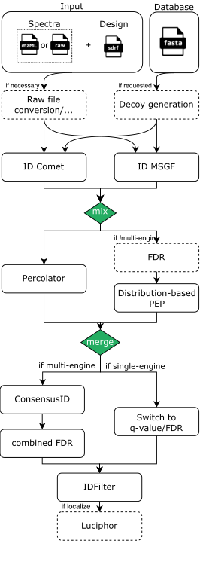

A common peptide/protein identification TMT/LFQ
Use multiple peptide identification tools Comet and MSGF+.
Use Percolator (SVM-based) to boost peptide identifications.
Apply multiple FDR-methods at peptide/protein identification level.
Phospho localization analysis using Luciphor.

Slide 9
Peptide Protein Identification
Tools used:
MS-GF+ peptide search engine:
a. by scoring MS/MS spectra
b. PSMs exported into .idXML without filtering for the re-scoring step with percolator
c. original file results in the result folder under searchenginemsgf
2. Comet:
a. open source
b. tandem mass spectrometry(MS/MS) sequence database search tool
c. main features: multithreading, speed and memory allocation
d. faster than MS-GF+, less memory, more CPU,but less than 15% PSMs identified
Percolator:
a. SVM-based re-scoring
b. improve identification results and obtain error probabilities for peptide spectrum matches
c. retention time, number of missed-cleavages, peptide identification score used to train SVM model
d. sufficient correct peptide spectrum matches needed to build a good mode
e. features used: score recalibration, calculation of error probabilities for individual PSMs, limited batch sizes
f. Troubleshooting: Score recalibration fails
cause: wrong setting for search parameters resulting in too little identifications
method: disable percolator by the command – posterior_probabilities ‘fit_distributions’
alternative plan: IDPosteriorErrorProbability toll: more robust, work with less data, but lower number of identification
ConsesusID

Slide 10
Identification False Discovery Rate(FDR) Estimation
Estimation procedures and levels of FDR control
1. PSM or peptide level
a. The first FDR control happens after PSM re-scoring by either Percolator
b. or a distribution-fitting approach.
Percolator: outputs its own PSM- or peptide-level FDR with correction for an estimated rate of incorrect targets
warning: peptide-level FDR with Percolator only for the BEST PSM per peptide
OpenMS’s distribution-fitting approach: only available for PSM-level
PSM-level always applied to the single file level, experiment-wide re-scoring and FDR control on PSM/peptide-level is
under consideration.
the protein-level FDR is sufficient to limit error rates for the overall analysis
Hints: The chosen FDR cutoff for PSMs/peptides influences the amount of PSMs available for ID-based feature finding, feature linking, as well as protein inference and grouping
2. Protein level
FDR control on protein (group) level uses the same formula as above, based on a ranking on the protein
scores/probabilities after inference.
On protein level, picked protein FDR can be chosen, which only counts the highest scoring hit for every target-decoy protein pair

Slide 11
Peptide Identification-Modification Localization/ False Localization Rate(FLR)
Luciphor
the site localization tool for analysis of post-translational modifications(PTMs)
The site-level localization score for generic PTMs & associated FDR or False Localization Rate(FLR)
Luciphor score added to each PTM site in the mzTab for each PSM
the workflow cannot filter peptides or PSMs based on the PTM localization scores, and the quality
of the PTM localization decided by the users
Usage:
Luciphor Modification localization is inactivated by default
– enable_mod_localization true for enabling the PTM localization in Luciphor
when enabled, the analysis done by default only on Phosphosites (S,Y,T)
The user can change the default parameters by passing a new value to the pipeline,
for example: –luciphor_decoy_mass 85.34

Slide 12
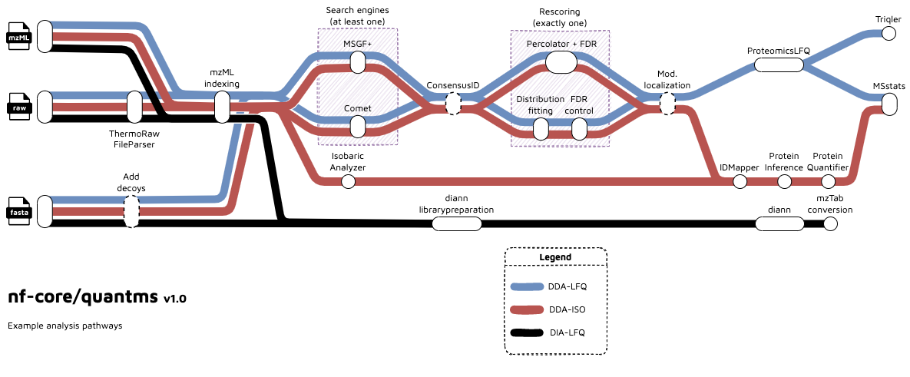
Quantification
In the proteininference step peptides and proteins from all samples are aggregated into a final protein list.
Final peptide and protein FDR threshold are applied at this steps.
Final outputs of the pipeline export the protein quantification values into mzTab, Triqler and Msstats

Slide 13
Label-free quantification with DDA (LFQ)-1
Label-Free Qualification/ Protein inference and quantification
Tool: proteomicsLFQ
Relevant parameters
a. Peptides Used for Quantification: -protein_quant = ‘unique_peptides’ (by default) or
-protein_quant ‘shared_peptides’
b. Quantification Methods: quantification_method=‘feature_intensity’(by default) or
quantification_method ‘spectral_counting’
c. Quantify Decoys: not qualified by default, but by using the parameter quantify_decoys
and is auto-enabled when triqler output is enabled
Match Between Runs(MBR)
To improve the quantified features
To enable MBRs: –targeted_only false
The peptide quantified in > 50% of all maps selected for MBR, and the mean observed RT (and theoretical m/z) of the peptide for a 2nd round of targeted extraction.

Slide 14
Label-free quantification with DDA (LFQ)-2
The methods for ProteomicsLFQ to extract features
ID-based (targeted only):
Uses targeted feature detection using RT and m/z information derived from identification
data to extract features. Note: only identifications found in a particular MS run are used to
extract features in the same run. No transfer of IDs (match between runs) is performed.
both ID-based and untargeted:
Adds untargeted feature detection to obtain quantities from unidentified features. Transfer of
Ids (match between runs) is performed by transfering feature identifications to coeluting,
unidentified features with similar mass and RT in other runs
Map alignment
Star alignment: by default, alignment_order=‘star’
uses the MapAlignmentAlgorithmIdentification algorithm to align all data to the reference run
with the highest number of identifications
Tree guided alignment
Output of a result of porteomicsLFQ analysis
mzTab file with analysis results
Analysis results for statistical downstream analysis in MSstats and Triqler
ConsensusXML file for visualization and further processing in OpenMS

Slide 15
Isobaric quantification with DDA (TMT)-1
Most common Isobaric labelling methods: Tandem Mass Tags(TMTs) and
Isobaric Tags for Relative and Absolute Quantification (iTRAQ)
Isobaric Analyzer
Labeling methods like iTRAQ 4-plex and 8-plex / TMT 6-plex, 10-plex, 11-plex, and 16-plex spported
In this step, the analyzer extracts the isobaric reporter ion intensities from centroided MS2 or MS3 data(MSn) in mzML files, then performs isotope corrections and stores the resuling quantification in a consensus map.
Each consensus feature represents one relevant MSn scan(e.g. HCD)
In TMT/iTRAQ data analysis, the SDRF must be annotated to capture the experimental design for the data analysis
Isobaric modification MUST be annotated as modification parameters in the SDRF, the label(comment[label]) is needed to define the specific channel for each sample. Channel TMT126 used as the reference channel.

Slide 16
Isobaric quantification with DDA (TMT)-2
Protein Inference
Aggregation
Bayesian
Protein FDR
Using the concatenated target-decoy database and the equation
FDR=(𝑁decoy+1)𝑁target. Groups are counted as decoy if they consist of only decoy proteins. FDRs are then
converted to q-values.
By default, quantms uses the “picked” target/decoy strategy (picked_FDR) which is recommended for large
proteomics experiments
Protein Quantification
the input consesusXML file
feature intensities accumulated to peptide abundances, and the peptide abundances are averaged to protein abundance. By default, the top 3 peptide abundances for quantification. Or the parameter –top 4
Only proteotypic peptides (those matching to exactly one protein) are used for protein quantification by default.
Peptide/protein IDs from multiple identification runs can be handled, but will not be differentiated
Peptides with the same sequence, but with different modifications are quantified separately on the peptide level but treated as one peptide for the protein quantification.
Output
mzTab, msstats output and OpenMS protein quantitation output

Slide 17
Data-independent acquisition (DIA) quantification
RAW file conversion to mzML (thermorawfileparser)
DIA-NN analysis (dia-nn)
Generation of output files (msstats)
QC reports generation (pmultiqc)

Slide 18
Formats in Quantms-Output Formats
DDA-LFQ quantification results:
proteomicslfq/out.consensusXML
proteomicslfq/out_msstats.csv
proteomicslfq/out_triqler.tsv
proteomicslfq/out.mzTab
DDA-ISO quantification results:
proteinquantifier/out.mzTab
proteinquantifier/peptide_out.csv
proteinquantifier/protein_out.csv
msstatsconverter/out_msstats.csv
DIA-LFQ quantification results:
convert2msstats/out_msstats.csv
MSstats-processed results
msstats/out_msstats.mzTab
MultiQC and pMultiQC
multiqc/<aligner>
multiqc_report.html: a standalone HTML file that can be viewed in your web browser.
multiqc_data/: directory containing parsed statistics from the different tools used in the pipeline.
results
spectra data:
thermorawfileparser/*.mzML
identification results:
searchenginecomet/*.idXML
searchenginemsgf/*.idXML
consensusID identifications:
consensusid/*.idXML
pipeline information:
pipeline_info/...
pipeline_info/ - Reports generated by Nextflow: execution_report.html, execution_timeline.html, execution_trace.txt and
pipeline_dag.dot/pipeline_dag.svg. - Reports generated by the pipeline:
pipeline_report.html, pipeline_report.txt and software_versions.yml.
The pipeline_report* files will only be present if the --email / --email_on_fail parameter's are used when running the pipeline.
- Reformatted samplesheet files used as input to the pipeline: samplesheet.valid.csv

Slide 19
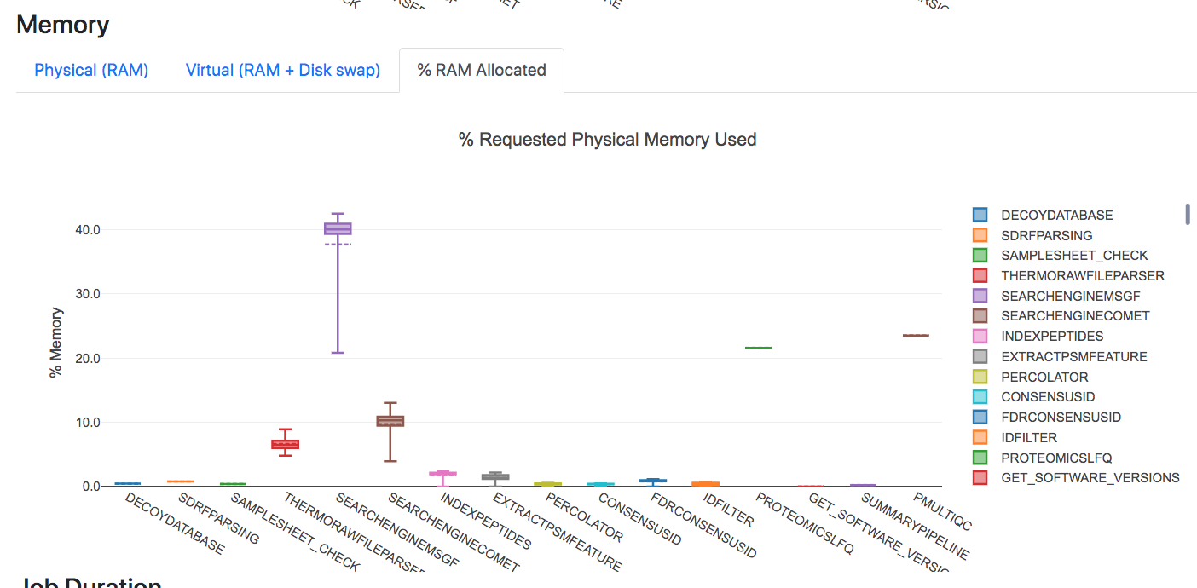
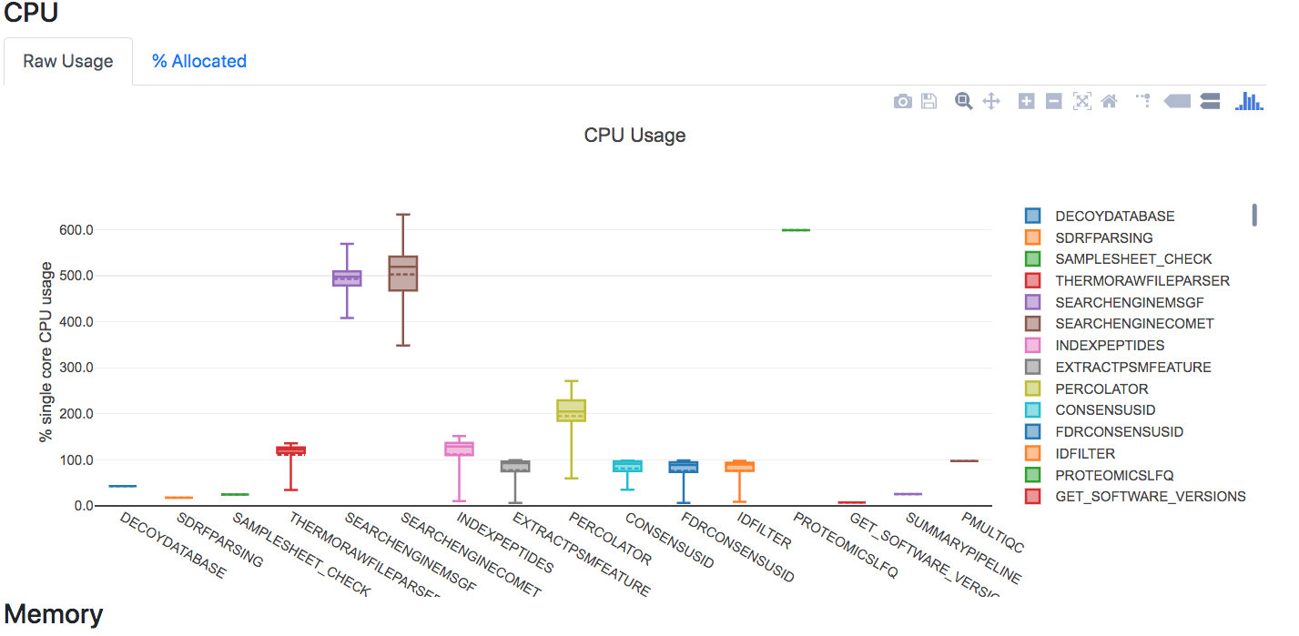
Reporting the workflow resources.

Slide 20
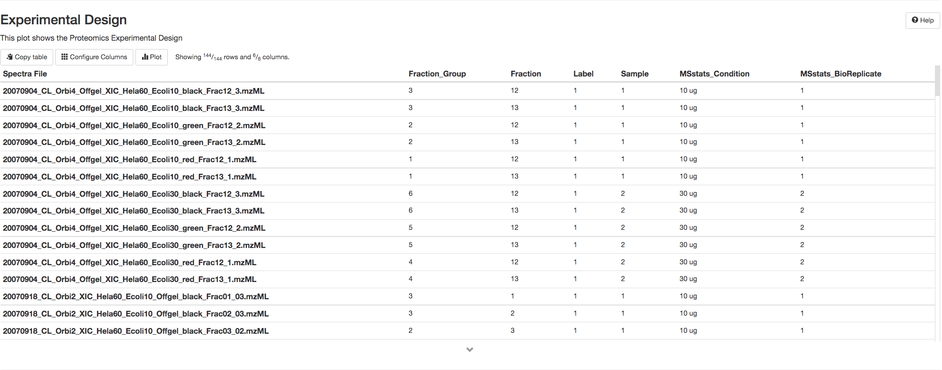
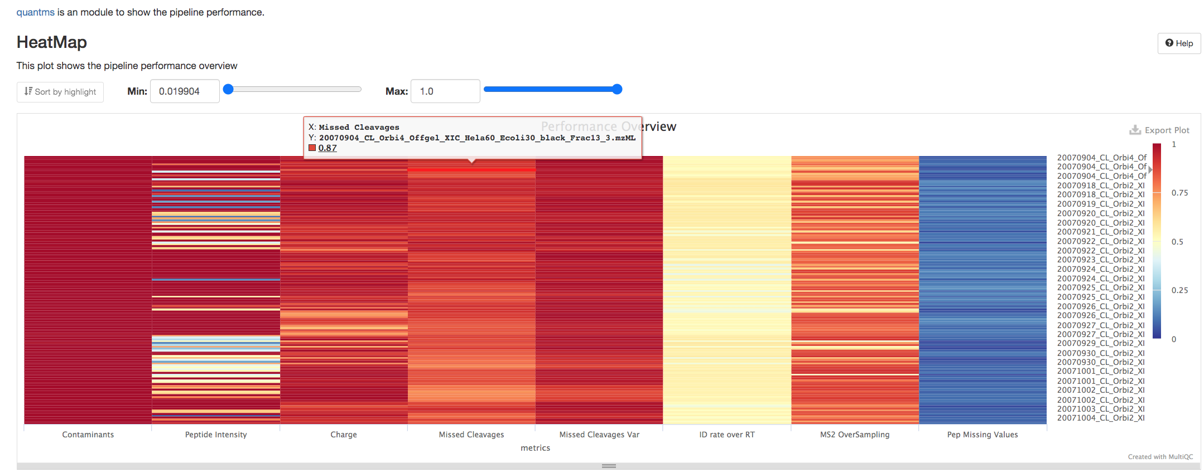
QC reports with pmultiqc
Experimental design in Msstats
Quality Control over all the MS runs:
Intensity
Charge
Rt
Miss-cleavages
https://tinyurl.com/2p85txhc

Slide 21
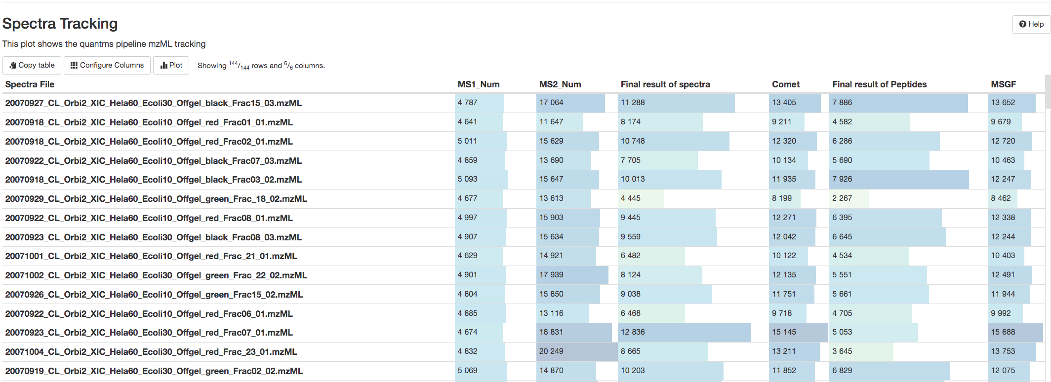
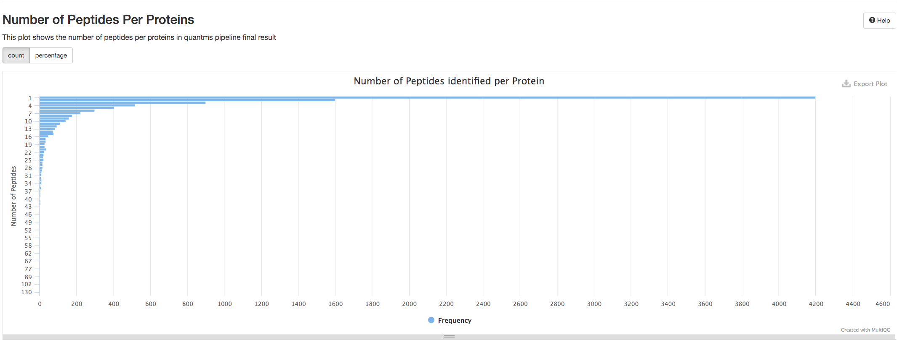
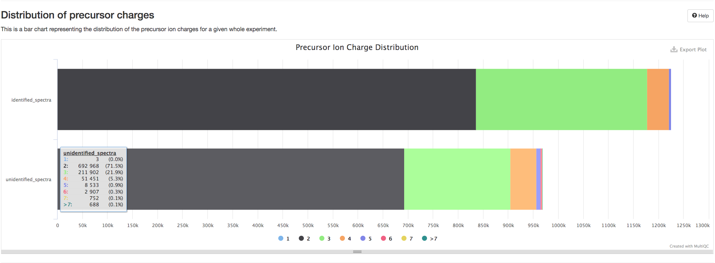
QC reports with pmultiqc
https://tinyurl.com/2p85txhc

Slide 22
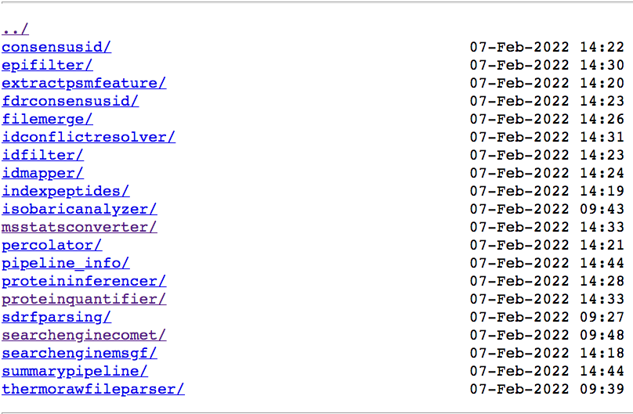
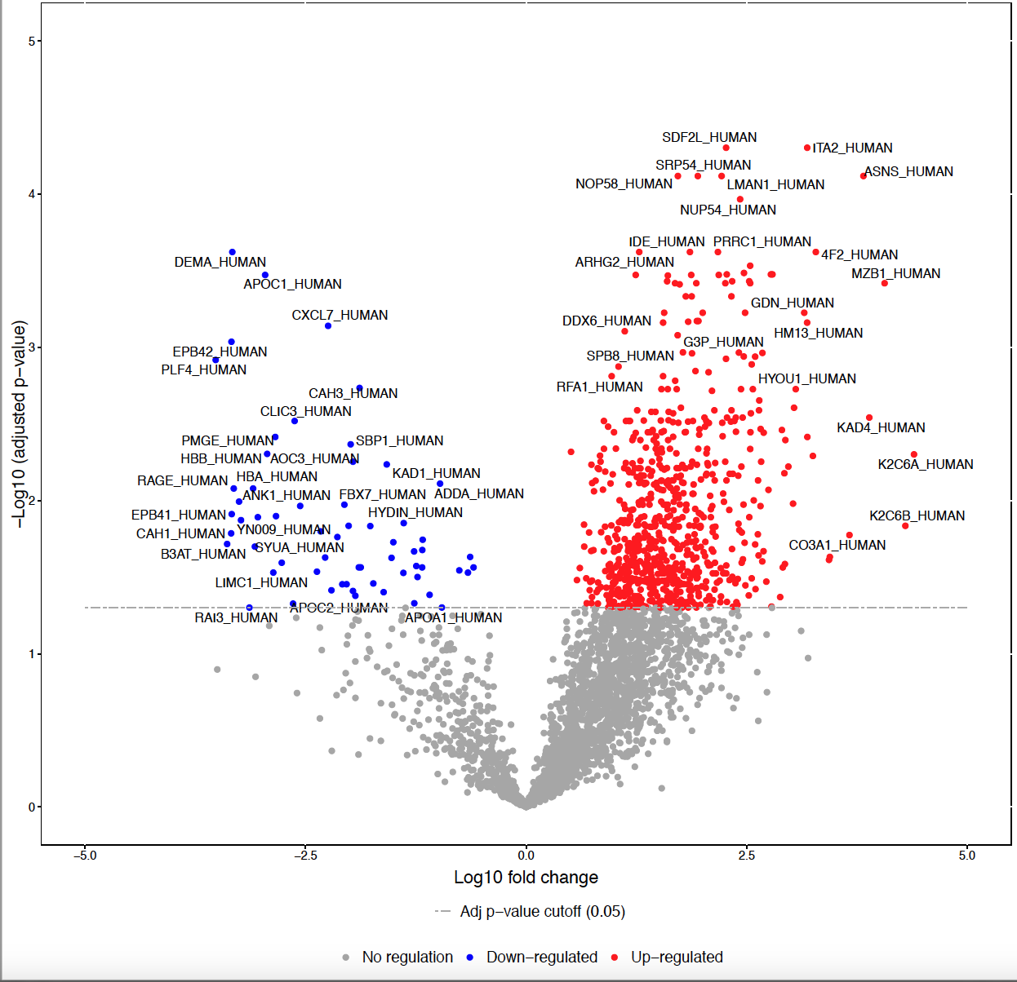
Results of quantms
Results, intermediate steps and information execution of the pipeline are stored in multiple folders.

