Slide 1

CCS6314 Cryptography and Data Security Assignment Group B
Group Member Lists:
Wong Zhi Lin 1201203299
Cheah Wei Yan 1201203703
Chay Chun Keat 1211200378
Dylan Cheng Zhi Xin 1211200579

Slide 2
Introduction
Cryptography: From Past to Present
Historically protected communication/data.
Evolved from simple classical ciphers to advanced systems.
Classical methods (substitution, transposition) now vulnerable.
Modern cryptography uses complex math & dual encryption.
Project Overview: Cryptography CLI Tool
CLI tool for experimenting with encryption/decryption.
Implements Playfair, Rail Fence, and Product Ciphers.
RSA key exchange for secure communication.
AES/Triple DES for symmetric encryption.
Investigation Focus
Testing speed and security of encryption/decryption protocols.
Analyzing weaknesses of classical ciphers.
Evaluating security of modern hybrid encryption.
Studying impact of data errors on encrypted data.
Key Benefit
Provides a practical, real-world understanding of cryptography.

Slide 3
Background Study
Background study in cryptography involves understanding its evolution from classical methods to modern standards.
Classical Cryptography:
Relies on substitution and transposition ciphers.
Substitution ciphers replace plaintext characters with different symbols based on a key.
Transposition ciphers shuffle the characters of the message.
Examples include the Playfair cipher and Rail Fence cipher.
Classical methods are vulnerable to frequency analysis and brute-force attacks due to advances in computing.
Playfair Cipher:
A substitution cipher that encrypts pairs of letters using a 5x5 key matrix.
More secure than simple monoalphabetic ciphers but still vulnerable to modern computational techniques.
Rail Fence Cipher:
A transposition cipher that writes plaintext in a zigzag pattern and reads it row by row.
Disrupts character placement but can be decrypted relatively easily.

Slide 4
Product Ciphers:
Combine Playfair and Rail Fence ciphers for stronger protection using both substitution and transposition.
Modern Cryptography:
Uses symmetric and asymmetric encryption methods for stronger security.
Symmetric encryption uses the same key for encryption and decryption, examples include AES and Triple DES[1].
Asymmetric encryption (public-key cryptography) uses a pair of keys: a public key for encryption and a private key for decryption; an example is RSA.
RSA solves the key distribution problem by securely transporting symmetric keys.
Data Integrity:
Bit errors during ciphertext transmission can compromise security.
Encryption methods like AES in CBC mode can be significantly affected by single-bit errors.
Secure communication systems must be designed to handle transmission errors.
Project Application:
CLI-based system to implement and evaluate cryptographic techniques.
Interactive user testing of encryption, decryption, and key exchange processes.
Analysis of classical and modern methods to understand their strengths, weaknesses, and practical uses.

Slide 5
Description of the Concepts, Methods, and Algorithms Used
Classical Symmetric Ciphers :
Playfair Cipher (Substitution Cipher)
Matrix: 5×5 matrix (e.g., keyword MONARCHY), excludes ‘J.’
Encryption Process:
Convert plaintext into letter pairs; add extra letters if needed.
Same row: Replace letters with next in row.
Same column: Replace letters with the one below.
Rectangle: Swap diagonally.
Decryption: Reverse the encryption steps.
Security:
More secure than monoalphabetic ciphers.
Vulnerable to digraph frequency analysis and brute-force attacks.

Slide 6
Rail Fence Cipher (Transposition Cipher)
Encryption Process:
Choose rail depth (number of rows).
Write plaintext in zigzag pattern across rows.
Read ciphertext row-wise.
Decryption:
Recreate zigzag pattern and read letters in the same sequence.
Security:
Harder to crack than simple ciphers.
Vulnerable to pattern recognition attacks.
Can be combined with substitution ciphers for better security.
Product Cipher (Playfair + Rail Fence)
Process: Combines Playfair (substitution) and Rail Fence (transposition).
Security Benefits:
Playfair disguises letter frequencies.
Rail Fence disrupts character order.
More resistant to traditional cryptanalysis.

Slide 7
Modern Cryptograpy: Hybrid Encryption Approach :
RSA Algorithm (Asymmetric Key Exchange)
Key Generation:
Choose large primes (p, q); compute n = p × q.
Calculate φ(n) = (p-1)(q-1).
Public key: Choose e (commonly 65537).
Private key: d = e⁻¹ mod φ(n).
Encryption: C = M^e mod n.
Decryption: M = C^d mod n.
Security:
Based on the difficulty of factoring large numbers.
Used for secure key exchange (not ideal for large data encryption).

Slide 8
AES (Advanced Encryption Standard)
Process:
Key Expansion: Generates multiple round keys.
Initial Round: Adds first-round key.
Main Rounds (10 rounds for AES-128):
SubBytes: Byte substitution using S-box.
ShiftRows: Left shift for diffusion.
MixColumns: Column mixing for further diffusion.
AddRoundKey: XOR with the round key.
Final Round: No MixColumns.
Security:
Resistant to brute-force due to large key sizes (128, 192, 256 bits).
Efficient and widely used in SSL/TLS and other applications.

Slide 9
Implementation Details
Development Environment and Tools
Language – Java
Java Version – JDK 8 or later
Libraries used – import java.security.SecureRandom;
import java.util.Base64;
import java.util.Scanner;
import javax.crypto.SecretKey;
import java.time.Duration;
import java.time.Instant;
import java.math.BigInteger;
import javax.crypto.spec.SecretKeySpec;
import javax.crypto.Cipher;
import javax.crypto.spec.IvParameterSpec;

Slide 10
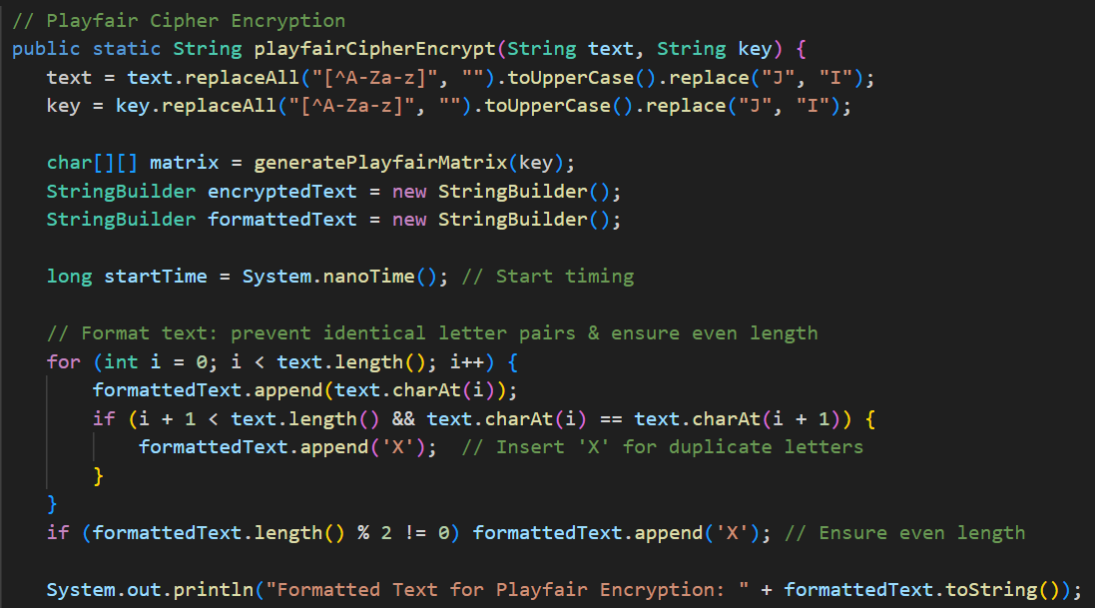
Implementation of Classical Symmetric Ciphers
Playfair Cipher Implementation

Slide 11
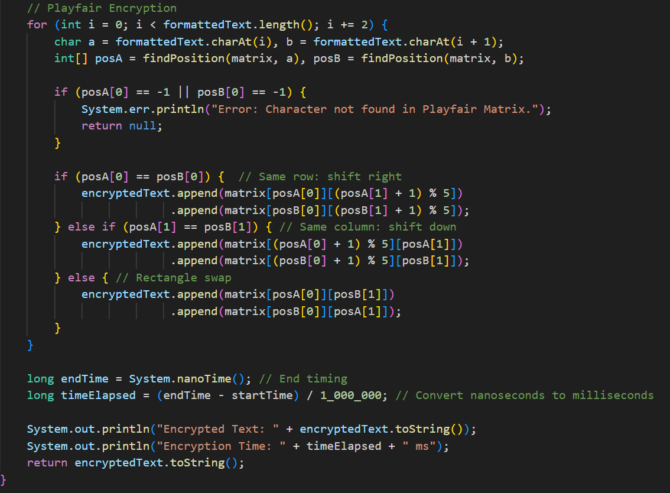
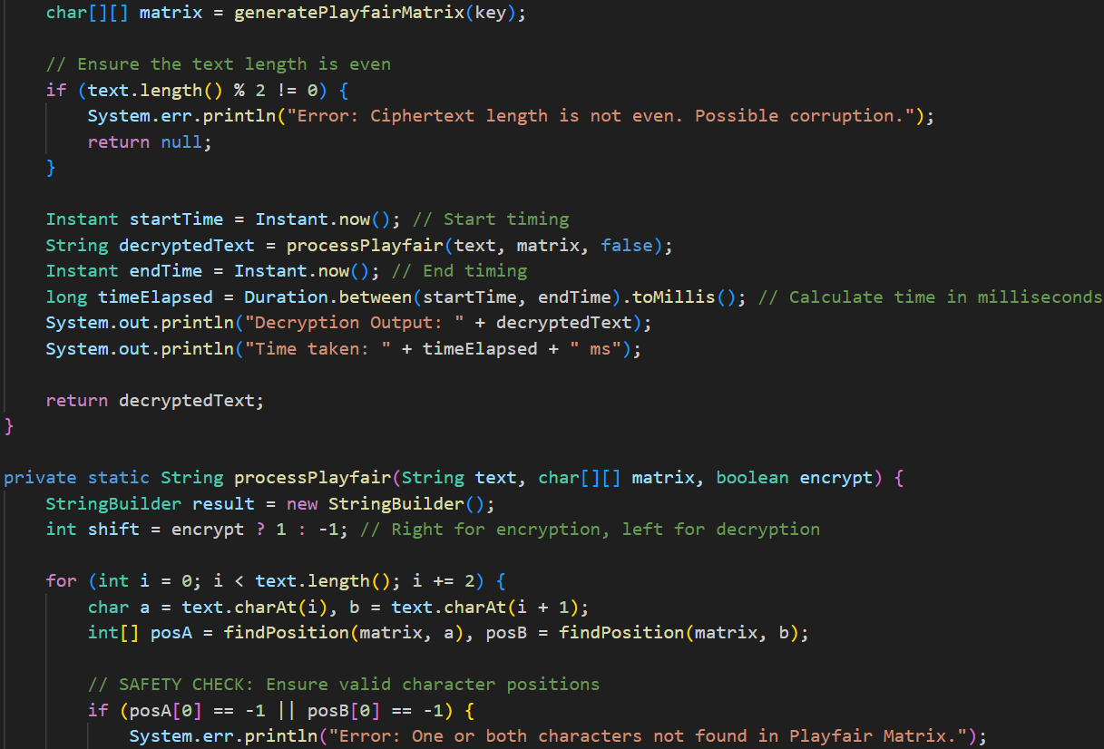

Slide 12
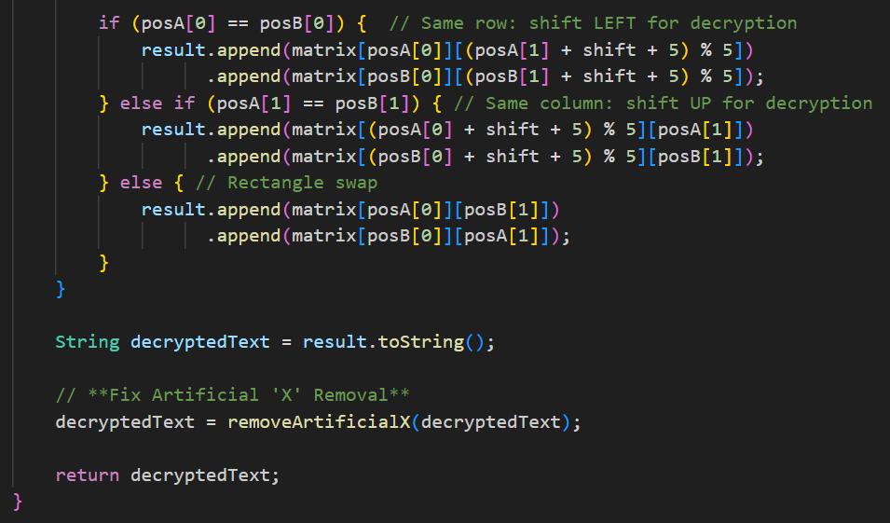

Slide 13
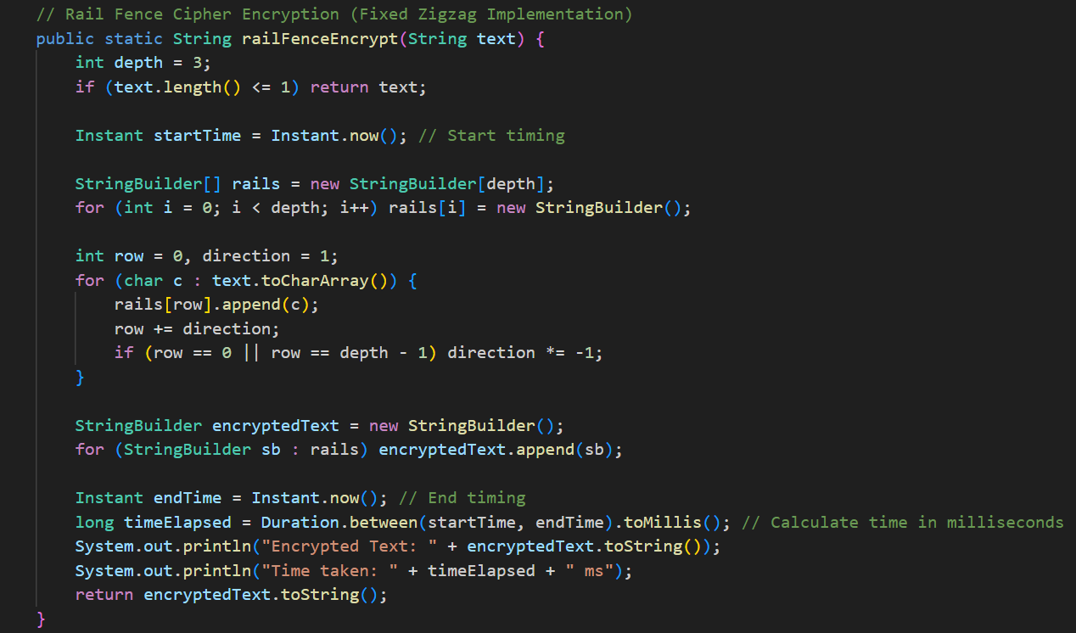
Rail Fence Cipher Implementation

Slide 14
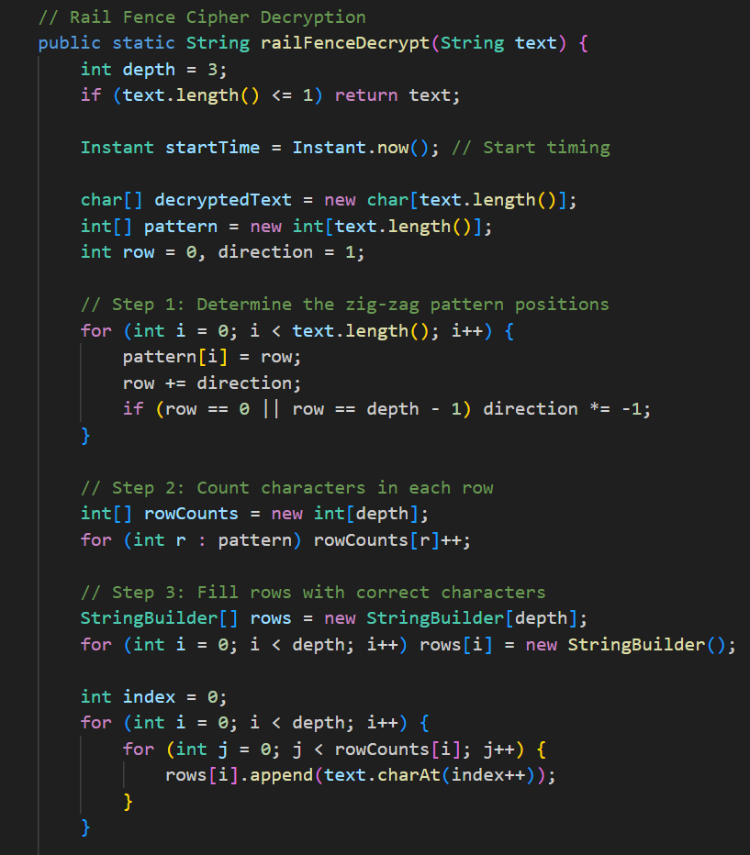
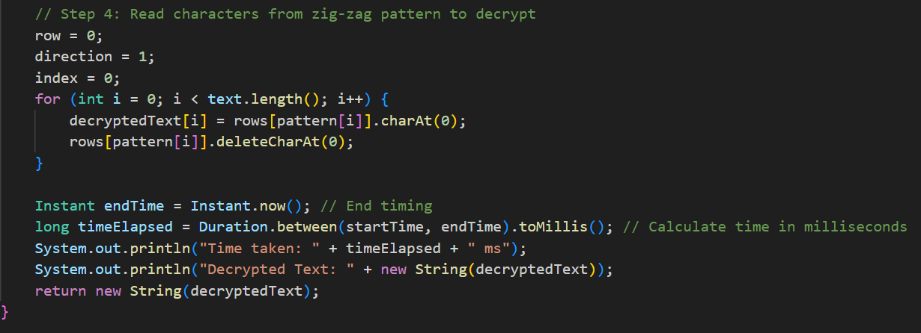

Slide 15
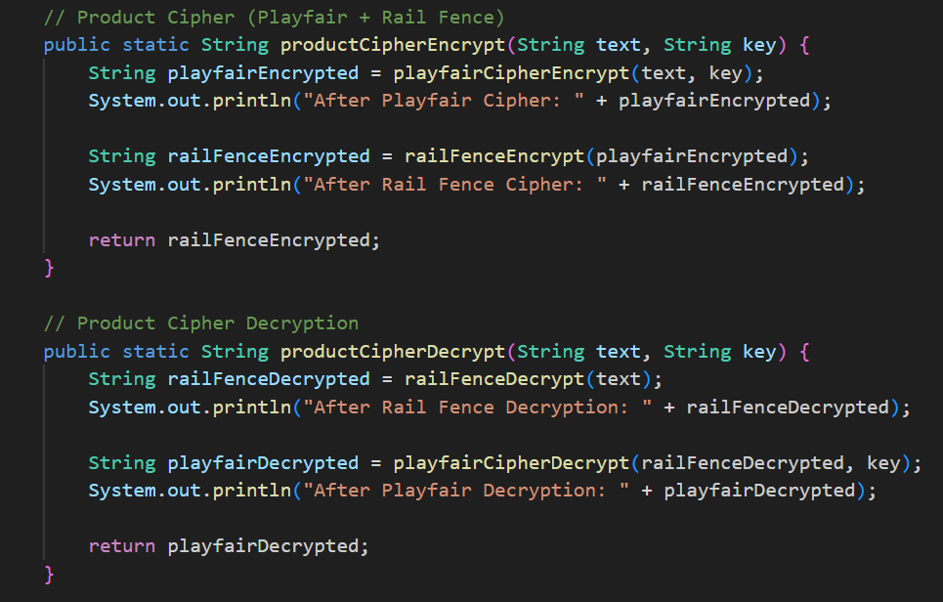
Product Cipher Implementation – Playfair + Rail Fence

Slide 16
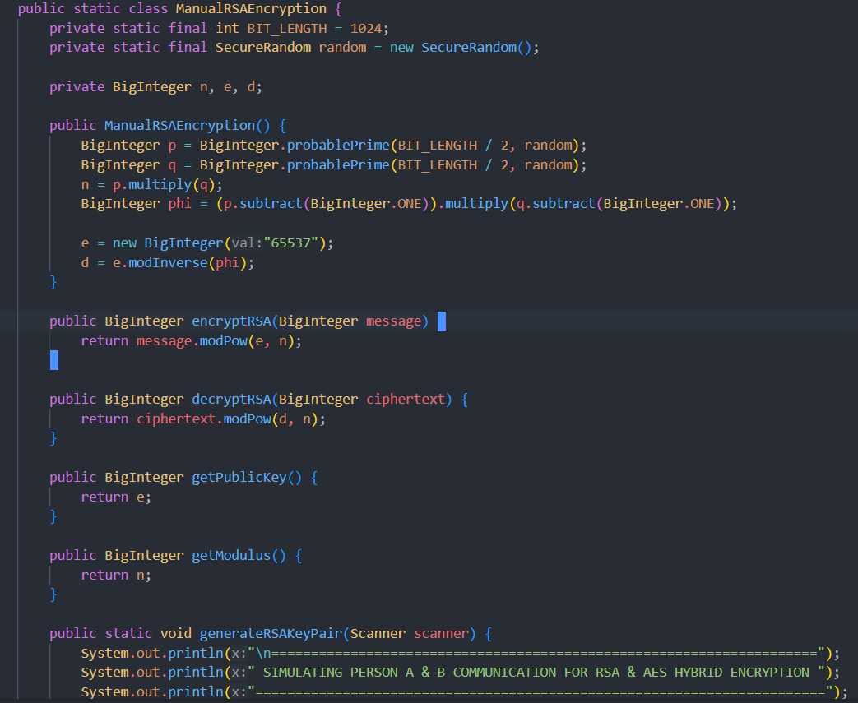
Implementation of Modern Cryptograhy
RSA Key Exchange Implementation

Slide 17
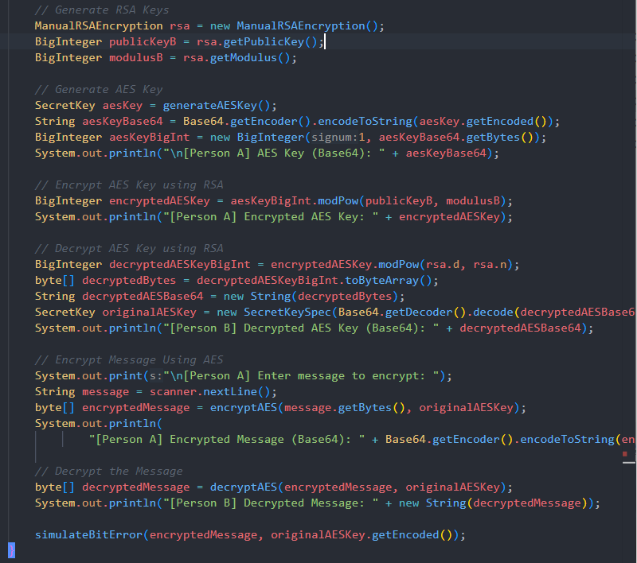

Slide 18
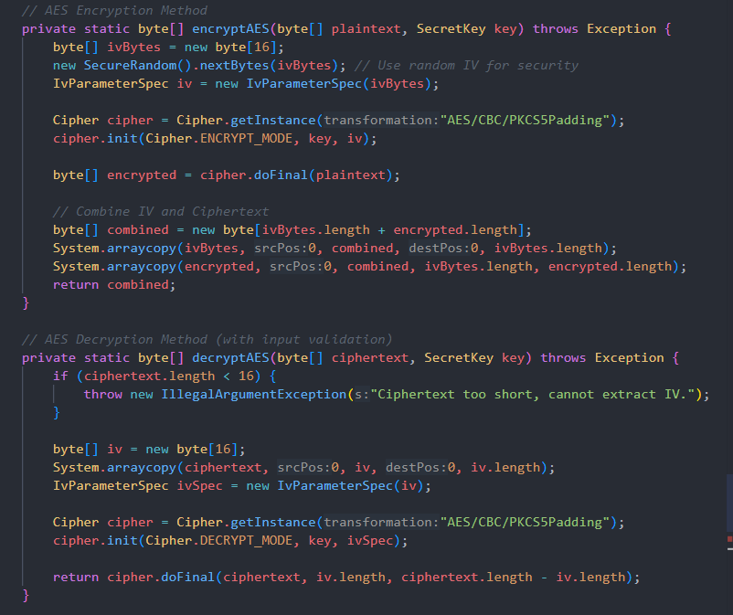
AES Encryption Implementation –CBC Mode

Slide 19
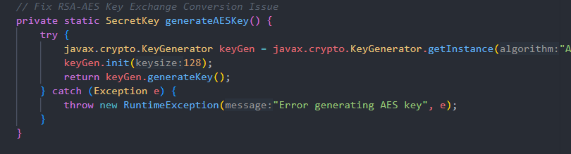
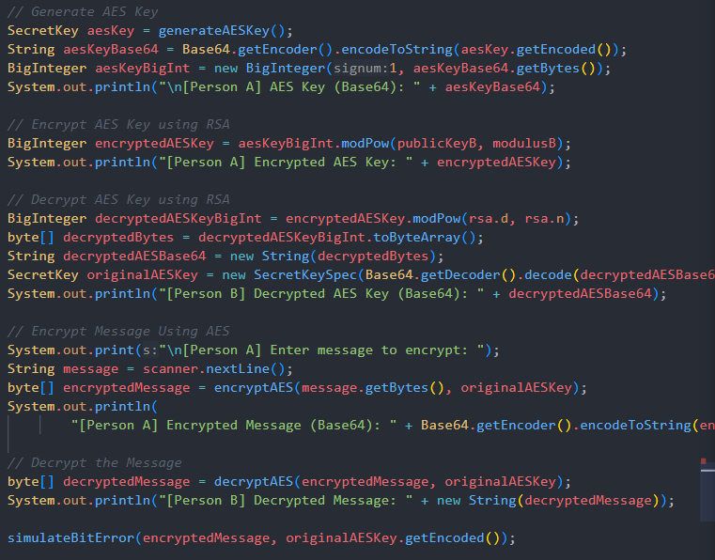

Slide 20
Comparison and Discussion of the Result
Playfair Cipher | Rail Fence Cipher (Depth=3) | Product Cipher (Playfair + Rail Fence)
Substitution-based encryption using a 5×5 matrix Fast encryption & decryption (~1 ms) Weakness: Susceptible to frequency analysis | Transposition-based encryption in a zigzag pattern Very fast encryption & decryption (~0 ms) Weakness: Easily broken by brute-force | Combination of substitution & transposition Improved security over individual ciphers Weakness: Still vulnerable to modern cryptanalysis

Slide 21
Comparison and Discussion of the Result
RSA Key Exchange | AES (CBC Mode)
Used for secure key distribution (asymmetric encryption) Based on the difficulty of factoring large prime numbers Weakness: Slow and not suitable for encrypting large data | Symmetric encryption with high security and fast processing Encrypts data in fixed 128-bit blocks Weakness: Sensitive to bit errors (error propagation in CBC mode)

Slide 22
Comparison and Discussion of the Result
Classical ciphers (Playfair, Rail Fence) are fast but weak
Product Cipher improves security but still not practical for modern use
RSA is great for key exchange but slow for large data
AES is efficient & highly secure, but sensitive to bit errors
Best practice: Use hybrid encryption (RSA for key exchange + AES for data encryption)

Slide 23
Conclusion
Hybrid encryption (RSA for key exchange + AES for data encryption) is the best approach for secure digital communication
Cryptographic methods must balance security, performance, and application needs
Encryption research is crucial for enhancing security measures and combating emerging threats
Understanding cryptography helps in making informed decisions for real-world cybersecurity applications

