Slide 1





CCS6354: Blockchain & Smart Contract
NFT-Based
Digital Certificates
Group AA

Slide 2







The team
Wong Zhi Lin
Cheah Wei Yan
Teong Zhong Ming
Dylan Cheng Zhi Xin
1201203299
1201203703
1211200626
1211200579

Slide 3

Introduction
In the digital age, blockchain technology offers trust, transparency, and security across various domains, including academic certification. Traditional paper-based certificates are prone to loss, forgery, and inefficiency, posing challenges for both institutions and students.
This research proposes an NFT-based digital certificate system for Multimedia University Malaysia (MMU) to address these issues. NFTs, as unique blockchain assets, ensure secure issuance, tamper-proof storage, and seamless verification of academic credentials. The system leverages blockchain's decentralized nature for transparency, scalability, and long-term reliability, modernizing MMU’s processes and enhancing its reputation as an innovative institution.
By adopting this solution, MMU can streamline administrative operations, reduce fraud, and adapt to the demands of a digital-first world, placing itself at the forefront of educational technology.

Slide 4




LITERATURE REVIEW
A. Survey of Related Work
Researchers have explored blockchain and NFTs for secure digital certification. For instance, Khati proposed an NFT-based system where students mint certificates as NFTs to ensure data provenance and verification. Karamachoski et al. developed a blockchain-based diploma management system using smart contracts to enhance transparency and reduce administrative overhead. Wu & Liu highlighted NFTs for micro-certifications and academic rewards, emphasizing improved data integrity. Prado & Henriques introduced "on-block certs" on Ethereum, eliminating reliance on traditional authorities while ensuring certificate authenticity.
B. Identified Gaps
Despite progress, key limitations persist:
Scalability: Public blockchain solutions face performance and cost challenges with large-scale use.
User Accessibility: Non-technical users struggle with blockchain-NFT integration.
Data Privacy: Public ledgers risk exposing sensitive certificate data.
Low Adoption Rate: NFT-based certification lacks widespread acceptance among institutions and employers.
C. Relevance to the Project
This project addresses these gaps by:
Efficient Verification: Simplifying certificate validation through a user-friendly interface.
Privacy-Centric Design: Using encryption and selective access for secure data sharing.
Improved Scalability: Adopting hybrid solutions, such as off-chain storage with on-chain NFT references.
Tailored for MMU’s needs, this system integrates with administrative processes to streamline certificate management, ensuring security, usability, and institutional relevance.

Slide 5
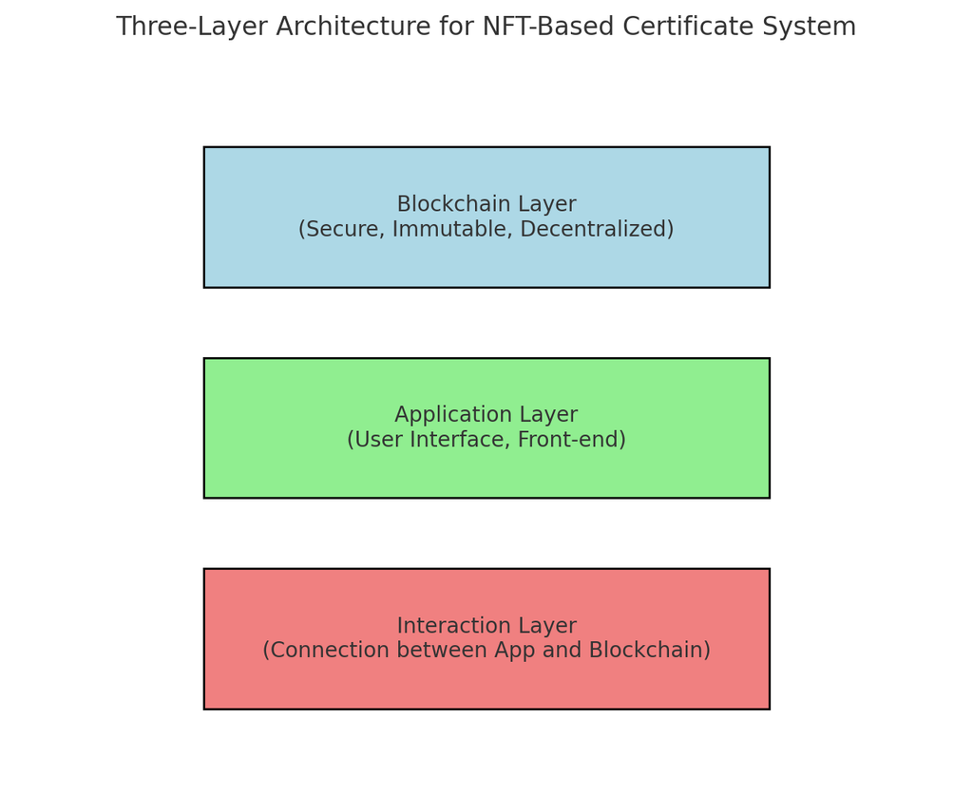

Methodology
•System Design Overview
1.Blockchain Layer:
Provides security, transparency, and immutability.
Uses Ethereum for creating and tokenizing unique certificates as NFTs.
Ensures trust through public verification.
2.Application Layer:
A user-friendly interface for administrators and students.
Built using HTML, CSS, and JavaScript.
Enables admins to post certificate details and students to verify their legitimacy.
3.Interaction Layer:
Connects the application and blockchain layers via Web3.js.
Handles transactions and real-time certificate validation.

Slide 6
Methodology
Smart Contract Development
•Technologies Used
Smart contracts were written in Solidity for creating, validating, and managing NFTs.
Development Tools:
Hardhat for testing, deployment, and smart contract management.
Ganache for simulating blockchain environments during testing.
Minting unique NFTs for certificates with metadata like student details and graduation date.
Certificate verification using blockchain records.
Ownership tracking via Ethereum wallet addresses.
Web Tools:
HTML, CSS, and JavaScript for the front-end.
Web3.js for blockchain interactions.
Wallet Integration:
MetaMask for secure authentication and transaction signing.

Slide 7

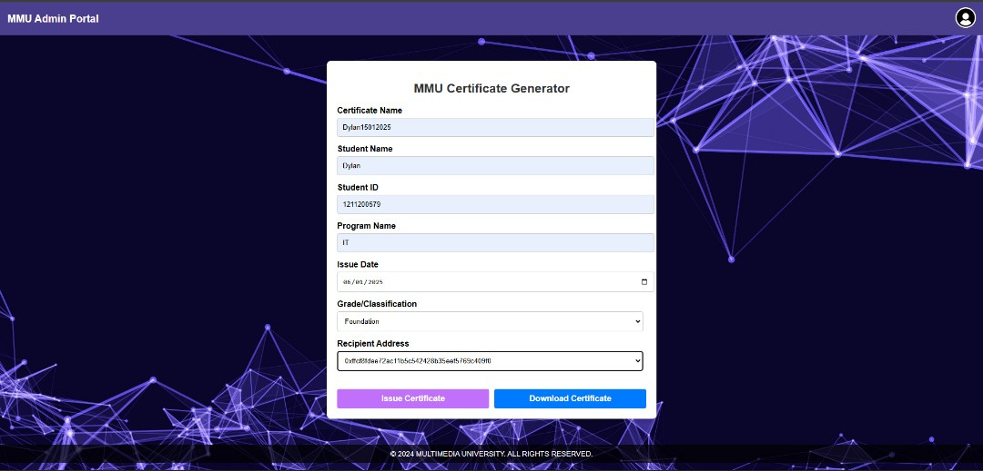
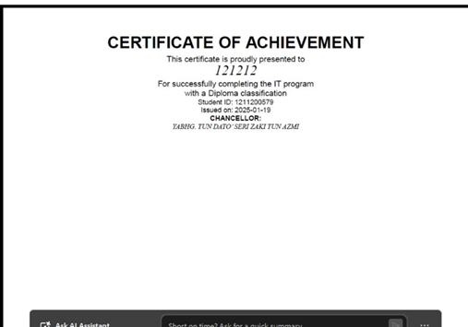
Research Result
Figure 2 shows the PDF generated
Figure 1 shows the MMU Certificate Generator

Slide 8
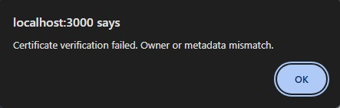
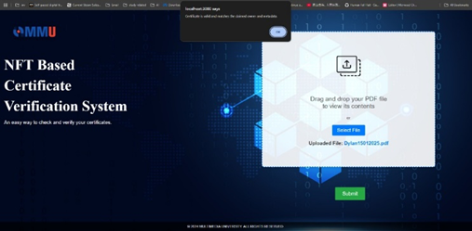
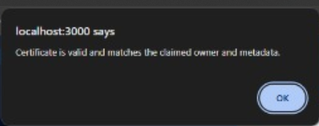
Research Result(cont.)
Figure 4 show the message that verification successful
Figure 3 show the error message if verification failed.

Slide 9
ANALYSIS AND INTERPRETATION
The system ensures secure and tamper-proof certificate issuance using blockchain and NFTs.
Verification tests confirmed high reliability and efficiency in preventing forgery.
Simplified user interface enables accessibility for non-technical users.
Challenges include high gas fees, scalability issues, and onboarding non-technical users.
Despite limitations, the system enhances credibility, efficiency, and paves the way for blockchain integration in education.

Slide 10
CONCLUSION
Purpose: Develop a blockchain-powered system to combat certificate forgery and loss while enhancing security, transparency, and credibility in academic credentials.
Key Features:
Admin Role:
Create certificates with student details.
Store certificates as NFTs on the blockchain for tamper-proof, decentralized records.
Option to download certificates as PDFs for offline use.
Student Role:
Upload certificates for verification.
Blockchain-based validation confirms authenticity with a "Verified Successfully" message for MMU-issued credentials.
Impact:
Ensures authenticity and reduces fraud significantly.
User-friendly for both administrators and students.
Pioneers the use of blockchain and NFTs for secure, reliable academic certification.
Future Scope: Encourages further blockchain-based innovations in the education sector.

Slide 11



DISCUSSIONS

Slide 12
THANK
YOU!

