Slide 1
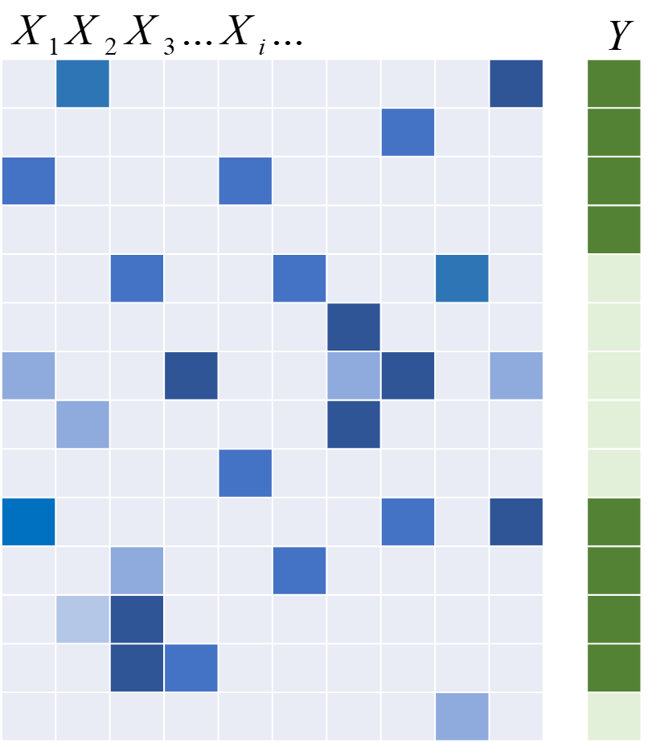
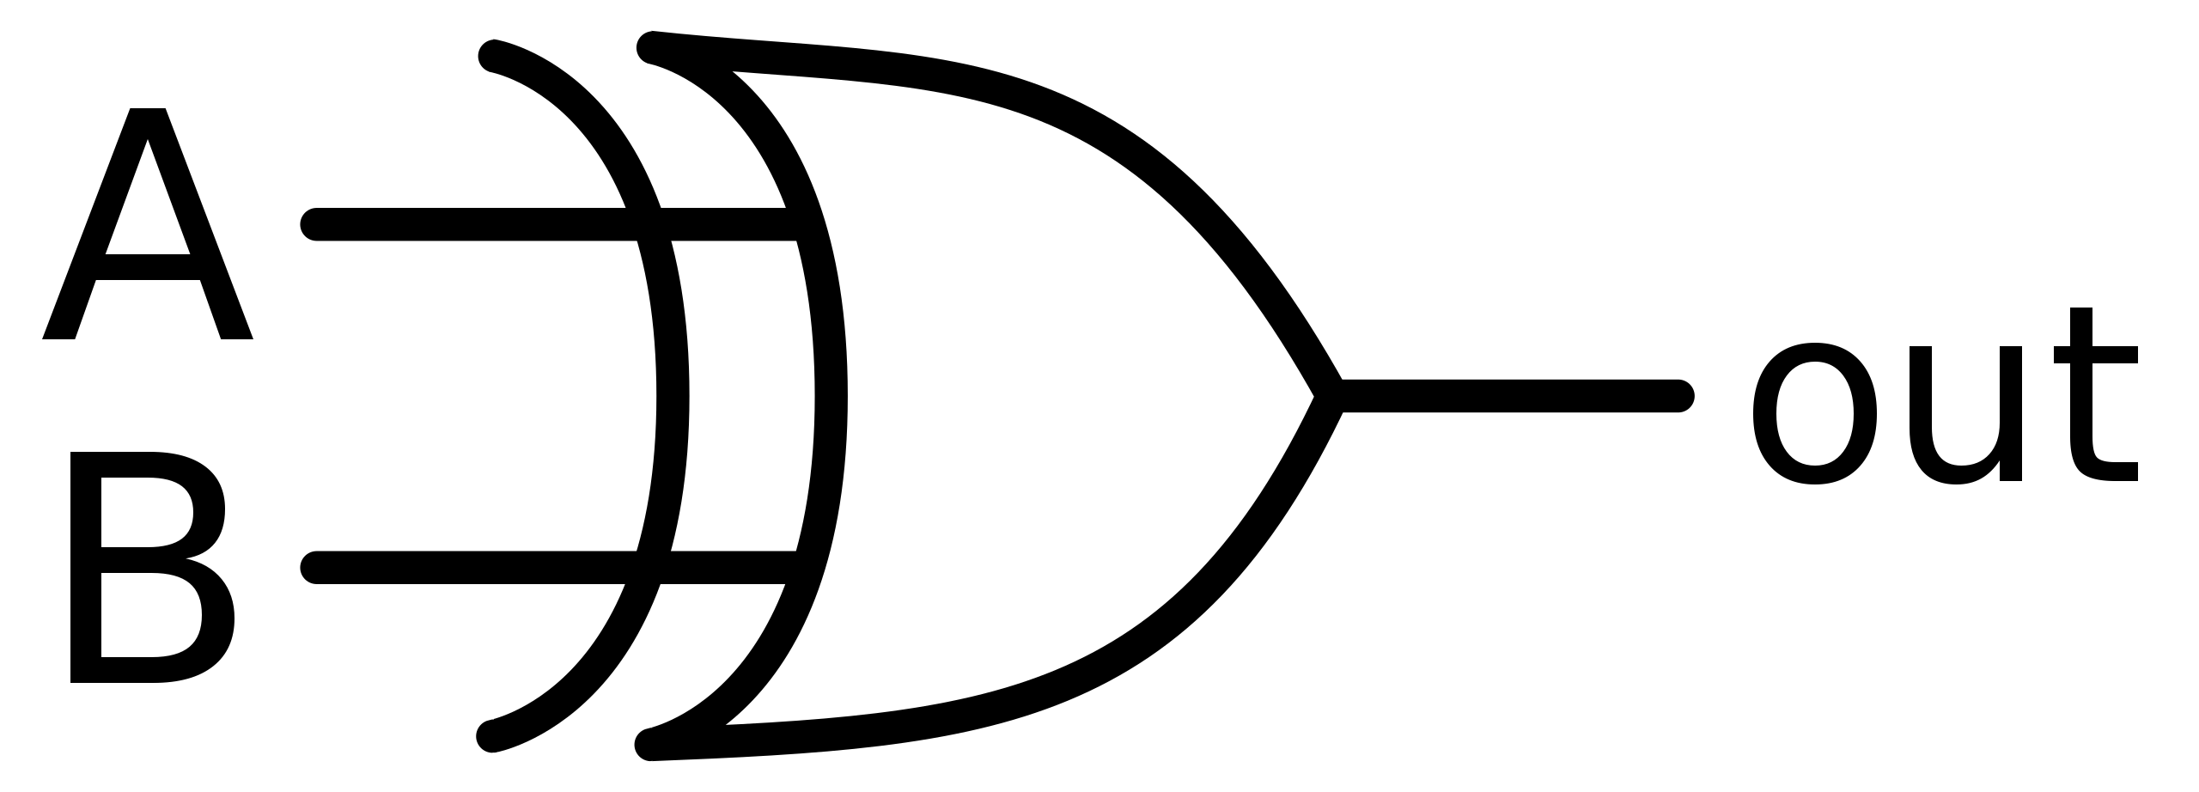


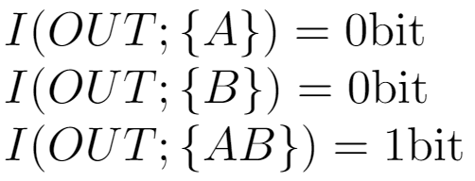



A | B | OUT
0 | 0 | 0
0 | 1 | 1
1 | 0 | 1
1 | 1 | 0

