Slide 1
사지방
오경준 양재혁

Slide 2
VarNet
MultiDomainNet
Ensemble
CrossDomainNet(7)
CrossDomainNet(8)

Slide 3
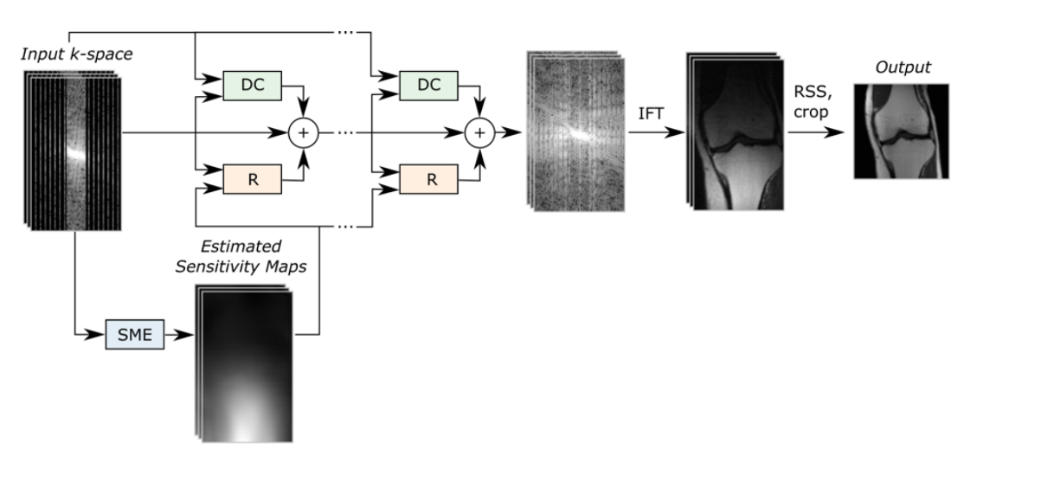
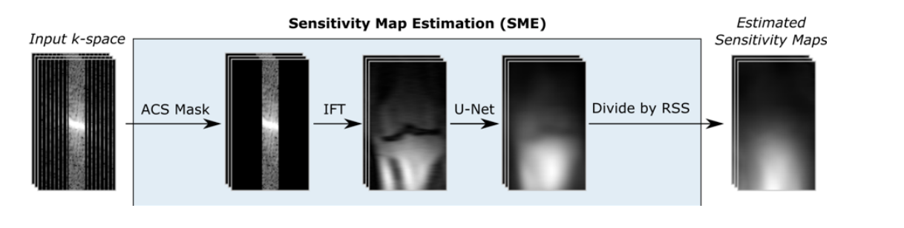
VarNet
FREEZE!

Slide 4
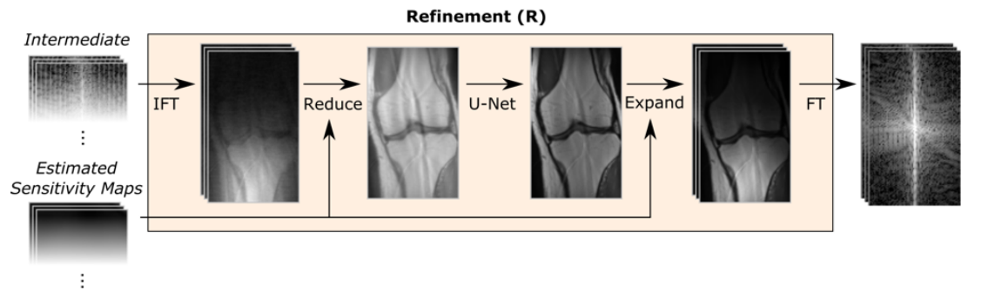




CrossDomainNet
& FT
IFT & Expand

Slide 5

MultiDomainNet
& FT
IFT & Expand

Slide 6
VarNet
I
I
I
I
I
I
I
I
MultiDomainNet
K+I
K+I
K+I
K+I
K+I
CrossDomainNet(7)
I
K
I
K
I
K
I
CrossDomainNet(8)
K
I
K
I
K
I
K
I

