Slide 1
Audience Segmentation Research Retail Customers Client Presentation Deck

Slide 2
Media Segmentation Research Objectives
1
Evaluate all audience segments by media target definition
Rank these by priority based on opportunity to support objectives
2
Discover insights into media preference, usage and behavior
Outline segment nuances and way to communicate with relevance
3
Provide strategy and creative teams with lifestyle beliefs and attitudes
Help craft relevant communications based on life stage and self-concepts
4
Look for useful insights into shopping habits, behavior and attitudes
Improve/leverage the retail experience
5
Summarize segments
Bullet point highlights

Slide 3
Methodology/Approach – Step 1
Compare demographic and psychographic data between those that prefer to drink/socialize out vs those who prefer to drink/socialize at home.
SPIRIT
DRINKERS
GEO-
VIRGINIA
DRINK
AT HOME
STEP 05
Most favorable target would be those that prefer to drink at home and purchase from ABC.
Only significant difference is age – A/22-34 & A/50-59 prefer to drink at home.
SPIRIT
DRINKERS
GEO-
VIRGINIA
DRINK OUT
Restaurant/Bar

Slide 4
Methodology/Approach – Step 2
Using the more preferred “drink at home”, the next step was to determine if those who drink at home 1-4 times a month have different behaviors and demographics then those that drink 10+ times a month.
SPIRIT
DRINKERS
GEO-
VIRGINIA
DRINK
AT HOME
1- 4
Drinks per Month
STEP 05
We found almost zero difference in demographics and behaviors between those who drink at home 1-4 times a month or 10+ times a month.
Statistically, there are no significant relevant differences.
SPIRIT
DRINKERS
GEO-
VIRGINIA
DRINK
AT HOME
10+
Drinks per Month

Slide 5
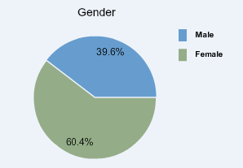
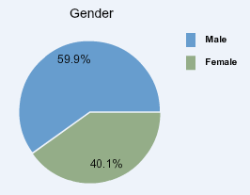
Methodology/Approach – Step 3
We repeated our methodology steps 1 & 2 for both Beer and Wine Drinkers in Virginia. We found that in almost all areas there were significant similarities and not enough variances to quantify a statistical difference.
There is a slight skew in gender and age.
STEP 05
Wine Drinkers
Beer Drinkers

Slide 6
Methodology/Approach – Step 4
There are few behavioral or attitude differences between; Those who drink at home or those who drink out, those who drink 10 or more drinks a month or those who drink 1-4 a month, and those who drink beer or those who drink wine.
There are some demographic differences between those that drink at home or drink out.
Because the differences seem to center around demographics our next step was to break down spirit drinkers age demographics by 5 year demo cells.
STEP 05
Spirit drinkers by 5 year increments
Grouped increments into similar behaviors and attitudes
Discovered 4 audience segments

Slide 7

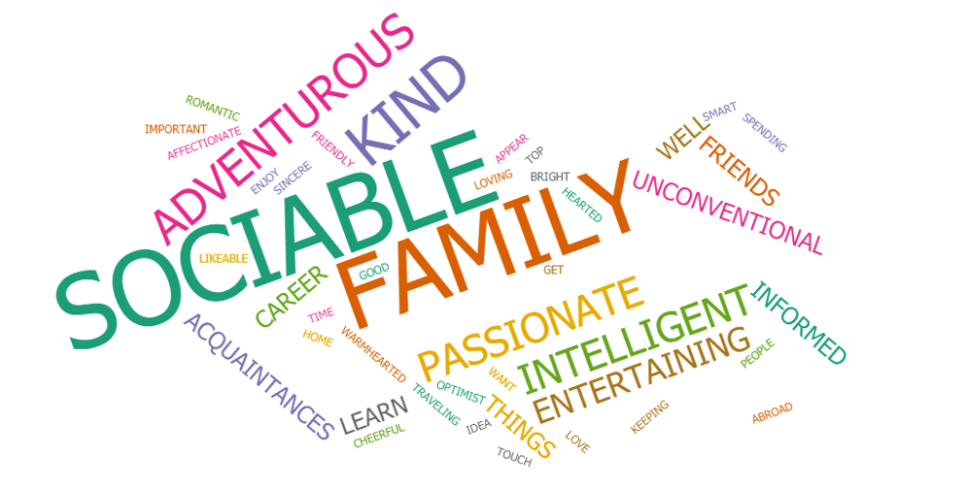
Segment 1 – Primary Audience 30-39
Demographic & Psychographic Summary
Demographics Adults 30-39. Slight advantage Male. HHI $88K. Married 59.3%. Kids 39.9%
Potential Base 28.8% of Spirit Drinkers.
Self Concepts Adventurous. Loving. Romantic. Smart. Likeable.
Brand Loyalty Buys unknown brands to save money (#1). Will buy spur of the moment. Likes to change brands often for variety. Not brand loyal.
Leisure Times Travel. Barbecuing. Board games. Beach trips. Entertaining at home.
Shopping Attitudes Store environment important (#1). Preplans shopping trips online. Looks for special offers. Responds to free standing displays with product.
Priorities Family. Career advancement. Aspires to own business. Likes to stay informed and continue to learn.
Shopping Behavior Largest groups are virtual shoppers (29%) and Upscale clicks & bricks (23%). 21% store/brand loyal

Slide 8
Segment 1 - Primary Audience
Weekly Reach by Channel and Time Spent with Each
99%
99%
88%
74%
68%
45%
23 Hours
14 Hours
7 Hours
8/12 Hours
8 Hours
2 Hours
Television
Mobil Phone
Radio
PC Home/Work
Streaming/Video
Newspaper
TV still provides the most reach and time spent by the consumer.
Mostly viewed live but are engaging in alternative viewing.
Both mobile and television provide full reach by channel. Television captures more hours, but mobile offers more diversity and real-time metrics.
Provides great reach but less time per week. The value here is that we know exactly what that 1 hour a day is and it is easy to target.
PC options are many; email, display, SEM, native content, and timed media based on device behavior.
This channel continues to grow in use by multiple age groups. There are many opportunities to engage the primary audience with video.
Newsprint only captures 2 hours per week. Print is still an option but community papers and tabloids do a better job of reaching the Primary audience.

Slide 9
Segment 1 – Primary Audience
Smartphone/Device Use
100%
86%
71%
68%
65%
1
Use Smartphone 14+ hours per week
84% access social media primarily via Smartphone
2
86% Access the Web via Smartphone
All Web interaction should be responsive
3
High social media frequency and engagement
71% visit social media sites 3+ times per day
4
Streaming media & music (multiple formats)
66% of this are accessing via Smartphone
5
60% reach with Tablet.
They spend over 7 hours a week – often used while watching TV.

Slide 10
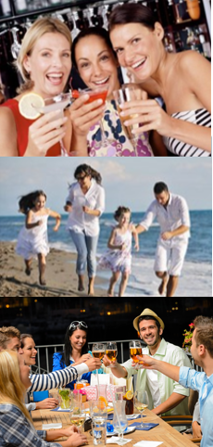

Segment 1 - Primary Audience
Actionable Insights:
Largest group of spirit drinkers
Most potential to increase transaction value and share of glass. Not brand loyal so upsell is possible. Base is largest in volume.
Not yet brand loyal
Beginning to have disposable income
Most ENGAGED in social media – more than 21-29 segment

Slide 11

Segment 2 – Persudables 21-29
Demographic & Psychographic Summary
Demographics Adults 21-29. Even split male/female. Married 23.9%. Kids 32.4%
Potential Base 25.3% of Spirit Drinkers.
Self Concepts Passionate. Risk Taker. Adventurous. Unconventional.
Brand Loyalty Low price more important than brand.
Often buys spur of the moment.
Likes to change brands often for variety.
Leisure Times Music is HUGE. Group activities/board games. Clubs/Dancing. Beach trips..
Shopping Attitudes Looks for discounts. Loves in-store samples. Looks for variety of stores (n/a for ABC)
Priorities Career focused. Envisions owning business one day. Sees the value in continuing to learn. .
Shopping Behavior 30% online shoppers. 24% status shoppers. 21% Upscale clicks & bricks

Slide 12
Segment 2 – Persudables
Weekly Reach by Channel and Time Spent with Each
98%
98%
83%
71%
70%
55%
23 Hours
16 Hours
6.5 Hours
8 Hours
9/12 Hours
9 Hours
Television
Mobile Phone
Radio
Streaming/Video
PC Home/Work
Game Console
TV still provides the most reach and time but with the Persuadable audience, much of the viewing is on devices other than the ‘TV set”.
Smartphone is the lifeline to their life. Everything is accessible to them via mobile. The difference from the Primary target is there is less engagement.
Like the Primary target there are fewer hours with this channel but they are easy to identify. We will see much heavier use with internet radio from this segment.
68% of streaming by 21-29 year olds is accessed by mobile phone.
21-29 year olds are using PC less at work than home. This isn’t surprising based on the type of jobs that most have at this age. PC at home is where we can engage with streaming and email.
No surprise here. Time spent reading is replaced with time spent gaming.

Slide 13
Segment 2 – Persudables
Smartphone/Device Use
86%
70%
68%
60%
30%
1
Almost all engagement is through Smartphone
Texting, Web visits, Social networking all at 86%
2
First place for music
70% reach with internet radio
3
Smartphone is preferred device for streaming video
LOTS of video content. Paired with PC at home gives significant reach
4
GPS and navigation Apps
Advertising store locations here could be beneficial.
5
Very low app download
Other than GPS apps, the Persuadable segments has the lowest App download %

Slide 14
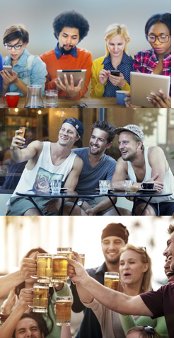


Segment 2 – Persudables
Actionable Insights:
2ND Largest group of spirit drinkers
The persuadable segment is easy to reach because of the amount of time they spend with content that is accessible.
This group isn’t the most likely to upgrade or spend more in retail, but they will be soon enough.
Still into club scene – drinking out
Not brand loyal and looking for discounts often due to income status
Video and social media rule!

Slide 15
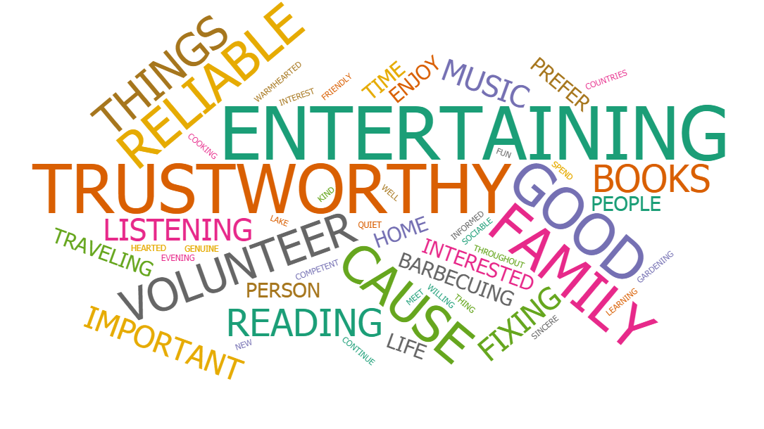

Segment 3 – Set & Secure 50-64
Demographic & Psychographic Summary
Demographics Adults 50-64. Even split male/female. HHI $95K. Married 66.6%. Kids 16.9%
Potential Base 22.9% of Spirit Drinkers.
Self Concepts Trustworthy. Good-hearted. Interested in international events & other cultures. Optimist. Creative.
Brand Loyalty Brand loyal group. Don’t buy unknown brands just to save money. Price not most important factor.
Leisure Times Barbequing with family/friends. Cooking for fun. Gardening. Listening to music. Reading. entertaining at home.
Shopping Attitudes Important the company acts ethically. Store environment matters. Will pay more for quality goods. Prefer goods made in USA.
Priorities FAMILY. Staying informed. Continuing to learn. Making time to stay in touch with friends.
Shopping Behavior Mix of Online (25%). Upscale clicks & bricks (24%). Just Essentials (17%). Traditionalist (11%). The lowest % of status shoppers (16%).

Slide 16
Segment 3 – Set & Secure 50-64
Weekly Reach by Channel and Time Spent with Each
98%
95%
91%
77%-58%
67%-70%
49%
25 Hours
9 Hours
7 Hours
8/13 Hours
2-3 Hours
7 Hours
Television
Mobil Phone
Radio
PC Home/Work
Newspaper
Streaming/Video
TV provides the most reach and time spent by the consumer. Almost exclusively live viewing. Set & Secure is easy to reach effectively with traditional TV. Cost could be prohibitive.
This group is working at the height of their career. They are using smartphone for just about everything. The difference is ‘more purposed’ use versus ‘found time’ use.
Highest segment for radio use. This is also heavy in terrestrial and satellite radio. Online radio (primarily Pandora) is also significant.
Set & Secure has sizeable variance in when they use PC. Higher reach at home (77% - 8 hrs) but more time spent at work (59% - 13 hrs.
Largest group that reads tradition newsprint. Spends 3 hours a week with magazines. Opportunity for co-branding with publications using zoned inserts.
While streaming has one of the lower % of reach, time spent is not bad. 49% reach when considering the price point and ability to optimize this channels makes Streaming still an good options for this segment

Slide 17
Segment 3 – Set & Secure 50-64
Smartphone/Device Use
89%
87%
71%
66%
49%
1
Using mobile for daily communication
89% are texting
2
Accessing the Web via Smartphone
Second highest activity.
3
High social media frequency and engagement
Somewhat surprising, 38% access social media 3+ times per day
4
Streaming music and video
64%-66% Using Smartphone to access both music and video weekly
5
Only 49% using Smartphone for email access
They are accessing email more through PC at work and at home.

Slide 18



Segment 3 – Set & Secure 50-64
Actionable Insights:
Brand loyal – life long customer
Represents ¼ of spirit drinkers. Large opportunity to introduce new spirits, higher quality products and gain a long term customer. They are loyal to their brands.
Only segment really interested in International events/customs
Prefer entertaining at home
Not status shoppers but will pay for quality

Slide 19
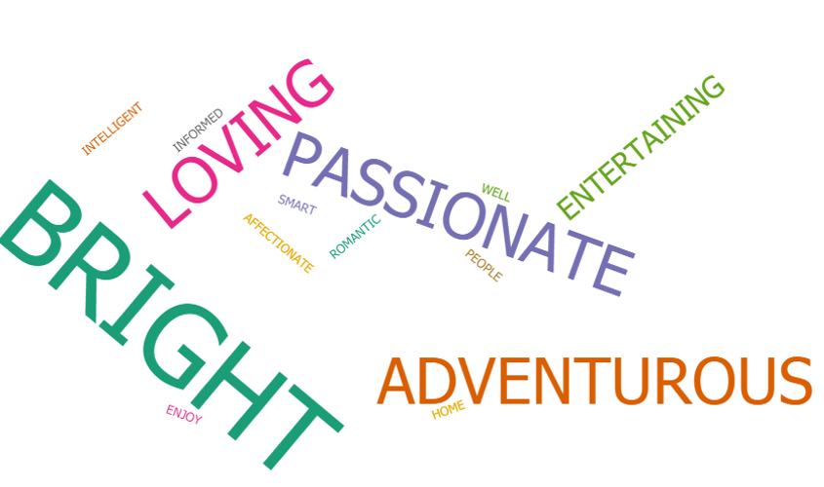
Segment 4 – Too Busy 40-49
Demographic & Psychographic Summary
Demographics Adults 40-49. Skew Male (54%). HHI $100K. Married 66%. Kids 57%
Potential Base 23% of Spirit Drinkers.
Self Concepts Not huge index in any self concept. Highest vertical %: intelligent, well-informed, loving, romantic
Brand Loyalty Interesting response: 35% will buy unknown brand to save money, 32% ALWAYS look for brand name on label.
Leisure Times Listen to music (73% vertical)! Barbeque at home. Go to the beach. Cooking for fun..
Shopping Attitudes Store environment. Signs and displays important (experiential). Online comparative shopper.
Based on “last 12 months life events” they don’t over index or have high vertical % in any significant categories. Assumption – too busy with career climb and family to care A LOT about anything specific. .
Shopping Behavior 45% Status Strivers + Upscale clicks and bricks. 29% online shoppers.

Slide 20
Segment 4 – Too Busy 40-49
Weekly Reach by Channel and Time Spent with Each
98%
98%
88%
78%-72%
58%
50%
24 Hours
12 Hours
7 Hours
8/13 Hours
7 Hours
1.5-3 Hours
Television
Mobile Phone
Radio
PC Home/Work
Streaming/Video
Print
In the heart of raising family stage of life. More staying at home, watching TV. This is the highest reach group with TV. Also large numbers in streaming video.
They are using their phone for almost every function. Likely have kids in the household they are communicating with via smartphone.
Same hourly use as Set & Secure, commuting back and forth to work, but slightly less reach. 88% still significant.
PC at work usage is higher than mobile. This is the only segment that does this. They are career building and spending a lot of time at work. PC at home has slightly higher reach but still 8 hours a week.
Along with over 7 hours a week of streaming media, this segment is the heaviest user of Tablet as well at 56% and 7.5 hours a week for tablet use.
A portion of the segment still reads the paper but spends only 1.5 hours a week. Magazine however, does well with 57% reach and over 3 hours per week.

Slide 21
Segment 4 – Too Busy 40-49
Smartphone/Device Use
87%
66%
65%
53%
53%
1
Use Smartphone 12+ hours per week
81-87% reach with web visits, texting and social media access
2
Streaming media
Surpasses talking on the phone for usage!
3
Listening to music
Active use with paired with streaming media
4
Reading news online – heavy tablet use
Just under the 50-64 group. Newsfeeds are a possible option for media placement
5
Reading Email on Smartphone
These seems low for working adults, but a large number are likely reading emails on PC.

Slide 22
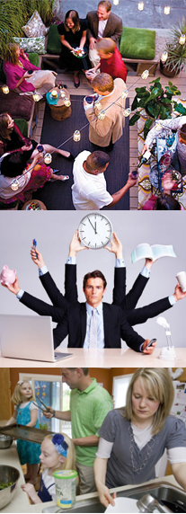


Segment 4 – Too Busy 40-49
Actionable Insights:
Primary focus is raising family
There is a reason this group is named Too Busy. In the throws of career building and raising families they don’t show any areas of persuasion.
40-49 group does represent 23% of spirit drinkers so they aren’t to be ignored.
This group will be exposed to most of the media outreach as a halo group.
Flat responses to attitudes and beliefs
Lifestyle provides clear path to effective media channels
Online shoppers but when in-store the experience matters

Slide 23



Segment Summary
MEDIA CHANNELS
Television is still provides the largest reach to all segments and now includes multiple devices for viewing – most of which carry advertising.
“Radio” now includes internet and podcasts.
Smartphone dominates in customer access points.
Video in all its forms is the fastest growing channel.
SOCIAL MEDIA
All visit social sites3X+ per day
48%+ visited Facebook
35%+ visited YouTube
80% accessed social media through Smartphone
.
TECHNOLOGY
Primary & Persuadables = Majority are Wizards.
Too Busy & Set/Secure = majority are apprentices: willing to learn.
SHOPPING
Attitudes were diverse amongst segments & messaging can address this.
Behaviors: Virtual Shoppers was the largest across all segments.
LEISURE TIME Audiences are in different life stages which effects leisure time. What they do have in common which ABC can leverage:
Cooking Out
Entertaining at Home
Going to beach/lake

