Slide 1
Machine Learning Algorithm in Loan Repayment
Presenter: Weixi Liu, Yixuan Jiao
Xie Tian, Fengrui Zhang
12/13/2018

Slide 2
What is LendingClub?
LendingClub is a US peer-to-peer lending company, which operates an online lending platform. In Exchange for returns, investors purchase notes backed by payments made on loans.
Our target is to investigate company money lending decision according to the feather of each client.

Slide 3
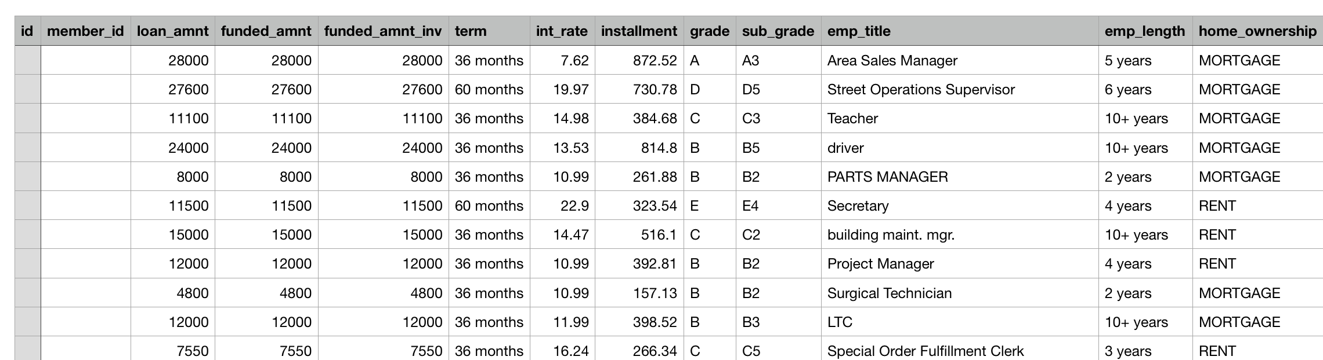
What is our Dataset?
Column: Include 136 client feathers
Row: Over 60,000 lending records last 10 years
Label: Payment status, “Good” or “bad”

Slide 4
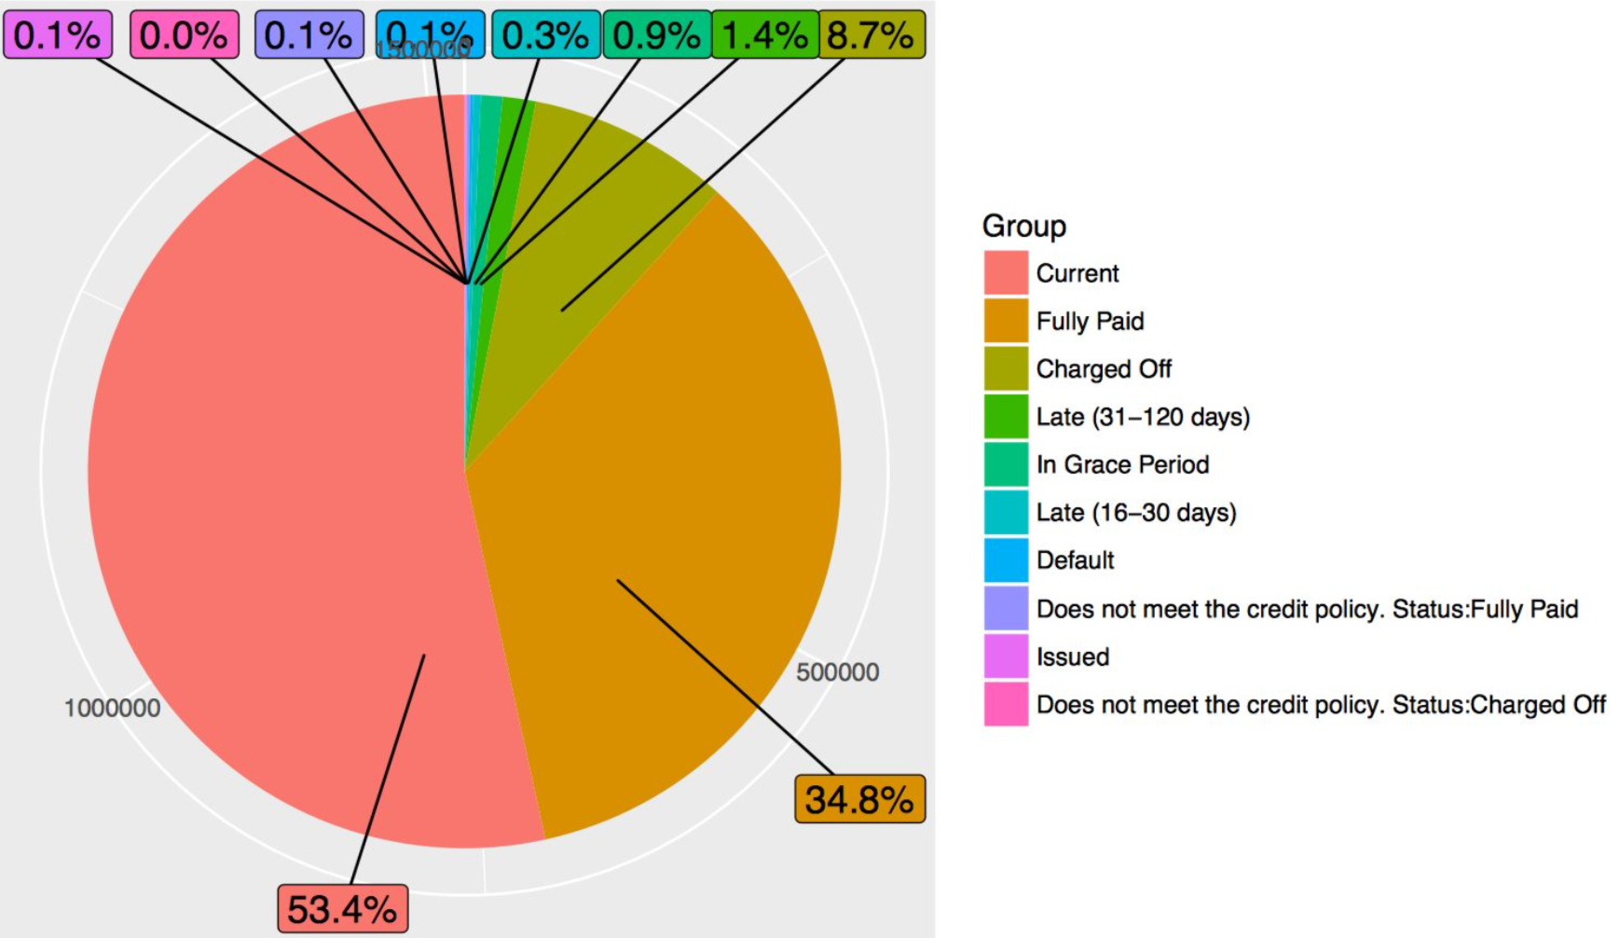
What is our data distribution?

Slide 5
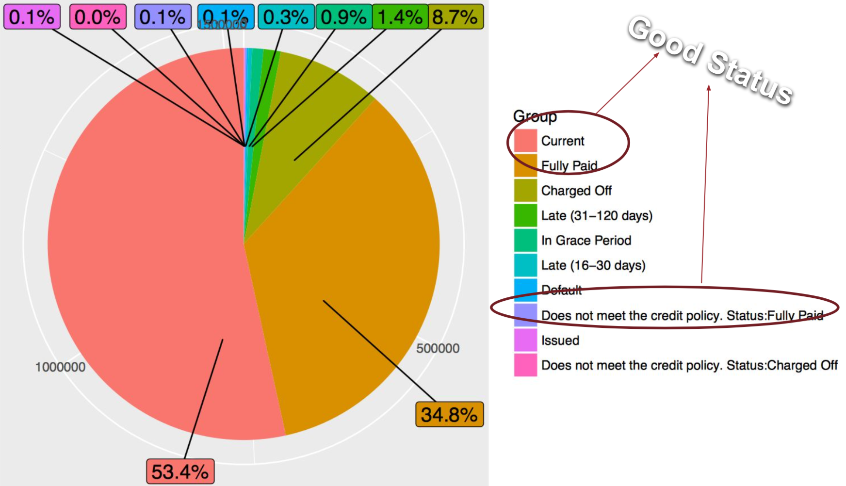
What is our data distribution?

Slide 6
Data Preprocessing
Features
1st Process nan-value
Delete column with large proportion empty
Data imputation by column average value
2nd Create dummy variables
3rd Check variables correlation
Delete high correlated variables
Delete zero correlated variables
4th Apply dimensional reduction tool (PCA)
136
67
44

Slide 7
Data Preprocessing
5th Data down Balance
Original contains 13000K “good” and 2000K “bad” records
Random pick 50K “good” and 50K “bad” as training data

Slide 8
Algorithm 1: Logistic Regression

Slide 9
Algorithm 2: k-Nearest Neighbors
Notes:
Ensemble learning is the process by which multiple models, such as classifiers or experts, are strategically generated and combined to solve a particular computational intelligence problem. For example, it can be used for text mining, recommendation system, etc. Ensemble learning is primarily used to improve the (classification, prediction, function approximation, etc.) performance of a model, or reduce the likelihood of an unfortunate selection of a poor one.

Slide 10
Algorithm 3: Random Forests
Notes:
Ensemble learning is the process by which multiple models, such as classifiers or experts, are strategically generated and combined to solve a particular computational intelligence problem. For example, it can be used for text mining, recommendation system, etc. Ensemble learning is primarily used to improve the (classification, prediction, function approximation, etc.) performance of a model, or reduce the likelihood of an unfortunate selection of a poor one.

Slide 11
Algorithm 4: Support Vector Machines
Notes:
Ensemble learning is the process by which multiple models, such as classifiers or experts, are strategically generated and combined to solve a particular computational intelligence problem. For example, it can be used for text mining, recommendation system, etc. Ensemble learning is primarily used to improve the (classification, prediction, function approximation, etc.) performance of a model, or reduce the likelihood of an unfortunate selection of a poor one.

Slide 12
Algorithm 5: Decision Tree
Notes:
Ensemble learning is the process by which multiple models, such as classifiers or experts, are strategically generated and combined to solve a particular computational intelligence problem. For example, it can be used for text mining, recommendation system, etc. Ensemble learning is primarily used to improve the (classification, prediction, function approximation, etc.) performance of a model, or reduce the likelihood of an unfortunate selection of a poor one.

Slide 13
Algorithm 6: Neural Network
Notes:
Ensemble learning is the process by which multiple models, such as classifiers or experts, are strategically generated and combined to solve a particular computational intelligence problem. For example, it can be used for text mining, recommendation system, etc. Ensemble learning is primarily used to improve the (classification, prediction, function approximation, etc.) performance of a model, or reduce the likelihood of an unfortunate selection of a poor one.

Slide 14
Comparison
 | KNN | SVM | DT | RF | logistic
Down sample
Down Sample with PCA

Slide 15
Future Work

Slide 16
Reference
[1] Peter Flach, Cambridge University Press. The Art and Science of Algorithms That Make Sense of Data
[2] Kyumin Lee, Worcester Polytechnic Institute Lecture Slides: CS539 Machine Learning
Notes:
Ensemble learning is the process by which multiple models, such as classifiers or experts, are strategically generated and combined to solve a particular computational intelligence problem. For example, it can be used for text mining, recommendation system, etc. Ensemble learning is primarily used to improve the (classification, prediction, function approximation, etc.) performance of a model, or reduce the likelihood of an unfortunate selection of a poor one.

Slide 17
Thank you!
Questions?

