Slide 1
AI-Enabled Sensing and Controlling

Slide 2
The Jist
AI-Enabled Sensing and Controlling refers to using artificial intelligence to perceive the environment (sensing) and make decisions/take actions (controlling) based on that perception.

Slide 3
Sensing Component: Camera-Based Perception
What the Camera "Sees":
Object Detection: Identifying and localizing vehicles, pedestrians, cyclists, traffic signs, lane markings
Classification: Determining object types (car, truck, motorcycle, bus)
Tracking: Following objects across frames to understand motion
Depth Estimation: Understanding distance to objects (monocular or stereo cameras)
Segmentation: Pixel-level understanding of drivable areas, obstacles, sky, etc.

Slide 4
Sensing Component: Camera-Based Perception
AI Models Used:
Convolutional Neural Networks (CNNs):
Extract visual features from camera images
YOLOv3, Faster R-CNN, MobileNet for object detection
Process images at 30+ FPS for real-time operation
Multi-Task Networks:
Simultaneously detect objects, lanes, and traffic signs
Efficient for embedded automotive hardware
Temporal Models (RNNs/Transformers):
Track objects across video frames
Predict future trajectories

Slide 5
Sensing Component: Camera-Based Perception
Key Advantages:
Cost-effective: Cameras are cheaper than LiDAR
Rich information: Color, texture, text on signs
Proven technology: Mature computer vision algorithms
Passive sensing: No active emissions needed
Challenges:
Weather sensitivity: Rain, fog, glare affect performance
Lighting conditions: Shadows, night driving, backlighting
Depth ambiguity: Harder to judge exact distances than LiDAR
Adversarial vulnerability: Susceptible to attacks

Slide 6
Controlling Component: Decision Making & Actuation
Perception to Action Pipeline:
Camera → AI Detection → Scene Understanding → Decision Logic → Vehicle Control
1. Scene Understanding:
Fuse detections from multiple cameras (360° coverage)
Build occupancy grid or semantic map
Identify critical objects (e.g., vehicles in collision path)
2. Decision Making:
Path Planning: Determine safe trajectory
Behavior Planning: Decide to slow down, change lanes, stop
Threat Assessment: Prioritize objects by collision risk
Rule Compliance: Follow traffic laws
3. Control Execution:
Longitudinal Control: Acceleration/braking
Lateral Control: Steering adjustments
Emergency Response: Automatic emergency braking (AEB)

Slide 7
Controlling Component: Decision Making & Actuation
AI Control Strategies:
Rule-Based Control:
If vehicle detected < 10m ahead → Apply brakes
If lane marking crossed → Steer back
Transparent, verifiable, but limited flexibility
Learning-Based Control:
Imitation Learning: Learn from human drivers
Reinforcement Learning: Optimize driving policies
End-to-End Learning: Direct camera-to-control mapping
More adaptive but harder to validate for safety
Hybrid Approaches (Most Common):
AI for perception and prediction
Validated algorithms for control
Human-interpretable decision logic

Slide 8
Real-World Applications
ADAS (Advanced Driver Assistance Systems):
Adaptive Cruise Control (ACC):
Camera detects lead vehicle
Maintains safe following distance
Adjusts speed automatically
Automatic Emergency Braking (AEB):
Detects imminent collision
Warns driver, then brakes if no response
Critical safety feature in modern vehicles
Lane Keeping Assist (LKA):
Cameras detect lane markings
Gently steers to keep vehicle centered
Prevents unintentional lane departure
Blind Spot Detection:
Side cameras monitor adjacent lanes
Alerts driver to vehicles in blind spots
Traffic Sign Recognition:
Reads speed limits, stop signs, yield signs
Displays to driver or adjusts cruise control
Autonomous Driving Levels:
Level 2 (Tesla Autopilot, GM Super Cruise): Camera-based partial automation
Level 3+: Cameras + LiDAR + Radar for redundancy
Tesla's Approach: Camera-only "vision" system(controversial in industry)

Slide 9
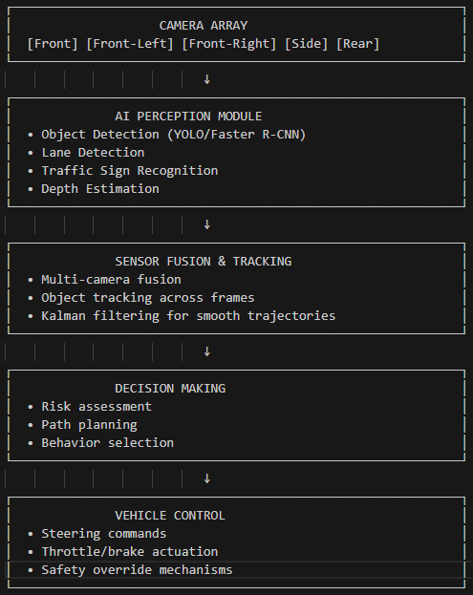
System Architecture Example

Slide 10
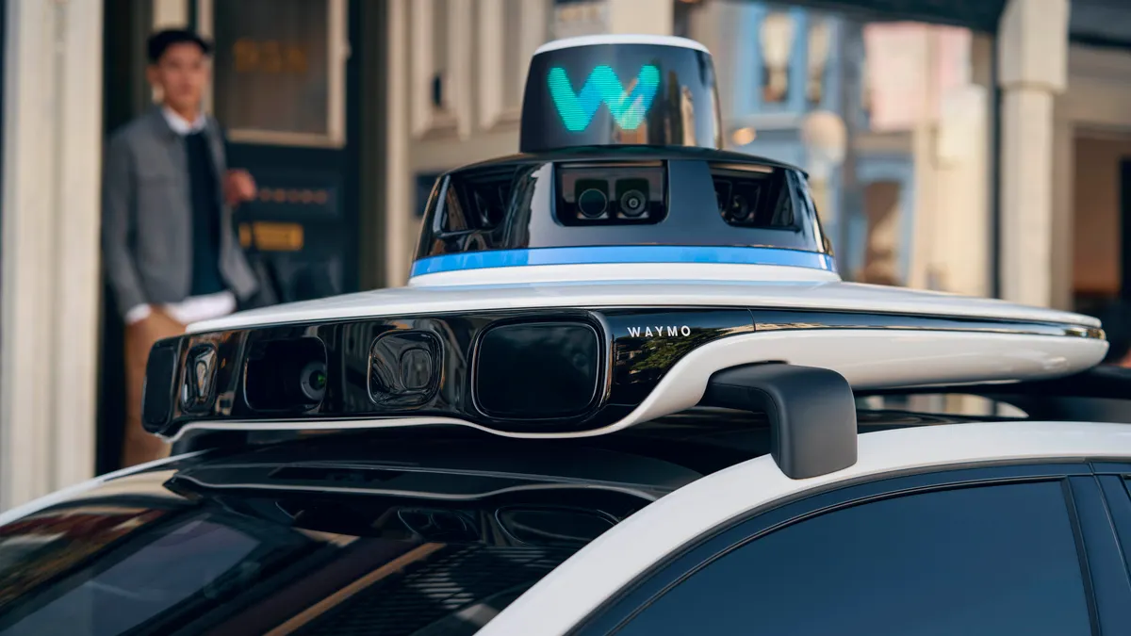
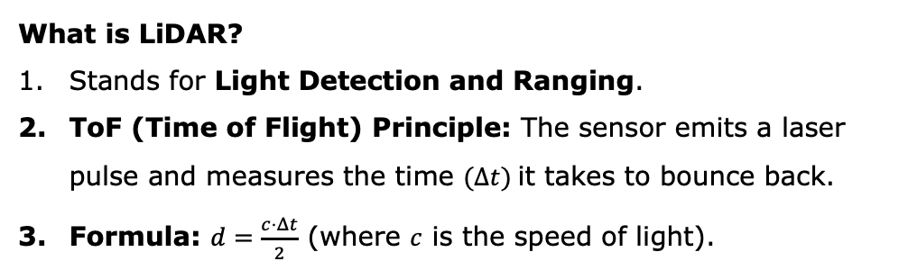
How LiDAR Lets Robots “See” the World
From Raw Data to Intelligence.
What is LiDAR?
Stands for Light Detection and Ranging.
ToF (Time of Flight) Principle: The sensor emits a laser pulse and measures the time $(Δt)$it takes to bounce back.
Formula: $d=\frac{c⋅Δt}{2}$ (where $c$ is the speed of light).
The Advantage:
Active Sensing: Works in total darkness (unlike cameras).
Direct Depth: Provides centimeter-level 3D geometry immediately.
Real-world Use: The backbone of Self-Driving Cars, Warehouse Robots (AGVs), and Drones.

Slide 11
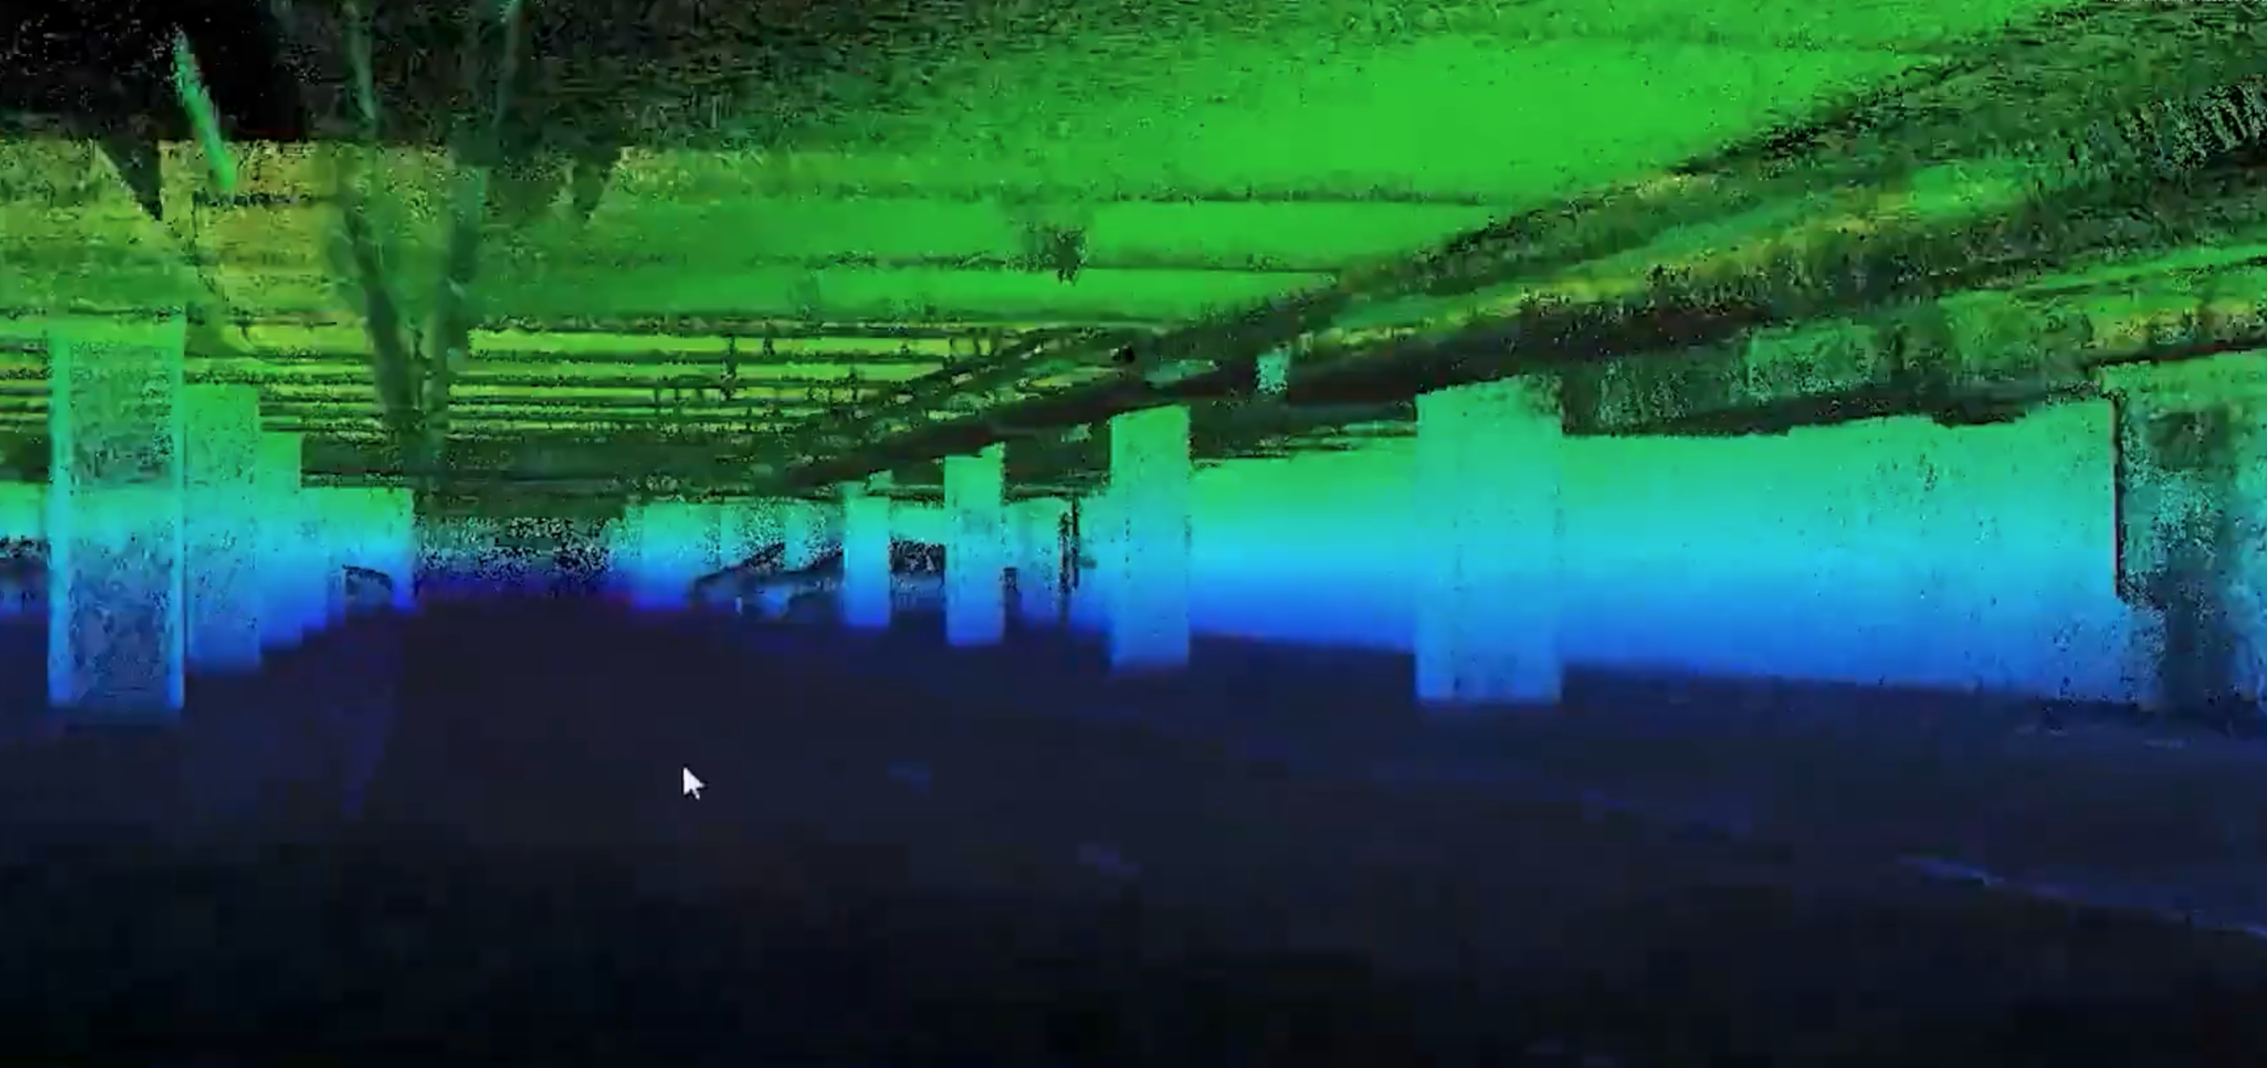
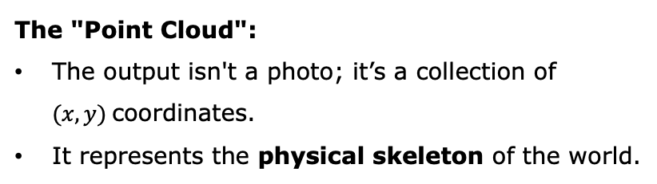
Data Representation: The Point Cloud
From Beams to Points.
The "Point Cloud":
The output isn't a photo; it’s a collection of $(x, y)$coordinates.
It represents the physical skeleton of the world.
Critical Concepts:
Occlusion: LiDAR cannot see through walls—it creates "shadows" behind objects.
Sparsity: The further the object, the fewer points we collect.

Slide 12
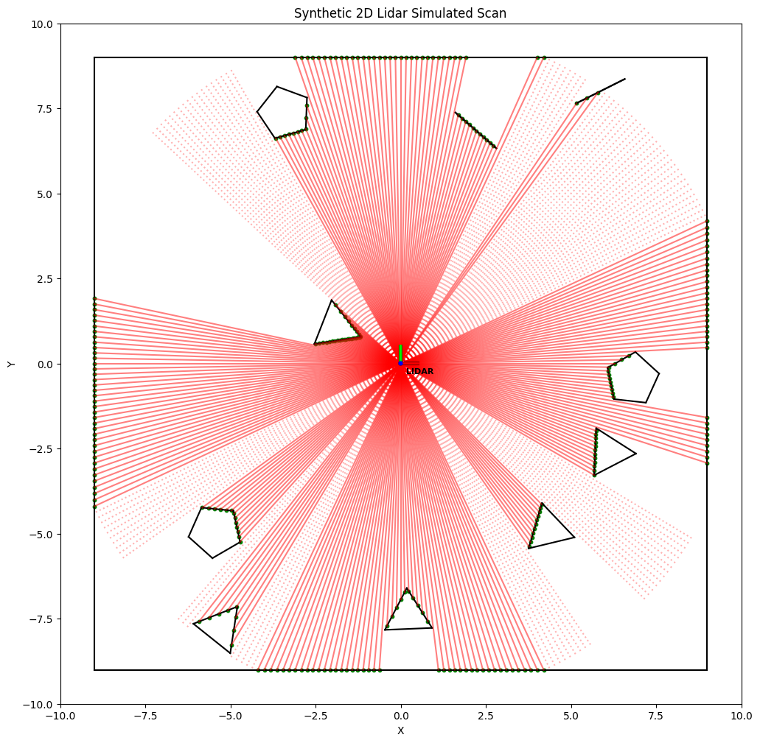
Hands-on Simulation — Building the LiDAR Engine
1. Environment Modeling (The "Digital Twin")
Virtual Space: A 2D coordinate system representing an 18 x 18 warehouse.
Dynamic Obstacles: Randomized generation of polygonal obstacles
using the shapely library to mimic real-world hazards like crates or pillars.
2. The Ray Casting Engine
360° Scanning: Simulating a hardware sensor by firing 360 virtual laser beams (1 beam per degree).
Geometric Intersection: Using shapely.geometry to calculate exact mathematical intersections between laser rays and obstacle boundaries.
Range Extraction: Determining the precise distance by identifying the nearest intersection point for each beam.
Notes:
In this notebook, we move from hardware concepts to software implementation. As you run the code, notice the 'Occlusion' effect: the LiDAR cannot see behind obstacles, creating blind spots (shadows). This raw geometric data — the Green Dots — is the foundation of our next two modules:
Part 2 — Obstacle Awareness
These LiDAR points illustrate how autonomous systems identify geometry, detect obstacles, and reason about free space.
Part 3 — Reinforcement Learning (Conceptual Bridge)
In real autonomous systems, LiDAR data can be converted into state representations for AI-driven navigation.
In our workshop, we will simulate this idea using a training environment where the agent learns to avoid collisions through trial-and-error.

Slide 13
Turning LiDAR Data into Perception & Planning
From Sensing to Intelligence.
Sense: Capture raw LiDAR distances (The Green Dots)
Think: Identify obstacles and "Safe Zones.
Act: Calculate steering and speed.
Moving from "What is around me?" to "What should I do?

Slide 14
Turning LiDAR Data into Perception & Planning
From Sensing to Intelligence.
AI use perception to support:
Short-term reactions: avoiding collisions
Mid-term planning: deciding where to move next
Long-term goals: reaching destinations safely
Moving from "What is around me?" to "What should I do?

Slide 15
Why LiDAR Perception is Foundational
From Sensing to Intelligence.
Enables safe autonomy
Supports navigation
Forms the base for:
Obstacle avoidance
Path planning
And eventually… Reinforcement Learning control
Moving from "What is around me?" to "What should I do?

Slide 16
Deep Reinforcement Learning for Autonomous Driving
Perception → Planning/Decision → Control
↑ ↑ ↑
Completed This Session Execution
What We Covered:
How LiDAR captures 3D point cloud data
How to detect vehicles, pedestrians, obstacles from point clouds
Output: position, velocity, and class of surrounding objects

Slide 17
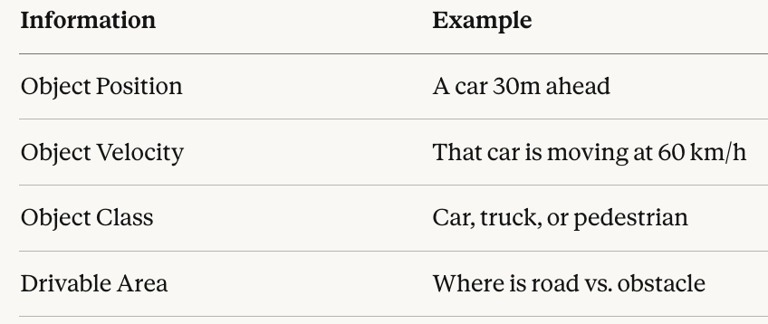
From Perception to Decision Input
The Decision Module Must Answer:
Should I change lanes?
Speed up or slow down?
When to overtake?
Core Challenge: How to convert perception data into driving actions?

Slide 18
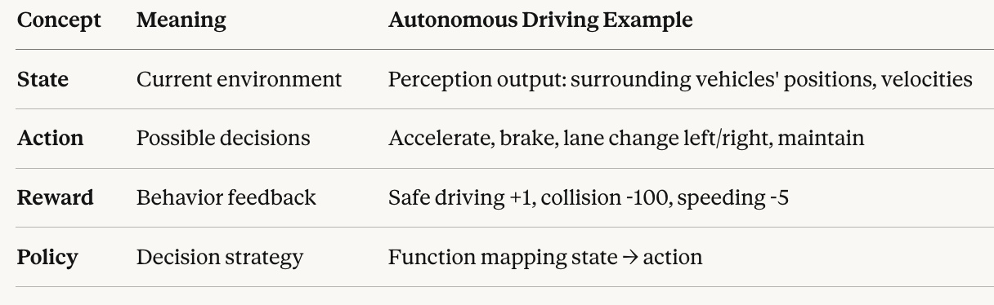
From Perception to Decision Input
What is Reinforcement Learning?
Core Idea: Learn optimal decisions through trial and error
Similar to How Humans Learn to Drive:
Beginner: Doesn't know when to change lanes
Tries changing lanes → Nearly crashes (negative feedback) → Learns to check mirrors first
Practice repeatedly → Develops driving intuition

Slide 19
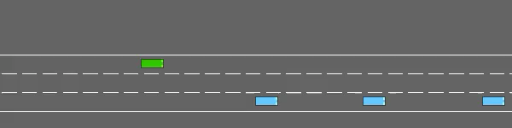
From Perception to Decision Input

