Slide 1
Geant4 Evaluation and Optimization of Portable Faraday Cup

Slide 2
Overview
Evaluation (% charge defect [%cd])
  HIT, Geant4
Optimization
  MCNP6: Height, Radius
  Geant4: film thickness, %cd minimization
Validation
  G4 Energy Spectra, go99 branching ratios
Discussion
  Dosimetric quiver plot, Deposition Histogram

Slide 3
Evaluation
Charge defect = ([q_in – q_out] – q_beam)/q_beam
Assumption:
Deposition/Removal of charge in Kapton produces mirror charge in Copper with magnitude linearly proportional to depth in Kapton between Copper and Silver interfaces

Slide 4
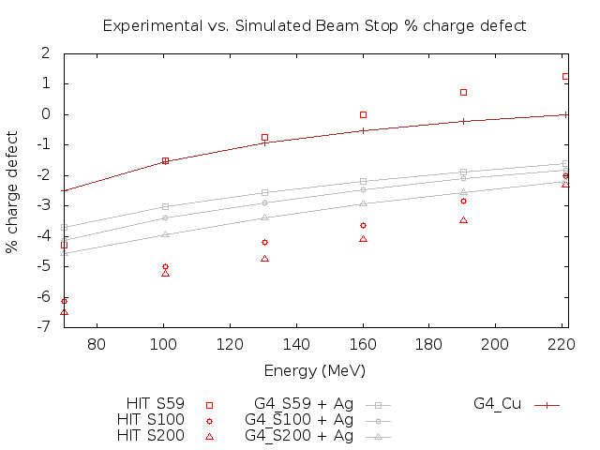
Evaluation
Fig 1: Comparison of Geant4 and HIT Experimental charge defect measurements

Slide 5
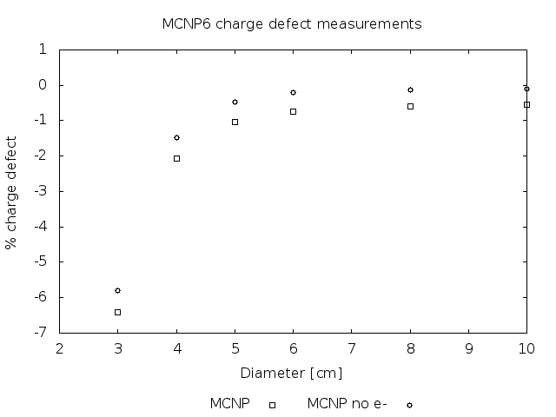
Optimization
Fig 2: Charge defect measurement for coarse device dimension optimization

Slide 6
Optimization
Goal: Minimize |%cd| by fine-tuning dimensions
Thus:
  Obtain functional Kapton thickness of energy
  such that [%cd](E=X, t_KA=Y) = 0
  Preliminary results show Y=36 microns when X=160 MeV

Slide 7
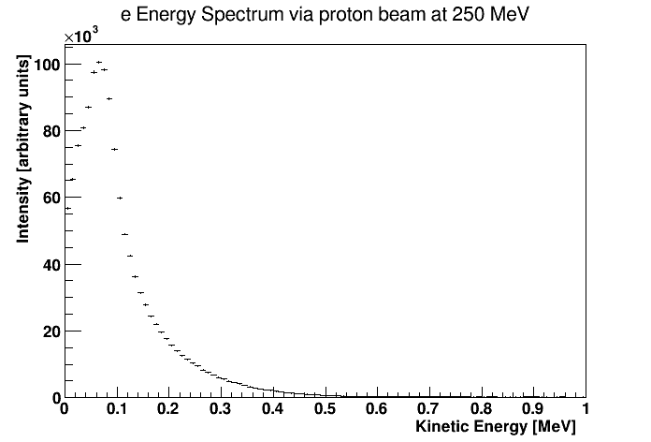
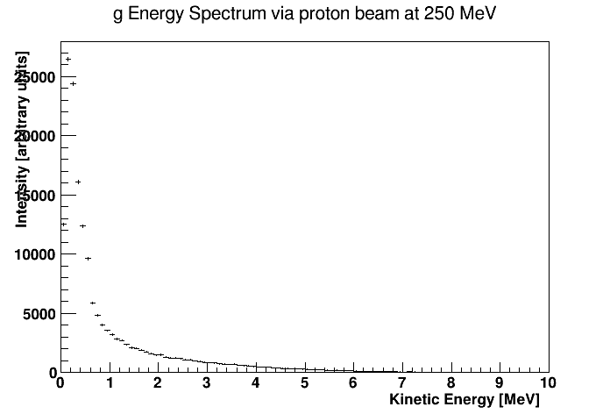
Validation
Fig 3: a) Beta spectra and b) gamma spectra in Copper via Geant4

Slide 8
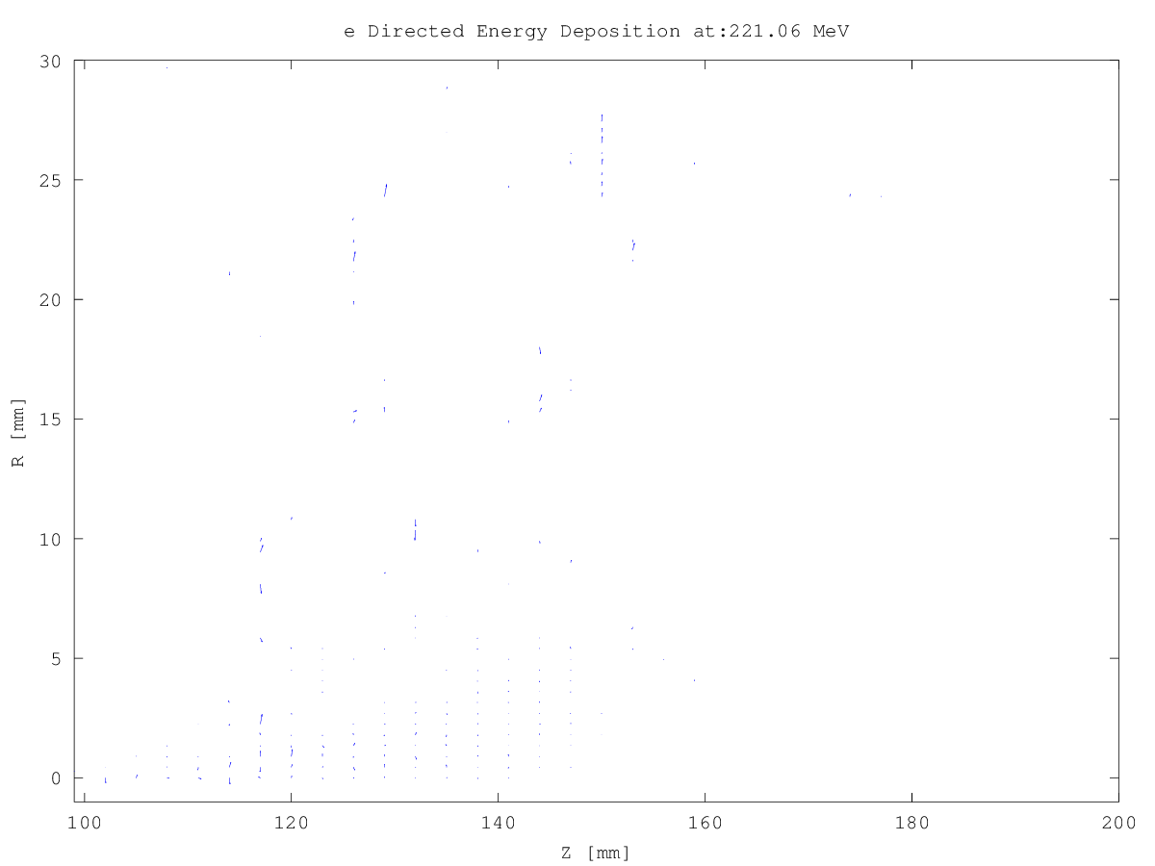
Discussion
Fig 4: Energy deposition gradient for electrons via Geant4; note both spray and halo/aura presence

Slide 9
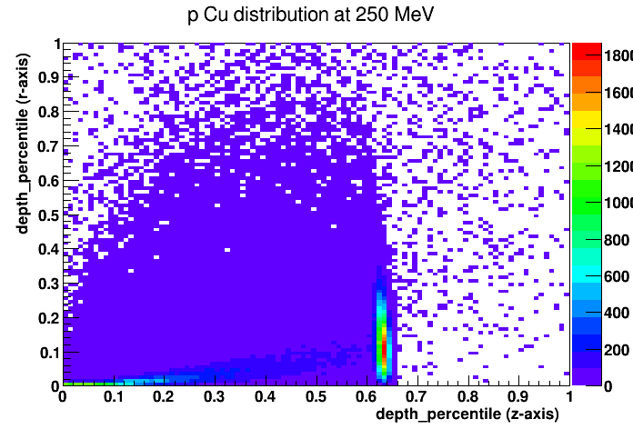
Discussion
Fig 5: Proton deposition count in Copper via Geant4

Slide 10
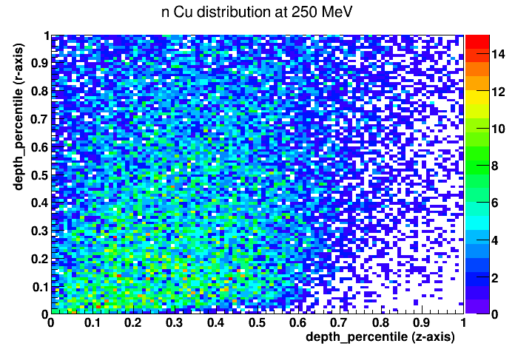
Discussion
Fig 5: Neutron deposition count in Copper via Geant4

