Slide 1
Welcome to Unified Curriculum and Course Design for Mechatronics and Robotics Engineering Workshop
National Science Foundation award #2030166
5-7 January 2022

Slide 2
Zoometiquette
Please no multitasking
Raise hand in Zoom to talk
Talk clearly, loudly, slowly
Mute when not speaking
Video preferred but not essential
Rename to include institution
Allow time – Zoom introduces delays
Minimize distractions
But we understand you may have family, pets, ...
Zoom recordings will be available publicly
Please no multitasking

Slide 3
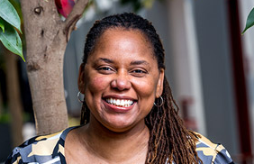
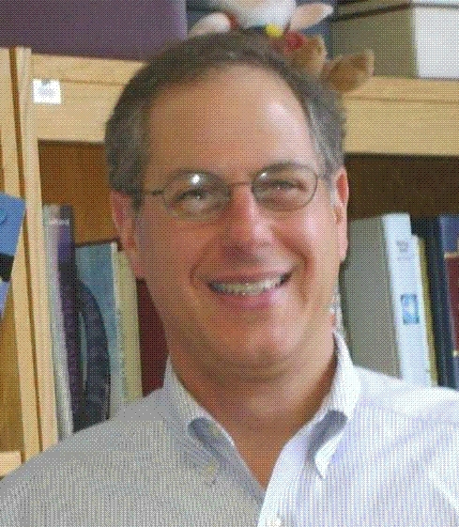
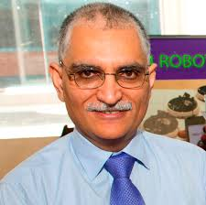
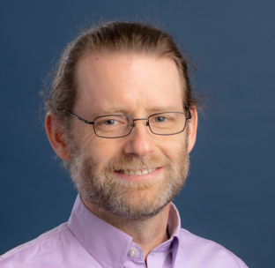
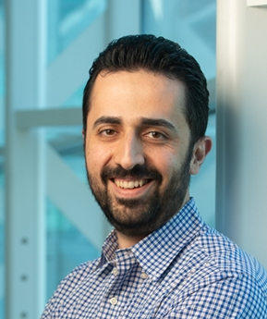
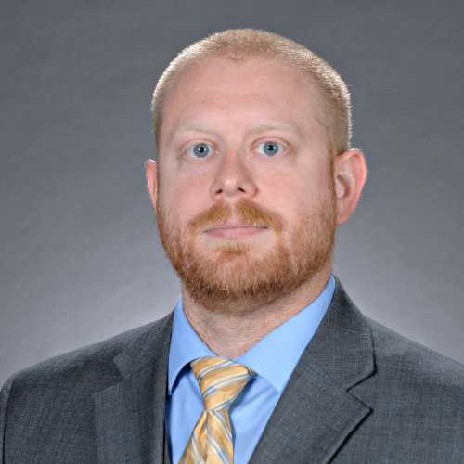
The FoMRE Team
Carlotta Berry, Rose-Hulman
Vikram Kapila, NYU
Mike Gennert, WPI
Greg Lewin, WPI
James Mynderse, LTU
Nima Lotfi, SIUE

Slide 4
Attendees
40+ participants
Protecting privacy, however, …
We’d like to list you all here for posterity
Default is Opt-In
Send email to michaelg@wpi.edu to Opt-out

Slide 5
Background
6 years’ experience as FoMRE Team
Shared vision for Mechatronics & Robotics Ed (MRE)
Activities:
Workshops
Community Forum
Webinars
ASEE, ABET
MRE Research & Papers
Raise external support from government and industry
More to come!

