Slide 1
Workshop Overview
National Science Foundation award #2030166
5-7 January 2022

Slide 2
FoMRE History
Launched with an NSF-funded Workshop in 2016
NYU Tandon (Nov’16)
Built an online community through FoMRE website
https://www.mechatronicseducation.org/
Received a second NSF grant in 2018 for a series of workshops
ASME DSCC (Sept’18)
Robotics Summit and Expo (June’19)
ASEE Annual Conf. (June’19)
LTU (Sept’19)
A series of articles in ASEE Annual Conf. (June’20)
Current workshop from a third NSF grant in 2020

Slide 3
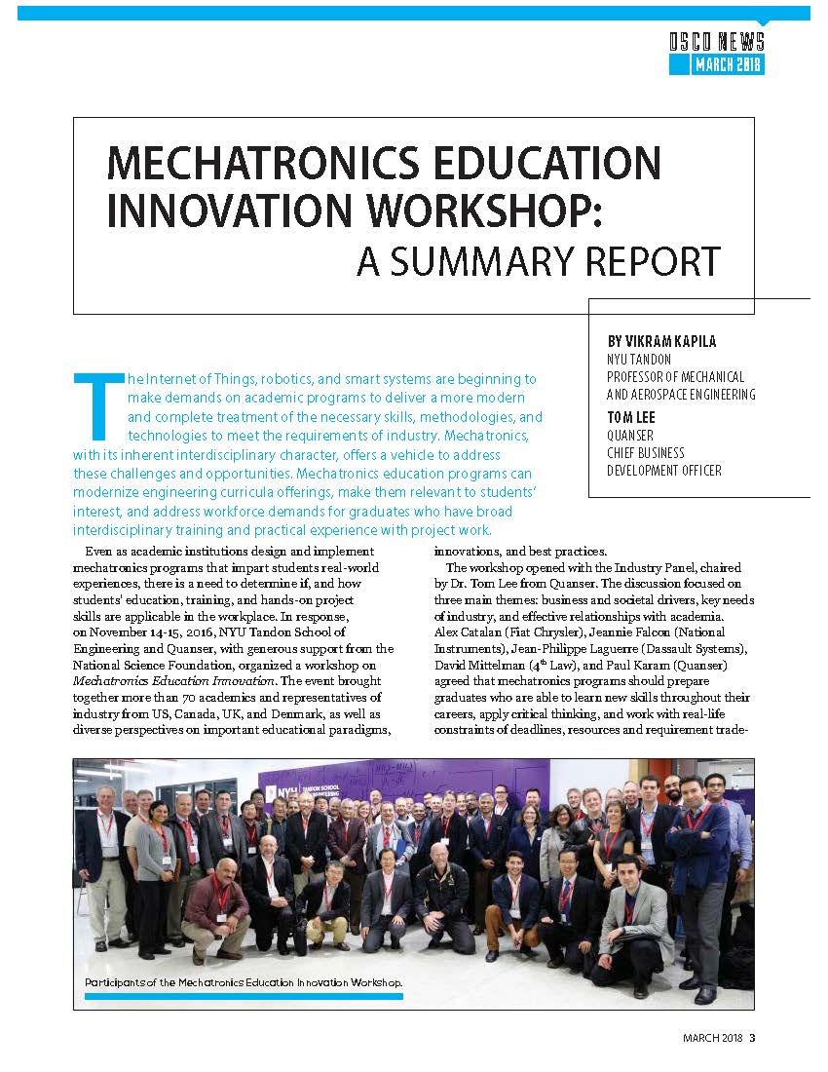
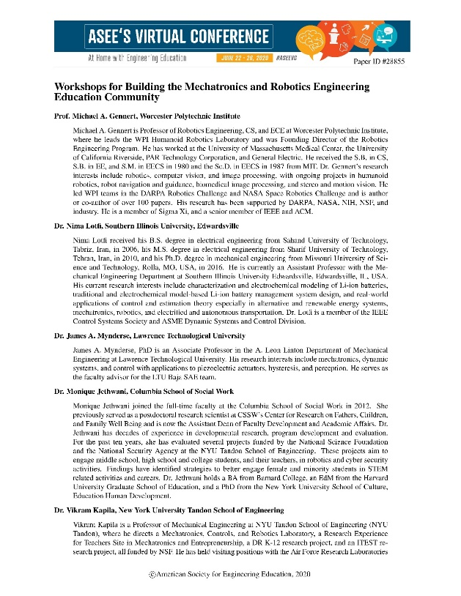
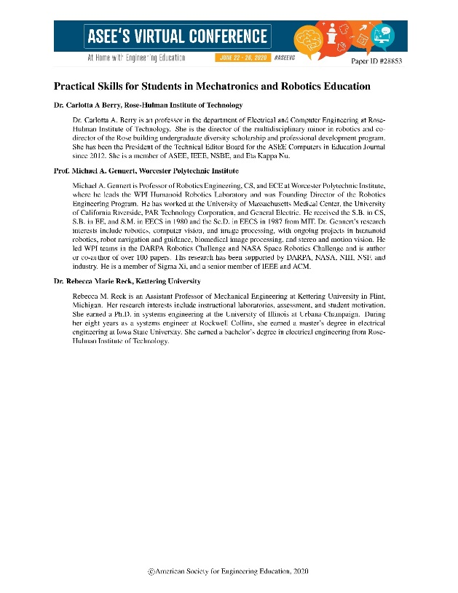
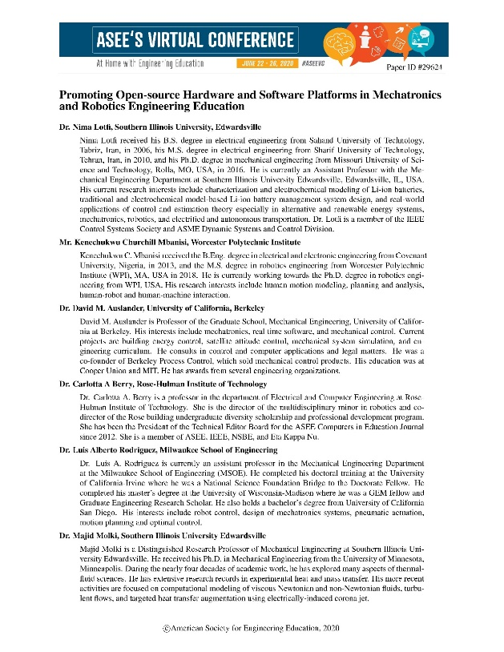
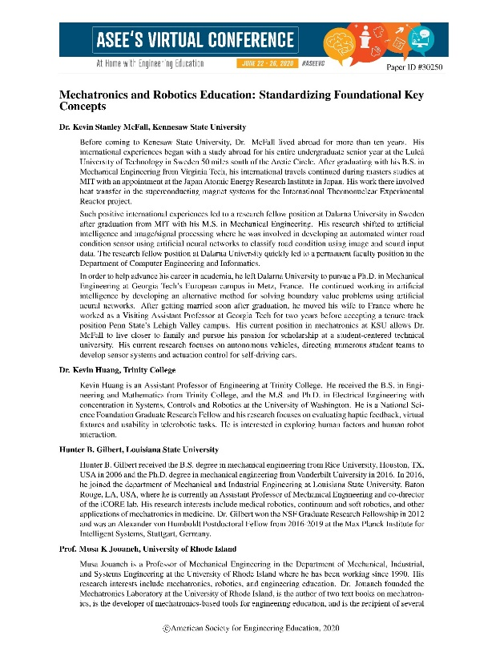
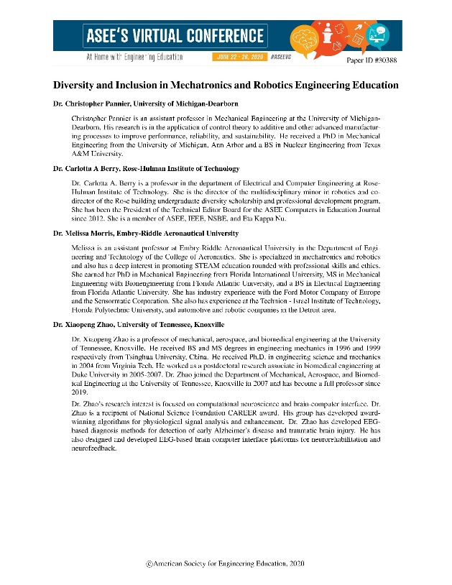

Slide 4
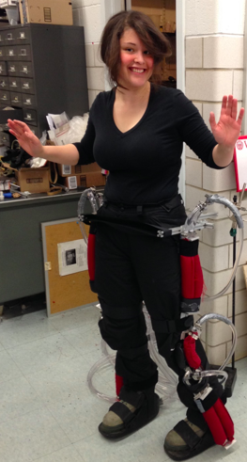
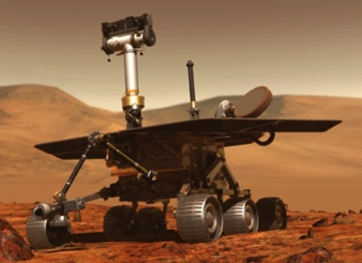
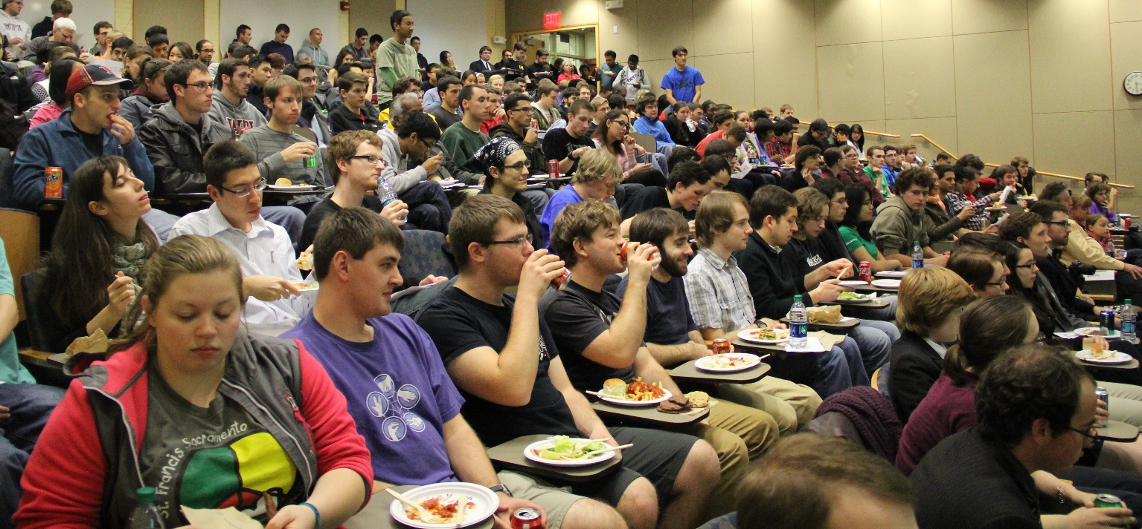
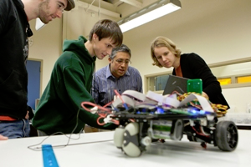

Vision
Mechatronics & Robotics Engineering will become
One of the most impactful disciplines of engineering
Attracting diverse and innovative students
Graduating professional engineers who will
design,
develop, and
implement transformative autonomous technologies,
Improving health & welfare
Extending human reach
“The Next Big Thing”
Notes:
Our vision is that Mechatronics & Robotics Engineering will become
One of the most impactful disciplines of engineering
Attracting diverse and innovative students
Graduating professional engineers who will
design,
develop, and
implement transformative autonomous technologies,
Improving health & welfare
Extending human reach to previously inaccessible realms large and small, near and far.
In other words, “The Next Big Thing”

Slide 5
Workshop Objectives
Prepare current and future MRE faculty
Familiarize MRE educators with advances in undergraduate MRE education
Unify and standardize MRE curricula and courses
Facilitate accreditation for MRE degree programs
Generate enthusiasm and a sense of community among MRE educators
Promote DEI within the MRE community

Slide 6
Workshop Evolution
Originally planned as in-person in 2021
20+ participants
1 kit each
Most funding for travel / hotel / meals
Then, COVID…
Here we are, remote
40+ participants
1 or 10 kits each
Most funding for kits
More Student Assistant support
Thanks to NSF for being flexible

Slide 7
Before / During / After
Before
Receive Pololu ROMI kits
Download & install Git repo software
Pre-survey (can still do!)
During
6 hands-on activities
Sessions on curriculum, HW, SW, roadmap, open discussion
Breakout groups
Breaks
After
Post-survey
Teach
Let us know!

Slide 8
Hands-on Activities
7 Sample exercises
90 minutes each
Short intro
1 hour to build / play
Short summary & reflection time
Student Assistant help available
Intro Course
4 Labs
Can be split into 8 or more
Advanced Course
3 Labs
Can be split / combined with Intro course

Slide 9
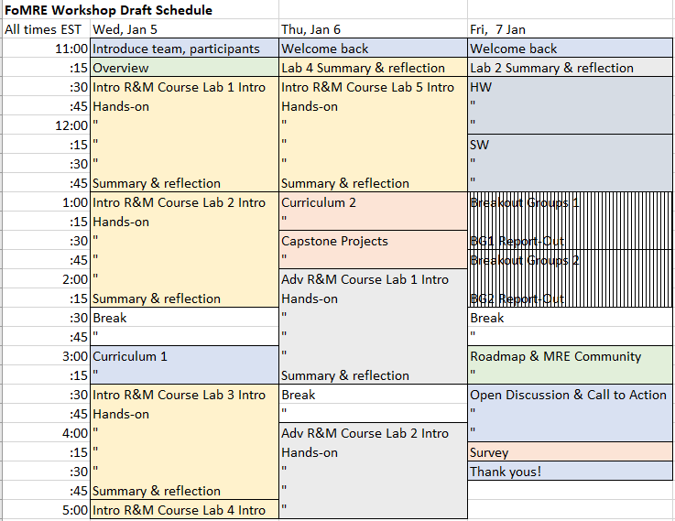
Schedule

Slide 10
Thank you!
Join us at
mechatronicseducation.org
or email any of us
And thanks to the NSF through award #2030166 and our Advisory Board
Notes:
To quote John Lennon, “I hope someday you’ll join us”
Thank you, thanks to NSF, Quanser, and our Advisory Board.

