Slide 1

Jonathan Leitschuh (RBE & CS)
Thomas Clark (CS)

Slide 2
Why GRIP?
Open CV is the most widely used computer vision library
Computer Vision is Hard!
Construct computer vision algorithms graphically
Allow for rapid prototyping of algorithms
Reduce the barrier to entry
Easily consume algorithmic results using network protocols such as Network Tables, ROS or HTTP
Notes:
A computer vision algorithm is a sequence of steps are hard to write and debug
Visualize
Preview intermediate steps

Slide 3
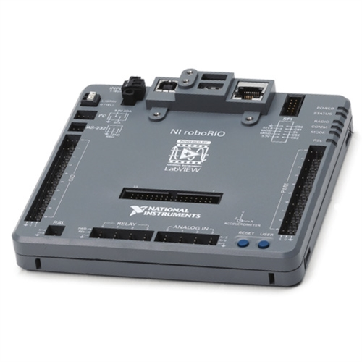
Requirements
Supported OS
OSX
Linux
Windows
Embedded ARM Linux
Other
Fast
Efficient
Intuitive/Sleek UI
Extensible
Deploy/Run Headless
Notes:
Embedded controller
Java 8, Java FX and Java CV

Slide 4
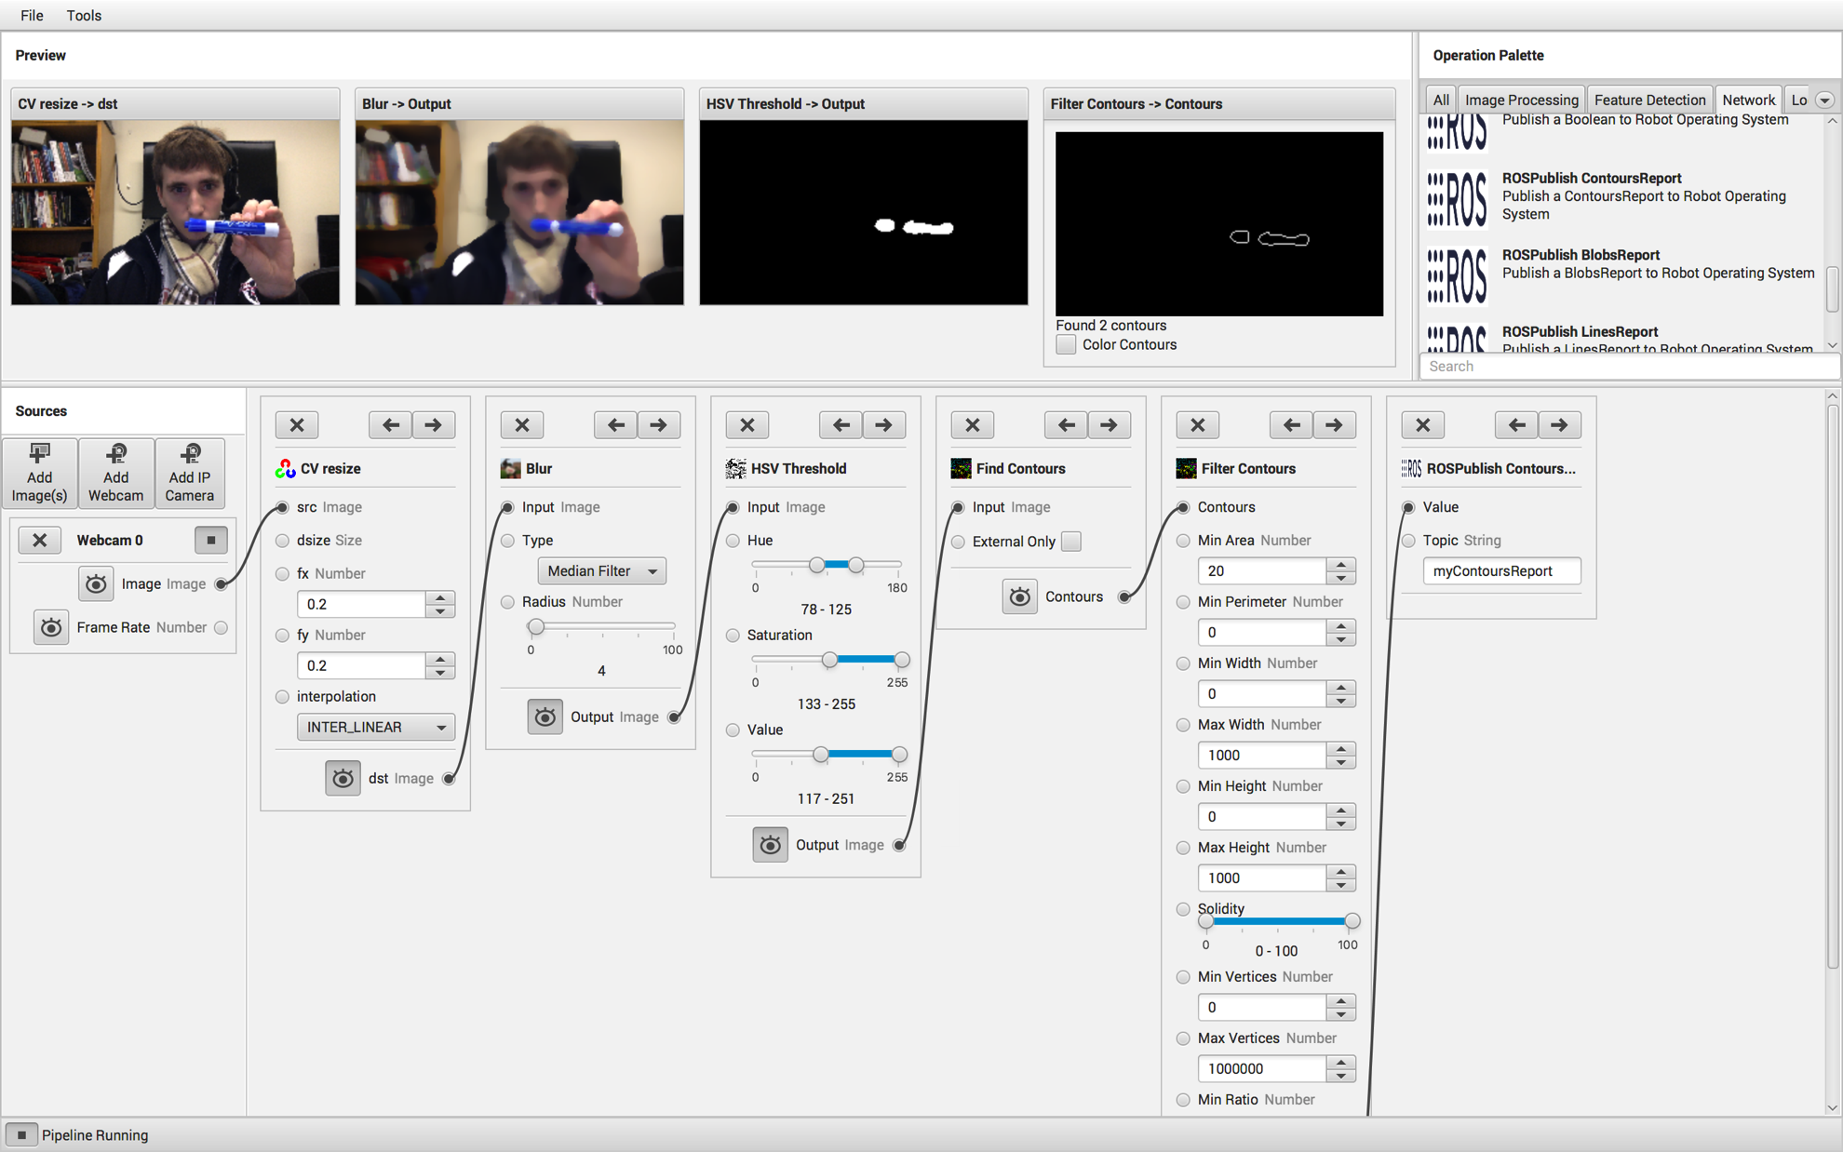
UI Overview

Slide 5
Architecture
Network Protocol
Network Protocol

Slide 6
Design Decisions
Java
Java FX
Java CV
Gradle
Junit
Controls FX
Guava
Guice
Travis CI
AppVeyor
Jacoco
CodeCov
Codacy
Error Prone
Version Eye
Gitter

Slide 7
Accomplishments
GRIP is 100% Open Source
Over 7,000 downloads on GitHub with 102 stars and 40 forks
Many contributors from out side of WPI
Very active community on Gitter
Adopted by Artaic LLC for the robotic creation of large scale mosaics
FIRST reports teams using computer vision in their robots has significantly increased due to the availability of GRIP
Fully automated test system for Linux and Windows
Pull Request approval/rejection from build status
Nearly impossible to break the master branch

Slide 8
Future
Automatic code generation
More network services (QT)
More Open CV operations
Support network data as input to pipeline
Support for Python Scripts
Deploy support for the Raspberry PI

Slide 9
Demo/Questions?

