Slide 1


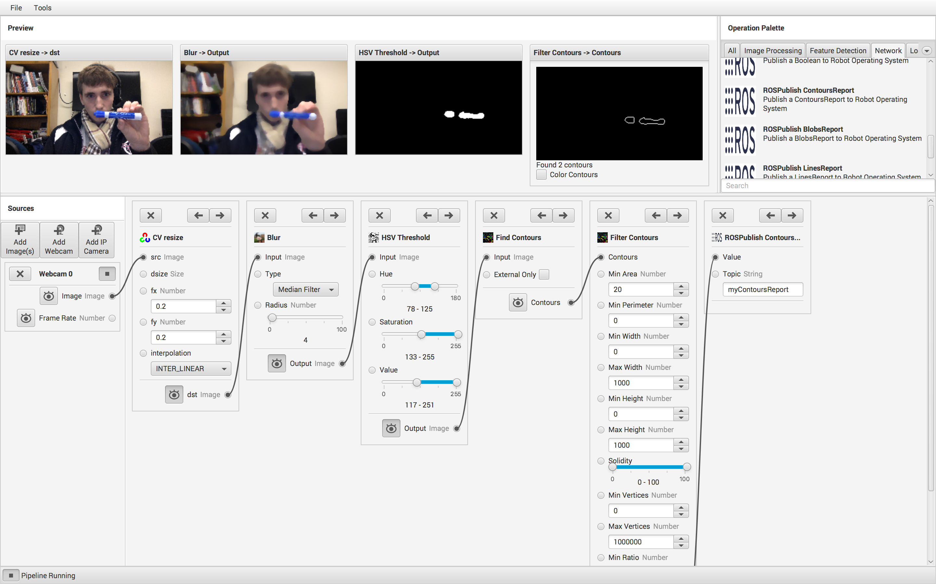
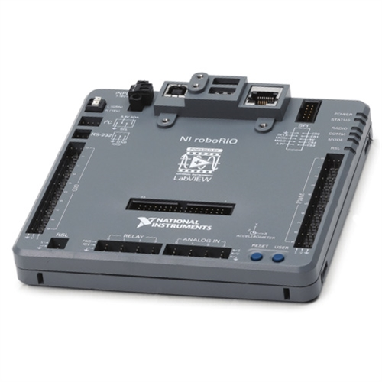
GRIP Computer Vision Engine
Jonathan Leitschuh (Robotics & Computer Science), Thomas Clark (Computer Science)
Advisor: Professor Brad Miller (Robotics), Professor Michael Gennert (Computer Science)
Abstract
GRIP (the Graphically Represented Image Processing engine) is an application to construct and deploy computer vision algorithms. Developing a vision program can be difficult because it is hard to visualize the intermediate results. Java and OpenCV were used to implement a graphical development tool. This simplifies and accelerates the creation of vision systems for experienced users and reduces the barrier to entry for inexperienced users. As a result, many teams with minimal computer vision knowledge successfully used our software in the 2016 FIRST Robotics Competition game.
Community
GRIP is 100% Open Source under a 3 clause BSD License
Over 7,000 downloads on GitHub with 101 Stars & 40 Forks
Many contributors from outside of WPI
Very active community on Gitter
Adopted by Artaic LLC. for the robotic creation of large scale mosaics
FIRST reports teams using computer vision in their robots has significantly increased due to the availability of GRIP
UI Overview
Architecture
GRIP is divided into two modules - the core and the graphical user interface (GUI). The core is responsible for performing the actual computer vision. The GUI allows the user to both manipulate the set of operations and preview the outputs of the core.
Preview Window
Shows live previews of the output for each step
Operation Palette
Contains all operations a user can add to a Pipeline.
Currently GRIP supports 65 different operations.
Sources
Provide input images and data to the pipeline
Publishing
Send the output data for the pipeline to Network Tables, ROS or an HTTP server
Pipeline
A series of steps and connections that make up a computer vision algorithm
Connection
Connects the output of one step to the input of another.
Step
The computer vision operations that make up the pipeline
Network Protocol
Network Protocol
Build System
Supported Operating Systems
Automated build/release system with Gradle
All pull requests tested and approved by Travis CI & AppVeyor
Static code analysis by Codacy
Compile time error checking with Error Prone
Automated Junit tests for the Core Module
Automated UI Tests with TestFX
Code coverage metrics with Jacoco and CodeCov
Automatic releases published by Travis CI & AppVeyor
Full integration with Gitter chat
Dependency version monitoring with VersionEye
Windows (x86/64)
Mac OSX
Linux (Ubuntu & Fedora)
Embedded Linux ARM (Headless)

