Slide 1
主要工作
Conensus_skeleton
Multiple neuron auto-tracing

Slide 2
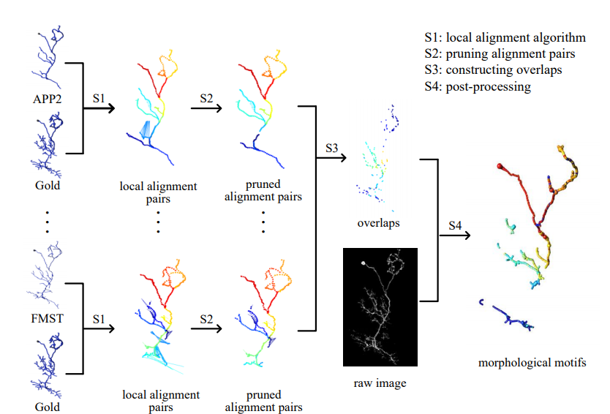
Conensus_skeleton
改进目前的Consensus_skeleton_2

Slide 3
Multiple soma auto-tracing
Soma检测（手工标注第一阶段）
Multiple soma confrontation-tracing

Slide 4
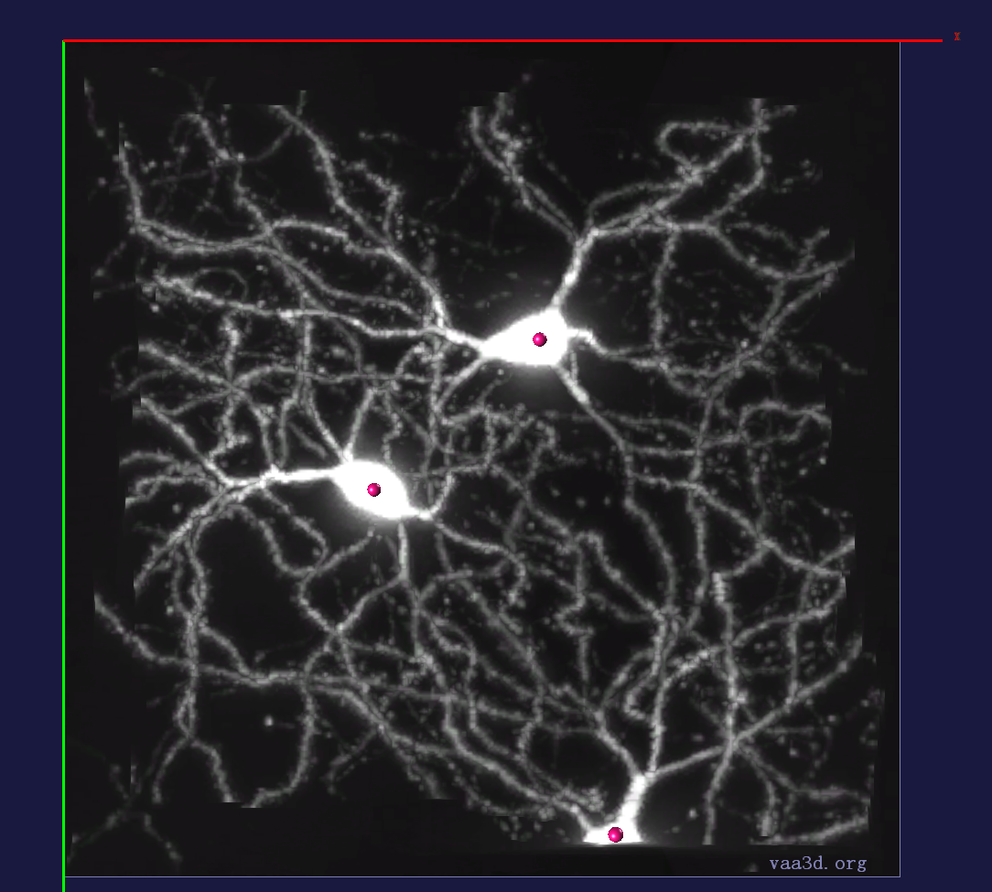
Soma检测

Slide 5
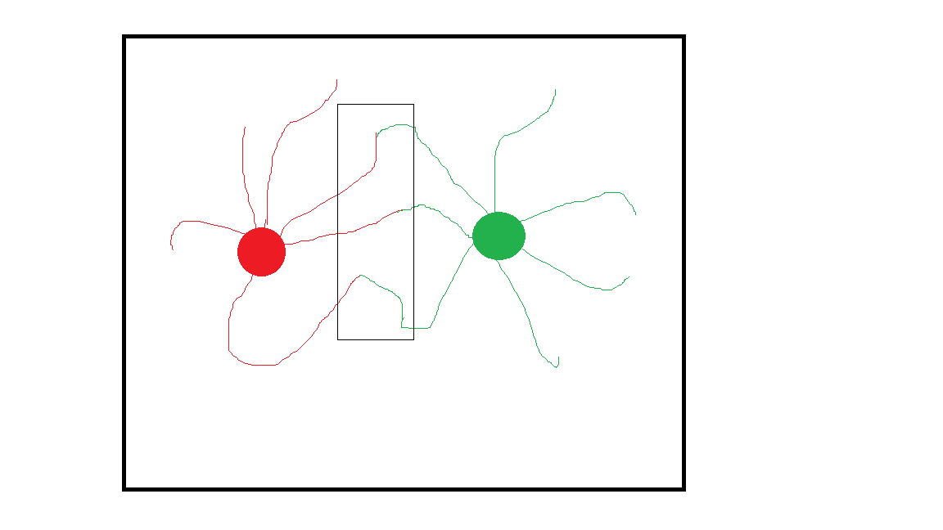
Multiple soma auto-tracing
App2缺点:一个block含有多个soma,tracing会出错
设想:soma>=2 confrontation-tracing可以减少tracing错误
Design a basic tracer with confrontation

Slide 6
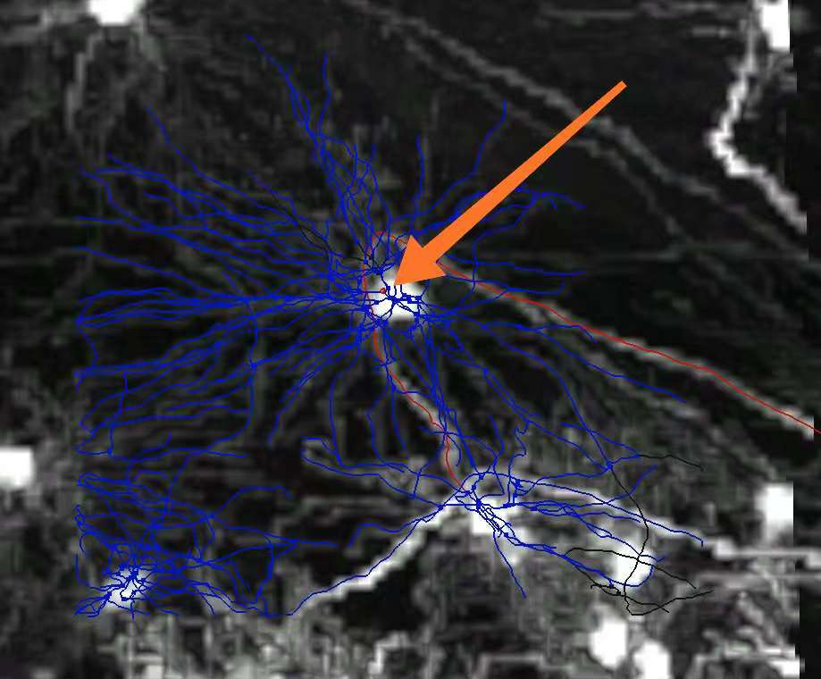
App2-error1

Slide 7
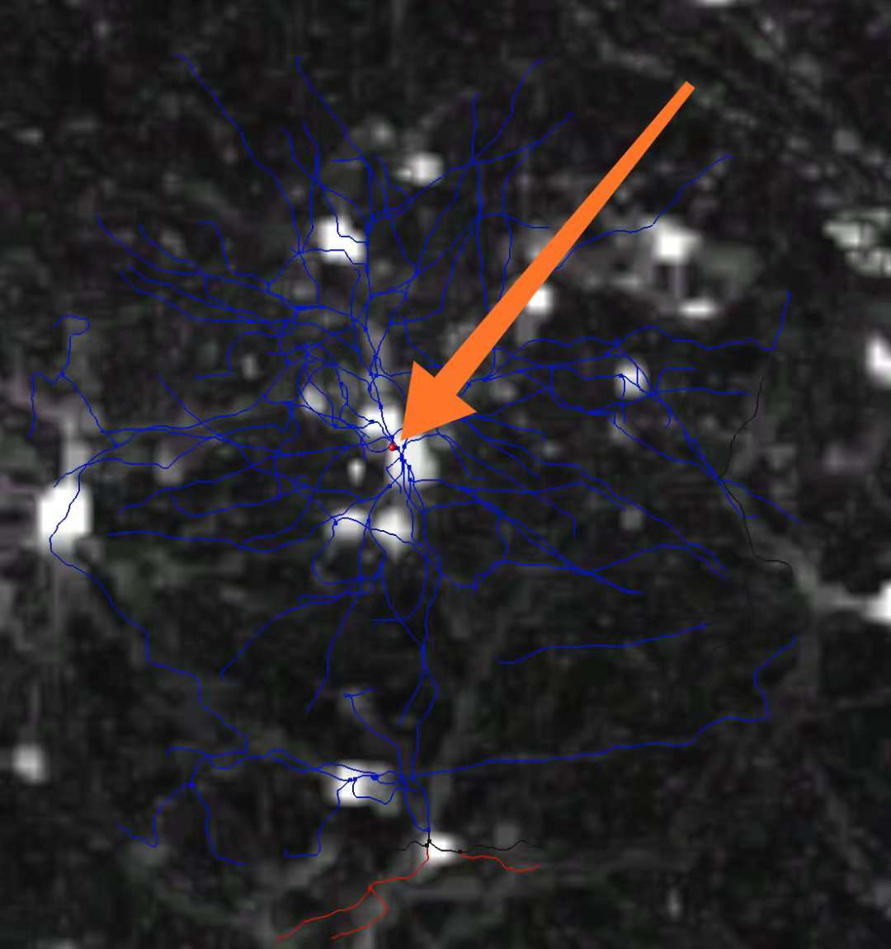
App2-error2

