Slide 1
Neuron reconstruction from fluorescence microscopy images using sequential Monte Carlo estimation
Miroslav Radojević ; Erik Meijering
2017 IEEE 14th International Symposium on Biomedical Imaging (ISBI 2017)
王鹏
2018-12-12

Slide 2
1. Abstract

Slide 3
Present a novel method for fully automatic neuron reconstruction based on sequential Monte Carlo estimation.
It uses newly designed models for predicting and updating branch node estimates as well as novel initialization and final tree construction strategies.
The results indicate that our method performs favorably compared to state-of-the-art alternative methods.

Slide 4
2. Method

Slide 5
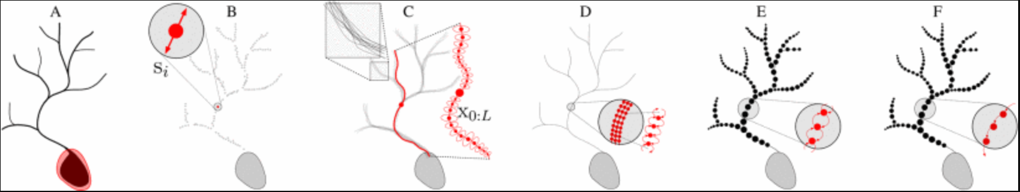
Overview
Schematic overview of the six main steps of the proposed method:
Soma extraction
Seed extraction
Branch tracing
Trace refinement
Node grouping
Tree construction

Slide 6
2.1 Soma Extraction
Performing gray-scale erosion using a structuring element with a slightly larger diameter than the largest expected branch diameter(腐蚀操作)
A segmentation of the soma can then be obtained by max-entropy thresholding（类似OTSU：T=argmax[H_b+H_f]）
In our applications it is sufficient to model the soma as a single node whose diameter can be estimated by fitting a sphere to the segmented image region.（球拟合）

Slide 7
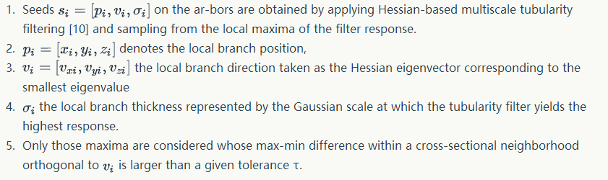
2.2 Seed Extraction
注：这一步是提取Brance上面的点，不是Soma点

Slide 8
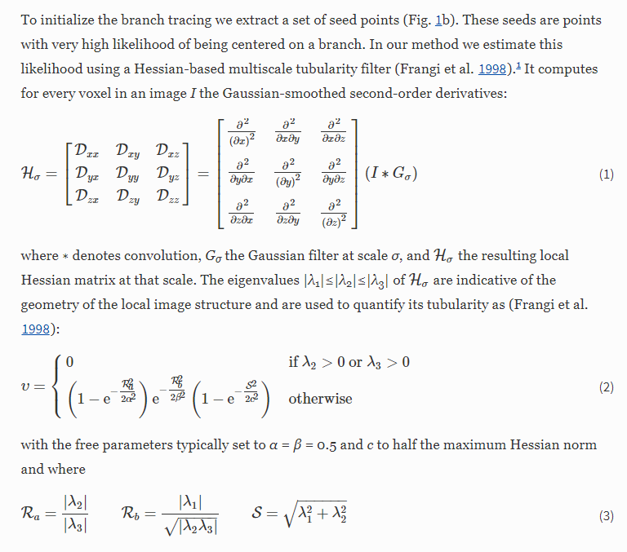

Slide 9
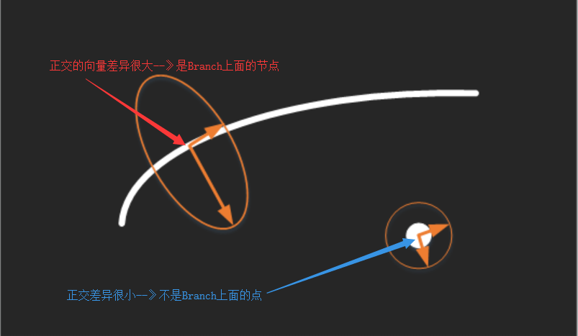
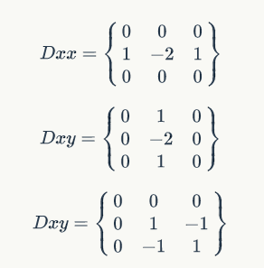
不同的高斯卷积核(Dxx,Dxy,Dyy)计算3个二阶导数的值；
构造hessian矩阵
求解lamda1-2
根据lamda判断所处位置特征

Slide 10
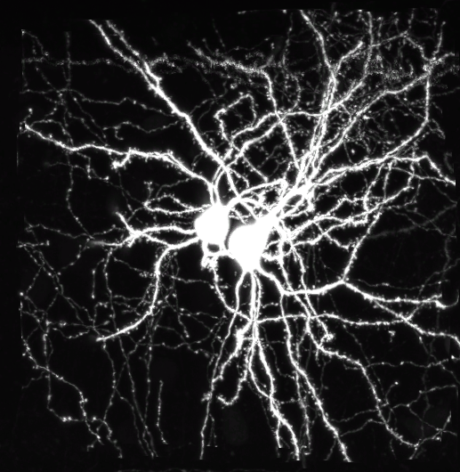
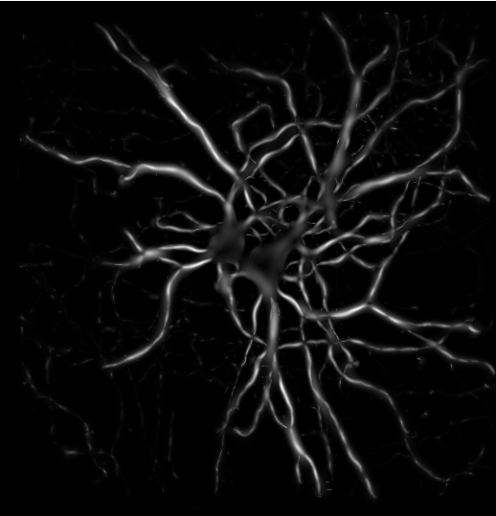
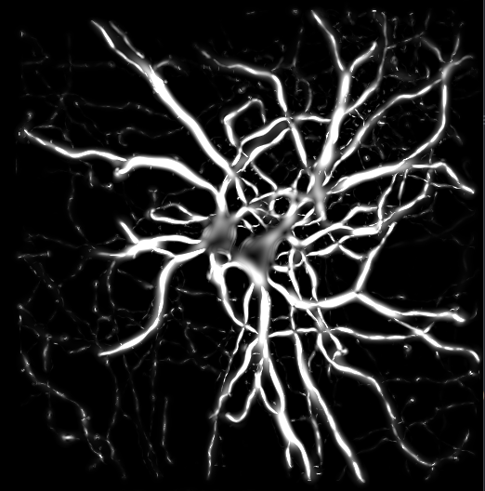
Hessian滤波尺度 sigma=[1,3,5,7,9] 滤波器大小w=3*[1,3,5,7,9]

Slide 11
Help
https://blog.csdn.net/isyiming/article/details/79942928
https://blog.csdn.net/u013921430/article/details/79770458

Slide 12
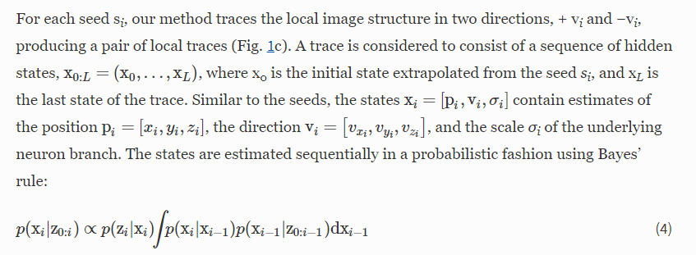
2.3 Branch Tracing (其实就是粒子滤波：蒙特卡洛+隐马尔可夫+贝叶斯)

Slide 13
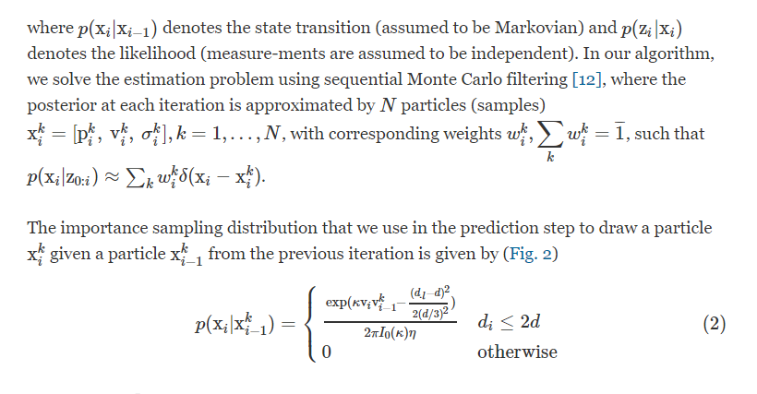

Slide 14
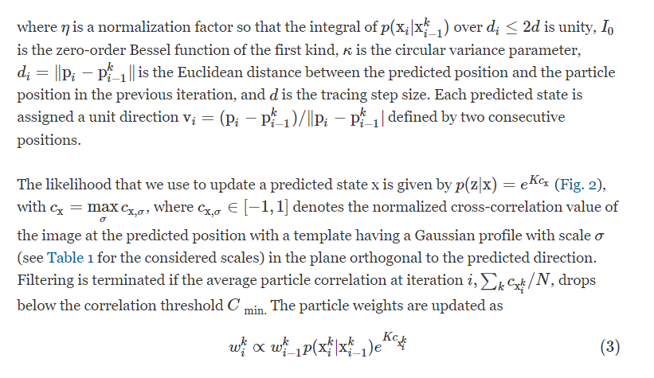

Slide 15
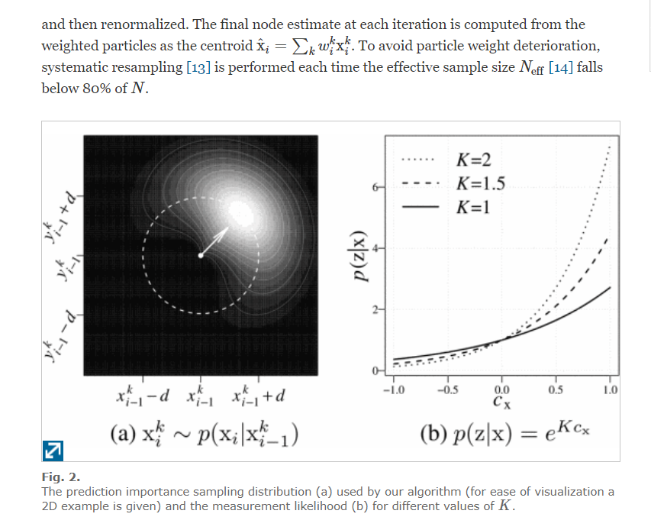

Slide 16
Help：
http://www.voidcn.com/article/p-txriitqs-z.html
https://zhuanlan.zhihu.com/p/26783371
https://blog.csdn.net/zzq123686/article/details/72903876
https://www.cnblogs.com/ycwang16/p/5995702.html

Slide 17
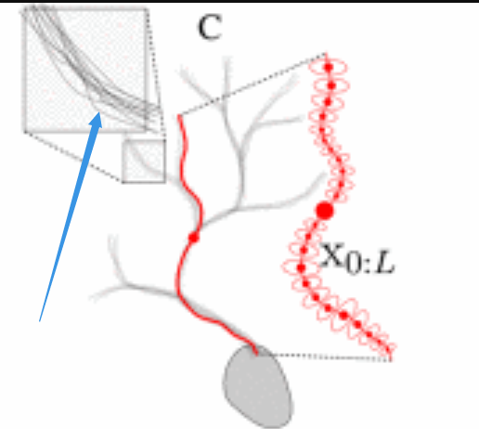

Slide 18
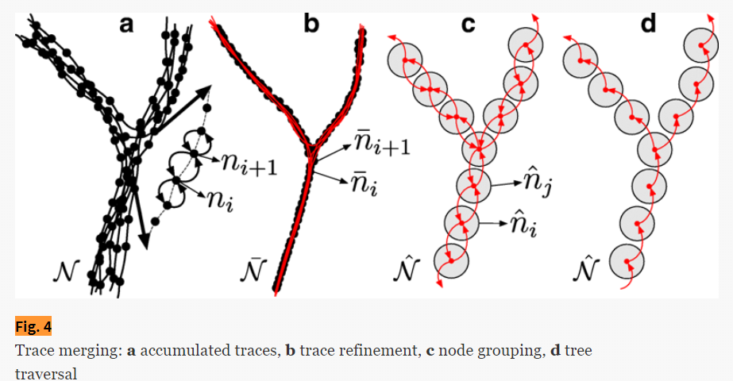
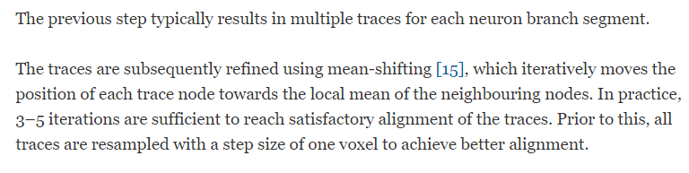
2.4 Trace Refinement（均值漂移）

Slide 19
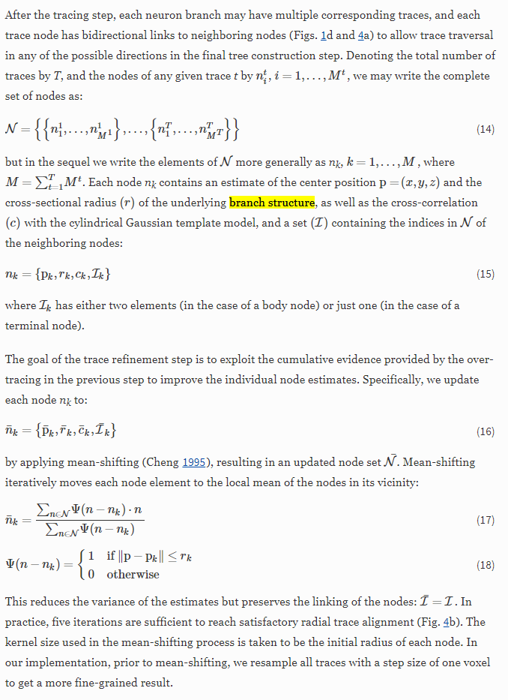

Slide 20
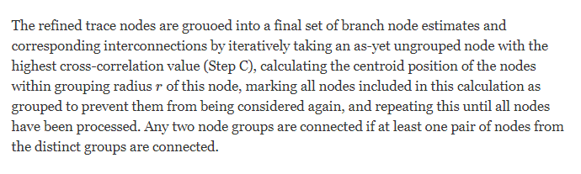
2.5 Node Grouning

Slide 21
2.6 Tree Construction
Finally the branch nodes and connections are traversed using a breadth-first search algorithm to obtain a graph representing the complete neuronal tree which can be exported to the standard SWC file format.

Slide 22
3. Results

Slide 23
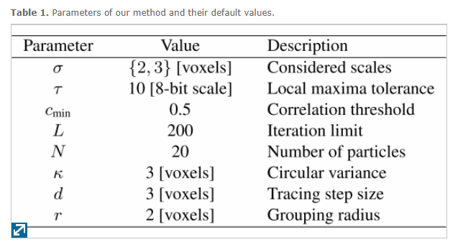
Parameters of our method and their default values.

Slide 24
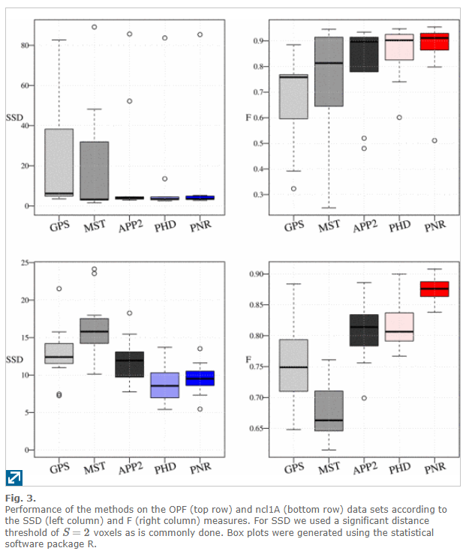
Two sets of measures were used to quantify the match between the obtained reconstructions and the available gold-standard reconstructions:
the spatial distance measures SD, SSD, and %SSD
the overlap measures P (precision), R (re-call), and F=2PR/(P+R) .
the results for the SSD (lower is better) and F (higher is better) measures and note that the other measures lead to very similar observations.

Slide 25
