Slide 1
STOCK PRICE PREDICTION
Submitted to: Electromotive Club
WINSTON PAIS(4NM21CS212)

Slide 2
ABSTRACT
THIS PROJECT AIMS TO FORECAST THE STOCK PRICES OF A GIVEN COMPANY USING VARIOUS TIME SERIES FORECASTING MODELS.
THE PROJECT USES HISTORICAL DATA OF TATA GLOBAL BEVERAGE COMPANY'S STOCK PRICES TO TRAIN AND VALIDATE THE MODELS AND THE CODE IS IMPLEMENTED USING GOOGLE COLABORATORY.
THE MODELS USED ARE MOVING AVERAGE, LINEAR REGRESSION, K-NEAREST NEIGHBORS, AUTO-ARIMA, PROPHET AND LSTM AND EACH MODEL IS EVALUATED USING THE ROOT MEAN SQUARED ERROR (RMSE) METRIC.
THE RESULTS SHOW THAT THE LSTM MODEL OUTPERFORMED ALL OTHER MODELS IN TERMS OF RMSE ON THE VALIDATION SET.
THIS PROJECT DEMONSTRATES THE EFFECTIVENESS OF VARIOUS TIME SERIES FORECASTING MODELS IN PREDICTING THE STOCK PRICES OF A GIVEN COMPANY AND PROVIDES INSIGHTS INTO SELECTING THE BEST MODEL FOR ANY GIVEN DATASET.

Slide 3
INTRODUCTION
THE AIM OF THIS PROJECT IS TO PREDICT THE CLOSING STOCK PRICES OF TATA GLOBAL BEVERAGES USING VARIOUS TIME SERIES FORECASTING MODELS.
the analysis was done using Python in google colaboratory.
The project includes an exploratory data analysis, followed by the implementation of various time series forecasting models such as Moving Average, Linear Regression, k-nearest neighbOURS, AUTO-ARIMA, PROPHET, AND LSTM
.
THE MODELS WERE TRAINED AND VALIDATED USING A TIME PERIOD OF 5 YEARS (FROM 2013 TO 2018) AND WERE THEN USED TO PREDICT THE STOCK PRICES.
THE PERFORMANCE OF EACH MODEL WAS EVALUATED USING THE ROOT MEAN SQUARE ERROR (RMSE) AND THE RESULTS WERE COMPARED TO DETERMINE THE BEST PERFORMING MODEL.

Slide 4
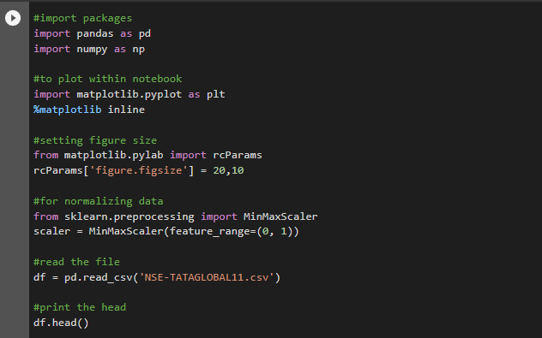
METHODOLOGY AND IMPLEMENTATION
IMPORTING AND LOADING THE REQUIRED LIBRARIES AND DATASETS: THE NECESSARY LIBRARIES SUCH AS PANDAS, NUMPY, MATPLOTLIB, MINMAXSCALER
are imported to the notebook, and the datasets are loaded.
FIG 1: IMPORTING LIBRARIES AND READING THE DATASET

Slide 5
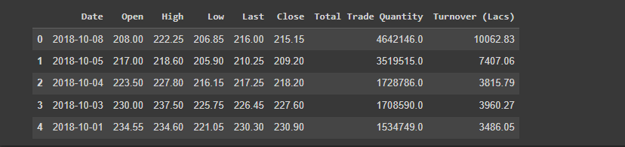
FIG 2: OUTPUT OF THE DATASET

Slide 6
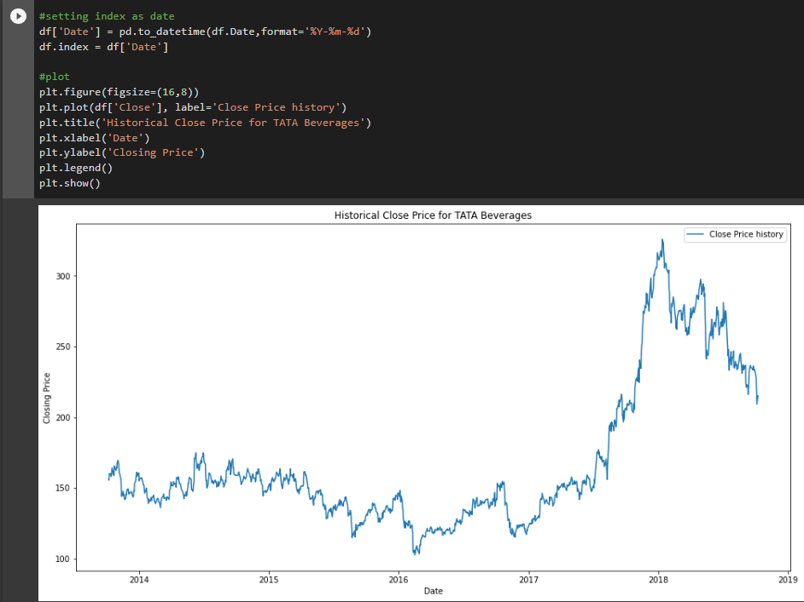
Data preprocessing: The data was preprocessed by removing any missing values, and by selecting the 'Close' column as the feature for predicting future stock prices.
FIG 3: PLOT FOR THE PRE-PROCESSED DATA

Slide 7
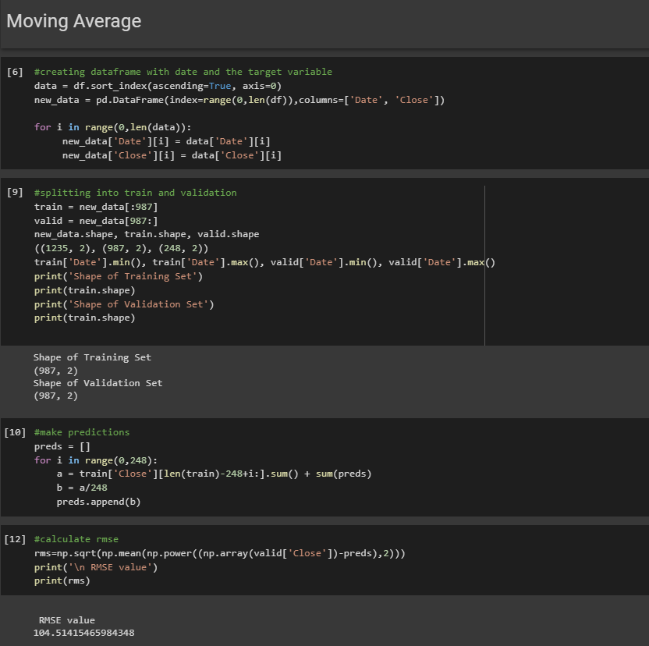
Model Building and Evaluation
Moving Average
FIG 4: CODE FOR MOVING AVERAGE

Slide 8
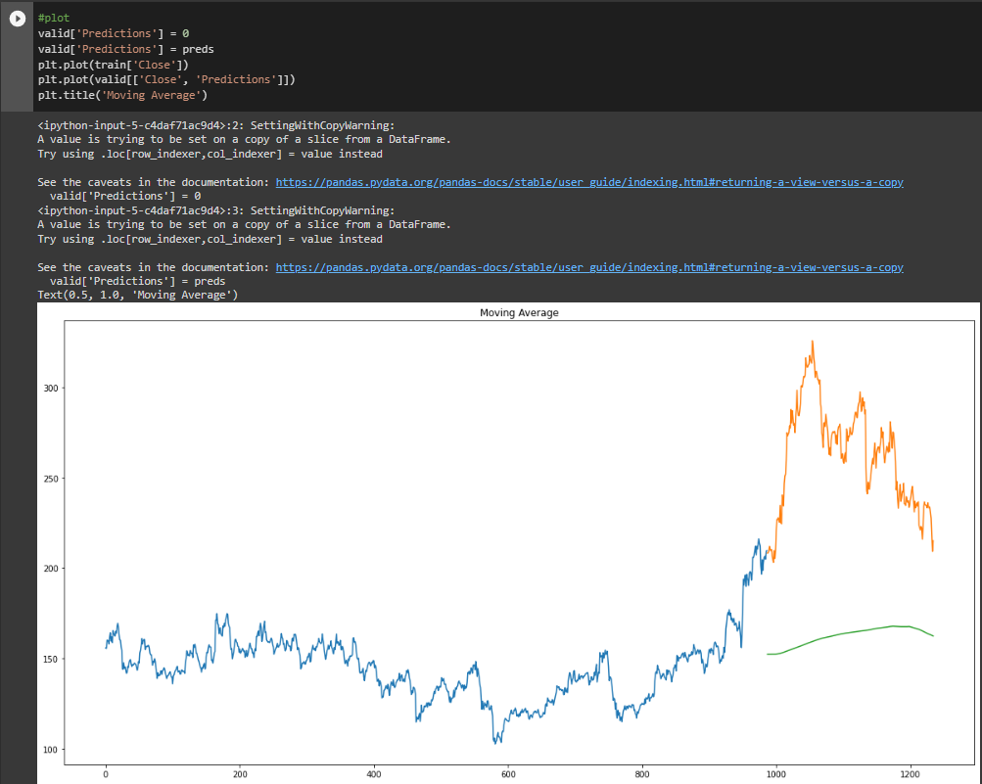
FIG 5: PLOT FOR MOVING AVERAGE

Slide 9
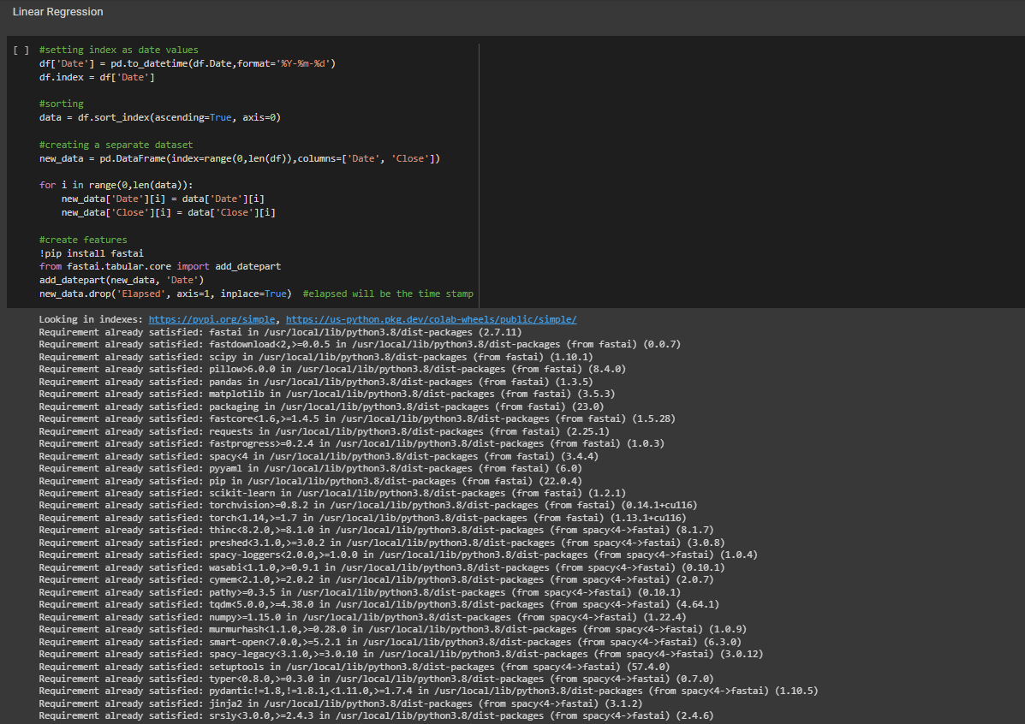
2.LINEAR REGRESSION
FIG 6: INSTALLING FASTAI AND CREATING A NEW DATASET

Slide 10
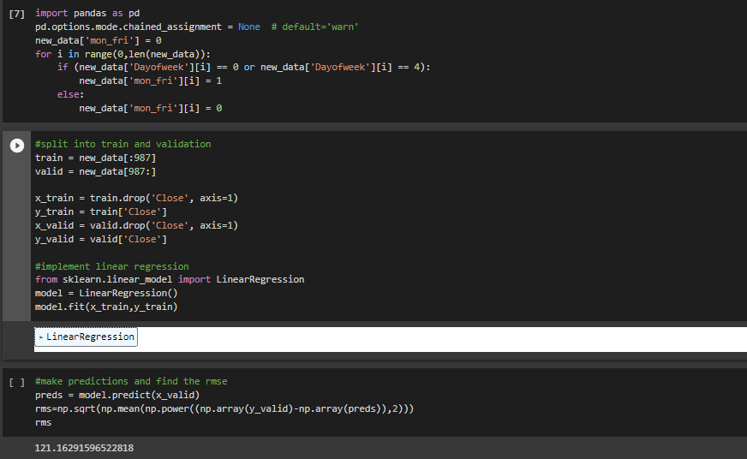
FIG 7: CODE FOR LINEAR REGRESSION AND RMSE VALUE

Slide 11
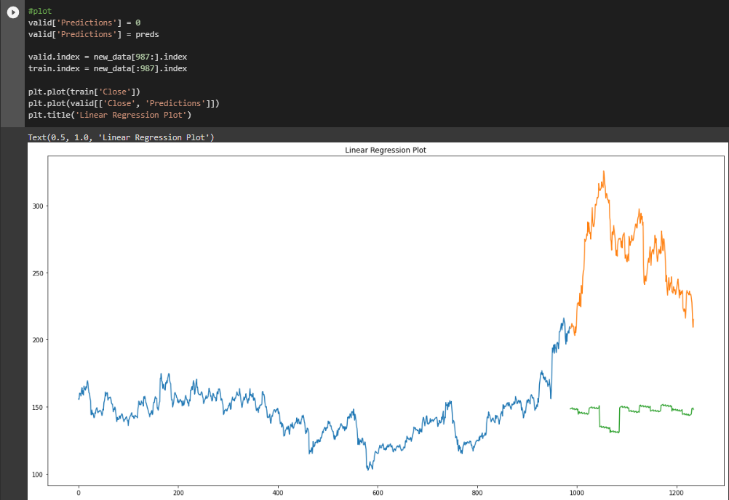
FIG 8: PLOT FOR LINEAR REGRESSION

Slide 12
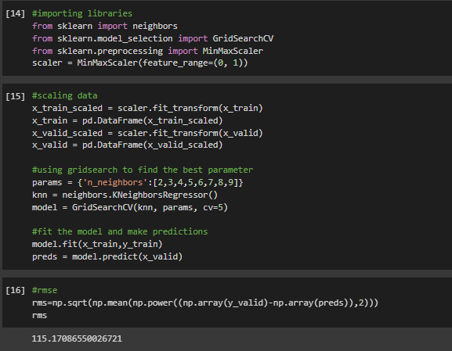
3.K-NEAREST NEIGHBOURS
FIG 9: CODE FOR K-NEAREST NEIGHBOURS AND RMSE VALUE

Slide 13
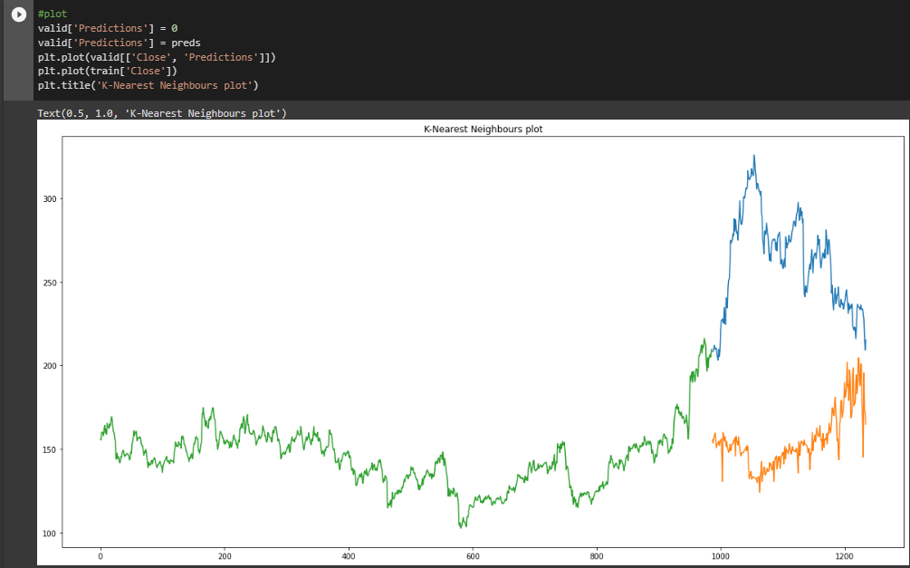
FIG 10: PLOT FOR K-NEAREST NEIGHBOURS

Slide 14
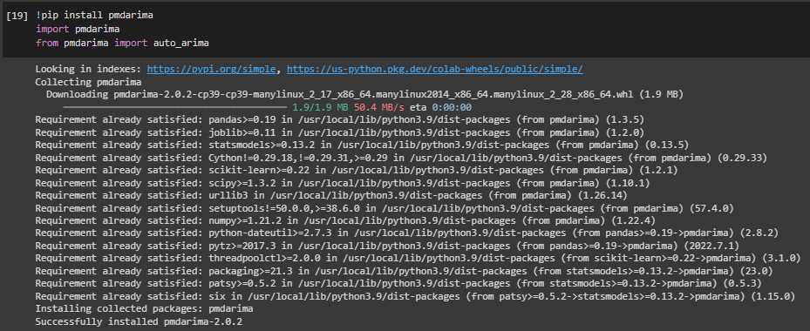
4.AUTO-ARIMA
FIG 11: INSTALLING PMDARIMA

Slide 15
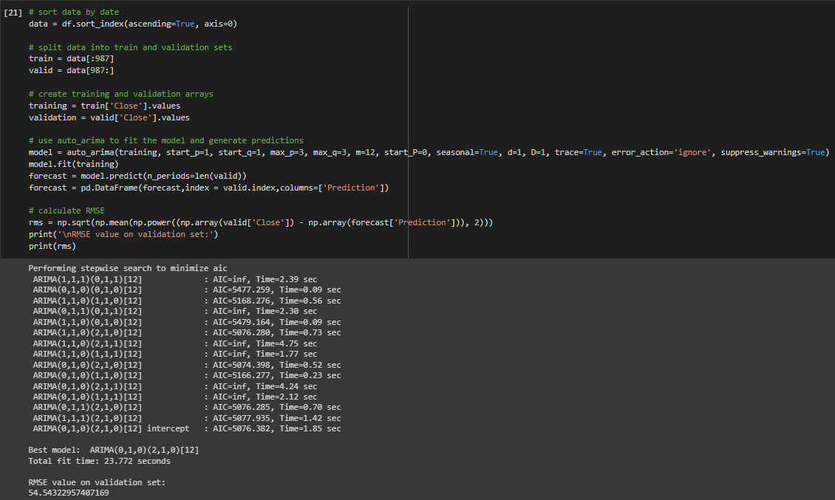
FIG 12: CODE FOR AUTO-ARIMA AND RMSE VALUE

Slide 16
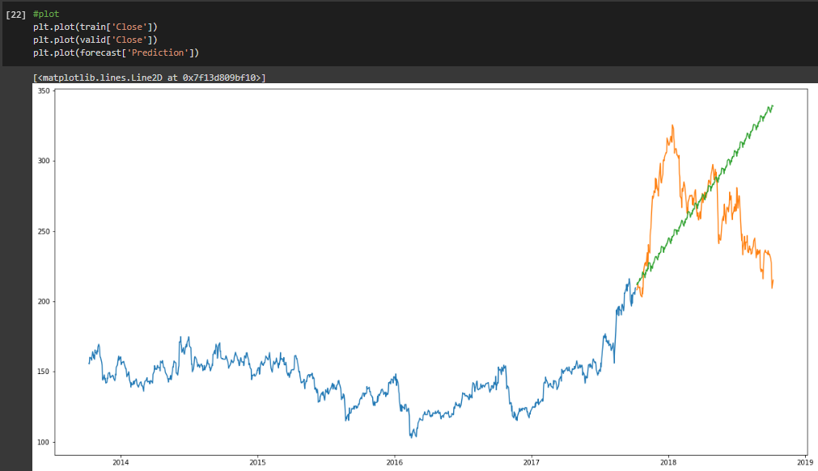
FIG 13: PLOT FOR AUTO-ARIMA

Slide 17
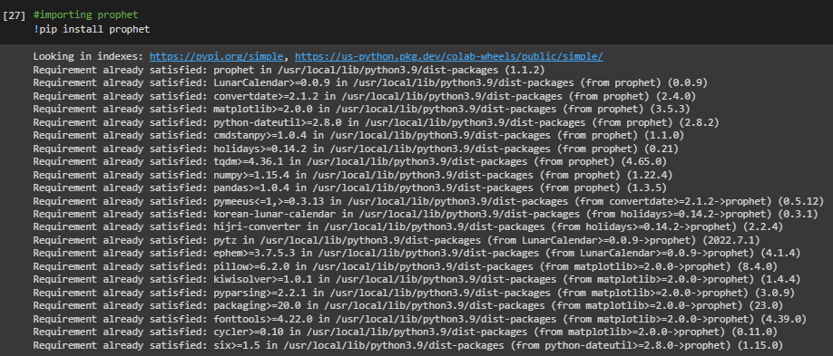
5.PROPHET
FIG 14: INSTALLING PROPHET

Slide 18
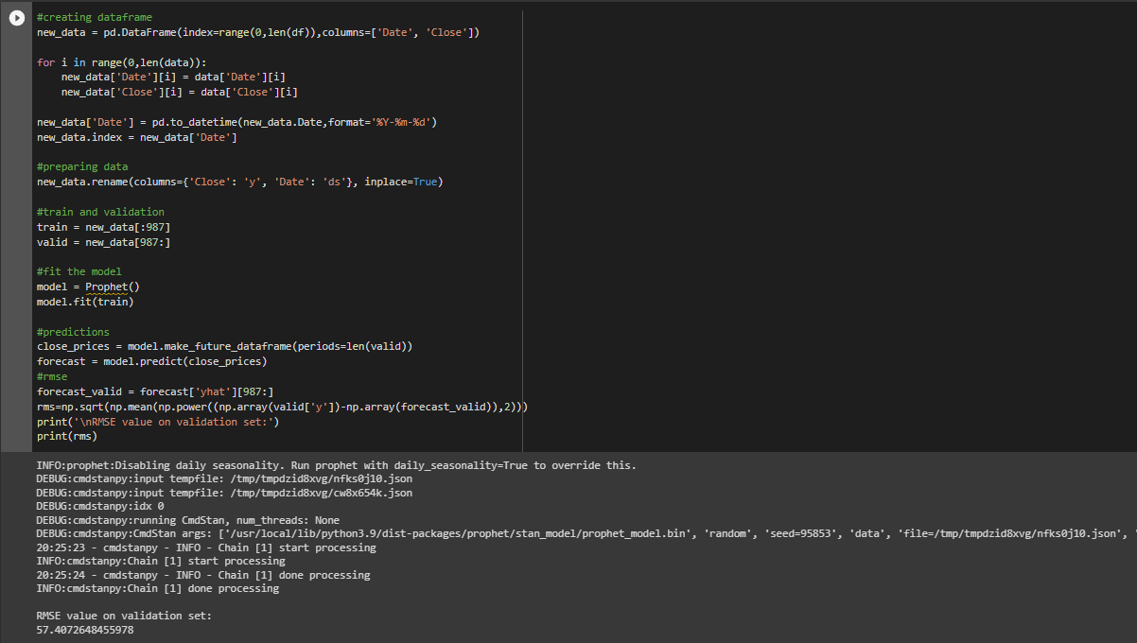
FIG 15: CODE FOR PROPHET AND RMSE VALUE

Slide 19
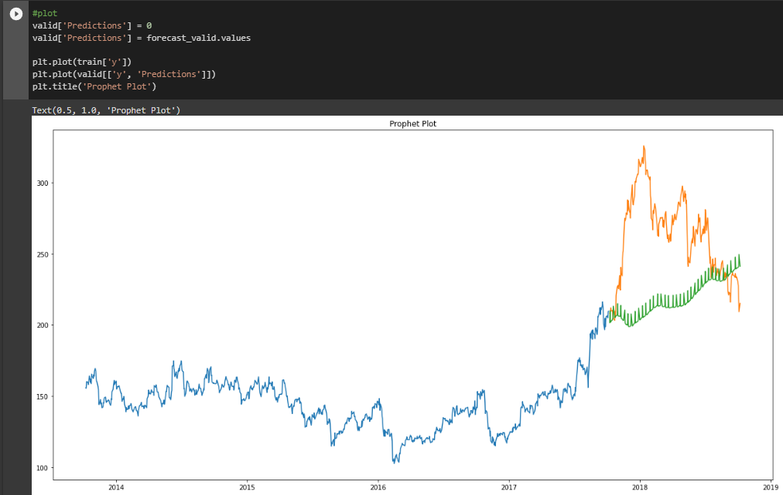
FIG 16: PLOT FOR PROPHET

Slide 20
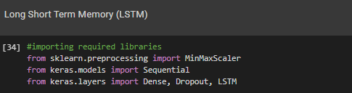
6.LONG SHORT TERM MEMORY (LSTM)
FIG 17: INSTALLING LIBRARIES FOR LSTM

Slide 21
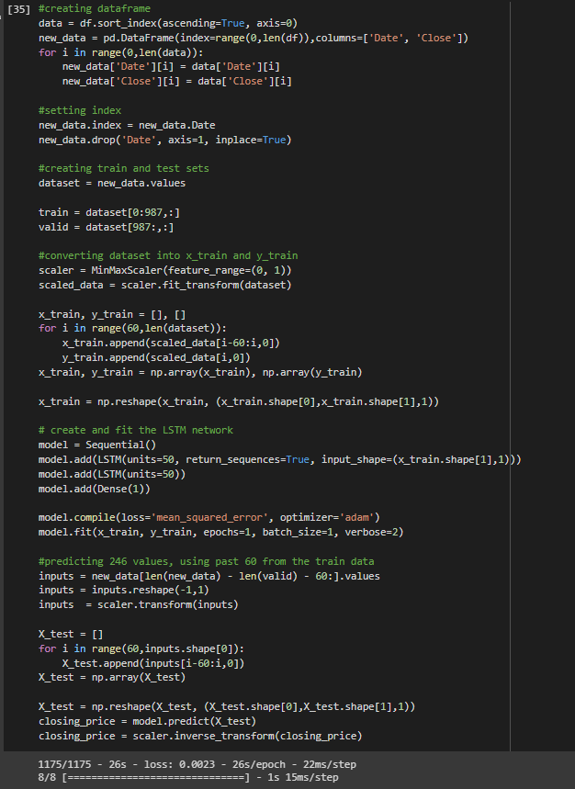
FIG 18: CODE FOR LSTM

Slide 22
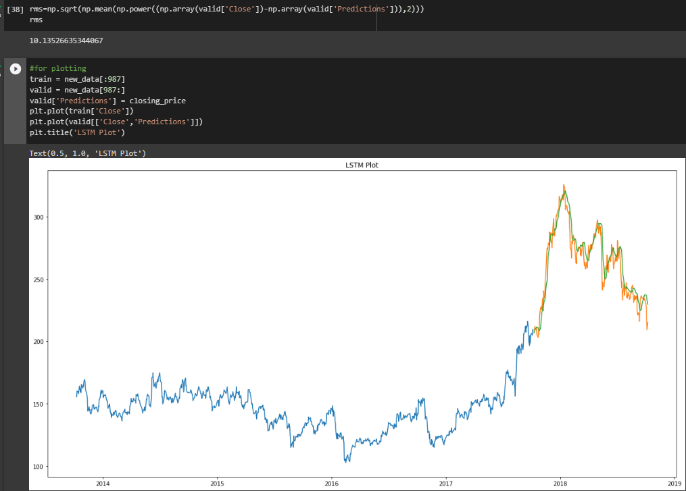
FIG 19: RMSE VALUE AND PLOT FOR LSTM

Slide 23
CONCLUSION
IN CONCLUSION, SIX DIFFERENT TIME SERIES MODELS, MOVING AVERAGE, LINEAR REGRESSION, K-NEAREST NEIGHBORS, AUTO-ARIMA, PROPHET, AND LSTM, WERE APPLIED TO PREDICT THE FUTURE STOCK PRICES OF TATA GLOBAL BEVERAGES.
THE PERFORMANCE OF EACH MODEL WAS EVALUATED USING THE ROOT MEAN SQUARED ERROR (RMSE) METRIC ON THE VALIDATION DATASET.
IT WAS OBSERVED THAT THE LSTM MODEL OUTPERFORMED ALL OTHER MODELS WITH THE LOWEST RMSE VALUE OF 10.13.
WHILE THE OTHER MODELS PERFORMED DECENTLY WELL, THEIR RMSE VALUES WERE SIGNIFICANTLY HIGHER THAN THAT OF THE LSTM MODEL.
OVERALL, THE RESULTS INDICATE THAT TIME SERIES MODELS CAN PROVIDE VALUABLE INSIGHTS INTO THE FUTURE TRENDS OF STOCK PRICES AND CAN BE USEFUL IN MAKING INFORMED INVESTMENT DECISIONS.

Slide 24
THANK YOU

